Slide 1
D.L. Moody and the Student Volunteer Movement
In the History of modern missions, probably no single factor has wielded a greater influence in the world wide outreach of the Church than the Student Volunteer Movement. -- David M. Howard (Perspectives)

Slide 2
It is no exaggeration to claim that one of the seminal moments in the history of Evangelical Protestant missions was the Student Volunteer Movement. In fact, it has been described as, “… history’s single most potent mission organization.” At the center of this movement was Dwight Moody and his schools in Northfield. In fact, Ralph Winter, one of the leading Missiologists of the previous generation, goes so far as to say that the entire movement was indebted to three distinct movements, the most important Dwight’s Moody personal faith. As Winters put it, the Student Volunteer Movement was a, “striking illustrated in the simple authenticity of Moody’s spiritual life …”
http://www.missionfrontiers.org/issue/article/four-men-three-eras Ralph Winter, International Journal of Frontier Missions, vol. 2, no. 2 April 1985, 156. Winter’s article provides an excellent overview

Slide 3
Sometime around 1885, Luther Wishard, then college secretary of the International Committee of the Young Men's Christian Associations of the United States and Canada, began proposing to Moody a conference for young men. That same year, during the conference at Northfield, Mr. Moody decided, unexpectedly, to hold a day of meetings dedicated to missions. The prominent missions advocate A. T. Pierson was present and Moody granted him control of the meetings that day. Pierson used the occasion to call for a united and concerted effort to share the Gospel throughout the world as quickly as possible. Wishard was at the conference and heard Pierson’s plea. Also present was J. E. K. Studd, older brother of C. T. Studd. C. T. Studd was one of the Cambridge seven. Both brothers had been impacted by Moody’s earlier work at Cambridge University.
http://www.ubf.org/world-mission-news/north-america/historical-highlights-student-volunteer-movement-campus-night-mark

Slide 4
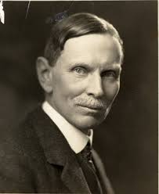
Mt. Hermon Bible Conference
July 7 – August 2, 1886
Held at Mt. Hermon Boys School
251 students from 89 colleges
Robert Wilder: - leader of Princeton Foreign Mission Society - recent graduate of Princeton - MK from India - let prayer meetings for missions - Meeting of the Ten Nations

Slide 5
Meeting of the Ten Nations
Ten representatives of ten nations appealing for missionaries to bring the Gospel…
2 missionary speakers at the conference: - A.T. Pierson - Dr. William Ashmore
By the end of the conference 99 students had signed a pledge: “"We are willing and desirous, God permitting, to become foreign missionaries.“
And they were praying for 1 more… - THE MOUNT HERMON 100

Slide 6
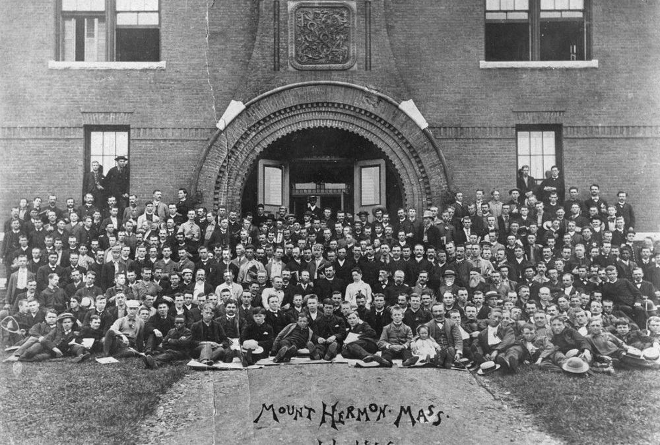
Mount Hermon 100

Slide 7
Student Volunteer Movement
Robert Wilder and John Forman spread the message…
1886 – 1887 school year
Visited 167 schools
2106 student volunteers
SVM formally organized in 1888
John R. Mott as chairman

Slide 8
Student Volunteer Movement
“PURPOSE STATEMENT” “The evangelization of the world in this generation”
FIVE OBJECTIVES: - Lead students to consider missions - Guide volunteers until they had a mission board - Unite student volunteers in a organized movement - Recruit enough volunteers to fill the needs of the various mission boards - educate students who remain at home to support those who go

Slide 9
Growth…
1891:
558 attended the conference in Cleveland
6200 Student Volunteers
321 had left for overseas service
1920:
2,783 students signed the volunteer decision card
6,890 attended the conference in Des Moines
637 left for overseas service
In all, a conservative estimate of 20,500 missionaries were recruited through the Student Volunteer Movement.

Slide 10
Decline…
The 1920 Des Moines Conference:
Students revolting against the leadership of SVM
Students were focused on the causes of the Great War
Students desired to take over the State and the Church to avoid world war in the future…
The liberalism that was affecting the mainline denominations was making inroads into SVM.
By 1940 the emphasis of SVM had moved more and more toward political and social action.
Merged with other student movements in 1966 to form the University Christian Movement.

Slide 11
D.L. Moody & SVM
Like other ministries that D.L. Moody was instrumental in, it took on a life of its own…
Fund raising Letter for 4th Mt. Hermon Bible Conference
Published College Stu

Slide 12
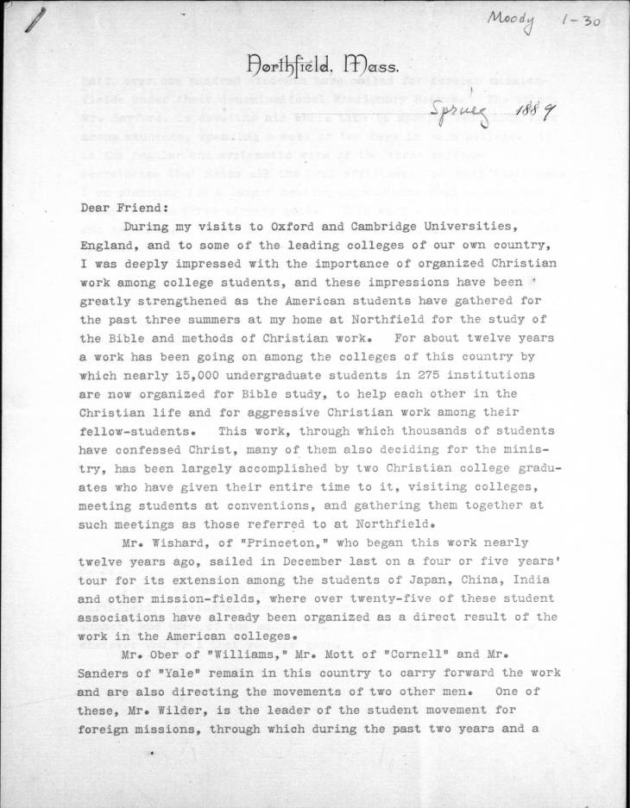
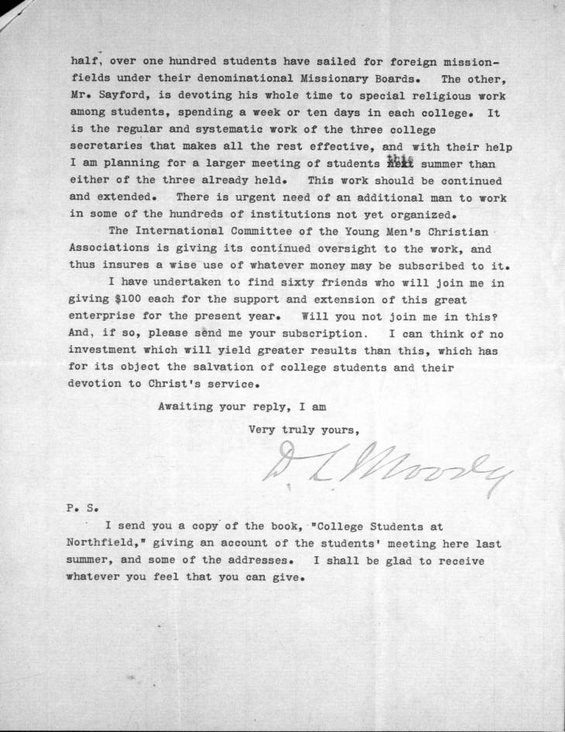

Slide 13
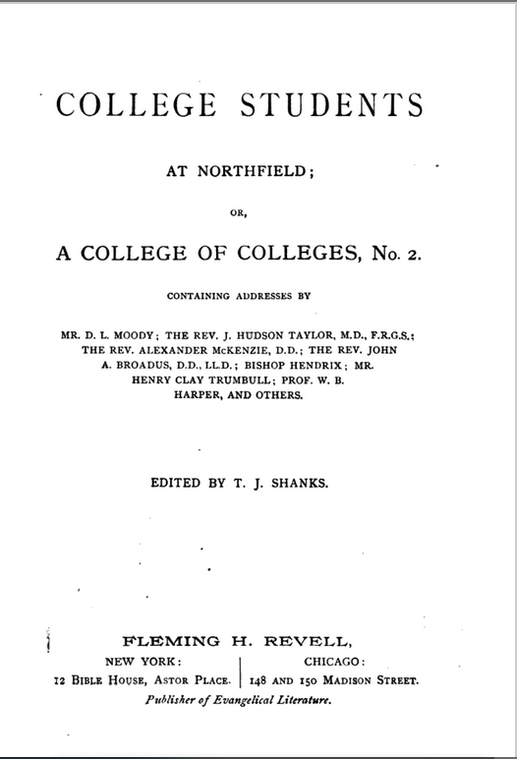
Notice the speakers…

Slide 14
Sources:
General Sources:
Moody, William. 1900. The Life of D.L. Moody, by His Son. Sword of the Lord Press. Murfreesboro, TN. (ISBN – 0-87398-508-7)
Winter, Ralph D., Steven C. Hawthorne, Darrell R. Dorr, D. Bruce Graham, and Bruce A. Koch. 1999. Perspectives on the World Christian Movement : A Reader. 3rd ed. William Carey Library. Pasadena, CA.
https://moodycenter.org/articles/d-l-moody-and-the-genesis-of-the-student-volunteer-movement/
https://en.wikipedia.org/wiki/Student_Volunteer_Movement
Students at Northfield:
https://www.google.com/books/edition/College_Students_at_Northfield/l903AQAAMAAJ?hl=en&gbpv=1&dq=College+Students+at+Northfield,+D.L.+Moody&printsec=frontcover
Fundraising Letter:
https://archives.moodycenter.org/digital/collection/p17348coll1/id/2359

