Slide 1

College Church Articles oF Faith
Scripture

Slide 2
Articles of Faith - Scripture
We believe that the Scriptures of the Old and New Testaments are given by inspiration of God, are without error in the original writings and are the only infallible rule of faith and practice.
“Inspired”
“Inerrant”
“Infallible”
2 Timothy 3:16-17 | 1 Thessalonians 2:13 | 2 Peter 1:19-21
the only infallible rule of faith and practice.

Slide 3
2 Timothy 3:16-17
2 Timothy 3:14– 2 Timothy 4:1–3
[14] But as for you, continue in what you have learned and have firmly believed, knowing from whom you learned it [15] and how from childhood you have been acquainted with the sacred writings, which are able to make you wise for salvation through faith in Christ Jesus. [16] All Scripture is breathed out by God and profitable for teaching, for reproof, for correction, and for training in righteousness, [17] that the man of God may be complete, equipped for every good work.
[1] I charge you in the presence of God and of Christ Jesus, who is to judge the living and the dead, and by his appearing and his kingdom: [2] preach the word; be ready in season and out of season; reprove, rebuke, and exhort, with complete patience and teaching. [3] For the time is coming when people will not endure sound teaching, but having itching ears they will accumulate for themselves teachers to suit their own passions, (ESV)

Slide 4
1 Thessalonians 2:13
1 Thessalonians 2:13
[13] And we also thank God constantly for this, that when you received the word of God, which you heard from us, you accepted it not as the word of men but as what it really is, the word of God, which is at work in you believers. (ESV)

Slide 5
2 Peter 1:19-21
2 Peter 1:19–21
[19] And we have the prophetic word more fully confirmed, to which you will do well to pay attention as to a lamp shining in a dark place, until the day dawns and the morning star rises in your hearts, [20] knowing this first of all, that no prophecy of Scripture comes from someone’s own interpretation. [21] For no prophecy was ever produced by the will of man, but men spoke from God as they were carried along by the Holy Spirit. (ESV)

Slide 6
The Inspiration, Inerrancy, and Sole Authority of Scripture

Slide 7
Inspiration
“Inspiration is that supernatural work of the Holy Spirit by which He superintended the writing process of Scripture so that all the very words and every part of the original writings were at the same time the words of the human writers and the very words of God.”
(Finkbeiner, Foundational Faith, 51)

Slide 8
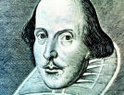
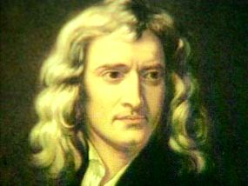
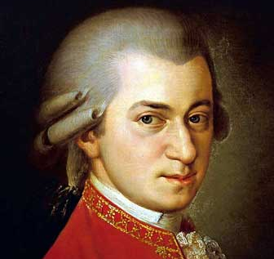
False Views of Inspiration: Natural Inspiration
Shakespeare: Literary Genius
Isaac Newton: Scientific Genius
Mozart: Musical Genius
In the same way, Natural Inspiration holds that the biblical writers were men of great “religious genius.”
Though their abilities were merely human, they reached a higher level of accomplishment in their field than most men.

Slide 9
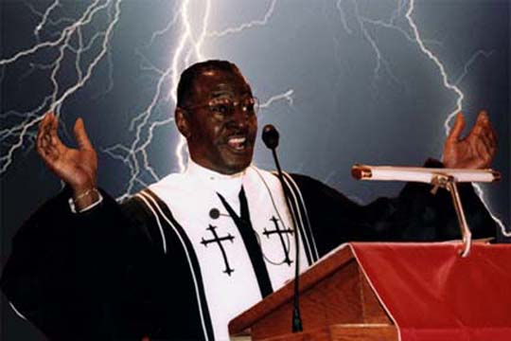
False Views of Inspiration: Mystical Inspiration
After a great sermon, we sometimes say the preacher was especially “inspired” or guided by the Spirit.
Mystical Inspiration suggests the biblical writers were similarly inspired.
Their work was the product of the Holy Spirit, but only as a part of His normal mode of ministry.

Slide 10
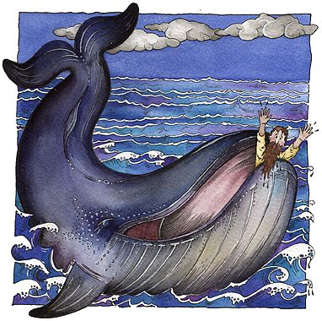
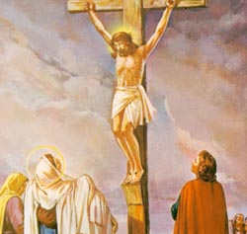
False Views of Inspiration: Partial / Variable Inspiration
There are degrees of inspiration.
On matters of science and history, the Bible may include errors or myths.
On essential matters of faith and doctrine, the Bible is trustworthy.

Slide 11
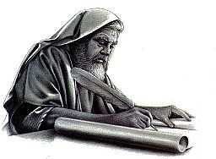
False Views of Inspiration: Inspired Concepts
Justification?
Juxtaposition?
Jurisdiction?
Whatever!
The Holy Spirit provided the concepts He wanted the writers to record but left the wording up to them.
This view allows that perhaps better words could have been used or that the writers got some of the information a bit muddled.

Slide 12
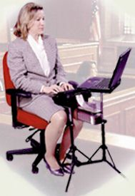
False Views of Inspiration: Dictation
The Holy Spirit directly provided the exact words for the biblical writers to record.
This view claims the words are not in any way the human author’s own words.
The biblical writers are, in effect, stenographers.

Slide 13
Key Texts on Inspiration
“All Scripture is inspired by God and profitable for teaching, for reproof, for correction, for training in righteousness…” 2 Tim. 3:16
“But know this first of all, that no prophecy of Scripture is a matter of one’s own interpretation, for no prophecy was ever made by an act of human will, but men moved by the Holy Spirit spoke from God.” 2 Peter 1:20-21

Slide 14

Key Terms on Inspiration
“God-breathed”
  theopneustos = theos, God + pneuma, breath, wind, spirit
“Moved” by the Spirit
  phero, carried or borne along
Verbal
  The Spirit used human words.
Plenary
  “Fully”: Each and every word of Scripture is inspired.
Like a wind-driven sailboat, the inspired authors were carried along by the Spirit.

Slide 15
The Bible’s’ Testimony to its Inspiration
Inspiration of the whole Old Testament
  “These are My words which I spoke to you … that all things which are written about Me in the Law of Moses and the Prophets and the Psalms must be fulfilled.” Luke 24:44
Inspiration of the words and letters
  “For truly I say to you, until heaven and earth pass away, not the smallest letter or stroke shall pass away from the Law, until all is accomplished.” Matthew 5:18
Inspiration of the promised New Testament
“I have many more things to say to you, but you cannot bear them now. But when He, the Spirit of truth, comes, He will guide you into all the truth” John 16:12-13

Slide 16
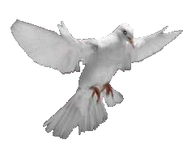


The Extent of Inspiration: The Autographs
Non-Inspired Manuscripts
Non-Inspired Modern Translations
!yhil¿a< ]ar;B; tyviareB] $r,a;h; taewÒ !yIm'V;h tae
jEn ajrch' h\n oj lovgo"
Inspired Hebrew and Greek Originals
Textual Criticism

Slide 17


Summary of Inspiration
The Divine Element: The Holy Spirit superintends the work of the writers, ensuring accuracy and integrity.
The Human Element: The writer’s own vocabulary, style and personality comes through in the work.
Result: The Bible has both divine and human authorship!

Slide 18
Inerrancy
“Inerrancy is the view that when all the facts become known, they will demonstrate that the Bible, in its original autographs and correctly interpreted, is entirely true and never false in all it affirms...” (Feinberg, EDT, 142)

Slide 19
By inerrancy we refer not only to the Bible's being 'without error' but also to its inability to err. Inerrancy, positively defined, refers to a central and crucial property of the Bible, namely, its utter truthfulness. The basis for the doctrine of biblical inerrancy is located both in the nature of God and in the Bible's teaching about itself. First, if God is perfect – all knowing, all wise, all-good – it follows that God speaks the truth. God does not tell lies; God is not ignorant. God's Word is thus free from all error arising either from conscious deceit or unconscious ignorance. Such is the unanimous confession of the Psalmist, the prophets, the Lord Jesus and the apostles. Second, the Bible presents itself as the Word of God written. God's Word is thus wholly reliable, a trustworthy guide to reality, a light unto our path. If the biblical and theological basis of the doctrine is so obvious, however, why have some in our day suggested that the inerrancy of the Bible is a relatively recent concept? It is true, as some have suggested that the inerrancy of the Bible is a relatively recent concept? Is it true, as some have argued, that the doctrine of inerrancy was 'invented' in the nineteenth century at Princeton by B B Warfield and Charles Hodge and is therefore a novelty in the history of theology? In answer to this question, it is important to remember that doctrines arise only when there is a need for them. Doctrine develops when something implicit in the faith is denied; false teaching provokes an explicit rebuttal. This is as true of inerrancy as it is of the doctrines of the Trinity, or of justification by faith. https://www.mercypres.org/wp-content/uploads/2014/02/The-Inerrancy-of-Scripture-Vanhoozer.pdf accessed 11/24/25

Slide 20
Perhaps the best way to resolve this confusion is to begin at the other end. What counts as an error? if I say that my lecture lasts an hour, when in fact it lasts only fifty-nine minutes, have I made an error? That depends on your expectation and on the context of my remark. In everyday conversation round figures are perfectly acceptable; no one would accuse me of getting my figures wrong. In other contexts, however, a different level of precision is required. A BBC television producer, for instance, would need to know the exact number of minutes. The point is that what counts a an error depends upon the kind of precision of exactness that the reader has a right to expect. "Error’ is thus a context- dependent notion. If I do not claim scientific exactitude or technical precision, it would be unjust to accuse me of having erred. Indeed, too much precision (‘my lecture is fifty-nine minutes and eight seconds long’) can be distracting and actually hinder clear communication.
Let us define error, then, as a failure to make good on or to redeem one’s claims. The Bible speaks truly because it makes good its claims. It thus follows that we should first determine just what kind of claims are being made before too quickly ruling ‘true’ or ‘false’. If error is indeed a context-dependent notion, those who see errors in Scripture would do well first to establish the context of Scripture’s claims. To interpret the Bible according to a wooden literalism fails precisely to attend to the kinds of claims Scripture makes. To read every sentence of the Bible as if it were referring to something in he world, or to a timeless truth, may be to misread much of Scripture. Just as readers need to be sensitive to metaphor (few would react to Jesus’ claim in John 10:9 ‘I am the door’ by searching for a handle) so readers must be sensitive to literary genre (e.g. to the literary context of biblical statements). https://www.mercypres.org/wp-content/uploads/2014/02/The-Inerrancy-of-Scripture-Vanhoozer.pdf accessed 11/24/25

Slide 21

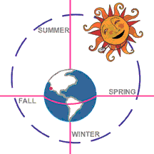
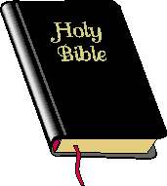

What is Inerrancy?
NO It does not mean there are no figures of speech in the Bible
NO It does not mean every expression is understood in a foolishly literal way
YES Scripture has no errors in what it asserts

Slide 22
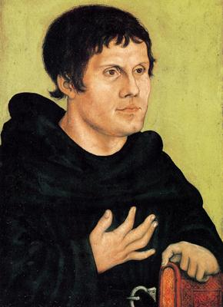
The Origin of Sola Scriptura
Sola Scriptura = “Scripture alone”
“In Martin Luther’s day, sola Scriptura had to do with the Bible being the sole ultimate authority for Christians over against challenges to it from the traditions of the medieval church, church councils and the pope. The Reformers wanted Scripture to stand alone as the church’s true authority.” (James M. Boice, The Gospel of Grace, 66)

Slide 23

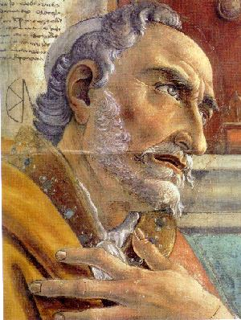

What does Sola Scriptura mean?
NO
It does not mean there are no other sources of revelation or truth.
NO
It does not mean we should ignore historical doctrines.
YES
Scripture (rightly interpreted) gives the final verdict!

Slide 24
Thomas aquinas
Nevertheless, sacred doctrine makes use of these authorities [the Fathers] as extrinsic and probable arguments; but properly uses the authority of the canonical Scriptures as an incontrovertible proof, and the authority of the doctors of the Church as one that may properly be used, yet merely as probable. For our faith rests upon the revelation made to the apostles and prophets who wrote the canonical books, and not on the revelations (if any such there are) made to other doctors. Hence Augustine says (Epis. ad Hieron. xix, 1): "Only those books of Scripture which are called canonical have I learned to hold in such honor as to believe their authors have not erred in any way in writing them. But other authors I so read as not to deem everything in their works to be true, merely on account of their having so thought and written, whatever may have been their holiness and learning.” Summa Theologica (1:1:8)

Slide 25
practically
In terms of doctrine, certainty comes from scripture alone. Calvin’s “learned ignorance,” we have no certainty outside the text. INFALLABILITY
The Bible is the Holy Spirit's fundamental tool! It is what He uses to transform us! USEFULNESS
Inerrancy assumes we correctly understand the text. The problem may be our understanding, not the text! INERRANCY, TRUTHFULNESS

