Slide 1
LIBERALISM or MODERNISM
At its core, Modernism is an attempt save Christianity. In short, Modernists or Liberalism is committed to making Christianity acceptable to modern people.
Key idea – accommodate Christianity to Modern world
Key People – Harry Emerson Fosdick, William Raney Harper, Shailer Mathews

Slide 2
Liberalism or Modernism
Example – Modern people cannot believe stories about people walking on water, or 5000 people fed from 5 loaves and 2 fishes. If we insist people believe things like this, Christianity will die in the modern world.
Those old people that wrote the Bible were not a modern scientific people. Because they did not understand science, they created those stories to explain what they could not understand. But we are modern, advanced people. We know better.
In essence, Modernists reduce Christianity to Ethics. Christianity is living like Jesus! What would Jesus Do NOT believing in miracles.

Slide 3
FUNDAMENTALISM
Key Idea – Supernatural is essential to Christianity
Key People – J. Gresham Machen, R. A. Torrey, James M.Grey, A. C. Dixon, Billy Sunday

Slide 4
The Fundamentals
Inerrancy of Scripture
Deity of Christ
Virgin Birth
Substitutionary Atonement
Christ’s Resurrection and Bodily Second Coming
Historicity of Miracles

Slide 5
Fundamentalism
Three Phases of Fundamentalism
Theological – Warfield, Gray, Machen
Cultural - 1925 – Scopes Monkey Trial – William Jennings Bryan
Sociological - Post Scopes – underground, lose denominations, schools, public opinion.

Slide 6
Impact - More Splits among the Protestants
Baptists in the North
The impact of modernism on the Northern Baptist Convention (now called the American Baptist Churches in the USA) led to the eventual withdrawal of a number of conservative and fundamentalist churches.

Slide 7
GARBC
The Baptist Bible Union (BBU) of 1923 was the forerunner to the GARBC. The final meeting of the BBU in 1932 in Chicago was the first meeting of the GARBC.

Slide 8
GARBC
They form a school - Grand Rapids Theological Seminary of Cornerstone University was founded as a degree-granting institution in 1948 when the State of Michigan authorized it to grant the Bachelor of Divinity degree (now called the Master of Divinity). The first graduating class in 1949 had two graduates. The institution originally opened in January 1941 as an evening Bible institute at Wealthy Street Baptist Church. In 1944, a day school started that became the seminary four years later, at which time the school was renamed Grand Rapids Bible Institute and Theological Seminary.

Slide 9
Conservative Baptist Association of America
It was organized in Atlantic City, New Jersey, in 1947. The Association operates under the name CBAmerica. The Conservative Baptist Association emerged as part of the continuing Fundamentalist-Modernist Controversy within the Northern Baptist Convention.

Slide 10
Conservative Baptists
They also formed a school - Denver Conservative Baptist seminary. By September of 1951, thirty-one students had enrolled and Dr. Carey S. Thomas—the Seminary’s first president—presided over the first graduating class the following year.

Slide 11
PRESBYTERIANS
Like their Baptist brethren, the Presbyterians will suffering through several splits

Slide 12
Presbyterians
The Bible Presbyterian Church was formed in 1937, predominantly through the efforts of such conservative Presbyterian clergymen as Carl McIntire, J. Oliver Buswell and Allan MacRae. Francis Schaeffer was the first minister to be ordained in the new denomination. The First General Synod of the Bible Presbyterian Church was held in 1938 in Collingswood, New Jersey.

Slide 13
Presbyterians
James Grescham Machen led the Presbyterian Constitutional Covenant Union to form a new denomination, the Presbyterian Church of America, that later changed its name to the Orthodox Presbyterian Church in 1939.

Slide 14
The Death of Modernism
Modernism / Liberalism killed by the realities of the 20th Century. The world was supposed to being getting better through science and Christian Civilization (Ethics of Jesus) HOWEVER:
WW I, Worldwide Depression, Rise of Totalitarianism, WW II, Nuclear Bomb
“A God without wrath brought men without sin into a Kingdom without judgment through the ministrations of a Christ without a Cross.”
From The Kingdom of God in America

Slide 15
RESPONSE: NEO – ORTHODOXY
Definition - Neo-Orthodoxy was / is theological movement among the liberal Protestants that sought to reestablish the doctrine of the Reformation, but with a new understanding. Stated another way – tried to replace the role of reason with classic theology from Luther and Calvin. BUT still has a regard for reason.
In comparison to Liberalism, Neo-Orthodoxy seemed quite conservative; but when correctly compared with Fundamentalism and the Word of God, it was simply the new modernism.

Slide 16
Neo Orthodoxy – Basic Beliefs
Neo-orthodoxy teaches that the Bible is a medium of revelation, while orthodoxy believes it is revelation. That means that, to the neo-orthodox theologian, revelation depends on the experience (or personal interpretation) of each individual. The Bible only “becomes” the Word of God when God uses its words to point someone to Christ. The details of the Bible are not as important as having a life-changing encounter with Jesus. Truth thus becomes a mystical experience and is not definitively stated in the Bible.
The neo-orthodox view of sin is that it is a rejection of our responsibility to treat our fellow man well. The result of sin is dehumanization, accompanied by unkindness, unforgiveness, loneliness, and a myriad of societal ills. Salvation comes to those who have a subjective encounter with Christ—no acceptance of a set of truths is necessary. Neo-orthodoxy places an emphasis on social work and our ethical responsibility to love others.
Neo-orthodoxy has influenced the less-conservative branches of Presbyterian and Lutheran churches in America, along with other denominations.

Slide 17
Major Figures
Karl Barth (1886-1968) - considered the "Father" of Neo-Orthodoxy, Neo-Orthodox theology is often referred to as Barthianism.
Emil Brunner (1889-1966) - the "less extreme colleague of Barth", Brunner saw "revelation essentially in terms of personal encounter with God. Brunner opposed...evangelical orthodoxy with its concept of revealed truth."
Rudolf Bultmann (1884-1976) – New Testament Scholar
Paul Tillich (1886-1965) - heavily influenced by German existential philosophy and focused on the meaning of "being". A forerunner to postmodern philosophy.

Slide 18
American Figures Reinhold and H. Richard Niebuhr
Reinhold Niebuhr, (born June 21, 1892, Wright City, Mo., U.S.—died June 1, 1971. Educated at Elmhurst College, Eden Seminary and finally Yale. American Protestant theologian who had extensive influence on political thought and whose criticism of the prevailing theological liberalism of the 1920s significantly affected the intellectual climate within American Protestantism. His exposure, as a pastor in Detroit, to the problems of American industrialism led him to join the Socialist Party for a time. A former pacifist, he actively persuaded Christians to support the war against Hitler and after World War II had considerable influence in the U.S. State Department. His most prominent theological work was The Nature and Destiny of Man, which was planned as a synthesis of the theology of the Reformation with the insights of the Renaissance.
http://www.britannica.com/EBchecked/topic/414557/Reinhold-Niebuhr

Slide 19
H. Richard Niebuhr (1891 -1962)
Educated at Elmhurst, Eden and Yale. Influenced by Karl Barth, Søren Kierkegaard, and Ernst Troelsch, Niebuhr advocated historical criticism of religious beliefs, urging that church teachings be interpreted in a way to make them meaningful in contemporary culture. Niebuhr argued that there is a correlation between religious belief and secular culture and that churches must account for the social context of their existence.
http://www.britannica.com/EBchecked/topic/414555/Helmut-Richard-Niebuhr

Slide 20
H. Richard Niebuhr
Critique of Liberalism.
“A God without wrath brought men without sin into a Kingdom without judgment through the ministrations of a Christ without a Cross.”
From The Kingdom of God in America

Slide 21
H. Richard Niebuhr
In Christ and Culture (1951), he showed the diversity of their understandings of the relationship between Christ and culture. In this book, he developed five typologies of the relationship. One typology is the "Christ of culture," as in Thomas Jefferson, Immanuel Kant, Albrecht Ritschl, and others, in which culture is blindly accepted with Christ as the fulfiller of culture. Another is "Christ against culture," as in Tertullian, Medieval monks, Mennonites, and Leo Tolstoy, in which all things worldly are rejected in front of Christ's sole authority. Then, there is the idea of "Christ above culture," as in Clement of Alexandria and Thomas Aquinas, where in spite of the placement of Christ above culture, faith in Christ is actually synthesized with the best impulses of human culture through the mediation of grace. Next is "Christ and culture in paradox," as in Martin Luther and others, where we simultaneously live in two separate worlds with an unrelieved tension. Finally, there is "Christ the transformer of culture," as in Augustine, John Calvin, John Wesley, Jonathan Edwards, and others, where believers in Christ are considered to actually change the culture for the better. http://www.newworldencyclopedia.org/entry/H._Richard_Niebuhr

Slide 22
Christ of Culture
Thomas Jefferson, Immanuel Kant, Albrecht Ritschl, and others, in which culture is blindly accepted with Christ as the fulfiller of culture.
active conformity

Slide 23
Christ against culture
Tertullian, Medieval monks, Mennonites, and Leo Tolstoy, in which all things worldly are rejected in front of Christ's sole authority.
inactive and pessimistic

Slide 24
Christ above culture
Clement of Alexandria and Thomas Aquinas, where in spite of the placement of Christ above culture, faith in Christ is actually synthesized with the best impulses of human culture through the mediation of grace.
active discerning synthesis

Slide 25
Christ and culture in paradox
Martin Luther and others, where we simultaneously live in two separate worlds with an unrelieved tension.
active pessimism

Slide 26
Christ the transformer of culture
Augustine, John Calvin, John Wesley, Jonathan Edwards, and others, where believers in Christ are considered to actually change the culture for the better.
active optimism

Slide 27
Death of Fundamentalism
Carl F. H. Henry
“Uneasy Conscience of Modern Fundamentalism” (1947)

Slide 28
Response: Neo-Evangelicalism and Billy Graham
Definition - The Neo-Evangelical movement was a response among orthodox evangelical Protestants to the separatism of fundamentalist Christianity beginning in the 1930. The term was first used by Ockenga in 1947, to identify a distinct movement within the broader evangelical fundamentalist Christianity of that day. What has been termed a split within the fundamentalist movement, came about as they disagreed among themselves about how Bible-believing Christians ought to respond to an unbelieving world. The neo-evangelicals urged that fundamentalists must engage the culture directly and constructively, and they began to express embarrassment about being known to the world as fundamentalists. As Kenneth Kantzer put it in those days, the name fundamentalist had become an embarrassment instead of a badge of honor.
http://www.theopedia.com/Neo_evangelicalism

Slide 29
Neo Evangelicalism
Billy Graham – Los Angeles Crusade (1949)
Christianity Today (1956) Started by Graham
National Association of Evangelicals (1942)
Fuller Seminary (1947)

Slide 30
Key Individuals
Billy Graham
Harold Ockenga
Kenneth Kantzer
E. J. Carnell
Carl F. H. Henry
Harold Lindsell
Charles Woodbridge

Slide 31
Civil Rights
Martin Luther King jr. (1929 – 68)
Morehouse, Crozer and Boston University
Influences
Historical Black Church
Walter Rauschenbusch and Social Gospel
Niebuhrs
Ghandi

Slide 32
Where are we going?
Progressive Evangelicalism – (neo liberalism?)
Traditional Evangelicalism with contemporary style worship – nondenominational/mega church
Liturgical / Conservative Anglicanism
Urban Churches – people of color

Slide 33
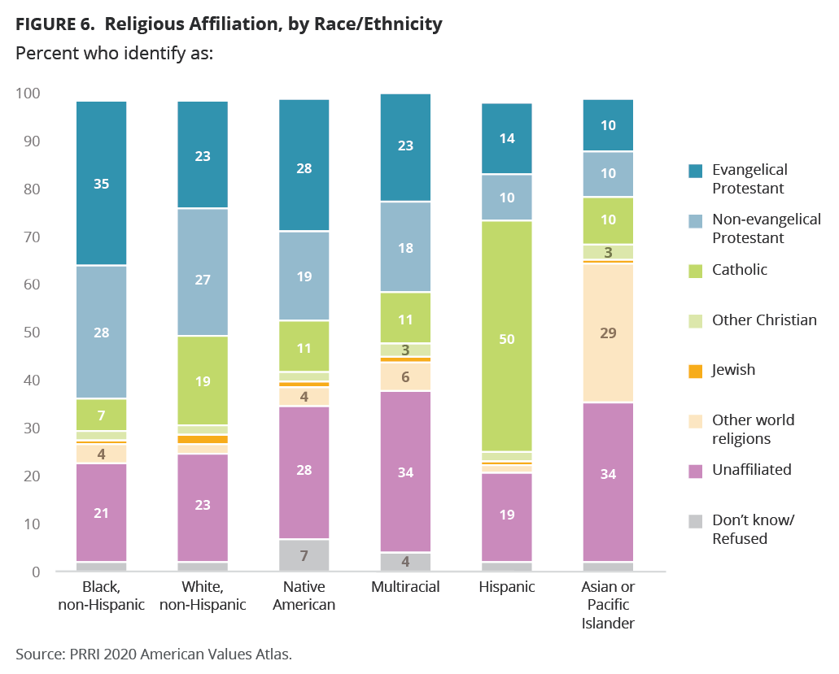

Slide 34
The Roman Catholic Church, with 62 million followers, is the largest Christian denomination in the United States.
The Southern Baptist Convention emerges as the most populous Protestant denomination in America, boasting a membership of 16 million.
United Methodist Church, with 7.6 million members
The National Baptist Convention, with 5 million members
The Evangelical Lutheran Church in America with 4.1 million members.

Slide 35
Southern Baptist Convention: 16.2 million members.
The United Methodist Church: 7.8 million members.
The Church of God in Christ: 5.5 million members.
National Baptist Convention: 5.0 million members.
Evangelical Lutheran Church, U.S.A.: 4.5 million members.
National Baptist Convention of America: 3.5 million members.
Assemblies of God: 2.9 million members.
Presbyterian Church (U.S.A.): 2.8 million members.
African Methodist Episcopal Church: 2.5 million members.
National Missionary Baptist Convention of America: 2.5 million members.
The Lutheran Church-Missouri Synod (LCMS): 2.3 million members.
The Episcopal Church: 2.0 million members.
Churches of Christ: 1.6 million members.
Pentecostal Assemblies of the World: 1.5 million members.
The African Methodist Episcopal Zion Church: 1.4 million members.

Slide 36
Lutheran Church of Hope
The fastest-growing Christian church in 2022 was the Lutheran Church of Hope, located in West Des Moines, Iowa. The Lutheran Church of Hope is led by pastor Mike Housholder.
The statistics from Outreach 100 show that the Lutheran Church of Hope had a 117% increase in its growth from the previous year.
The total attendance at Mike Housholder’s church is 9,915 people per week. With these numbers and the rise in the percentage of attendees, the Lutheran Church of Hope is the largest church and fastest-growing church in 2022.
The Lutheran Church of Hope was founded in 1994 and currently only has one location — the church located in West Des Moines.
As shown by the statistics with Outreach 100, online attendance has heavily increased by 700% compared to 2021, and in-person attendance has increased to 25-50%.
What is even greater is that the Lutheran Church of Hope shows in its statistics that salvation reports have gone up 100% compared to previous years.

