Slide 1
Article 2
The Trinity

Slide 2
The Trinity
WE BELIEVE in one God–the Creator and Ruler of the universe, existing in a divine and incomprehensible Trinity–the Father; the Son, Jesus Christ; and the Holy Spirit–each possessing divine perfection.

Slide 3
Biblical Supports
The grace of the Lord Jesus Christ and the love of God and the fellowship of the Holy Spirit be with you all. (ESV) II Corinthians 13:14
Go therefore and make disciples of all nations, baptizing them in the name of the Father and of the Son and of the Holy Spirit, (ESV) Matthew 28:19
But the Helper, the Holy Spirit, whom the Father will send in my name, he will teach you all things and bring to your remembrance all that I have said to you. (ESV) John 14:26
But when the Helper comes, whom I will send to you from the Father, the Spirit of truth, who proceeds from the Father, he will bear witness about me. (ESV) John 15:26
“according to the foreknowledge of God the Father, in the sanctification of the Spirit, for obedience to Jesus Christ and for sprinkling with his blood: “(ESV) 1 Peter 1:1–2

Slide 4
The Mystery of the Trinity
The term “Trinity” does not appear in the Bible.
Trinitas was first used by the church father Tertullian around AD 200.
Nevertheless, the doctrine is certainly taught in the Scriptures.
At the same time, the biblical doctrine of the Trinity cannot be understood apart from historical arguments, formulations, and creeds.

Slide 5
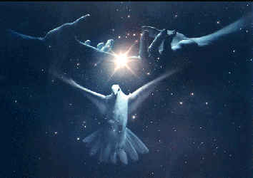
The Mystery of the Trinity
This doctrine is beyond the grasp of reason alone. God will always be incomprehensible to Man.
  “For My thoughts are not your thoughts, neither are your ways My ways,” declares the Lord. “For as the heavens are higher than the earth, so are My ways higher than your ways, and My thoughts than your thoughts.” Is. 55:8-9

Slide 6
False Concepts of the Trinity
Monarchianism
Emphasizes unity
of God but not
the diversity of
persons
Tritheism
There are three separate gods
Father
Son
Spirit
Modalism: God revealed in different modes
Father
Arianism
The Son is not “of the same substance” as God. He is a created being
Spirit
Son
Son
Father

Slide 7
A nice guy, a bishop, and a pain in the neck …
The Development of the Doctrine
The deity of Christ and the doctrine of God

Slide 8
The Edict of Milan
The legalization of Christianity
In 313, the Western emperor, Constantine, met with his rival and counterpart, the Eastern emperor, Licinius, in the city of Milan, Italy. As part of their discussions, they issued a joint statement, later known as the Edict of Milan. This proclamation protected full rights for Christian citizens of the Empire, restoring their property, releasing them from prisons, and effectively banning government persecution of their faith.

Slide 9
Who Is Christ?
If He is God, How Many Gods are there?
Jews – Radical monotheism – Here Oh Israel, the lord or God, He is One!
Gentiles – Mostly polytheism, many gods

Slide 10
The Nice Guy
Arius - 250-336
Arius - Nothing is known of the early life of Arius except that he may have been born in Libya and may have studied under Lucian, the revered teacher and martyr of Antioch. It is certain that he was pastor of the Baucalis church on the Alexandrian waterfront, where he won many supporters by his preaching. He may have aspired to the episcopacy in Alexandria, which went instead to his fellow presbyter, Alexander.
Not until 318, however, did Arius become prominent and then only as a heretic. He began by criticizing the Trinitarian views of Bishop Alexander, accusing him of Sabellianism (an early heresy which did not distinguish clearly between the "Persons" of the Trinity). But when Arius explained his position, he caused greater alarm with his own views, and soon he was condemned and exiled from his diocese.

Slide 11
Arius Argument
ARIUS’S ARGUMENT - Solid on God's Transcendence and Unity -because of this, he believes the Son or Jesus must be someone other than God.
He argues:
Son is begotten, or there was a time that Jesus was not.
Jesus begotten/ therefore a creature.
Jesus had a beginning.
Jesus had no special communication or direct knowledge of God.
Jesus is subject to change and, in principle, to sin- although he didn't.

Slide 12
What did he teach?
The dogmas which, going beyond Scripture, they have invented and asserted, are the following:
“God was not always the Father, but there was once when God was not the Father. The Word of God was not always in existence, but came into being from nothing, for ‘the God who is’ made ‘him who did not previously exist’ out of nothing. For this reason, there was once when he did not exist; for the Son is a creature (ktisma) and a created being (poiēma). He is neither like the Father in essence (kat’ ousian), nor is he by nature either the Father’s true Word or his true Wisdom, but rather one of the things he made (poiēmatōn) and one of those he begot (genētōn). He is called Word and Wisdom only by analogy, since he himself came into being from the actual (idios) Word of God and the Wisdom which is in God, by which God made all things including him. (8.) His nature is mutable and susceptible of change, as are all rational beings. And thus, the Word is alien to, other than, and excluded from the essence (ousia) of God; and the Father is invisible to the Son. For the Word neither knows the Father perfectly and accurately, nor can he see him perfectly. For the Son does not even know his own essence as it exists, (9.) since he was made for our sake, in order that God could create us through him, as through an instrument, and he would never have existed if God had not wanted to create us.”
(10.) Someone asked them whether the Word of God could turn to evil, like the devil has. And they were not afraid to answer, “Yes, he could. Since he is begotten, his nature is able to change.”

Slide 13
Arius’ Appeal
1. It was reasonable and logical [Jesus had no beginning is nonsense]
2. Monotheistic [Easier to grasp than Trinity.]
3. Basic Distrust of Matter [God not mixing with matter.]
4. Scriptural Argument
a. [Christ "changing" while on earth]
b. Proverbs 8
c. Colossian-"first born among many"
d. Romans 8:29, Hebrews 3:2, John 17:3, John 14:28
Conclusion--Jesus had a special role, but He wasn't God. [ Jehovah's Witness are Arian's.]

Slide 14
The Bishop
Alexander of Alexandra
Bishop and defender of the faith. He was born circa (c.) 250, probably in Alexandria, Egypt, becoming the bishop of the see in 313. The heresy of Arianism was sweeping the region, as Arius was preaching the doctrine there. Alexander excommunicated Arius in 321, a decision upheld by a council. Alexander is also credited with drawing up the acts of the First General Council of Nicaea in 325. He was described by contemporaries as "a lover of God . . .just . . . eloquent." https://www.catholic.org/saints/saint.php?saint_id=1246

Slide 15
There’s trouble a brewin’ in the
Empire
Constantine is now publicly identified himself with Christianity. He wants his empire unified under Christianity. Problem, CHRISTIANS CANNOT AGREE ON WHO IS JESUS AND WHO IS GOD.
Constantine cannot have this! Some have resorted to violence, battling over which group has the correct theology. Constantine has invited all of the bishops of the church to attend a great church council to be held in Nicaea, hoping to settle these problems and others.

Slide 16
The players at Nicaea
Arius
Alexander of Alexandria
Athanasius – a protege of Alexander - HE IS THE PAIN IN THE NECK….
“Athanasius contra mundum.” “If the world is against the truth, then I am against the world.”
He is exiled 5 times…..

Slide 17
It came down to three words…
Is Jesus _________ with the Father?
  Heterousius
  Homoiousius
  Homoousius
  οὐσία, ousía, "substance, being".

Slide 18
Why did they conclude this?
Undermined Christian doctrine of redemption - Christians teach Jesus is the source of Salvation.
1. If Jesus is not God, He couldn't truly save - creatures cannot save themselves, only the creator.
WHY?
  Sin Kills - demands recreation - only God can recreate. Corruption – the importance of the incarnation….
  Deals directly with the offended party
2. Scripture Texts
II Peter 1:1-4, I Cor. 2:8, Heb 13:8, Phil. 2:6-11, Acts 8:37, John 1:1

Slide 19
Application
If you do not get Jesus Christ right, you destroy salvation – Jesus cannot be less God than the Father.
Think Christianly – theological ideas are connected
We are Trinitarian. We worship Father, Son and Holy Spirit – NOT JUST JESUS.
PRAY THE TRINITY
Holy Spirit is NOT an it!!!!!

Slide 20
Creed of Nicaea
It seemed appropriate to attach the following which was expounded at Nicaea:
We believe in one God, the Father Almighty, Maker of all things seen and unseen.
And in one Lord, Jesus Christ the Son of God, begotten of the Father, the only-begotten, that is, of the essence of the Father, God from God, Light from Light, true God from true God, begotten, not made, of the same being as the Father, through whom all things came to be, both the things in heaven and on earth, who for us humans and for our salvation came down and was made flesh, becoming human, who suffered and rose again on the third day, ascended into heaven, who is coming to judge the living and the dead.
And in the Holy Spirit.
The catholic and apostolic church condemns those who say concerning the Son of God that “there was a time when he was not” or “he did not exist before he was begotten” or “he came to be from nothing” or who claim that he is of another subsistence (hypostasis) or essence (ousia), or a creation (ktistos), or changeable (alloiōtos), or alterable (treptos).

Slide 21
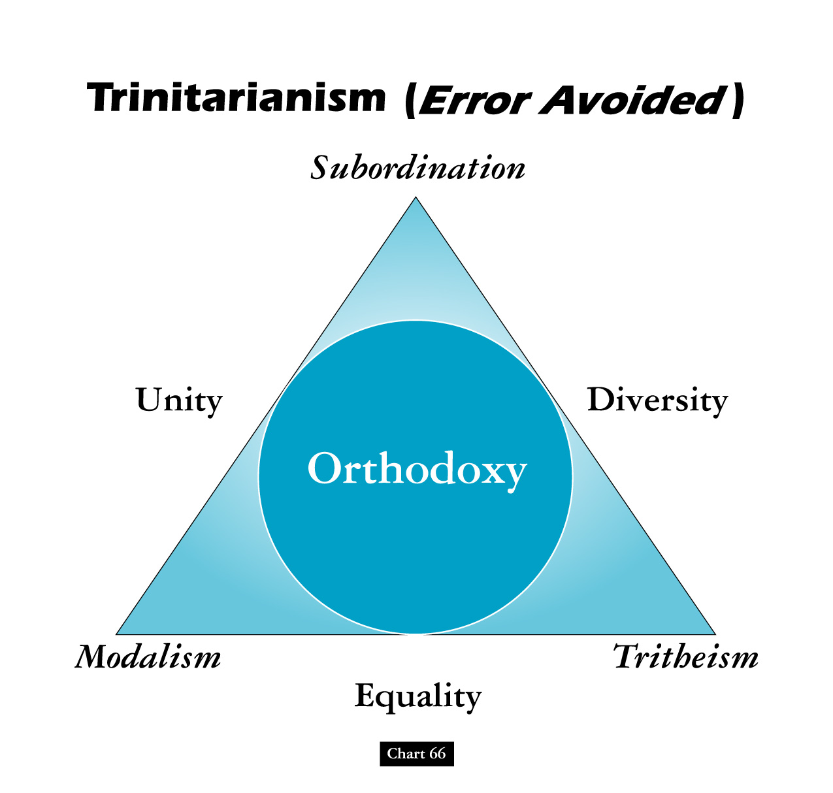

Slide 22

Definition of the Trinity
“God eternally exists as three persons, Father, Son, and Holy Spirit, and each person is fully God, and there is one God.”
“There is one only and true God, but in the unity of the Godhead there are three coeternal and coequal Persons, the same in substance, but distinct in subsistence.”

Slide 23
Definition of the Trinity
The Nicene Creed (AD 381) “I believe in one God the Father...and in one Lord Jesus Christ, the only-begotten Son of God, begotten of the Father before all worlds; God of God, Light of Light, very God of very God. He is begotten, not made, being of one substance with the Father.”

Slide 24
God is…
One in Essence/Substance
  “Hear, O Israel! The Lord is our God, the Lord is one! Deuteronomy 6:4
  “For there is one God, and one mediator also between God and men, the man Christ Jesus.” I Tim. 2:5
  “You believe that God is one. You do well.” James 2:19

Slide 25
God is…
Three in Person – “baptizing them in the name of the Father, the Son, and the Holy Spirit.” Matthew 28:19
  The Father is God
  “Yet for us there is but one God, the Father, from whom are all things, and we exist for Him.” I Cor. 8:6
  The Son is God
    “In the beginning was the Word, and the Word was with God, and the Word was God.” John 1:1
  The Spirit is God
    “But Peter said, ‘Ananias, why has Satan filled your heart to lie to the Holy Spirit, and to keep back some of the price of the land? …You have not lied to men, but to God.’” Acts 5:3-4

Slide 26
Distinctive Relationships within the Trinity
Only the Father
is Unoriginate. He
is not begotten nor
does he proceed!
The Son
is
Eternally
Begotten.
The Father generates the Son
“Begotten” is a biblical word used in a theological sense to describe the Father/Son relationship in the Trinity.

Slide 27
Distinctive Relationships within the Trinity
Only the Father
is Unoriginate. He
is not begotten nor
does he proceed!
The Son
is
Eternally
Begotten.
The Father generates the Son
The Spirit
eternally
proceeds from
Father and Son.
“When the Helper . comes, whom I will send to you from the Father, the Spirit of truth who proceeds from the Father, He will bear witness of Me,” John 15:26
“Procession” is the theological term to describe the Spirit’s relationship to the Father and Son.

Slide 28



Implications of The Trinity
The Father wills to seek us out for relationship.
The Son obediently becomes the instrument for relationship.
The Spirit empowers us for relationship.

