Slide 1
Article 3
Original Sin and Depravity

Slide 2
We believe that our first parents were created holy and upright, that they fell from this condition, and that in consequence the whole human race is in their nature dead in trespasses and sins.
Romans 5:12 | Genesis 1:27-28,31 | Ecclesiastes 7:29 | Ephesians 2:1-5

Slide 3
Genesis 1: 27 - 31
So God created man in his own image,in the image of God he created him; male and female he created them. And God blessed them. And God said to them, “Be fruitful and multiply and fill the earth and subdue it, and have dominion over the fish of the sea and over the birds of the heavens and over every living thing that moves on the earth.” And God said, “Behold, I have given you every plant yielding seed that is on the face of all the earth, and every tree with seed in its fruit. You shall have them for food. And to every beast of the earth and to every bird of the heavens and to everything that creeps on the earth, everything that has the breath of life, I have given every green plant for food.” And it was so. And God saw everything that he had made, and behold, it was very good. And there was evening and there was morning, the sixth day. (ESV)

Slide 4
Ecclesiastes 7:29
See, this alone I found, that God made man upright, but they have sought out many schemes. (ESV)

Slide 5
Romans 5:12
Therefore, just as sin came into the world through one man, and death through sin, and so death spread to all men because all sinned— (ESV)

Slide 6
Ephesians 2:1-5
And you were dead in the trespasses and sins in which you once walked, following the course of this world, following the prince of the power of the air, the spirit that is now at work in the sons of disobedience— among whom we all once lived in the passions of our flesh, carrying out the desires of the body and the mind, and were by nature children of wrath, like the rest of mankind. But God, being rich in mercy, because of the great love with which he loved us, even when we were dead in our trespasses, made us alive together with Christ—by grace you have been saved— (ESV)

Slide 7
Three separate idea
Adam and Eve were created, “holy” and “upright”
Adam and Eve fell – were no longer “holy” or “upright.”
(This is called “original sin”)
3. As a result, the whole human race is “dead” and lives in a state of sin.(This is called “depravity”)
I call this the “three D’s” – humans are now Dead, Damned and Depraved

Slide 8
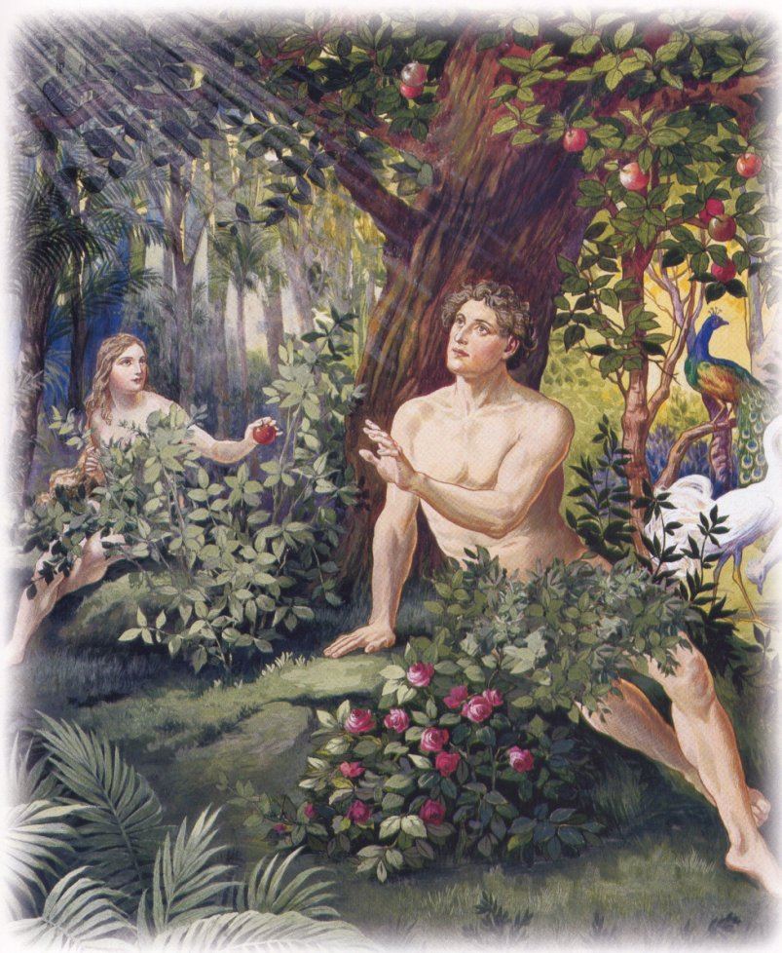
Humans at Creation: Holy and Upright
Adam and Eve possessed “unconfirmed creature holiness.”
They were without sin, and they had no tendency to sin.
The Fall did not result from a deficiency in how they were created. However, as creatures, they were capable of sinning.

Slide 9
Humans at Creation
God could not have created a being with free will and eliminated the possibility of sin. Nor could God have created an immutably holy being. Creatures, by definition, are mutable. God made the best possible creature.

Slide 10
Human Nature: an aside . . .
Sinfulness is a part of our fallenness, NOT our humanness. Adam and Eve before the fall were human and NOT sinful. Jesus has a human nature without sin. Our problem is our fallenness not our humanness. We will be human in heaven.

Slide 11
The Original sin: How did it happen?
Humans’ Responsibility
To exercise dominion.
Then God said, “Let Us make man in Our image, according to Our likeness; and let them rule over the fish of the sea and over the birds of the sky and over … all the earth.” Gen. 1:26
To enjoy God and His garden.
The LORD God commanded the man, saying, “From any tree of the garden you may eat freely…
3.To abstain from the Tree.
…but from the tree of the knowledge of good and evil you shall not eat, for in the day that you eat from it you will surely die.” Genesis 2:16-17

Slide 12
The Temptation – Satan’s Tactics
Now the serpent … said to the woman, “Indeed, has God said, ‘You shall not eat from any tree of the garden’? … You surely will not die! For God knows that in the day you eat from it your eyes will be opened, and you will be like God, knowing good and evil.” Gen 3:1, 4-5
He addressed Eve alone
He denied God’s Word
He questioned God’s goodness
He distorted the truth

Slide 13
The Temptation: Eve’s Rationalizations
When the woman saw that the tree was good for food, and that it was a delight to the eyes, and that the tree was desirable to make one wise, she took from its fruit and ate; and she gave also to her husband with her, and he ate. Genesis 3:6
The fruit would be delicious to eat. Why would God withhold fruit that is beautiful to the eyes? And God would want me to be wise like Him!”
Lust of the flesh
Lust of the eyes
Boastful pride of life
1 John 2:16. For all that is in the world—the desires of the flesh and the desires of the eyes and pride of life—is not from the Father but is from the world. (ESV)

Slide 14
The Temptation: Adam’s Acquiescence
“… she gave also to her husband with her, and he ate.” Genesis 3:6
Eve was the first to eat, but Adam bears the responsibility for the sin.
Sin is transmitted to humans through Adam, not Eve.
“Sin came into the world through one man …” Romans 5:12

Slide 15
The Result of Original Sin: Death and Damnation
Death and damnation to all
Romans 5:12“Therefore…through one man sin entered into the world, and death through sin, and so death spread to all men, because all sinned.”
Romans 3:23 for all have sinned and fall short of the glory of God, (ESV)
Romans 6:23 For the wages of sin is death, but the free gift of God is eternal life in Christ Jesus our Lord. (ESV)

Slide 16
The Result of Original Sin: Depravity
Humans are totally depraved.
This is a statement of quality, not quantity. “Total depravity does not mean that everyone is as thoroughly depraved in his actions as he could possibly be, nor that everyone will indulge in every form of sin, nor that a person cannot appreciate and even do acts of goodness; but it does mean that the corruption of sin extends to all men and to all parts of men so that there is nothing within the natural man that can give him merit in God’s sight.” (Enns, MHT, 310-311)

Slide 17
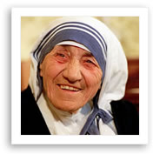
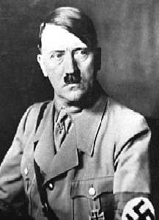
The Result of Original Sin: Depravity
Humans have an innate sin nature.
For all have sinned and fall short of the glory of God. Rom. 3:23
I was brought forth in iniquity; in sin my mother conceived me. Ps 51:5
Different in actions, but not
with respect to sin nature.

Slide 18
The Result of Original Sin: Chaos and death in the Created Order.
Romans 8:19–22
For the creation waits with eager longing for the revealing of the sons of God. For the creation was subjected to futility, not willingly, but because of him who subjected it, in hope that the creation itself will be set free from its bondage to corruption and obtain the freedom of the glory of the children of God. For we know that the whole creation has been groaning together in the pains of childbirth until now. (ESV)

Slide 19
How is Adam’s Sin transferred to his descendants? Pelagianism
Pelagius was a British monk who came to Rome around AD 400.
No sin transmitted from Adam.
Adam is only a bad example.
Salvation through perfect living is possible.
Adam’s Sin set a bad example –we are free to choose good or evil.
Not Compatible with CCIW’s statement

Slide 20
How is Adam’s Sin Transferred to his descendants? Environmental
Humans are good, but the environment in which we live is corrupt. That is what causes us to sin.
Not Compatible with CCIW’s statement

Slide 21
How is Adam’s Sin transferred to his descendants? Augustinian View
Augustine said everyone has fallen in Adam’s sin.
Non posse non peccare: “Not possible not to sin.”
Levi was “in the loins” of Abraham when he paid tithes to Melchizedek (Heb. 7:9-10). He was “seminally present” as future seed.
The idea is that sin is transmitted through male semen. Humans choose to sin because it is in their nature to sin. Choices reflect being. Humans must sin because it is part of their nature to sin.

Slide 22
Implications of Augustinian view
Thirdly, this was befitting to the dignity of Christ’s humanity in which there could be no sin, since by it the sin of the world was taken away, according to John 1:29: “Behold the Lamb of God” (i.e. the Lamb without stain) “who taketh away the sin of the world.” Now it was not possible in a nature already corrupt, for flesh to be born from sexual intercourse without incurring the infection of original sin. Whence Augustine says (De Nup. et Concup. i): “In that union,” viz. the marriage of Mary and Joseph, “the nuptial intercourse alone was lacking: because in sinful flesh this could not be without fleshly concupiscence which arises from sin, and without which He wished to be conceived, Who was to be without sin.
https://spiritualdirection.com/2021/12/20/on-the-perpetual-virginity-of-mary-and-the-limits-of-the-chosen accessed December 14, 2025

Slide 23
Implications of Augustinian view
I answer that, Without any hesitation we must abhor the error of Helvidius, who dared to assert that Christ's Mother, after His Birth, was carnally known by Joseph, and bore other children. For, in the first place, this is derogatory to Christ's perfection: for as He is in His Godhead the Only-Begotten of the Father, being thus His Son in every respect perfect, so it was becoming that He should be the Only-begotten son of His Mother, as being her perfect offspring.
Secondly, this error is an insult to the Holy Ghost, whose "shrine" was the virginal womb ["Sacrarium Spiritus Sancti" (Office of B. M. V., Ant. ad Benedictus, T. P.), wherein He had formed the flesh of Christ: wherefore it was unbecoming that it should be desecrated by intercourse with man.
Thirdly, this is derogatory to the dignity and holiness of God's Mother: for thus she would seem to be most ungrateful, were she not content with such a Son; and were she, of her own accord, by carnal intercourse to forfeit that virginity which had been miraculously preserved in her.
https://www.newadvent.org/summa/4028.htm accessed December 14, 2025.

Slide 24
How is Adam’s Sin Transferred to his Descendants? Federal View
Some Reformed Theology teaches that Adam was not the seminal head but the federal (covenantal) head of Man.
God entered into a covenant of works with Adam and named him the official representative of the human race.
By sinning and breaking that covenant, he plunged all whom he represented into sin.

Slide 25
How is Adam’s sin transferred to his descendants? Unity Theory
Ancient Jews understood well the idea of corporate identity. They never thought of themselves as isolated personalities or as a mass of separate individuals who happened to have the same bloodline as their families and fellow Jews. What one of them did affected all the others, and what the others did affected him-in a way that is difficult for modern, individual-oriented man to comprehend.
It was on that basis that God frequently punished or blessed an entire tribe, city, or nation because of what a few, or even just one, of its members did. In light of that principle, Abraham asked the Lord to spare Sodom if only a few righteous people could be found there (Gen. 18:22–33). It was also on the basis of that principle that God held all Israel accountable and eventually destroyed Achan’s family along with him because of that one man’s disobedience in keeping for himself some of the booty from Jericho (see Josh. 7:1–26). https://www.gty.org/library/bibleqnas-library/QA0290/inheriting-adams-sin accessed December 15, 2025

Slide 26
How is Adam’s sin transferred to his descendants? Unity Theory
God made men a procreative race, and when they procreate they pass on to their children, and their children’s children, their nature - physical, psychological, and spiritual.
Mankind is a single entity, constituting a divinely ordered solidarity. Adam represents the entire human race descended from him. Therefore, when Adam sinned, all mankind sinned, and because his first sin transformed his inner nature, that now depraved nature was also transmitted to his posterity. Because he became spiritually polluted, all his descendants would be polluted similarly. That pollution has accumulated and intensified throughout the ages of human history. Instead of evolving, man has devolved, degenerating into greater and greater sinfulness. ). https://www.gty.org/library/bibleqnas-library/QA0290/inheriting-adams-sin accessed December 15, 2025

Slide 27
Application
Sin is deeply woven into us as individuals, our cultures, and even the physical created order. We live in a world littered with pain, chaos, twistedness, and cruelty.
The profound nature of sin is illustrated in physical death. The degree to which we fail to take sin seriously is illustrated by our attempts to see death as natural - “the circle of life.” Death is one of our great enemies, but God Himself, in Christ, has defeated sin and death!

