Slide 1
We believe in the Incarnation, death, and bodily resurrection of the Son of God; and that salvation is attained only through repentance and faith in Him.
Article 4

Slide 2
John 1:1–14
In the beginning was the Word, and the Word was with God, and the Word was God. He was in the beginning with God. All things were made through him, and without him was not anything made that was made. In him was life, and the life was the light of men. The light shines in the darkness, and the darkness has not overcome it. There was a man sent from God, whose name was John. He came as a witness, to bear witness about the light, that all might believe through him. He was not the light, but came to bear witness about the light. The true light, which gives light to everyone, was coming into the world. He was in the world, and the world was made through him, yet the world did not know him. He came to his own, and his own people did not receive him. But to all who did receive him, who believed in his name, he gave the right to become children of God, who were born, not of blood nor of the will of the flesh nor of the will of man, but of God. And the Word became flesh and dwelt among us, and we have seen his glory, glory as of the only Son from the Father, full of grace and truth. ESV)

Slide 3
1 Corinthians 15:3–4
For I delivered to you as of first importance what I also received: that Christ died for our sins in accordance with the Scriptures, that he was buried, that he was raised on the third day in accordance with the Scriptures, (ESV)

Slide 4
Acts 4:10–12
let it be known to all of you and to all the people of Israel that by the name of Jesus Christ of Nazareth, whom you crucified, whom God raised from the dead—by him this man is standing before you well. This Jesus is the stone that was rejected by you, the builders, which has become the cornerstone. And there is salvation in no one else, for there is no other name under heaven given among men by which we must be saved.” (ESV)

Slide 5
Christology
Three ideas
Incarnation
Death
Resurrection

Slide 6
Incarnation
Incarnation literally means 'to take on flesh'. For Christians, the incarnation shows that Jesus was fully God and fully human.

Slide 7
The Humanity of Christ
Bible’s Teaching
And she gave birth to her firstborn son; and she wrapped Him in cloths, and laid Him in a manger, because there was no room for them in the inn. Luke 2:7
But when the fullness of the time came, God sent forth His Son, born of a woman, born under the Law. Galatians 4:4

Slide 8
The Humanity of Christ
And Jesus kept increasing in wisdom and stature, and in favor with God and men. Luke 2:52
“In pouring this ointment on my body, she has done it to prepare me for burial.” Mt 26:12
Soul/Spirit: “Into Thy hands I commend my spirit!” Luke 23:46
Hunger: “And after He had fasted forty days and forty nights, He then became hungry.” Matthew 4:2; cf. Mt 21:18
Thirst: “I am thirsty.” John 19:28

Slide 9
The Humanity of Christ
Weariness: “So Jesus, being wearied from His journey, was sitting by the well. It was about the sixth hour.” John 4:6
Grief: “Jesus wept.” John 11:35
Compassion: “Seeing the people, He felt compassion for them, because they were distressed and dispirited like sheep without a shepherd.” Matthew 9:36
Sorrow/Longing: “Approaching Jerusalem, He saw the city and wept over it.” Luke 19:41; cf. Mt. 23:37
Anger: “After looking around at them with anger, grieved at their hardness of heart…” Mark 3:5; cf. 10:14

Slide 10
The History of the Doctrine
Question: If Jesus is God, how is He also human?
Early Tendencies in Christology
A Mere Man <---------------> Divine, not fully Man

Slide 11
Early Errors
Adoptionism - denied the virgin birth, taught that Jesus was a normal human who was exceedingly wise, and that he was “adopted” by the Christ-spirit upon his baptism.
Docetism – Docetism, which challenged the biblical testimony of Christ’s full humanity. Jesus only “appeared” human. The Apostle John warned against this error, noting that some refused to acknowledge “that Jesus Christ as come in the flesh” (1Jn. 4:1-3).

Slide 12
Apollinarianism
Apollinaris of Laodicea (d. 390) believed that in taking on human nature, the Word became united with a body only. So eager was he to avoid the Arian error and emphasize the deity of Christ and unity of his person that he denied Jesus as having a human soul. The soul was replaced with the divine Word, or logos. Jesus, in other words, was not an ordinary human being.
https://www.thegospelcoalition.org/essay/christological-controversies-in-the-early-church/ accessed December 21, 2024

Slide 13
Nestorianism
In the early fifth century, Nestorius of Constantinople (c. 386–450) taught that Jesus Christ was actually two distinct persons. Nestorius struggled to affirm the traditional title for Mary as theotokos (“God-bearer”), as this seemed to deny the human qualities of Christ. He struggled to conceive how it could be that God was born from a human, or that God suffered and died. Therefore, Nestorianism posited that in Christ was both the human person and divine person, but that each operated independently. At one point it would be the divine person working, and at another point it was the human. In this way, Nestorians sought to deal with Scripture that spoke to both Christ’s divine characteristics and his human ones. https://www.thegospelcoalition.org/essay/christological-controversies-in-the-early-church/ accessed December 21, 2024

Slide 14
Eutchyianism
Teachings from the monk Eutychus of Constantinople (c. 380–c. 456), Eutchyianism combines the two natures into one single nature. The official term for this theological error was monophysitism. Eutychus believed that both natures existed before the incarnation, but following the birth of Christ, there was only one nature. The human nature according to Eutyches was a mere appearance, harkening back to views of the Docetists.
https://www.thegospelcoalition.org/essay/of/ accessed December 21, 2024

Slide 15
Council of Chalcedon – 451 AD

Slide 16
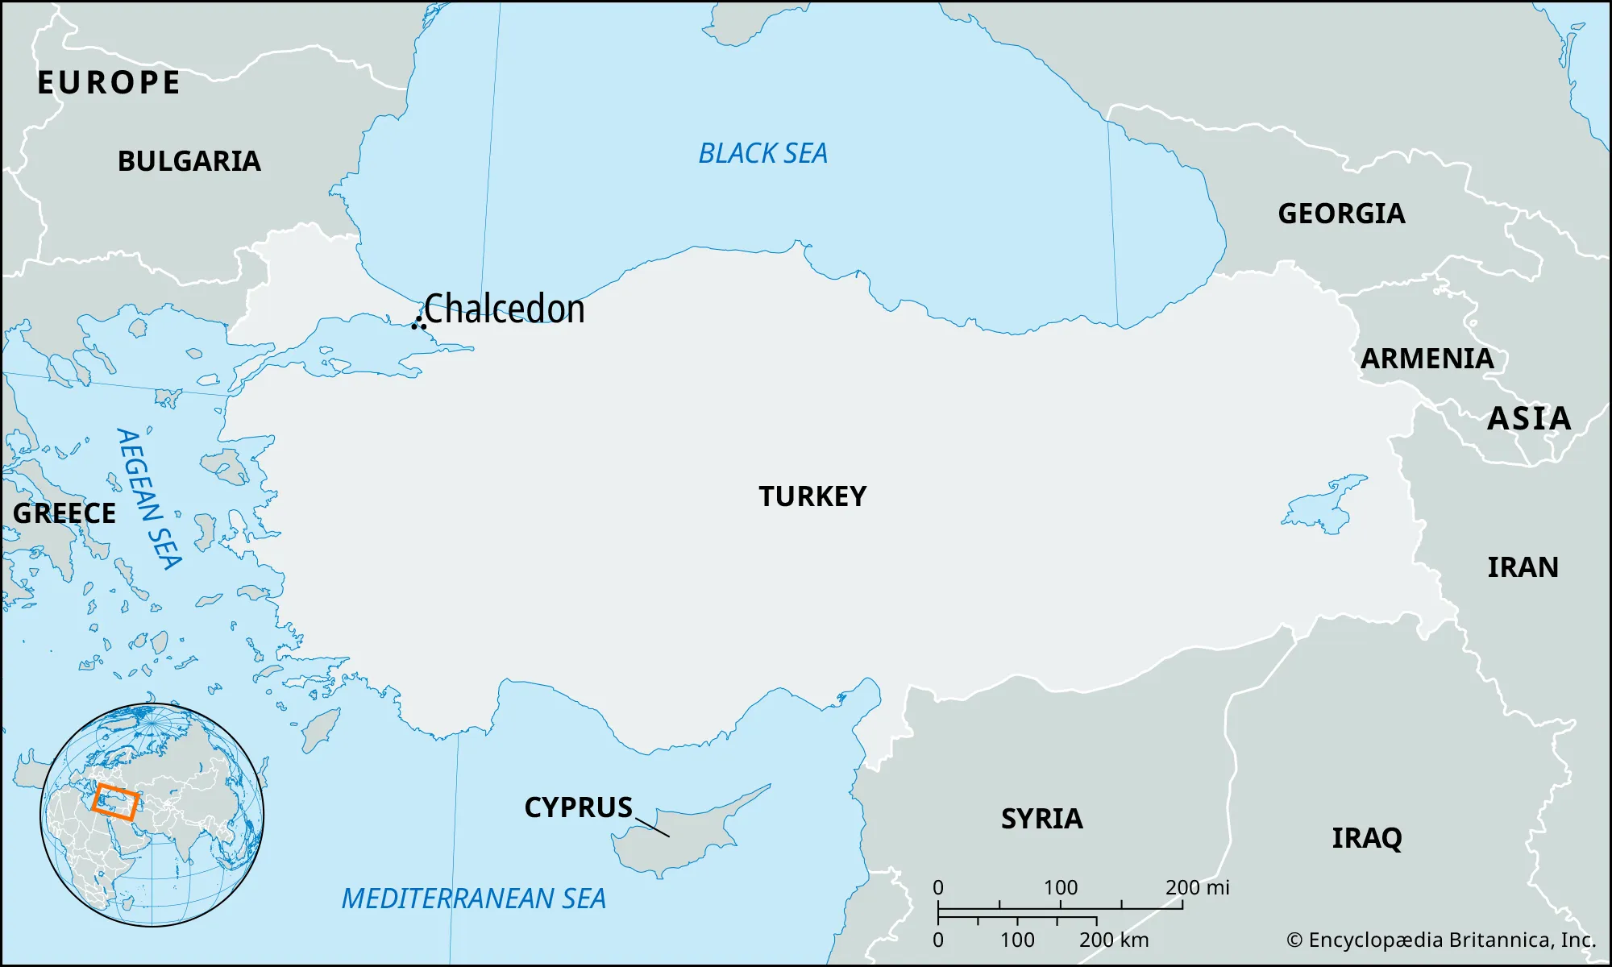

Slide 17
How do we solve this?
Start with what we know!
Only God can Save! (Nicaea 325 AD)
The Principle of Adoption – only that which is assumed is redeemed.
The distinction between “person” and “nature.”

Slide 18
The Definition of Chalcedon

Slide 20
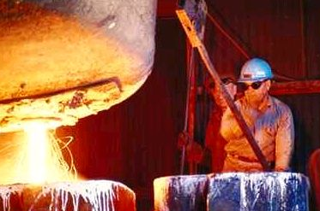
The Hypostatic Union
Hypostasis means “person.”
Christ is only one person.
In Him there is a union of full humanity and full divinity.
The two natures of Christ are not mixed to produce a third thing. He is fully God and fully Man.
Steel is an alloy of iron and carbon.

Slide 21
Christ is:
one person
in two natures
without confusion
without change
without division
without separation

Slide 22
Implications
Only Jesus Christ can save us.
Jesus Christ will save us in our entirety!
No part of you is unsavable, and every part of you will be saved.

