Slide 1
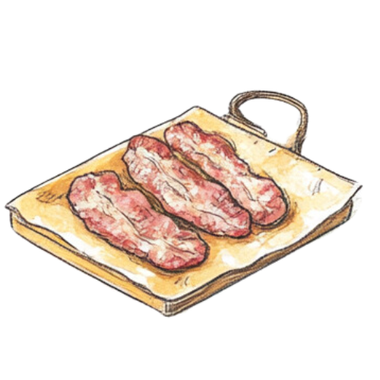
Applicable for:
ministry volunteers
training and appreciation
enticing volunteers to attend training by feeding them
At the beginning of each school year, we have a breakfast for all known ministry volunteers at that time, so we can train them all as a large group.

Slide 2
150 volunteers
LOTS of Breakfast food
Pastoral prayer
Kids’ Harbor handbooks and T-shirts
1 Large group training
Volunteer requirements
Policies and procedures
Resources
1 small group training
Nursery-specific training
Preschool-specific training
Elementary-specific training

Slide 3
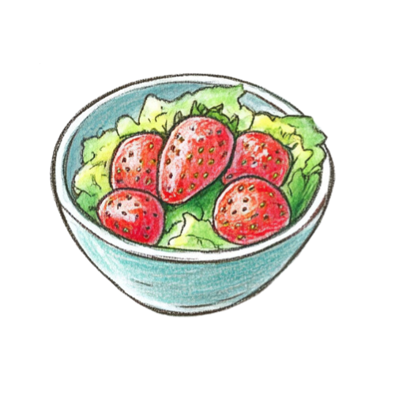
Hospitality Team for food service
AV equipment
Training powerpoint
Team leaders for training
Large room set up for eating
Writing utensils and sticky notes
Delicious food

Slide 4
Presentation Title
Presenter Name
Applicable for: ages, need, context
Brief Summary Statement

Slide 5
Tell Us More
Presenter Name
Use this space to tell us what do you do and how it was accomplished

Slide 6
Resources
Presenter Name
What resources are needed to accomplish this
or were used in the creation of this idea?
Please share a photo, if available.

