Slide 1
We believe in the Incarnation, death, and bodily resurrection of the Son of God; and that salvation is attained only through repentance and faith in Him.
Article 4

Slide 2
Theological content of this article
1. “We believe in the Incarnation, death, and bodily resurrection of the Son of God”
This is Christology – the study of Christ.
The Person of Christ - “the Incarnation” and “the Son of God”
The Work of Christ – “death, and bodily resurrection”
2. “salvation is attained only through repentance and faith in Him.”
This is Soteriology – the study of Salvation

Slide 3
John 1:1–14
In the beginning was the Word, and the Word was with God, and the Word was God. He was in the beginning with God. All things were made through him, and without him was not anything made that was made. In him was life, and the life was the light of men. The light shines in the darkness, and the darkness has not overcome it. There was a man sent from God, whose name was John. He came as a witness, to bear witness about the light, that all might believe through him. He was not the light, but came to bear witness about the light. The true light, which gives light to everyone, was coming into the world. He was in the world, and the world was made through him, yet the world did not know him. He came to his own, and his own people did not receive him. But to all who did receive him, who believed in his name, he gave the right to become children of God, who were born, not of blood nor of the will of the flesh nor of the will of man, but of God. And the Word became flesh and dwelt among us, and we have seen his glory, glory as of the only Son from the Father, full of grace and truth. ESV)

Slide 4
1 Corinthians 15:3–4
For I delivered to you as of first importance what I also received: that Christ died for our sins in accordance with the Scriptures, that he was buried, that he was raised on the third day in accordance with the Scriptures, (ESV)

Slide 5
Acts 4:10–12
let it be known to all of you and to all the people of Israel that by the name of Jesus Christ of Nazareth, whom you crucified, whom God raised from the dead—by him this man is standing before you well. This Jesus is the stone that was rejected by you, the builders, which has become the cornerstone. And there is salvation in no one else, for there is no other name under heaven given among men by which we must be saved.” (ESV)

Slide 6
Christology
Three ideas
Incarnation
Death
Resurrection

Slide 7
Incarnation
Incarnation literally means 'to take on flesh'. For Christians, the incarnation shows that Jesus was fully God and fully human.

Slide 8
The Humanity of Christ
Bible’s Teaching
And she gave birth to her firstborn son; and she wrapped Him in cloths, and laid Him in a manger, because there was no room for them in the inn. Luke 2:7
But when the fullness of the time came, God sent forth His Son, born of a woman, born under the Law. Galatians 4:4

Slide 9
The Humanity of Christ
And Jesus kept increasing in wisdom and stature, and in favor with God and men. Luke 2:52
“In pouring this ointment on my body, she has done it to prepare me for burial.” Mt 26:12
Soul/Spirit: “Into Thy hands I commend my spirit!” Luke 23:46
Hunger: “And after He had fasted forty days and forty nights, He then became hungry.” Matthew 4:2; cf. Mt 21:18
Thirst: “I am thirsty.” John 19:28

Slide 10
The Humanity of Christ
Weariness: “So Jesus, being wearied from His journey, was sitting by the well. It was about the sixth hour.” John 4:6
Grief: “Jesus wept.” John 11:35
Compassion: “Seeing the people, He felt compassion for them, because they were distressed and dispirited like sheep without a shepherd.” Matthew 9:36
Sorrow/Longing: “Approaching Jerusalem, He saw the city and wept over it.” Luke 19:41; cf. Mt. 23:37
Anger: “After looking around at them with anger, grieved at their hardness of heart…” Mark 3:5; cf. 10:14

Slide 11
The History of the Doctrine
Question: If Jesus is God, how is He also human?
Early Tendencies in Christology
A Mere Man <---------------> Divine, not fully Man

Slide 12
Early Errors
Adoptionism - denied the virgin birth, taught that Jesus was a normal human who was exceedingly wise, and that he was “adopted” by the Christ-spirit upon his baptism.
Docetism – Docetism, which challenged the biblical testimony of Christ’s full humanity. Jesus only “appeared” human. The Apostle John warned against this error, noting that some refused to acknowledge “that Jesus Christ as come in the flesh” (1Jn. 4:1-3).

Slide 13
Apollinarianism
Apollinaris of Laodicea (d. 390) believed that in taking on human nature, the Word became united with a body only. So eager was he to avoid the Arian error and emphasize the deity of Christ and unity of his person that he denied Jesus as having a human soul. The soul was replaced with the divine Word, or logos. Jesus, in other words, was not an ordinary human being.
https://www.thegospelcoalition.org/essay/christological-controversies-in-the-early-church/ accessed December 21, 2024

Slide 14
Nestorianism
In the early fifth century, Nestorius of Constantinople (c. 386–450) taught that Jesus Christ was actually two distinct persons. Nestorius struggled to affirm the traditional title for Mary as theotokos (“God-bearer”), as this seemed to deny the human qualities of Christ. He struggled to conceive how it could be that God was born from a human, or that God suffered and died. Therefore, Nestorianism posited that in Christ was both the human person and divine person, but that each operated independently. At one point it would be the divine person working, and at another point it was the human. In this way, Nestorians sought to deal with Scripture that spoke to both Christ’s divine characteristics and his human ones. https://www.thegospelcoalition.org/essay/christological-controversies-in-the-early-church/ accessed December 21, 2024

Slide 15
Eutchyianism
Teachings from the monk Eutychus of Constantinople (c. 380–c. 456), Eutchyianism combines the two natures into one single nature. The official term for this theological error was monophysitism. Eutychus believed that both natures existed before the incarnation, but following the birth of Christ, there was only one nature. The human nature according to Eutyches was a mere appearance, harkening back to views of the Docetists.
https://www.thegospelcoalition.org/essay/of/ accessed December 21, 2024

Slide 16
Council of Chalcedon – 451 AD

Slide 17
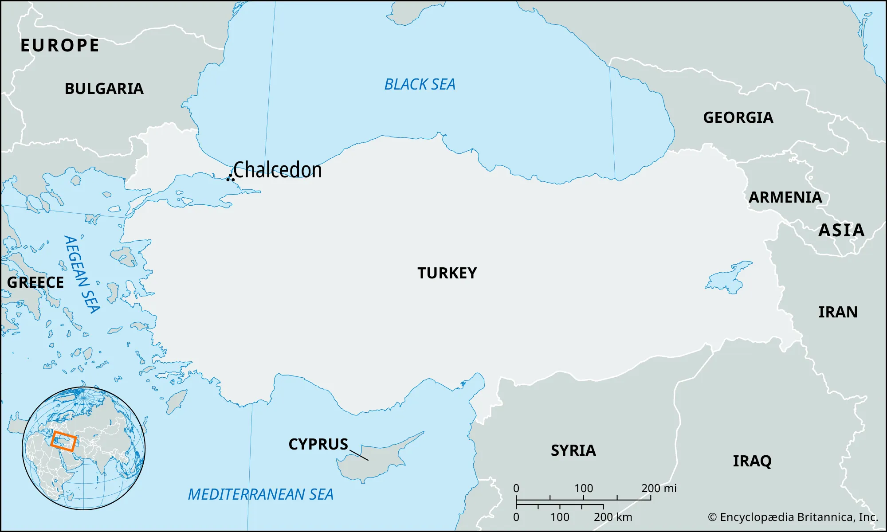

Slide 18
How do we solve this?
Start with what we know!
Only God can Save! (Nicaea 325 AD)
The Principle of Adoption – only that which is assumed is redeemed.
The distinction between “person” and “nature.”

Slide 19
The Definition of Chalcedon

Slide 21
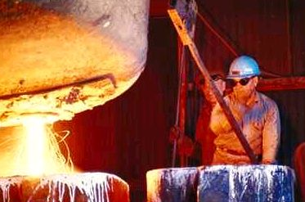
The Hypostatic Union
Hypostasis means “person.”
Christ is only one person.
In Him there is a union of full humanity and full divinity.
The two natures of Christ are not mixed to produce a third thing. He is fully God and fully Man.
Steel is an alloy of iron and carbon.

Slide 22
Christ is:
one person
in two natures
without confusion
without change
without division
without separation

Slide 23
Implications
Only Jesus Christ can save us.
Jesus Christ will save us in our entirety!
No part of you is unsavable, and every part of you will be saved.

Slide 24
The Death of Christ

Slide 25
It was predetermined in eternity
1 Peter 1:18-20 For you know that it was not with perishable things such as silver or gold that you were redeemed from the empty way of life handed down to you from your ancestors, 19 but with the precious blood of Christ, a lamb without blemish or defect. 20 He was chosen before the creation of the world but was revealed in these last times for your sake.
Revelation 13:8 All inhabitants of the earth will worship the beast—all whose names have not been written in the Lamb’s book of life, the Lamb who was slain from the creation of the world. taken from https://www.wordsoflife.co.uk/bible-studies/study-8-the-significance-of-his-death/ - accessed 1/11/2025

Slide 26
Predicted in the Old Testament
Luke 24:25-27 He said to them, “How foolish you are, and how slow to believe all that the prophets have spoken! ²⁶ Did not the Messiah have to suffer these things and then enter his glory?” ²⁷ And beginning with Moses and all the Prophets, he explained to them what was said in all the Scriptures concerning himself.
see also - Isaiah 53
https://www.wordsoflife.co.uk/bible-studies/study-8-the-significance-of-his-death/ - accessed 1/11/2025

Slide 27
The Lord Jesus came into the world to die
These scriptures make this quite clear. He was not surprised or disappointed by his arrest and execution.
He knew his death was necessary. Hebrews 9:22 In fact, the law requires that nearly everything be cleansed with blood, and without the shedding of blood there is no forgiveness.
He knew He had come to die. Matthew 16:21 From that time on Jesus began to explain to his disciples that he must go to Jerusalem and suffer many things at the hands of the elders, the chief priests and the teachers of the law, and that he must be killed and on the third day be raised to life.
See also -Matthew 17:12; Luke 9:51; John 3:14 and John 10:11).
https://www.wordsoflife.co.uk/bible-studies/study-8-the-significance-of-his-death/ - accessed 1/11/2025

Slide 28
The Lord Jesus died willingly, voluntarily
As the sinless One, there was no cause of death in Himself.
John 10: 17,18 “The reason my Father loves me is that I lay down my life—only to take it up again. ¹⁸ No one takes it from me, but I lay it down of my own accord. I have authority to lay it down and authority to take it up again.”
See Also Matthew 26:53 say. Luke 22:53; John 7:30 and John 8:20. He voluntarily laid down His life for us because it was the will of His Father that He should do so and because He loved us so much!
https://www.wordsoflife.co.uk/bible-studies/study-8-the-significance-of-his-death/ - accessed 1/11/2025

Slide 29
The Lord Jesus died as a sacrifice for sin, to put away sin
Why did He die? He died to put away sin by the sacrifice of Himself.
Hebrews 9:26 “Otherwise Christ would have had to suffer many times since the creation of the world. But he has appeared once for all at the culmination of the ages to do away with sin by the sacrifice of himself.”
See also - Isaiah 53:5-6; John 1:29; 1 Corinthians 15:3; 2 Corinthians 5:21; and 1 Peter 2:24.
https://www.wordsoflife.co.uk/bible-studies/study-8-the-significance-of-his-death/ - accessed 1/11/2025

Slide 30
The Lord Jesus died as our Substitute, bearing our penalty
He died instead of us, in our place, and He bore the punishment which was due to us
John 10:11 “I am the good shepherd. The good shepherd lays down his life for the sheep.
1 Peter 3:18. “For Christ also suffered once for sins, the righteous for the unrighteous, to bring you to God.”
1 Peter 2:24 “He himself bore our sins” in his body on the cross, so that we might die to sins and live for righteousness; “by his wounds you have been healed.”
https://www.wordsoflife.co.uk/bible-studies/study-8-the-significance-of-his-death/ - accessed 1/11/2025

Slide 31
The Death of the Lord Jesus was victorious
Christ’s death accomplished what it intended to do. His death is sufficient for all, but it is efficient only for those who believe. His death was victorious because He rose again, demonstrating that His death had met all the claims of divine justice and that salvation had been procured for all who would believe.
John 3:16. For God so loved the world that he gave his one and only Son, that whoever believes in him shall not perish but have eternal life.
1 John 2:2. He is the atoning sacrifice for our sins, and not only for ours but also for the sins of the whole world.
https://www.wordsoflife.co.uk/bible-studies/study-8-the-significance-of-his-death/ - accessed 1/11/2025

Slide 32
He is the atoning sacrifice for our sins, (1 John 2:2.) The Doctrine of Atonement

Slide 33
Meaning of the term “atonement”
The words “atone” and “atonement” are derived from the expressions “make at one”, and “at onement”. Usage of the latter phrase can be traced to as early as the 1300s in the writings of John Wycliffe (Hayes 1998). The word thus carries at its heart the notion of putting parties at one—unifying, or reconciling. The Oxford English Dictionary offers several definitions of atonement:
“the condition of being at one with others” (def. 1),
“the action of setting at one, or condition of being set at one, after discord or strife” (def. 2),
“reconciliation or restoration of friendly relations between God and sinners” (def. 3), and
“propitiation of an offended or injured person, by reparation of wrong or injury; amends, satisfaction, expiation” (def. 4).
https://plato.stanford.edu/entries/atonement/ accessed 1/11/2025

Slide 34
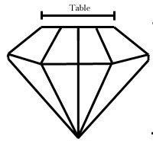
Views of the Atonement
The atonement is like a diamond. It has many facets, all of which contribute to the beauty of the whole.
The main facet of the “brilliant cut” diamond is the “table.” So too, the idea of substitute punishment is the main theme of the atonement.

Slide 35
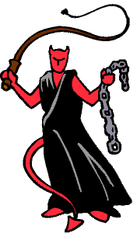
Views of the Atonement
GOD
1. Ransom to Satan Theory
The death of Jesus was a ransom paid to Satan to pay him for the rightful claims he had against man.
This view is not correct. God . does not owe Satan anything.
However, the Bible does teach the . triumph of Christ over sin, death . . and Satan.

Slide 36
Views of the Atonement
GOD
2. Satisfaction Theory
Major proponent was St. Anselm (1033-1109).
Rejected the ransom to Satan theory and re-focused on God.
Man by his sin infinitely robbed God of His honor.
Jesus’ death infinitely satisfies this offense.
Offended
Honor
Offense canceled; the Cross provides Satisfaction!

Slide 37
Views of the Atonement
GOD
3. Moral Influence Theory
Held by Peter Abelard (1079-1142), and most liberal theologians today.
The sight of Christ’s death should awaken love for God in sinners, and cause them to turn from sin.
Love Awakened
Proof of God’s Love
This is a subjective rather . than objective theory of the . . atonement.

Slide 38
Views of the Atonement
GOD
4. Governmental Theory
Held by Hugo Grotius (1583- 1645), who was a lawyer.
Sin undermines God’s right to rule the world.
The death of Christ displays God’s displeasure with sin.
People must learn this lesson and amend their lives, so that God’s rule can be restored.
Repentance
Proof of God’s Anger

Slide 39
Views of the Atonement
GOD
5. Penal Substitution
The Cross fulfills God’s just . demand for punishment, while . mercifully providing a . substitute for us.
Wrath
Punishment is meted out, but the Cross is a substitute!
The doctrine is first clearly articulated by the Reformers.
Stands in the train of thought of St. Anselm.
This is the main “facet” of the biblical theology of atonement.
Just punishment

Slide 40
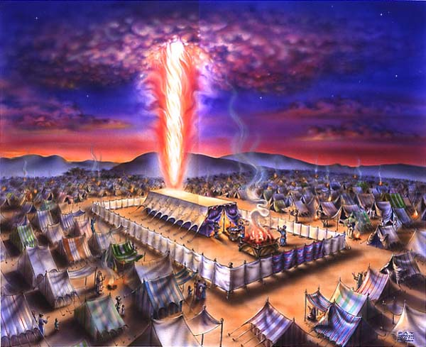
The Old Testament Background
1. The Tabernacle
Its layout says, “The Lord desires a relationship with His people, but sin must be dealt with before anyone can enter the Holy of Holies.”

Slide 41
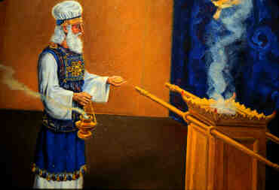
The Old Testament Background
2. The Animal Sacrifices
These bloody sacrifices reminded the people to take sin seriously!

Slide 42
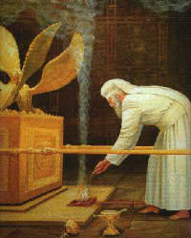
The Old Testament Background
3. The Day of Atonement
The High Priest continually offered sacrifices year after year for the sins of the people.

Slide 43
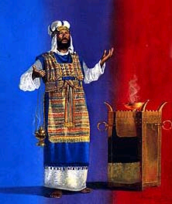
The Old Testament Background
“Then Aaron shall lay both of his hands on the head of the live goat, and confess over it all the iniquities of the sons of Israel …and he shall lay them on the head of the goat and send it away into the wilderness .” Lev. 16:21
“But when Christ appeared as a high priest of the good things to come, He entered through the greater and more perfect tabernacle… not through the blood of goats and calves, but through His own blood, He entered the holy place once for all, having obtained eternal redemption.” Heb. 9:11-14

Slide 44
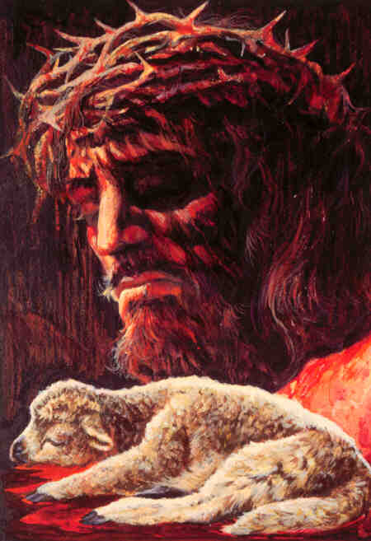
The New Testament Meaning of the Cross
It was a Sacrifice: a substitution.
Key Word:
Vicarious
In place of another
But God demonstrates His own love toward us, in that while we were yet sinners, Christ died for us. Romans 5:8
For even the Son of Man did not come to be served, but to serve, and to give His life a ransom for many. Mark 10:45
The LORD has laid on him the iniquity of us all. Isaiah 53:6

Slide 45
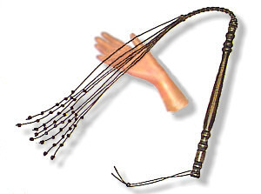
The New Testament Meaning of the Cross
It was a Sacrifice: a penalty paid.
[God] made him who knew no sin to be sin on our behalf… 2 Cor. 5:21
For the wages of sin is death, but the free gift of God is eternal life in Christ Jesus our Lord. Romans 6:23
For Christ also died for sins once for all, the just for the unjust, so that He might bring us to God, having been put to death in the flesh… 1 Peter 3:18

Slide 46
The Accomplishments of the Cross
It turned away God’s wrath: propitiation.
“whom God displayed publicly as a propitiation in His blood through faith. This was to demonstrate His righteousness, because in the forbearance of God He passed over the sins previously committed…” Romans 3:25
“and He Himself is the propitiation for our sins; and not for ours only, but also for those of the whole world.” 1 John 2:2
“In this is love, not that we loved God, but that He loved us and sent His Son to be the propitiation for our sins.” 1 John 4:10
WRATH
GOD
WRATH

Slide 47
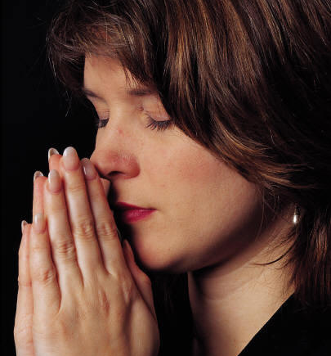
The Accomplishments of the Cross
It paid the price of sin: redemption.
For you have been bought with a price: therefore glorify God in your body. 1 Corinthians 6:20
It accomplished reconciliation.
For if while we were enemies we were reconciled to God through the death of His Son, much more, having been reconciled, we shall be saved by His life. Romans 5:10
It made forgiveness possible.
In Him we have redemption through His blood, the forgiveness of our trespasses, according to the riches of His grace. Eph. 1:7
It resulted in justification.
Therefore, having been justified by faith, we have peace with God through our Lord Jesus Christ, Romans 5:1; cf. 3:24

Slide 48
The Resurrection
“If Christ has not been raised, your faith is worthless; you are still in your sins. Then those also who have fallen asleep in Christ have perished. If we have hoped in Christ in this life only, we are of all men most to be pitied. But now Christ has been raised from the dead, the first fruits of those who are asleep.” -- 1 Corinthians 15

Slide 49
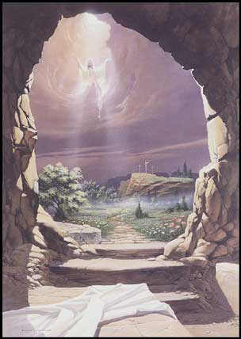
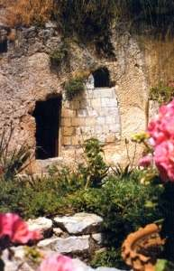
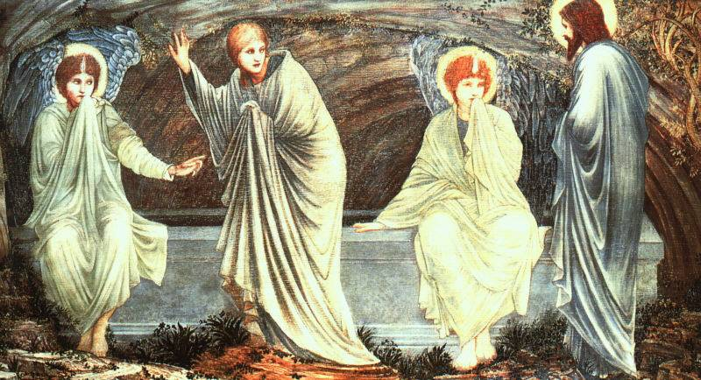
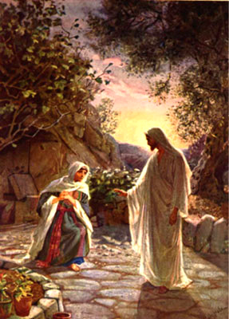
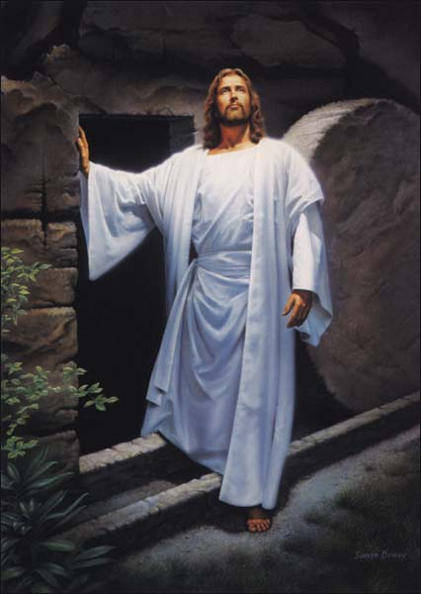
The Nature of the Resurrection
It is a fact attested by the Gospels.
It is an actual resurrection from the dead.
It is a bodily resurrection.
It is a firstfruits resurrection.
He is Risen Indeed!

