Slide 1

We believe in the Incarnation, death, and bodily resurrection of the Son of God; and that salvation is attained only through repentance and faith in Him.
Article 4

Slide 2
Theological content of this article
1. “We believe in the Incarnation, death, and bodily resurrection of the Son of God”
This is Christology – the study of Christ.
The Person of Christ - “the Incarnation” and “the Son of God”
The Work of Christ – “death, and bodily resurrection”
2. “salvation is attained only through repentance and faith in Him.”
This is Soteriology – the study of Salvation

Slide 3
John 1:1–14
In the beginning was the Word, and the Word was with God, and the Word was God. He was in the beginning with God. All things were made through him, and without him was not anything made that was made. In him was life, and the life was the light of men. The light shines in the darkness, and the darkness has not overcome it. There was a man sent from God, whose name was John. He came as a witness, to bear witness about the light, that all might believe through him. He was not the light, but came to bear witness about the light. The true light, which gives light to everyone, was coming into the world. He was in the world, and the world was made through him, yet the world did not know him. He came to his own, and his own people did not receive him. But to all who did receive him, who believed in his name, he gave the right to become children of God, who were born, not of blood nor of the will of the flesh nor of the will of man, but of God. And the Word became flesh and dwelt among us, and we have seen his glory, glory as of the only Son from the Father, full of grace and truth. ESV)

Slide 4
1 Corinthians 15:3–4
For I delivered to you as of first importance what I also received: that Christ died for our sins in accordance with the Scriptures, that he was buried, that he was raised on the third day in accordance with the Scriptures, (ESV)

Slide 5
Acts 4:10–12
let it be known to all of you and to all the people of Israel that by the name of Jesus Christ of Nazareth, whom you crucified, whom God raised from the dead—by him this man is standing before you well. This Jesus is the stone that was rejected by you, the builders, which has become the cornerstone. And there is salvation in no one else, for there is no other name under heaven given among men by which we must be saved.” (ESV)

Slide 6
Christology
Three ideas
Incarnation
Death
Resurrection

Slide 7
Incarnation
Incarnation literally means 'to take on flesh'. For Christians, the incarnation shows that Jesus was fully God and fully human.

Slide 8
The Humanity of Christ
Bible’s Teaching
And she gave birth to her firstborn son; and she wrapped Him in cloths, and laid Him in a manger, because there was no room for them in the inn. Luke 2:7
But when the fullness of the time came, God sent forth His Son, born of a woman, born under the Law. Galatians 4:4

Slide 9
The Humanity of Christ
And Jesus kept increasing in wisdom and stature, and in favor with God and men. Luke 2:52
“In pouring this ointment on my body, she has done it to prepare me for burial.” Mt 26:12
Soul/Spirit: “Into Thy hands I commend my spirit!” Luke 23:46
Hunger: “And after He had fasted forty days and forty nights, He then became hungry.” Matthew 4:2; cf. Mt 21:18
Thirst: “I am thirsty.” John 19:28

Slide 10
The Humanity of Christ
Weariness: “So Jesus, being wearied from His journey, was sitting by the well. It was about the sixth hour.” John 4:6
Grief: “Jesus wept.” John 11:35
Compassion: “Seeing the people, He felt compassion for them, because they were distressed and dispirited like sheep without a shepherd.” Matthew 9:36
Sorrow/Longing: “Approaching Jerusalem, He saw the city and wept over it.” Luke 19:41; cf. Mt. 23:37
Anger: “After looking around at them with anger, grieved at their hardness of heart…” Mark 3:5; cf. 10:14

Slide 11
The History of the Doctrine
Question: If Jesus is God, how is He also human?
Early Tendencies in Christology
A Mere Man <---------------> Divine, not fully Man

Slide 12
Early Errors
Adoptionism - denied the virgin birth, taught that Jesus was a normal human who was exceedingly wise, and that he was “adopted” by the Christ-spirit upon his baptism.
Docetism – Docetism, which challenged the biblical testimony of Christ’s full humanity. Jesus only “appeared” human. The Apostle John warned against this error, noting that some refused to acknowledge “that Jesus Christ as come in the flesh” (1Jn. 4:1-3).

Slide 13
Apollinarianism
Apollinaris of Laodicea (d. 390) believed that in taking on human nature, the Word became united with a body only. So eager was he to avoid the Arian error and emphasize the deity of Christ and unity of his person that he denied Jesus as having a human soul. The soul was replaced with the divine Word, or logos. Jesus, in other words, was not an ordinary human being.
https://www.thegospelcoalition.org/essay/christological-controversies-in-the-early-church/ accessed December 21, 2024

Slide 14
Nestorianism
In the early fifth century, Nestorius of Constantinople (c. 386–450) taught that Jesus Christ was actually two distinct persons. Nestorius struggled to affirm the traditional title for Mary as theotokos (“God-bearer”), as this seemed to deny the human qualities of Christ. He struggled to conceive how it could be that God was born from a human, or that God suffered and died. Therefore, Nestorianism posited that in Christ was both the human person and divine person, but that each operated independently. At one point it would be the divine person working, and at another point it was the human. In this way, Nestorians sought to deal with Scripture that spoke to both Christ’s divine characteristics and his human ones. https://www.thegospelcoalition.org/essay/christological-controversies-in-the-early-church/ accessed December 21, 2024

Slide 15
Eutchyianism
Teachings from the monk Eutychus of Constantinople (c. 380–c. 456), Eutchyianism combines the two natures into one single nature. The official term for this theological error was monophysitism. Eutychus believed that both natures existed before the incarnation, but following the birth of Christ, there was only one nature. The human nature according to Eutyches was a mere appearance, harkening back to views of the Docetists.
https://www.thegospelcoalition.org/essay/of/ accessed December 21, 2024

Slide 16
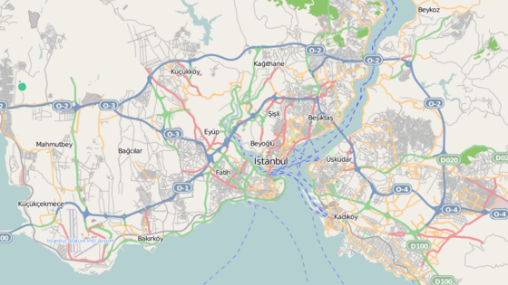
Council of Chalcedon – 451 AD

Slide 17
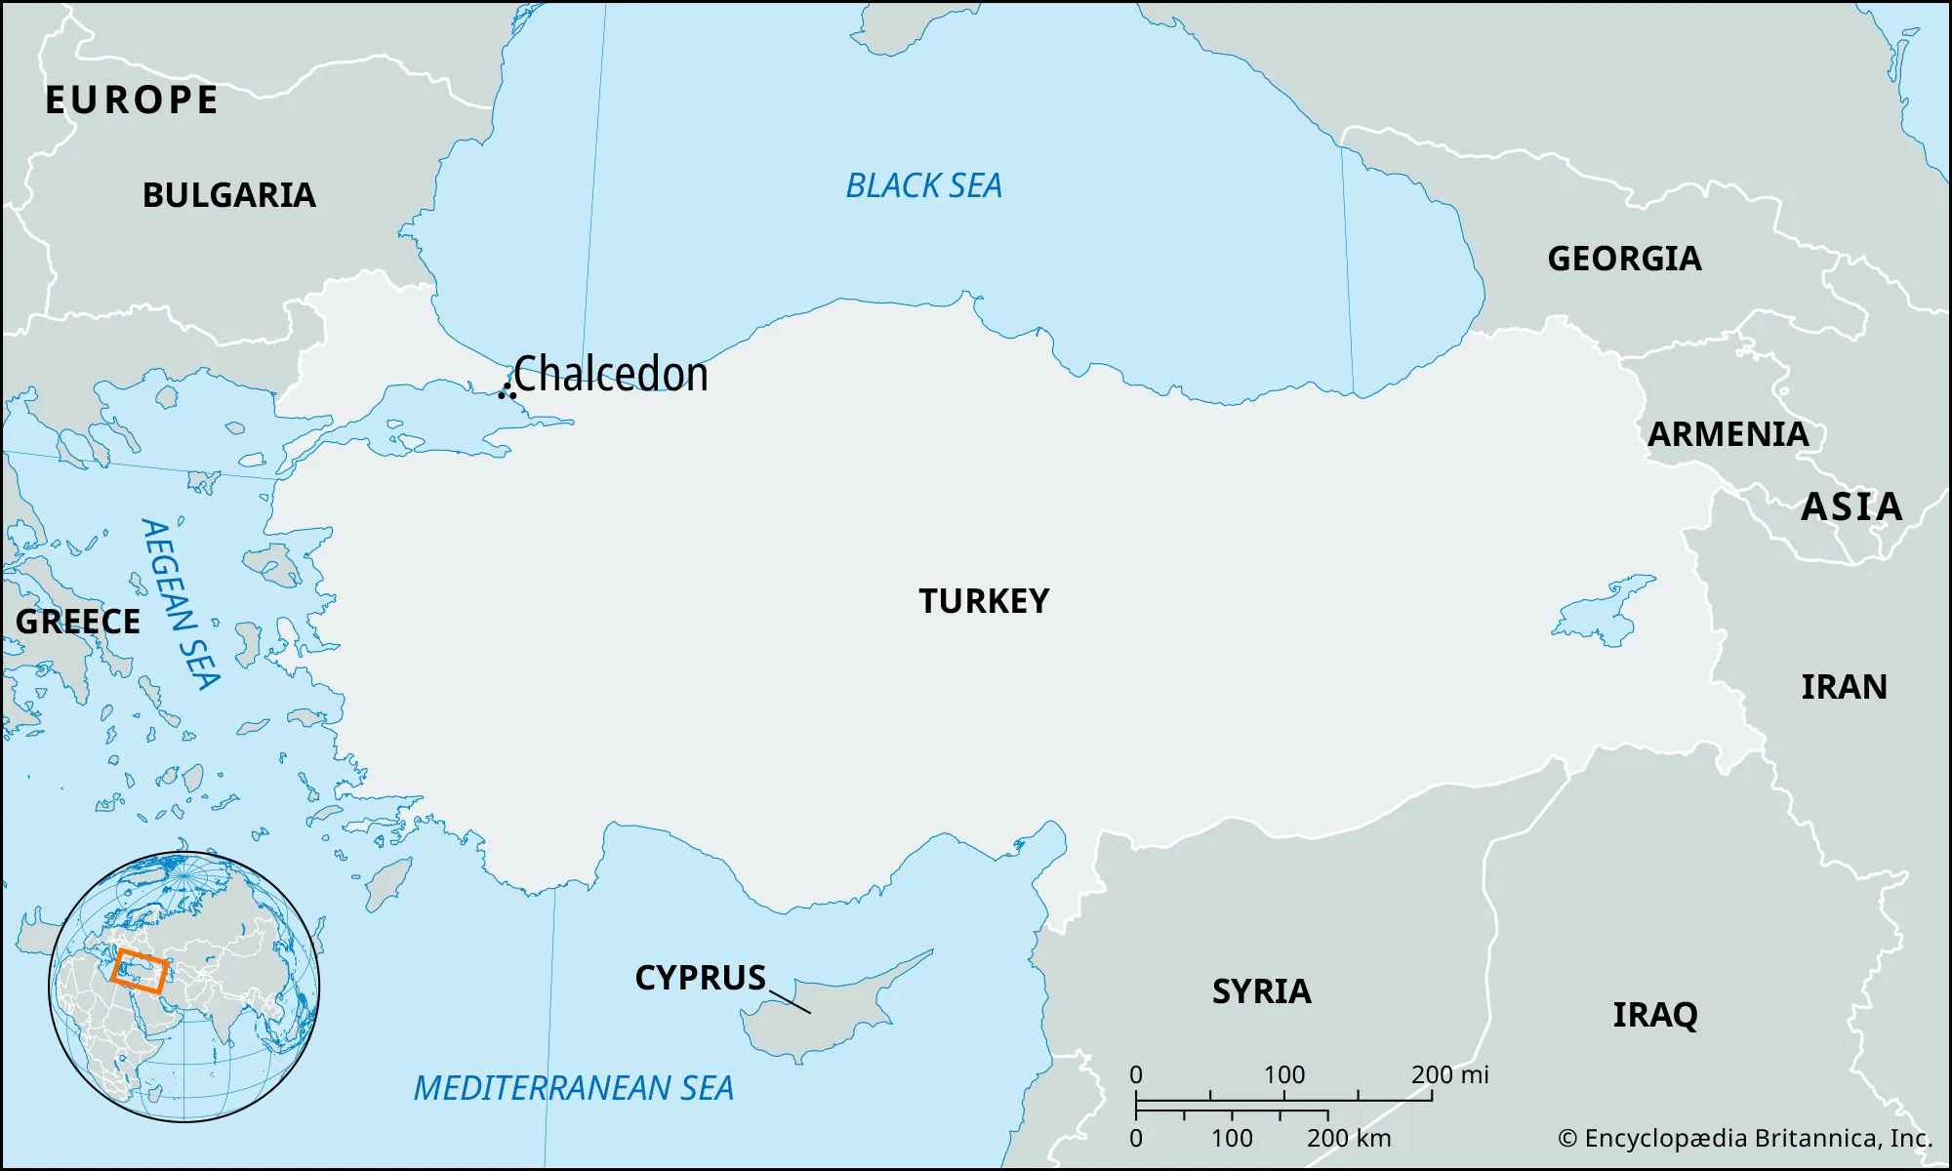

Slide 18
How do we solve this?
Start with what we know!
Only God can Save! (Nicaea 325 AD)
The Principle of Adoption – only that which is assumed is redeemed.
The distinction between “person” and “nature.”

Slide 19
The Definition of Chalcedon

Slide 20
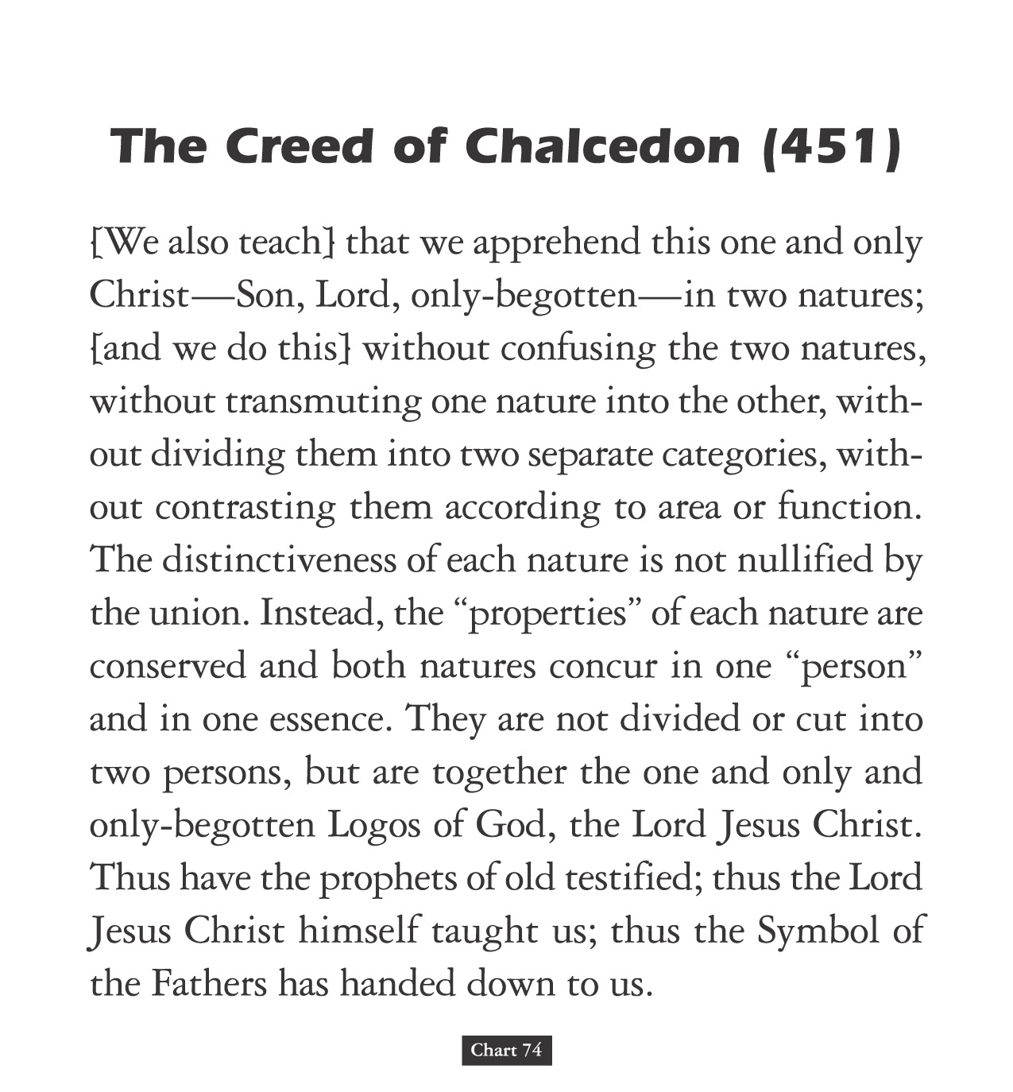

Slide 21
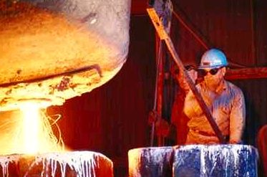
The Hypostatic Union
Hypostasis means “person.”
Christ is only one person.
In Him there is a union of full humanity and full divinity.
The two natures of Christ are not mixed to produce a third thing. He is fully God and fully Man.
Steel is an alloy of iron and carbon.

Slide 22
Christ is:
  one person
  in two natures
  without confusion
  without change
  without division
  without separation

Slide 23
Implications
Only Jesus Christ can save us.
Jesus Christ will save us in our entirety!
No part of you is unsavable, and every part of you will be saved.

Slide 24
The Death of Christ

Slide 25
It was predetermined in eternity
1 Peter 1:18-20 For you know that it was not with perishable things such as silver or gold that you were redeemed from the empty way of life handed down to you from your ancestors, 19 but with the precious blood of Christ, a lamb without blemish or defect. 20 He was chosen before the creation of the world but was revealed in these last times for your sake.
Revelation 13:8 All inhabitants of the earth will worship the beast—all whose names have not been written in the Lamb’s book of life, the Lamb who was slain from the creation of the world. taken from https://www.wordsoflife.co.uk/bible-studies/study-8-the-significance-of-his-death/ - accessed 1/11/2025

Slide 26
Predicted in the Old Testament
Luke 24:25-27 He said to them, “How foolish you are, and how slow to believe all that the prophets have spoken! ²⁶ Did not the Messiah have to suffer these things and then enter his glory?” ²⁷ And beginning with Moses and all the Prophets, he explained to them what was said in all the Scriptures concerning himself.
see also - Isaiah 53
https://www.wordsoflife.co.uk/bible-studies/study-8-the-significance-of-his-death/ - accessed 1/11/2025

Slide 27
The Lord Jesus came into the world to die
These scriptures make this quite clear. He was not surprised or disappointed by his arrest and execution.
He knew his death was necessary. Hebrews 9:22 In fact, the law requires that nearly everything be cleansed with blood, and without the shedding of blood there is no forgiveness.
He knew He had come to die. Matthew 16:21 From that time on Jesus began to explain to his disciples that he must go to Jerusalem and suffer many things at the hands of the elders, the chief priests and the teachers of the law, and that he must be killed and on the third day be raised to life.
See also -Matthew 17:12; Luke 9:51; John 3:14 and John 10:11).
https://www.wordsoflife.co.uk/bible-studies/study-8-the-significance-of-his-death/ - accessed 1/11/2025

Slide 28
The Lord Jesus died willingly, voluntarily
As the sinless One, there was no cause of death in Himself.
John 10: 17,18 “The reason my Father loves me is that I lay down my life—only to take it up again. ¹⁸ No one takes it from me, but I lay it down of my own accord. I have authority to lay it down and authority to take it up again.”
See Also Matthew 26:53 say. Luke 22:53; John 7:30 and John 8:20. He voluntarily laid down His life for us because it was the will of His Father that He should do so and because He loved us so much!
https://www.wordsoflife.co.uk/bible-studies/study-8-the-significance-of-his-death/ - accessed 1/11/2025

Slide 29
The Lord Jesus died as a sacrifice for sin, to put away sin
Why did He die? He died to put away sin by the sacrifice of Himself.
Hebrews 9:26 “Otherwise Christ would have had to suffer many times since the creation of the world. But he has appeared once for all at the culmination of the ages to do away with sin by the sacrifice of himself.”
See also - Isaiah 53:5-6; John 1:29; 1 Corinthians 15:3; 2 Corinthians 5:21; and 1 Peter 2:24.
https://www.wordsoflife.co.uk/bible-studies/study-8-the-significance-of-his-death/ - accessed 1/11/2025

Slide 30
The Lord Jesus died as our Substitute, bearing our penalty
He died instead of us, in our place, and He bore the punishment which was due to us
John 10:11 “I am the good shepherd. The good shepherd lays down his life for the sheep.
1 Peter 3:18. “For Christ also suffered once for sins, the righteous for the unrighteous, to bring you to God.”
1 Peter 2:24 “He himself bore our sins” in his body on the cross, so that we might die to sins and live for righteousness; “by his wounds you have been healed.”
https://www.wordsoflife.co.uk/bible-studies/study-8-the-significance-of-his-death/ - accessed 1/11/2025

Slide 31
The Death of the Lord Jesus was victorious
Christ’s death accomplished what it intended to do. His death is sufficient for all, but it is efficient only for those who believe. His death was victorious because He rose again, demonstrating that His death had met all the claims of divine justice and that salvation had been procured for all who would believe.
John 3:16. For God so loved the world that he gave his one and only Son, that whoever believes in him shall not perish but have eternal life.
1 John 2:2. He is the atoning sacrifice for our sins, and not only for ours but also for the sins of the whole world.
https://www.wordsoflife.co.uk/bible-studies/study-8-the-significance-of-his-death/ - accessed 1/11/2025

Slide 32
He is the atoning sacrifice for our sins, (1 John 2:2.)
The Doctrine of Atonement

Slide 33
Meaning of the term “atonement”
The words “atone” and “atonement” are derived from the expressions “make at one”, and “at onement”. Usage of the latter phrase can be traced to as early as the 1300s in the writings of John Wycliffe (Hayes 1998). The word thus carries at its heart the notion of putting parties at one—unifying, or reconciling. The Oxford English Dictionary offers several definitions of atonement:
“the condition of being at one with others” (def. 1),
“the action of setting at one, or condition of being set at one, after discord or strife” (def. 2),
“reconciliation or restoration of friendly relations between God and sinners” (def. 3), and
“propitiation of an offended or injured person, by reparation of wrong or injury; amends, satisfaction, expiation” (def. 4).
https://plato.stanford.edu/entries/atonement/ accessed 1/11/2025

Slide 34
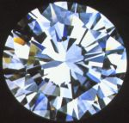
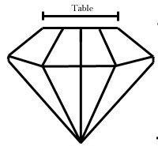
Views of the Atonement
The atonement is like a diamond. It has many facets, all of which contribute to the beauty of the whole.
The main facet of the “brilliant cut” diamond is the “table.” So too, the idea of substitute punishment is the main theme of the atonement.

Slide 35

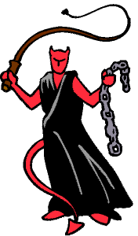
Views of the Atonement
GOD
1. Ransom to Satan Theory
The death of Jesus was a ransom paid to Satan to pay him for the rightful claims he had against man.
This view is not correct. God . does not owe Satan anything.
However, the Bible does teach the . triumph of Christ over sin, death . . and Satan.

Slide 36
Views of the Atonement
GOD
2. Satisfaction Theory
Major proponent was St. Anselm (1033-1109).
Rejected the ransom to Satan theory and re-focused on God.
Man by his sin infinitely robbed God of His honor.
Jesus’ death infinitely satisfies this offense.
Offended
Honor
Offense canceled; the Cross provides Satisfaction!

Slide 37

Views of the Atonement
GOD
3. Moral Influence Theory
Held by Peter Abelard (1079-1142), and most liberal theologians today.
The sight of Christ’s death should awaken love for God in sinners, and cause them to turn from sin.
Love Awakened
Proof of God’s Love
This is a subjective rather . than objective theory of the . . atonement.

Slide 38
Views of the Atonement
GOD
4. Governmental Theory
Held by Hugo Grotius (1583- 1645), who was a lawyer.
Sin undermines God’s right to rule the world.
The death of Christ displays God’s displeasure with sin.
People must learn this lesson and amend their lives, so that God’s rule can be restored.
Repentance
Proof of God’s Anger

Slide 39
Views of the Atonement
GOD
5. Penal Substitution
The Cross fulfills God’s just . demand for punishment, while . mercifully providing a . substitute for us.
Wrath
Punishment is meted out, but the Cross is a substitute!
The doctrine is first clearly articulated by the Reformers.
Stands in the train of thought of St. Anselm.
This is the main “facet” of the biblical theology of atonement.
Just punishment

Slide 40
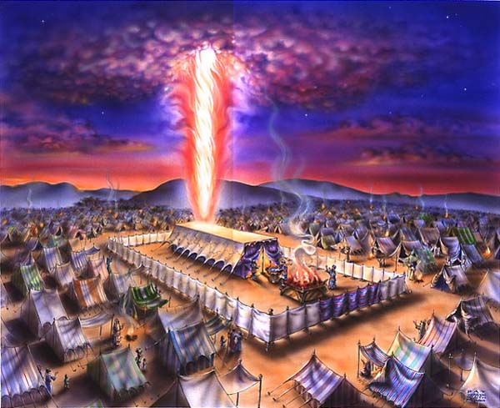
The Old Testament Background
1. The Tabernacle
Its layout says, “The Lord desires a relationship with His people, but sin must be dealt with before anyone can enter the Holy of Holies.”

Slide 41
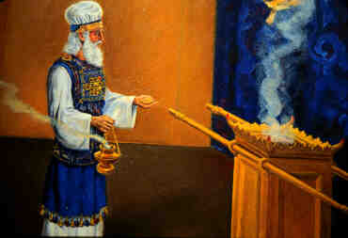
The Old Testament Background
2. The Animal Sacrifices
These bloody sacrifices reminded the people to take sin seriously!

Slide 42
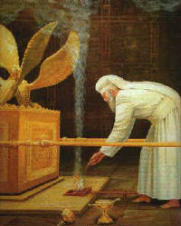
The Old Testament Background
3. The Day of Atonement
The High Priest continually offered sacrifices year after year for the sins of the people.

Slide 43
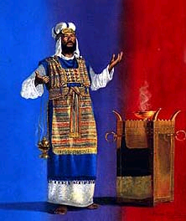
The Old Testament Background
“Then Aaron shall lay both of his hands on the head of the live goat, and confess over it all the iniquities of the sons of Israel …and he shall lay them on the head of the goat and send it away into the wilderness .” Lev. 16:21
“But when Christ appeared as a high priest of the good things to come, He entered through the greater and more perfect tabernacle… not through the blood of goats and calves, but through His own blood, He entered the holy place once for all, having obtained eternal redemption.” Heb. 9:11-14

Slide 44
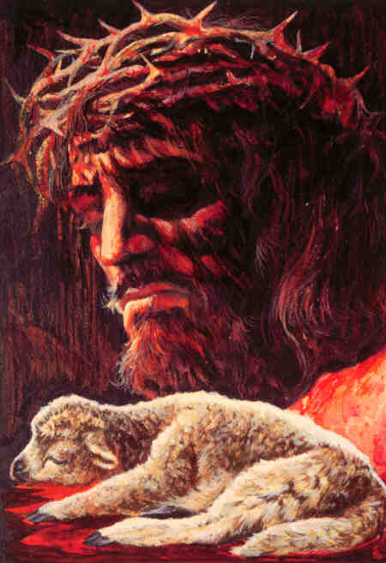
The New Testament Meaning of the Cross
It was a Sacrifice: a substitution.
Key Word:
Vicarious
In place of another
But God demonstrates His own love toward us, in that while we were yet sinners, Christ died for us. Romans 5:8
For even the Son of Man did not come to be served, but to serve, and to give His life a ransom for many. Mark 10:45
The LORD has laid on him the iniquity of us all. Isaiah 53:6

Slide 45
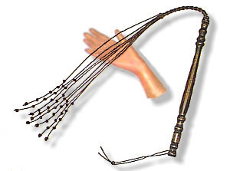
The New Testament Meaning of the Cross
It was a Sacrifice: a penalty paid.
[God] made him who knew no sin to be sin on our behalf… 2 Cor. 5:21
For the wages of sin is death, but the free gift of God is eternal life in Christ Jesus our Lord. Romans 6:23
For Christ also died for sins once for all, the just for the unjust, so that He might bring us to God, having been put to death in the flesh… 1 Peter 3:18

Slide 46
The Accomplishments of the Cross
It turned away God’s wrath: propitiation.
“whom God displayed publicly as a propitiation in His blood through faith. This was to demonstrate His righteousness, because in the forbearance of God He passed over the sins previously committed…” Romans 3:25
“and He Himself is the propitiation for our sins; and not for ours only, but also for those of the whole world.” 1 John 2:2
“In this is love, not that we loved God, but that He loved us and sent His Son to be the propitiation for our sins.” 1 John 4:10
WRATH
GOD
WRATH

Slide 47


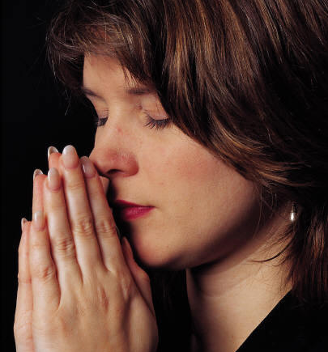

The Accomplishments of the Cross
It paid the price of sin: redemption.
For you have been bought with a price: therefore glorify God in your body. 1 Corinthians 6:20
It accomplished reconciliation.
For if while we were enemies we were reconciled to God through the death of His Son, much more, having been reconciled, we shall be saved by His life. Romans 5:10
It made forgiveness possible.
In Him we have redemption through His blood, the forgiveness of our trespasses, according to the riches of His grace. Eph. 1:7
It resulted in justification.
Therefore, having been justified by faith, we have peace with God through our Lord Jesus Christ, Romans 5:1; cf. 3:24

Slide 48
The Resurrection
“If Christ has not been raised, your faith is worthless; you are still in your sins. Then those also who have fallen asleep in Christ have perished. If we have hoped in Christ in this life only, we are of all men most to be pitied. But now Christ has been raised from the dead, the first fruits of those who are asleep.” -- 1 Corinthians 15

Slide 49
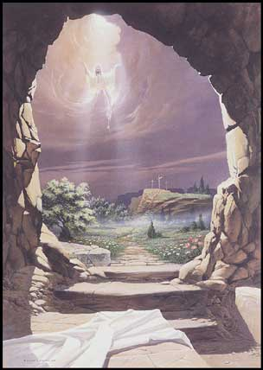
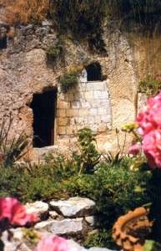
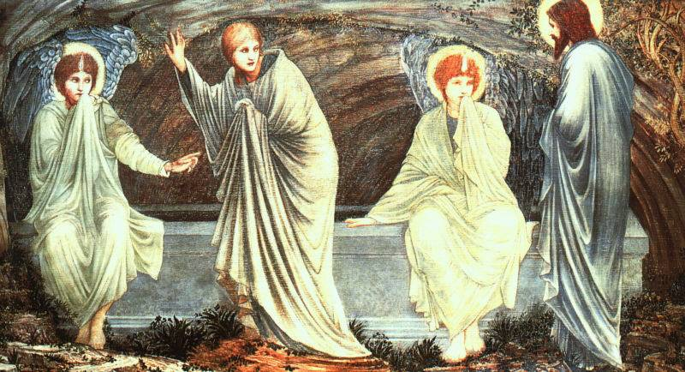
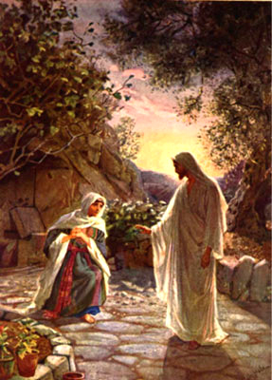
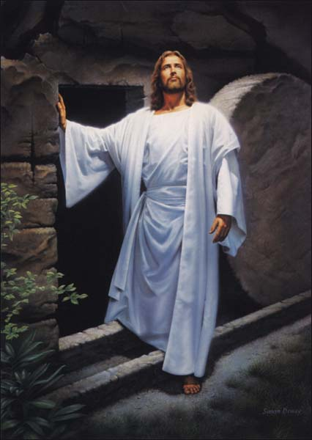

The Nature of the Resurrection
It is a fact attested by the Gospels.
It is an actual resurrection from the dead.
It is a bodily resurrection.
It is a firstfruits resurrection.
He is Risen Indeed!

Slide 50
Salvation
Article 4 says , “the Incarnation, death, and bodily resurrection of the Son of God” make “salvation” possible. What do we mean by “Salvation?”

Slide 51
Salvation includes:
Regeneration (also in Article #5)
Justification
Sanctification (Article #6)
Glorification (Article #9 and 10)

Slide 52
Regeneration
Salvation involves being made alive.
And you were dead in the trespasses and sins in which you once walked, following the course of this world, following the prince of the power of the air, the spirit that is now at work in the sons of disobedience— among whom we all once lived in the passions of our flesh, carrying out the desires of the body and the mind, and were by nature children of wrath, like the rest of mankind. But God, being rich in mercy, because of the great love with which he loved us, even when we were dead in our trespasses, made us alive together with Christ—by grace you have been saved— and raised us up with him and seated us with him in the heavenly places in Christ Jesus, so that in the coming ages he might show the immeasurable riches of his grace in kindness toward us in Christ Jesus. For by grace you have been saved through faith. And this is not your own doing; it is the gift of God, not a result of works, so that no one may boast. Eph 2: 1-9

Slide 53
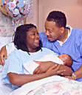
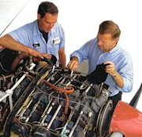
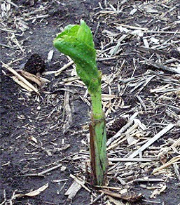
What is Regeneration?
“You must be born again!” John 3:7
Greek palingenesia from palin = again + genesis, birth
NO
It is not something that occurs in the physical realm.
NO
It is not simply “fixing” something slightly broken.
YES
It is God’s gift of new life to those who were spiritually dead.

Slide 54

Regeneration
It is completely a work of God.
  “But as many as received Him, to them He gave the right to become children of God, even to those who believe in His name, who were born, not of blood nor of the will of the flesh nor of the will of man, but of God.” Jn. 1:12-13
It is instantaneous and below our consciousness.
It makes us “new creatures.”
  “If any man is in Christ, he is a new creature; the old things have passed away; behold, new things have come.” 2 Cor. 5:17

Slide 55
The Components of Salvation
Arminianism and Calvinism

Slide 56
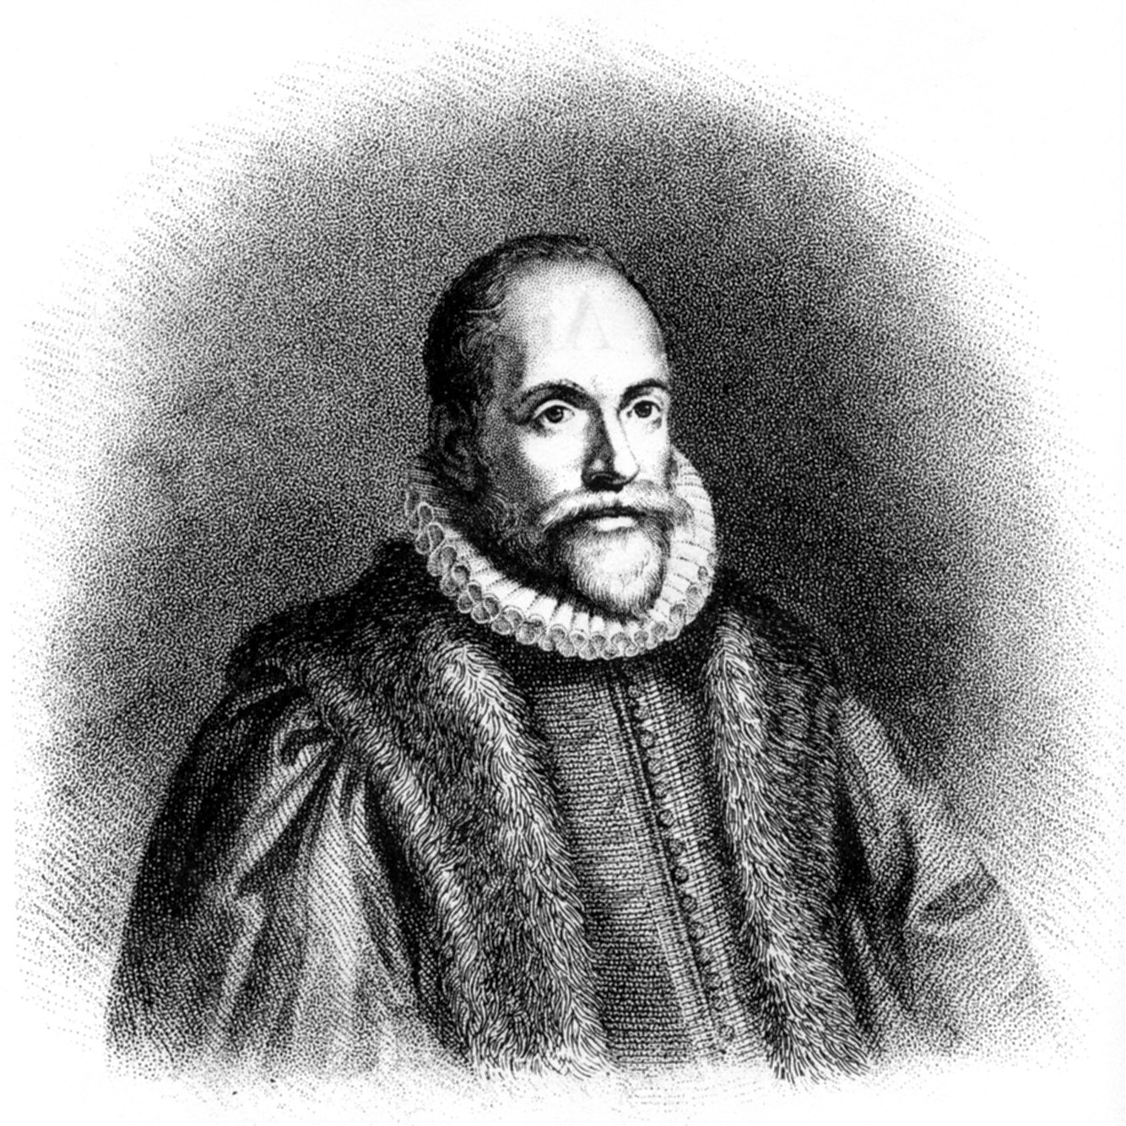
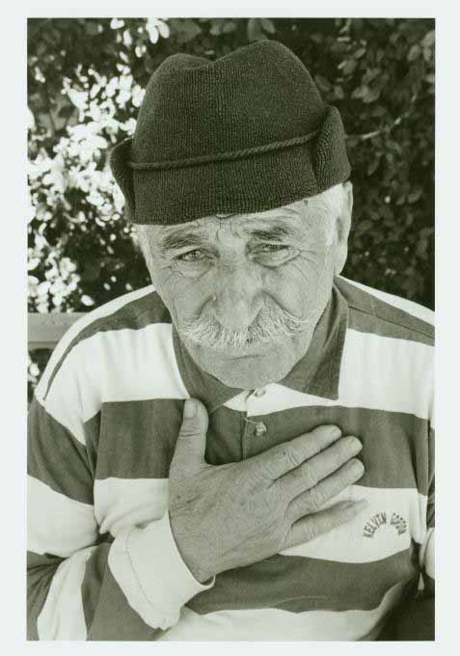
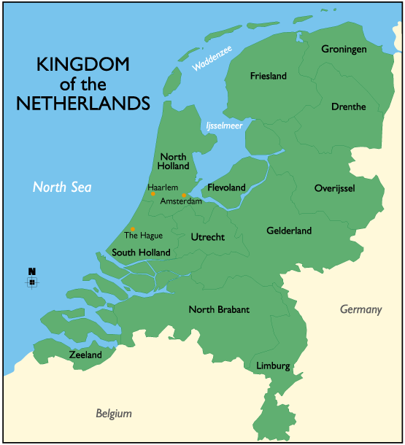
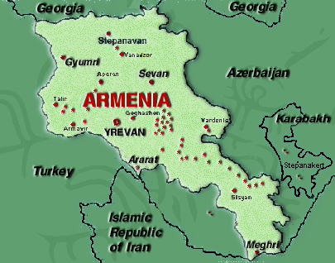
Arminianism
This is Jacob Arminius.
This is an Armenian.
Not the same
This is Holland.
This is Armenia.
Not the same

Slide 57
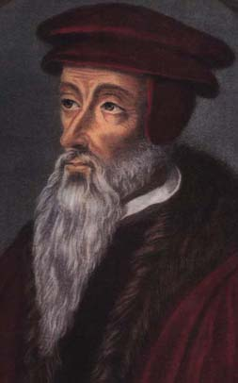
Arminianism and Calvinism
The Protestant Reformation spread to the Netherlands, and the Dutch Church became Calvinist.
Arminius’ followers presented a “Remonstrance” (protest) to Dutch church authorities in 1610.
The Calvinists held a Synod in the city of Dort in 1618. They refuted the Remonstrance on five key points.
John Calvin (d. 1564)
J. Arminius (d. 1609)

Slide 58
Arminian Theology
Remonstrance of 1610
Election (or reprobation) is based on foreseen faith (or unbelief).
Christ’s death obtained salvation for everyone.
Fallen man cannot achieve saving faith without God’s grace.
Grace is necessary for all good works, but is not irresistible.
Grace can preserve the faithful, but it can also be lost.
1. Free Will & Human Ability (because of grace)
2. Conditional Election
3. General Atonement
4. Resistible Grace
5. Falling from Grace (loss of salvation)

Slide 59


The 5 steps of Calvinism
Justification Sanctificatation
Total Depravity
Unconditional Election
Limited Atonement
Irresistible GRACE
Perseverance of the Saints
Dordt 1618

Slide 60
Verses Used in the Debate
“…not wishing for any to perish but for all to come to repentance.” 2 Peter 3:9
“Come to Me, all who are weary and heavy-laden, and I will give you rest.” Mt. 11:28
“…whoever believes in Him shall not perish, but have eternal life.” John 3:16
“No one can come to Me unless the Father who sent Me draws him.” John 6:44
“He chose us in Him before the foundation of the world ... He predestined us to adoption as sons through Jesus Christ” Eph. 1:4-5
“as many as had been appointed to eternal life believed.” Acts 13:48

Slide 61

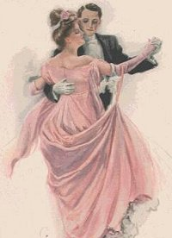
The Order of Salvation: This is a typical “Reformed” model
It’s not a series of distinct stages …
…but divine movement and human response.
Though it’s not entirely temporal, we can list the order this way:
  Election
  Effectual Calling
  Regeneration
  Conversion (Faith + Repentance)
Justification
Adoption
Sanctification
Glorification

Slide 62
Other Models
There are MULTIPLE models and variations in terms. There are disagreements within the models. What follows is a broad generalization of the major traditions. The following slides contain three Protestant traditions and the Roman Catholic teaching.

Slide 63
Calvinist: 1 Calling Regeneration Faith Repentance Justification Sanctification Perseverance Glorification | Lutheran:2 Calling Illumination Repentance Regeneration Faith Justification (Apparently simultaneous with justification are also adoption, mystical union, and sanctification, though sanctification also continues as long as faith continues) Glorification | Arminian/Wesleyan:3 Calling Repentance Faith Justification Regeneration Sanctification Preservation Glorification
^{1.} Demarest, Bruce (2006). "The 'Order of Salvation'". In Feinberg, John S. (ed.). The Cross and Salvation: The Doctrine of Salvation. Wheaton: Good News Publishers. pp. 36–44.
[2. https://reformedanswers.org/answer.asp/file/40371. accessed 2/3/2025.
^{3.} Olson, Roger E. (2013). "An Arminian Ordo Salutis (Order of Salvation)". Roger E. Olson: My evangelical, Arminian theological musings. Patheos

Slide 64
Roman Catholic Order of Salvation
“The Roman Catholic Church defines "justification" and "sanctification" differently than do most Protestant denominations, so it is a bit harder to compare their order. According to them, "justification" is the act by which God transforms a person from being actually unrighteous to being actually righteous. Because a person may slip in and out of justification, it is a repeatable event. "Justification is also used to refer to the continuing state of possessing "sanctifying grace." Their order begins with the Church and baptism, which affects regeneration, followed by sufficient grace which strengthens the will and illumines the mind. Assuming the person in question assents to this illumination, cooperating grace prepares man for justification through various stages which include belief, repentance, and love of God. Once prepared, the person receives infused grace, supernatural virtues, forgiveness, justification, and the beginning of sanctification (if we may call it that). Thereafter, good works ensure the completion/preservation of justification/sanctification, and finally culminate in glorification.” Taken from - https://reformedanswers.org/answer.asp/file/40371. accessed 2/3/2025.

Slide 65


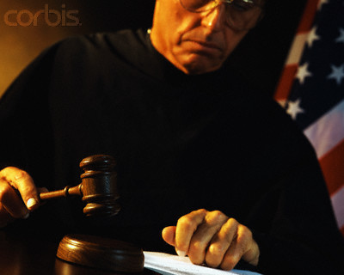
Justification
Not guilty!
NO
It is not having a “clean slate” from never having committed sin.
NO
It is not being given the strength to wipe our own slates clean of sin.
YES
It is the legal declaration that in Christ, God has wiped our slates clean for us.
Notes:
Having a clean slate is not exactly what the NPP says, but it is similar, in that covenantal nomism suggests the Jews were already accepted, and only had to maintain their relationship to the covenant.

Slide 66

The Importance of Justification
Martin Luther said that this doctrine was the article upon which the church stands or falls.
John Calvin wrote in the Institutes that the doctrine of justification by faith is “the main hinge on which [true] religion turns.”
“The primary issue in the Protestant Reformation was a dispute with the Roman Catholic church over justification. If we are to safeguard the truth of the gospel for future generations, we must understand the truth of justification.” (Grudem, ST, 722)

Slide 67
Romans 3:21-28
²¹ But now apart from the law the righteousness of God has been made known, to which the Law and the Prophets testify. ²² This righteousness is given through faith in Jesus Christ to all who believe. There is no difference between Jew and Gentile, ²³ for all have sinned and fall short of the glory of God, ²⁴ and all are justified freely by his grace through the redemption that came by Christ Jesus. ²⁵ God presented Christ as a sacrifice of atonement, through the shedding of his blood—to be received by faith. He did this to demonstrate his righteousness, because in his forbearance he had left the sins committed beforehand unpunished— ²⁶ he did it to demonstrate his righteousness at the present time, so as to be just and the one who justifies those who have faith in Jesus.
²⁷ Where, then, is boasting? It is excluded. Because of what law? The law that requires works? No, because of the law that requires faith. ²⁸ For we maintain that a person is justified by faith apart from the works of the law. (NIV)

Slide 68
The New Testament Teaching: Romans 3:21-28
“But now apart from the Law the righteousness of God has been manifested, being witnessed by the Law and the Prophets,”
The roots of justification are in the Old Testament (v. 21).
“Then [Abraham] believed in the LORD; and He reckoned it to him as righteousness.” Genesis 15:6
“If there is a dispute between men, and they go to court … the judges decide their case, and they justify the righteous and condemn the wicked.” Deut. 25:1

Slide 69
The New Testament Teaching: Romans 3:21-28
“…even the righteousness of God through faith in Jesus Christ for all those who believe.”
The roots of justification are in the Old Testament (v. 21).
The appropriation of justification is by faith alone (v. 22).

Slide 70
The New Testament Teaching: Romans 3:21-28
“for there is no distinction; for all have sinned and fall short of the glory of God,”
The roots of justification are in the Old Testament (v. 21).
The appropriation of justification is by faith alone (v. 22).
The necessity of justification is based on the universality of sin (v. 23).

Slide 71
The New Testament Teaching: Romans 3:21-28
“being justified as a gift by His grace through the redemption which is in Christ Jesus; whom God displayed publicly as a propitiation in His blood through faith.”
The roots of justification are in the Old Testament (v. 21).
The appropriation of justification is by faith alone (v. 22).
The necessity of justification is based on the universality of sin (v. 23).
The basis of justification is Christ’s atoning work. (v. 24-25).

Slide 72
The New Testament Teaching: Romans 3:21-28
“This was to demonstrate His righteousness…so that He would be just and the Justifier of the one who has faith in Jesus.”
The roots of justification are in the Old Testament (v. 21).
The appropriation of justification is by faith alone (v. 22).
The necessity of justification is based on the universality of sin (v. 23).
The basis of justification is Christ’s atoning work. (v. 24-25).
The legitimacy of justification is based on God’s character. (v. 26).

Slide 73
The New Testament Teaching: Romans 3:21-28
“Where then is boasting? It is excluded. By what kind of law? Of works? No, but by a law of faith. For we maintain that a man is justified by faith apart from works of the Law.”
The roots of justification are in the Old Testament (v. 21).
The appropriation of justification is by faith alone (v. 22).
The necessity of justification is based on the universality of sin (v. 23).
The basis of justification is Christ’s atoning work. (v. 24-25).
The legitimacy of justification is based on God’s character. (v. 26).
The summary of justification: it is by faith, not works! (v. 27-28).
See also Galatians 2:15-16

Slide 74

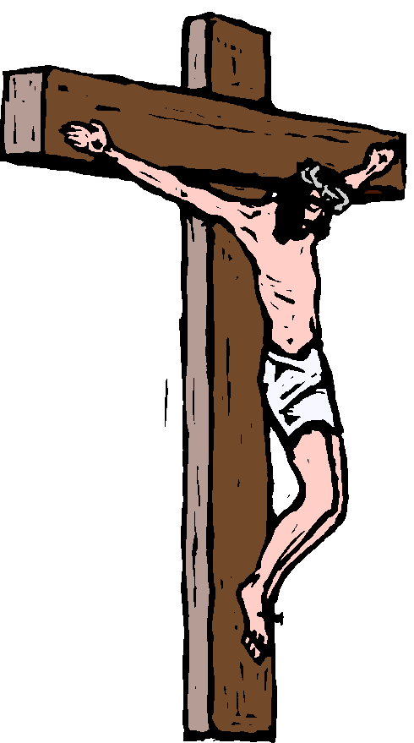
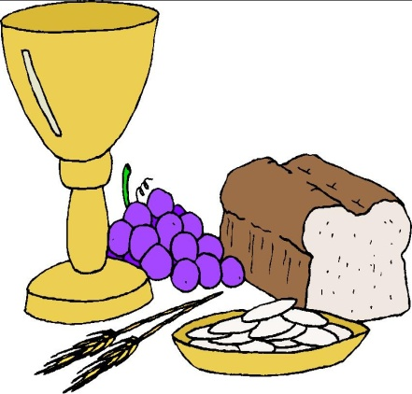
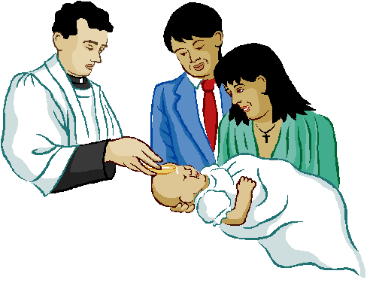
The Roman Catholic Concept of Justification
Justification is an infusion of grace which results in a change of nature such that a person can merit God’s favor.
GOD
COOPERATION
Ability to Love God
Original
Sin
DIVINE GRACE

Slide 75

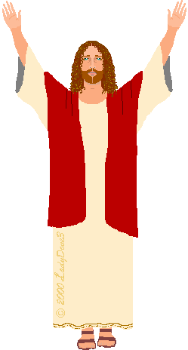
Three Imputations
Adam’s Sin Imputed to Us Rom 5:12
Our Sin Imputed to Christ
1 Pet 2:24
Christ’s Righteousness Imputed to Us
Rom. 4:24
“Through one man sin entered into the world, and death through sin, and so death spread to all men.”
“[Righteousness] will be counted to us who believe in him who raised from the dead Jesus our Lord.”
“And He Himself bore our sins in His body on the cross.”
Original
Sin
Original
Sin +
Sins

Slide 76
“… salvation is attained only through repentance and faith in Him.”
Repentance
2. Faith

Slide 77

Terminology of Repentance
  Metanoia– a change of mind
    “For the sorrow that is according to the will of God produces a repentance without regret, leading to salvation.” 2 Cor. 7:10
  Epistrepho – a change of behavior
    “You turned from idols to serve a living and true God.” 1 Thess. 1:9

Slide 78
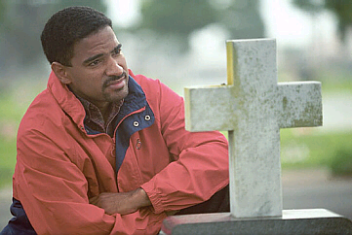
The Three Elements of Faith
Yes: I understand the Gospel.
Notitia: Knowledge of the Truth
Assensus: Mental Assent
Fiducia: Trust or Commitment
I commit myself to those claims!
Those claims are true.

Slide 79
Luther on Repentance
When our Lord and Master Jesus Christ said, “Repent” [Matthew 4:17], he willed the entire life of believers to be one of repentance.
2. This word cannot be understood as referring to the sacrament of penance, that is , confession and satisfaction, as administered by the clergy.
3. Yet it does not mean solely inner repentance; such inner repentance is worthless unless it produces various outward mortifications of the flesh

Slide 80
Luther on Faith
Faith is not the human notion and dream that some people call faith. When they see that no improvement of life and no good works follow—although they can hear and say much about faith—they fall into the error of saying, “Faith is not enough; one must do works in order to be righteous and be saved.” This is due to the fact that when they hear the gospel, they get busy and by their own powers create an idea in their heart which says, “I believe”; they take this then to be a true faith. But, as it is a human figment and idea that never reaches the depths of the heart, nothing comes of it either, and no improvement follows.

Slide 81
Luther on Faith
Faith, however, is a divine work in us which changes us and makes us to be born anew of God, John 1[:12-13]. It kills the old Adam and makes us altogether different men, in heart and spirit and mind and powers; and it brings with it the Holy Spirit. O it is a living, busy, active, mighty thing, this faith. It is impossible for it not to be doing good works incessantly. It does not ask whether good works are to be done, but before the question is asked, it has already done them, and is constantly doing them. Whoever does not do such works, however, is an unbeliever. He gropes and looks around for faith and good works, but knows neither what faith is nor what good works are. Yet he talks and talks, with many words, about faith and good works.

Slide 82
Luther on Faith
Faith is a living, daring confidence in God’s grace, so sure and certain that the believer would stake his life on it a thousand times. This knowledge of and confidence in God’s grace makes men glad and bold and happy in dealing with God and with all creatures. And this is the work which the Holy Spirit performs in faith. Because of it, without compulsion, a person is ready and glad to do good to everyone, to serve everyone, to suffer everything, out of love and praise to God who has shown him this grace. Thus it is impossible to separate works from faith, quite as impossible as to separate heat and light from fire. Beware, therefore, of your own false notions and of the idle talkers who imagine themselves wise enough to make decisions about faith and good works, and yet are the greatest fools. Pray God that he may work faith in you. Otherwise you will surely remain forever without faith, regardless of what you may think or do. Martin Luther, “Preface to the Epistle of St. Paul to the Romans

