Slide 1
Sanctification
Articles 5 and 6

Slide 2
Key ideas
Adoption
Union with Christ

Slide 3
Adoption
The Greco-Roman Background
Adoption conferred the legal rights and privileges of a legitimate heir.
Adoption was irrevocable.
“I, Horion, acknowledge that I hold and consider [the child] as my true son with regard to maintaining for him the rights of succession to my estate. It shall not be lawful for me to cast him aside…It shall not be lawful for us, Heracles and Isarion, to reclaim the child from you, Horion, because we have once and for all given him over to you for adoption.” -- Roman adoption agreement, AD 335
Notes:
Even in Roman days, a father was nervous about giving his son the car keys!

Slide 4
Adoption
The Biblical Teaching
“God sent forth His Son…so that He might redeem those who were under the Law, that we might receive the adoption as sons. Because you are sons, God has sent forth the Spirit of His Son into our hearts, crying, ‘Abba! Father!’ Therefore you are no longer a slave, but a son; and if a son, then an heir through God.” Gal. 4:4-7 (cf. Rom. 8:15-17)
“He predestined us to adoption as sons through Jesus Christ to Himself, according to the kind intention of His will…” Eph. 1:5-6

Slide 5
Benefits of Adoption
We are no longer children of wrath but children of God.
We have the privilege to approach the Throne of Grace.
We enjoy the blessings of God’s protection and care.
We have the rights and blessings of sons and daughters.
We will experience Fatherly discipline.

Slide 6
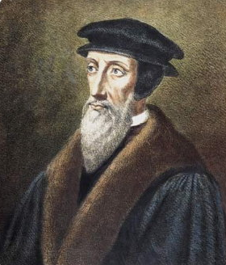
Union with Christ
“That joining together of Head and members, that indwelling of Christ in our hearts – in short, that mystical union - are accorded by us the highest degree of importance, so that Christ, having been made ours, makes us sharers with him in the gifts with which he has been endowed. We do not contemplate him outside ourselves from afar in order that his righteousness may be imputed to us but because we put on Christ and are engrafted into his body – in short, because he deigns to make us one with him. For this reason, we glory that we have fellowship of righteousness with him.”
-Institutes of the Christian Religion 3.11.10
John Calvin

Slide 7
Union with Christ
Spiritual
We are united to Christ by the indwelling Holy Spirit.
Relational
The union brings us into relationship with the Father and the Spirit.
Mystical
It is a “mystery” unknown prior to Christ and is hard to express.
Personal
The union is intimate, like a marriage.

Slide 8
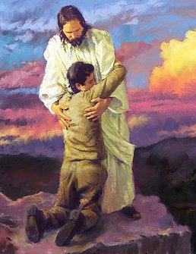
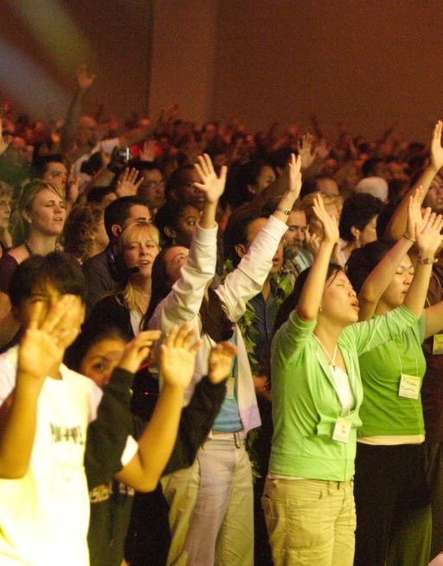
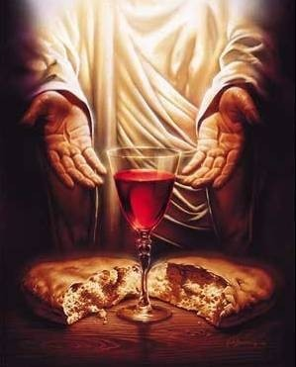
Union with Christ
Salvation
Church
Sanctification
Sacraments

Slide 9
Sanctification
Saints = “set apart ones,” Greek hagios = holy
The concept is twofold: to be set apart by God, and to set ourselves apart from sin!
“So then, my beloved, work out your salvation with fear and trembling; for it is God who is at work in you, both to will and to work for His good pleasure.” Phil. 2:12-13
“For by grace you have been saved through faith; and that not of yourselves, it is the gift of God; not as a result of works, so that no one may boast.
For we are His workmanship, created in Christ Jesus for good works, which God prepared beforehand so that we would walk in them.” Eph. 2:8-10

Slide 10
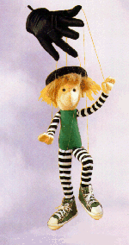
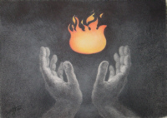
What is Sanctification?
NO
It is not following legalistic rules that superficially define what is “bad.”
NO
It is not something in which we are passive. It requires vigorous effort on our part.
YES
It is a work of the Holy Spirit within us, in which we participate as well.

Slide 11
The Process of Sanctification
FINAL We will be perfect.
“We know that when He appears, we will be like Him, because we will see Him just as He is.” 1 Jn 3:2
EXPERIENTIAL We must stay clean.
“Walk by the Spirit, and you will not carry out the desire of the flesh,” Gal. 5:16
POSITIONAL We are clean.
“To the church of God which is at Corinth, to those who have been sanctified in Christ Jesus, saints by calling…” 1 Cor. 1:2

Slide 12
Biblical Steps to Sanctification
Remember you are freed from sin’s reign.
Prayer, Scripture, the Body of Christ.
Put the flesh to death; strive for holiness.
Seek God’s forgiveness when you fall.

Slide 13
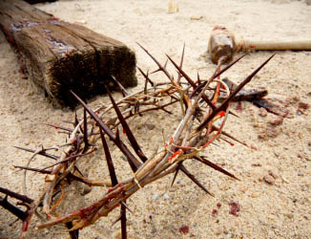
God’s Megaphone: Suffering and Sanctification
“God whispers to us in our pleasures, speaks to us in our conscience, but shouts in our pains. Pain is God’s megaphone to rouse a deaf world.” – C.S. Lewis, The Problem of Pain
“I count all things to be loss in view of the surpassing value of knowing Christ Jesus my Lord, for whom I have suffered the loss of all things, and count them but rubbish so that I may gain Christ...that I may know Him and the power of His resurrection and the fellowship of His sufferings, being conformed to His death, in order that I may attain to the resurrection from the dead.” Phil. 3:8-11
Suffering is often the path to spiritual growth in the Christian life.

