Slide 1
WE BELIEVE in the personal bodily return of Christ in power and great glory as King of Kings and Lord of Lords, and in Christ’s ultimate and complete triumph and the establishment of “new heavens and a new earth, wherein dwelleth righteousness.”
Article #10
Acts 1:11 | 2 Peter 3:10-13 | Revelation 19:16, 21:1-7

Slide 2
Scriptures
“Men of Galilee,” they said, “why do you stand here looking into the sky? This same Jesus, who has been taken from you into heaven, will come back in the same way you have seen him go into heaven.” Acts 1:11
“But the day of the Lord will come like a thief. The heavens will disappear with a roar; the elements will be destroyed by fire, and the earth and everything done in it will be laid bare. Since everything will be destroyed in this way, what kind of people ought you to be? You ought to live holy and godly lives as you look forward to the day of God and speed its coming. That day will bring about the destruction of the heavens by fire, and the elements will melt in the heat. But in keeping with his promise we are looking forward to a new heaven and a new earth, where righteousness dwells. 2 Peter 3:10-13

Slide 3
Scriptures
On his robe and on his thigh he has this name written: king of kings and lord of lords. Revelation 19:16
Then I saw “a new heaven and a new earth,”^{[a]} for the first heaven and the first earth had passed away, and there was no longer any sea. I saw the Holy City, the new Jerusalem, coming down out of heaven from God, prepared as a bride beautifully dressed for her husband. And I heard a loud voice from the throne saying, “Look! God’s dwelling place is now among the people, and he will dwell with them. They will be his people, and God himself will be with them and be their God. ‘He will wipe every tear from their eyes. There will be no more death’ or mourning or crying or pain, for the old order of things has passed away.” He who was seated on the throne said, “I am making everything new!” Then he said, “Write this down, for these words are trustworthy and true.” He said to me: “It is done. I am the Alpha and the Omega, the Beginning and the End. To the thirsty I will give water without cost from the spring of the water of life. Those who are victorious will inherit all this, and I will be their God and they will be my children. Revelation 21:1-7

Slide 4
Personal, bodily return of Christ
Christ’s return will be physical, not just “spiritual.” just as His resurrection was physical and not just spiritual.
The charts in the following slides outlining the various views come from - https://www.growingchristians.org/hermeneutics/principle-20

Slide 5
Two Perspectives
Dispensational Theology
Israel and the Church are distinct.
The prophecies to Israel belong to Israel and must be fulfilled literally.
For example: Christ will reign as King in Jerusalem
The promises to Israel are not given to the Church.
Covenant Theology
The Church is the New Israel.
Prophecies to Israel are spiritually fulfilled in and by the Church.
For example: Christ spiritually “reigns” in our hearts

Slide 6
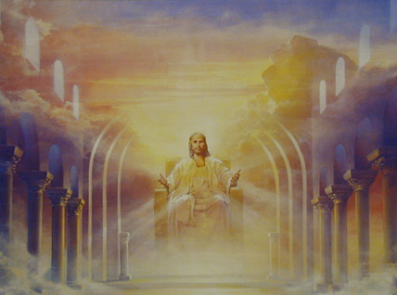
Overview: the Millennium
The reign of Christ on the earth for 1000 years.
Revelation 20
Is this a literal event?
When will it happen?
Where will it happen?

Slide 7
Postmillennial
An older form of postmillennialism argued for a literal 1000-year reign of Christ, which would be a future golden age of evangelism and Christianizing of the world, although it argued that Christ reigned from heaven during this time, not bodily in Jerusalem (as in premillennialism). The most of today’s postmillennialism today does not argue for a literal 1000-year reign of Christ, but instead understands the millennium of Revelation 20 to be a symbolic or visionary depiction of the entire time between Christ’s first and second coming. Both forms of postmillennialism contend that the millennium will be a time in which the gospel advances and triumphs in the world, and that alongside that triumph there will be a righteous transformation of human culture and institutions. The older view insists that things will get gradually better throughout this entire age, but will get suddenly and dramatically better when the millennium arrives. The newer, more popular, view simply sees that transformation as gradually taking place until the return of Christ.
https://americanreformer.org/2024/03/eschatology-and-politics/#:~:text=at%20those%20improvements.-,This%20is%20sometimes%20captured%20in%20the%20old%20dispensationalist%20catchphrase:%20%E2%80%9CYou,lose%20down%20here%E2%80%9D%20entirely%20literally.

Slide 8
Amillennialists
Amillennialists agree with the newer form of postmillennialism regarding the symbolic and visionary nature of Revelation 20’s millennium: it is a visionary, not literal, depiction of Christ’s heavenly reign over the earth in the time between his first and second coming. The millennium spans the entirety of this age. During this age, the kingdom of God will advance to the four corners of the earth and then at the very end of the age, there will be a brief outbreak of Satanic opposition to God’s kingdom (Rev 20:3, 17–20), which will be crushed by Christ as he returns to save his people once-and-for-all and usher in the new creation.
Where amillennialists disagree with postmillennialists is over the latter’s insistence that even the non-churchly institutions of this world will necessarily become increasingly Christian over time. Amillennialism teaches that the kingdom of God will spread throughout the whole earth, but that this can happen in the midst of outward opposition and hostility. The amillennial view is not identical with the premillennial view, however, on the point of premillennialists’ inbuilt cultural pessimism, a pessimism derived from their understanding that every dispensation ends in human failure.
https://americanreformer.org/2024/03/eschatology-and-politics/#:~:text=at%20those%20improvements.-,This%20is%20sometimes%20captured%20in%20the%20old%20dispensationalist%20catchphrase:%20%E2%80%9CYou,lose%20down%20here%E2%80%9D%20entirely%20literally.

Slide 9
Premillennialists
Historical and dispensational premillennialists agree that in the future there will be a literal, bodily reign of Christ in Jerusalem for 1000 years and that this millennium comes after a time of increased persecution and tribulation in the world. They disagree, however, on the nature of the tribulation period. Historical premillennialists believe that the millennium comes after the whole church (Jewish and Gentile believers in Christ) suffers a period of intense tribulation, whereas dispensationalists contend that all Christians will be removed from the earth immediately before this intense period of tribulation begins in what they call the rapture. Among dispensationalists, there is some debate over the precise timing of the rapture, though most believe it occurs before the final tribulation. Due to an understanding of certain prophecies in Daniel, most dispensationalists believe this tribulation will last for seven years.
https://americanreformer.org/2024/03/eschatology-and-politics/#:~:text=at%20those%20improvements.-,This%20is%20sometimes%20captured%20in%20the%20old%20dispensationalist%20catchphrase:%20%E2%80%9CYou,lose%20down%20here%E2%80%9D%20entirely%20literally.

Slide 15
Overview: The Rapture
Greek harpazo, Latin raptus, to seize, snatch, catch up
In the Rapture, Christians are caught up in the clouds to be with Jesus forever.
“Then we who are alive and remain will be caught up together with them in the clouds to meet the Lord in the air, and so we shall always be with the Lord.” 1 Thess. 4:17
“If I go and prepare a place for you, I will come again and receive you to Myself, that where I am, there you may be also.” John 14:3

Slide 16
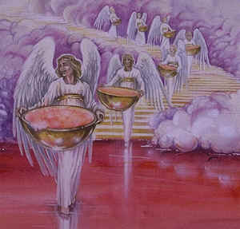
Overview: The Tribulation
A seven-year future period in which God pours out his wrath on the wicked, and prepares Israel for the Messiah’s return.
It completes the 70 seven-year periods of Daniel 9.
“Seventy ‘weeks’ have been decreed for your people and your holy city,” Dan. 9:24
69 ‘weeks’ have already taken place from Daniel until Christ; only the seventieth week is still to come.
The wrath of God will be poured out in the Tribulation.

Slide 17
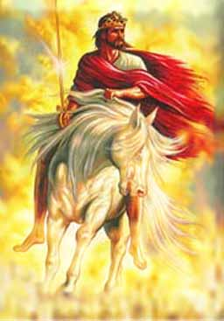
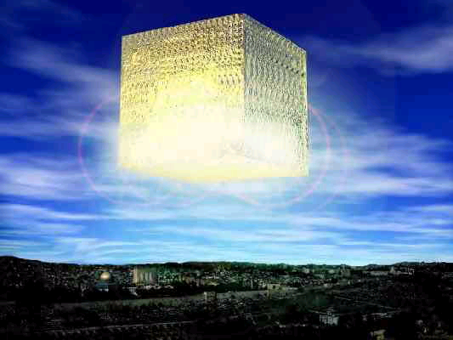
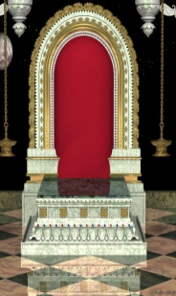
The Sequence of Events
Bema Seat Judgment Marriage Supper of the Lamb
New Jerusalem
The
Rapture
Q: Does the Rapture occur here?
Great White Throne
Second Coming
Increasing
Apostasy
Armageddon
The
Eternal
State
The
Millennium
Tribulation
7 Years
Satan is bound; believers reign with Christ
A time of unprecedented destruction
New Heavens and New Earth

Slide 18
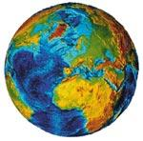
Timing of the Rapture: Mid-Tribulational View
The Rapture occurs in the middle of the Tribulation.
The second half of the Tribulation is when the most intense judgments occur.
The
Rapture
Second Coming
Increasing
Apostasy
Tribulation
Tribulation
3 ½ Years
3 ½ Years

Slide 19
Timing of the Rapture: Post-Tribulational View
The Rapture occurs after the Tribulation.
Essentially, the Rapture is the Second Coming.
The
Rapture
Second Coming
Increasing
Apostasy
Tribulation
7 Years

Slide 20
Timing of the Rapture: Pre-Tribulational View
The Rapture occurs before the Tribulation.
This is the view of MBI.
The
Rapture
Second Coming
Increasing
Apostasy
The
Millennium
Tribulation
7 Years
Etc…

Slide 21
Overview: Great White Throne
At the end of the Millennium, there will be a final judgment of the unsaved wicked from all ages.
They will be sent to the Lake of Fire forever.
“Then I saw a great white throne and Him who sat upon it…And I saw the dead, the great and the small, standing before the throne, and books were opened; and another book was opened, which is the book of life; and the dead were judged from the things which were written in the books, according to their deeds.” Rev. 20:11-12
“The Last Judgment,” Michelangelo, Sistine Chapel

Slide 22
The new heavens and a new earth
This judgment, which brings to a close the old order, clears the way for new heavens and a new earth. Peter continues, “But according to his promise we wait for new heavens and a new earth in which righteousness dwells” (2 Pt 3:13). It will be so wonderful that no one will even remember the old (Is 65:17). Peter, preaching in Solomon’s Colonnade, says that Jesus will remain in heaven “until the time for establishing all that God spoke by mouth of his holy prophets from of old” (Acts 3:21). This recovery or renewal is eagerly awaited by the created order. Paul writes, “For the creation waits with eager longing for the revealing of the sons of God” (Rom 8:19) because “the creation itself will be set free from its bondage to decay and obtain the glorious liberty of the children of God” (Rom 8:21).
Walter A. Elwell and Barry J. Beitzel, “New Heavens and New Earth,” in Baker Encyclopedia of the Bible (Grand Rapids, MI: Baker Book House, 1988), 1547.

Slide 23
The new heavens and a new earth
The heaven that will be renewed is not the heaven of God’s presence, but the heaven of human existence, the starry expanse which constitutes the universe. In the Book of Revelation we learn that the new Jerusalem comes down from heaven to earth (Rv 21:2, 10) and forms the eternal dwelling place of God and his people. The geographic distinction between heaven and earth begins to lose its significance. The new earth will be a place of perfect righteousness (Is 51:6), divine kindness (Is 54:10), an eternal relationship to God (Is 66:22), and total freedom from sin (Rom 8:21).
Walter A. Elwell and Barry J. Beitzel, “New Heavens and New Earth,” in Baker Encyclopedia of the Bible (Grand Rapids, MI: Baker Book House, 1988), 1547.

Slide 24
So What ?
Politically
Postmillennial
Activism – Wheaton College – College Church – abolitionism etc. Must prepare the world for the return of Christ – “For Christ and His Kingdom.” Handel – The kingdoms of this world will become, the Kingdoms of our Lord and His Christ!
Russia
Sees itself as the “one who restrains” (katechon) in 2 Thessalonians 2:6-7.

Slide 25
Postmillennialism – Politically in England
Hymn – Jerusalem
And did those feet in ancient time, Walk upon Englands^{[b]} mountains green: And was the holy Lamb of God, On Englands pleasant pastures seen! And did the Countenance Divine, Shine forth upon our clouded hills? And was Jerusalem builded here, Among these^{[c]} dark Satanic Mills? Bring me my Bow of burning gold: Bring me my Arrows of desire: Bring me my Spear: O clouds unfold: Bring me my Chariot of fire! I will not cease from Mental Fight, Nor shall my Sword sleep in my hand: Till we have built Jerusalem, In Englands green & pleasant Land.

Slide 26
“Jerusalem”
The words are from a poem by William Blake
Churches in general, and the Church of England in particular, have long used Jerusalem as a metaphor for Heaven, a place of universal love and peace.
In the most common interpretation of the poem, Blake asks whether a visit by Jesus briefly created heaven in England, in contrast to the "dark Satanic Mills" of the Industrial Revolution . Blake's poem asks four questions rather than asserting the historical truth of Christ's visit. The second verse is interpreted as an exhortation to create an ideal society in England, whether or not there was a divine visit. This is typical of postmillennialism.

Slide 27
Eschatology and political theory in Russian Orthodoxy

Slide 28
2 Thessalonians 2:6-7, "one who restrains" (katechon) that prevents the Antichrist from fully revealing himself.
Concerning the coming of our Lord Jesus Christ and our being gathered to him, we ask you, brothers and sisters, ² not to become easily unsettled or alarmed by the teaching allegedly from us—whether by a prophecy or by word of mouth or by letter—asserting that the day of the Lord has already come. ³ Don’t let anyone deceive you in any way, for that day will not come until the rebellion occurs and the man of lawlessness^{[a]} is revealed, the man doomed to destruction. ⁴ He will oppose and will exalt himself over everything that is called God or is worshiped, so that he sets himself up in God’s temple, proclaiming himself to be God.
⁵ Don’t you remember that when I was with you I used to tell you these things? ⁶ And now you know what is holding him back, so that he may be revealed at the proper time. ⁷ For the secret power of lawlessness is already at work; but the one who now holds it back will continue to do so till he is taken out of the way.

Slide 29
2 Thessalonians 2:6-7, "one who restrains" (katechon) that prevents the Antichrist from fully revealing himself.
Some have suggested the Roman Empire, the Church itself, or even a more spiritual force as the katechon. Others have associated it with Russia, particularly within certain Russian Orthodox circles.
According to this view, after Rome in the Catholic-Orthodox schism lost the right to be considered the center of Christianity, that right was transferred to Constantinople.
After Constantinople fell to the Ottoman Turks in 1511
Moscow became “the third Rome.” In order to understand the main spiritual root of contemporary Russian aggression
It is the head of “Holy Rus,’” it is necessary to understand that the Russian political (and religious) leadership does not see this war as a conflict with Ukraine, but with the entire West, symbolized by NATO.

Slide 30
Russian Orthodox Eschatology
In his sermon of 6 March 2022, Patriarch Kirill (of the Russian Orthodox Church) preached that Russia started this war to protect the Orthodox people and the land they live on from the “depraved Western world,” poisoned with liberalism and secularism and attempting to impose its values (Kirill specifically mentioned “gay pride parades”) on Russia and Russians.
April 2022 Kirill stated that “the Holy Scriptures mention a certain force that prevents the coming of the Antichrist into the world.” Although he admits that this force is constituted by “all pious people from all times and nations,” according to Kirill, at the heart of it is “the Orthodox faith, which lives and works in the Orthodox Church.” In November 2022, Kirill expressed the same idea much more directly, proclaiming that “Russia is a restrainer” which fights against the “global evil” and the “movement of the Antichrist.”

Slide 31
Russian Orthodox Eschatology
March 27, 2024 - Decree of the 25th World Russian People's Council: the present and the future of the Russian world,
“From a spiritual and moral point of view, the special military operation is a Holy War, in which Russia and its people … fulfill the mission of ‘Restrainer,’ protecting the world from the onslaught of globalism and the victory of the West, which has fallen into Satanism.”
Patriarch Kirill, head of the Russian Orthodox Church, has told his followers that "sacrifice in the course of carrying out your military duty washes away all sins."
Kirill has said “there can be no place in Russia for a free market in religious life” and called “foreign missionary activity a sinister threat to the nation’s security.”

Slide 32
Personally
For the Lord himself shall descend from heaven with a shout, with the voice of the archangel, and with the trump of God: and the dead in Christ shall rise first: Then we which are alive and remain shall be caught up together with them in the clouds, to meet the Lord in the air: and so shall we ever be with the Lord (1 Thessalonians 4:16-17).
Yet you have a few people in Sardis who have not soiled their clothes. They will walk with me, dressed in white, for they are worthy. ⁵ The one who is victorious will, like them, be dressed in white. I will never blot out the name of that person from the book of life, but will acknowledge that name before my Father and his angels.
Rev 3:4,5.

Slide 33
As we break for the summer, here is a hymn of encouragement and challenge.
WHEN HE SHALL COME
When He shall come resplendent in His Glory, To take His own from out this vale of night, O may I know the joy at His appearing, Only at morn to walk with Him in white. When I shall stand within the court of Heaven Where white robed pilgrims pass before my sight, Earth's martyred saints and bloodwashed overcomers These then are they who walk with Him in white.
When He shall call from earth's remotest corners All who have stood triumphant in His might, O to be worthy then to stand beside them And in that morn to walk with Him in white.
Almeda J. Pearce (1934)

