Slide 1
WE BELIEVE in the personal bodily return of Christ in power and great glory as King of Kings and Lord of Lords, and in Christ’s ultimate and complete triumph and the establishment of “new heavens and a new earth, wherein dwelleth righteousness.”
Article #10
Acts 1:11 | 2 Peter 3:10-13 | Revelation 19:16, 21:1-7

Slide 2
Scriptures
“Men of Galilee,” they said, “why do you stand here looking into the sky? This same Jesus, who has been taken from you into heaven, will come back in the same way you have seen him go into heaven.” Acts 1:11
“But the day of the Lord will come like a thief. The heavens will disappear with a roar; the elements will be destroyed by fire, and the earth and everything done in it will be laid bare. Since everything will be destroyed in this way, what kind of people ought you to be? You ought to live holy and godly lives as you look forward to the day of God and speed its coming. That day will bring about the destruction of the heavens by fire, and the elements will melt in the heat. But in keeping with his promise we are looking forward to a new heaven and a new earth, where righteousness dwells. 2 Peter 3:10-13

Slide 3
Scriptures
On his robe and on his thigh he has this name written: king of kings and lord of lords. Revelation 19:16
Then I saw “a new heaven and a new earth,”^{[a]} for the first heaven and the first earth had passed away, and there was no longer any sea. I saw the Holy City, the new Jerusalem, coming down out of heaven from God, prepared as a bride beautifully dressed for her husband. And I heard a loud voice from the throne saying, “Look! God’s dwelling place is now among the people, and he will dwell with them. They will be his people, and God himself will be with them and be their God. ‘He will wipe every tear from their eyes. There will be no more death’ or mourning or crying or pain, for the old order of things has passed away.” He who was seated on the throne said, “I am making everything new!” Then he said, “Write this down, for these words are trustworthy and true.” He said to me: “It is done. I am the Alpha and the Omega, the Beginning and the End. To the thirsty I will give water without cost from the spring of the water of life. Those who are victorious will inherit all this, and I will be their God and they will be my children. Revelation 21:1-7

Slide 4
Personal, bodily return of Christ
Christ’s return will be physical, not just “spiritual.” just as His resurrection was physical and not just spiritual.
The charts in the following slides outlining the various views come from - https://www.growingchristians.org/hermeneutics/principle-20

Slide 5
Two Perspectives
Dispensational Theology
Israel and the Church are distinct.
The prophecies to Israel belong to Israel and must be fulfilled literally.
For example: Christ will reign as King in Jerusalem
The promises to Israel are not given to the Church.
Covenant Theology
The Church is the New Israel.
Prophecies to Israel are spiritually fulfilled in and by the Church.
For example: Christ spiritually “reigns” in our hearts

Slide 9
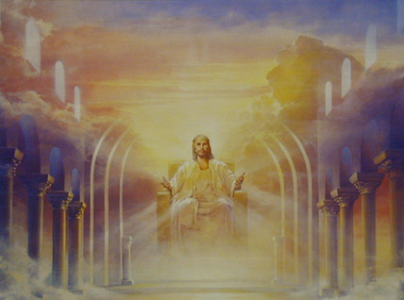
Overview: the Millennium
The reign of Christ on the earth for 1000 years, in fulfillment of the biblical promises to Israel.
Is a time of unprecedented prosperity and peace.
“And he laid hold of the dragon, the serpent of old, who is the devil and Satan, and bound him for a thousand years.” Rev. 20:2
“…they will be priests of God and of Christ and will reign with Him for a thousand years.” Rev. 20:6

Slide 12
Overview: The Rapture
Greek harpazo, Latin raptus, to seize, snatch, catch up
In the Rapture, Christians are caught up in the clouds to be with Jesus forever.
“Then we who are alive and remain will be caught up together with them in the clouds to meet the Lord in the air, and so we shall always be with the Lord.” 1 Thess. 4:17
“If I go and prepare a place for you, I will come again and receive you to Myself, that where I am, there you may be also.” John 14:3

Slide 13
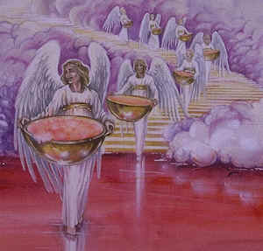
Overview: The Tribulation
A seven-year future period in which God pours out his wrath on the wicked, and prepares Israel for the Messiah’s return.
It completes the 70 seven-year periods of Daniel 9.
“Seventy ‘weeks’ have been decreed for your people and your holy city,” Dan. 9:24
69 ‘weeks’ have already taken place from Daniel until Christ; only the seventieth week is still to come.
The wrath of God will be poured out in the Tribulation.

Slide 14
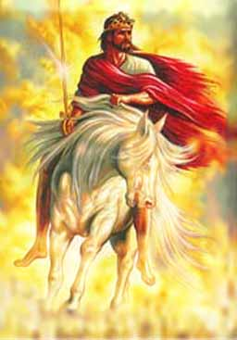
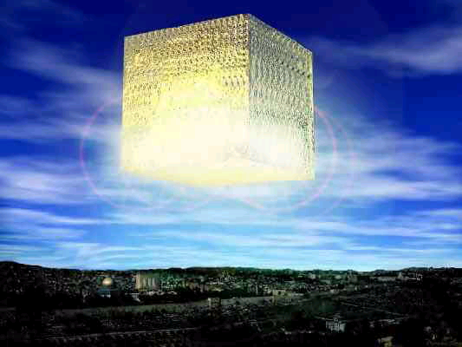
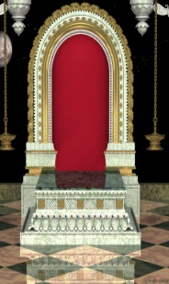
The Sequence of Events
Bema Seat Judgment Marriage Supper of the Lamb
New Jerusalem
The
Rapture
Q: Does the Rapture occur here?
Great White Throne
Second Coming
Increasing
Apostasy
Armageddon
The
Eternal
State
The
Millennium
Tribulation
7 Years
Satan is bound; believers reign with Christ
A time of unprecedented destruction
New Heavens and New Earth

Slide 15
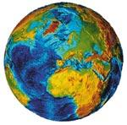
Timing of the Rapture: Mid-Tribulational View
The Rapture occurs in the middle of the Tribulation.
The second half of the Tribulation is when the most intense judgments occur.
The
Rapture
Second Coming
Increasing
Apostasy
Tribulation
Tribulation
3 ½ Years
3 ½ Years

Slide 16
Timing of the Rapture: Post-Tribulational View
The Rapture occurs after the Tribulation.
Essentially, the Rapture is the Second Coming.
The
Rapture
Second Coming
Increasing
Apostasy
Tribulation
7 Years

Slide 17
Timing of the Rapture: Pre-Tribulational View
The Rapture occurs before the Tribulation.
This is the view of MBI.
The
Rapture
Second Coming
Increasing
Apostasy
The
Millennium
Tribulation
7 Years
Etc…

Slide 18
Overview: Great White Throne
At the end of the Millennium, there will be a final judgment of the unsaved wicked from all ages.
They will be sent to the Lake of Fire forever.
“Then I saw a great white throne and Him who sat upon it…And I saw the dead, the great and the small, standing before the throne, and books were opened; and another book was opened, which is the book of life; and the dead were judged from the things which were written in the books, according to their deeds.” Rev. 20:11-12
“The Last Judgment,” Michelangelo, Sistine Chapel

