Slide 1
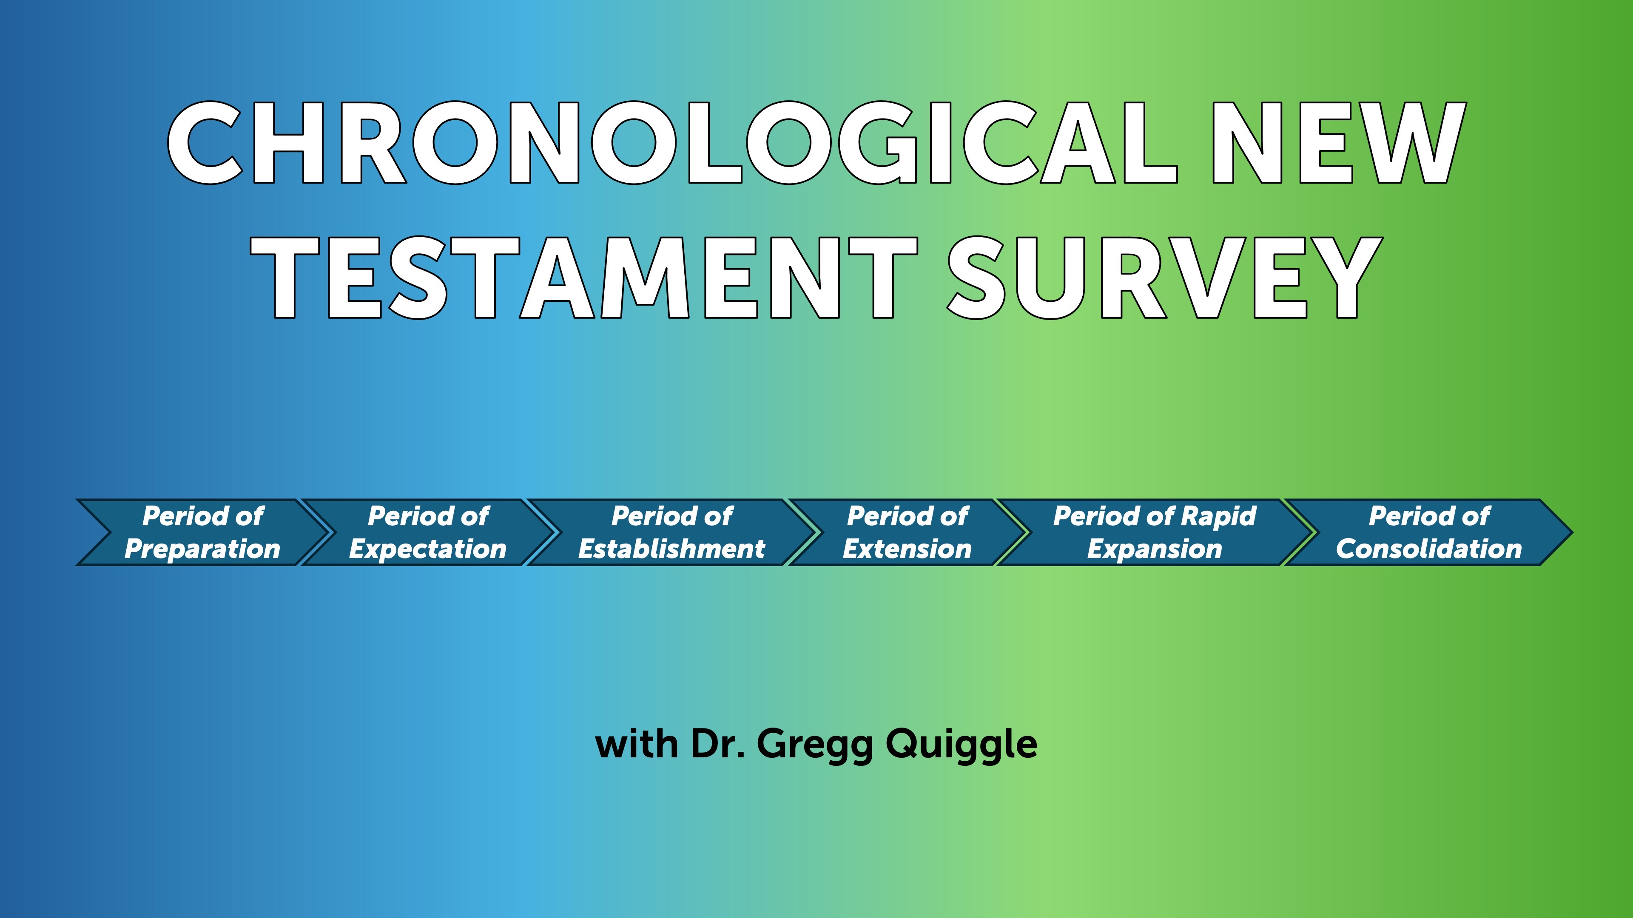

Slide 2
The Period of Establishment
Unit # 3 - The “establishment of the church.” We will focus will be on the birth and the growth of the church in Jerusalem.

Slide 3
The Period of Establishment
We move into the third historical period in our survey of the New Testament. This is the “establishment of the church.” In this period, the focus will be on the birth and the growth of the church in Jerusalem.
Scripture reference for this period is Acts 1:1 through 6:7.

Slide 4
The Book of Acts
The full title is ”The Acts of the Apostles,” but I think it is better thought of as ”The Acts of the Holy Spirit through the Apostles.” It is really not a story about humans; it is the story of the third person of the Trinity as He works with humans, and His work is to glorify Christ. So, in that sense, it is an extension of the Gospels. The continuing work of Christ through the Holy Spirit.

Slide 5
Acts 1:1-10
In my former book, Theophilus, I wrote about all that Jesus began to do and to teach ² until the day he was taken up to heaven, after giving instructions through the Holy Spirit to the apostles he had chosen. ³ After his suffering, he presented himself to them and gave many convincing proofs that he was alive. He appeared to them over a period of forty days and spoke about the kingdom of God. ⁴ On one occasion, while he was eating with them, he gave them this command: “Do not leave Jerusalem, but wait for the gift my Father promised, which you have heard me speak about. ⁵ For John baptized with^{[a]} water, but in a few days you will be baptized with^{[b]} the Holy Spirit.”⁶ Then they gathered around him and asked him, “Lord, are you at this time going to restore the kingdom to Israel?”⁷ He said to them: “It is not for you to know the times or dates the Father has set by his own authority. ⁸ But you will receive power when the Holy Spirit comes on you; and you will be my witnesses in Jerusalem, and in all Judea and Samaria, and to the ends of the earth.”⁹ After he said this, he was taken up before their very eyes, and a cloud hid him from their sight.¹⁰ They were looking intently up into the sky as he was going, when suddenly two men dressed in white stood beside them. ¹¹ “Men of Galilee,” they said, “why do you stand here looking into the sky? This same Jesus, who has been taken from you into heaven, will come back in the same way you have seen him go into heaven.”

Slide 6
The Pattern of Establishment
These Chapters will show a consistent pattern
Luke explains to us how the church overcame a series of threats. The pattern for the opposition is external, internal, external, internal. What I mean by that is the church was threatened externally with persecution, and it was jeopardized internally by problems within the body of Christ.

Slide 7
Pentecost and the Holy Spirit
What is Pentecost?
In the OT, Shavuot, “The Festival of Weeks,” is a harvest festival that is celebrated seven weeks and one day after the first day of Passover in Deuteronomy 16:9-12, or seven weeks and one day after the Sabbath according to Leviticus 23:16. Because it fell on the fiftieth day after Passover, Weeks was also called “Pentecost”, that is, “fiftieth” (e.g., Acts 2:1; 20:16; 1 Cor 16:8).
Over time, Pentecost came to be celebrated as the anniversary feast of the giving of the Law or the establishment of the covenant at Sinai. This is attested in Jewish writings such as Jubilees (1st century BC) and the Babylonian Talmud.
It is also tied to the “Year of Jubilee.” During this year, ancestral land sold by Israelites was returned, and those who sold themselves into slavery due to poverty regained freedom. The land was also “freed” from work; no planting, harvesting, or reaping occurred during the fiftieth year. Like the sabbatical year, the jubilee was a Sabbath for people and land, marking the remission of debts, emancipation, and rest under God’s care.

Slide 8
Pentecost and the Holy Spirit
Before returning to heaven, Christ promised to send the Holy Spirit. He spent about forty days on earth after his resurrection, providing convincing proofs he was alive, according to Acts 1. He gave his followers irrefutable evidence of his victory over death.
He charged them with growing the kingdom, promising to send the Holy Spirit to give them power as his witnesses in Jerusalem, Judea, Samaria, and to the ends of the earth. He told them to wait in Jerusalem for this supernatural power. Christ kept his promise. On the Day of Pentecost, while his followers gathered in an upper room, Acts chapter 2 describes a sudden sound like a violent wind that filled the entire house where they were seated. They also saw what appeared to be tongues of fire dividing and settling on each of them. All of them were filled with the Holy Spirit and started speaking in different languages.

Slide 9
Observations on Pentecost
There are a couple of significant features to note about the gift of the Spirit on the Day of Pentecost. First, the Spirit came on all of Jesus’ disciples; there were no exceptions, everyone was filled with the Spirit. Secondly, Jesus had promised in the gospel of John that when he left them, he would send them another counselor who would be with them forever, and that promise was fulfilled when Christ poured out the Holy Spirit on the Day of Pentecost. And this gift of the Spirit marked the birth of the church; this was the beginning of what Paul later calls the body of Christ. Third, the Spirit was visibly manifested by speaking in tongues. Now that’s a controversial issue, it’s clear to me, at least, that here in this second chapter of Acts that it was a foreign language, it was a known language, because people who had come to Jerusalem from all over the world for the Day of Pentecost heard the followers of Christ praising God in their own language, and this is what amazed them, this is what captured their attention.

Slide 10
Peter’s Sermon Acts 2:14 - 40
The Spirit energized Peter to preach a convincing sermon on Pentecost, proving Jesus was Messiah and Lord through miracles, resurrection, and the Holy Spirit. Peter explained that Christ’s miracles, His resurrection—fulfilled by David's Psalm 16—and the Holy Spirit's outpouring were evidence of His divine identity. He concluded that Jesus, crucified by the people, was both Lord and Christ. The audience was overwhelmed, asking what to do, leading Peter to call for repentance and baptism, marking the church’s beginning with about 3,000 added believers. This growth showcases the beginning of Christ building His church

Slide 11
What is the “Church?”
“Church” comes from the Greek word ekklēsia. It had the basic meaning of “assembly.”
The church, then, consists of those whom the Lord has called out of the world into union and fellowship with Christ and into communion with each other. https://learn.ligonier.org/articles/what-is-the-church
The church can be defined as a supernatural community formed by the Spirit, united with Christ, bonded together by love, and empowered by the Holy Spirit to worship the Lord and witness to the world. From Bill Marty with additions from me.

Slide 12
What is the “Church?” - Characteristics
The Word is preached
The Ordinances/Sacraments are practiced
The offices are functioning
The gifts are functioning

Slide 13
The First Jewish Church, Acts 2: 42-47
This was a supernatural community, different from other branches of Judaism. The word “devoted” implies ongoing, regular commitment—centered on teaching and fellowship. Their teachings likely covered the Old Testament as well as the life, death, and resurrection of Jesus. Fellowship included sharing meals and the Lord’s Table. They gathered for corporate prayer, performed miracles and wonders that validated their message, and shared resources willingly to support fellow believers. They worshipped in the temple, considering themselves a faithful remnant of Israel, and experienced a brief period of joy and unity, free from persecution or internal conflict. The church expanded quickly, fulfilling Christ’s promise in Matthew 16:18, concluding on a victorious note.

Slide 14
Acts 3 and 4 – Growth and Opposition
Peter, John, and the healing of the lame beggar
Peter preaches to the crowd – 5,000 converted
Peter and John arrested, and brought before the Sanhedrin
The believer’s worship and rejoice

Slide 15
Healing the lame beggar
While on the way to the temple, Peter and John heard this pitiful cry of a beggar, “Alms! Alms!” And to most passersby, this man was a nuisance; he was like these guys who ask for a handout on the street of Chicago. We would probably avoid them if we could see them coming, but Peter and John were different. Instead of walking faster or crossing over to the other side of the street, they paused and looked this man straight in the eye. And Peter and John said, “We don’t have any silver or gold, but we have something better.” And Peter took him by the hand, and he pulled him up and the man was instantaneously healed, and he leaped up and with great joy and rejoicing he ran into the temple. When word of this man’s healing swept through Jerusalem, it was like wildfire. And so, Peter seized the opportunity to preach another message.

Slide 16
Quick observation
Even in a predominantly materialistic age, there are still some things that money can’t buy. The lame man begged for money, instead he received new legs. Many in America today are like the lame man in our story. Many think that their greatest need is for material, perhaps money, but perhaps their greatest need is spiritual. They need the power of Christ to change you. Peter’s promise is for you. His promise is for today: “Repent, then, and turn to God, so that your sins may be wiped out, that times of refreshing may come from the Lord” [Acts 3:19]. And you, too, can walk and leap and praise God because you will be able to stand in the presence of the Living God, guilt-free, restored, and cleansed. The old hymn put it well: “What can wash away my sin? Nothing but the blood of Jesus. What can make me whole again? Nothing but the blood of Jesus.”

Slide 17
Peter’s Second Sermon Acts 3: 11-24
In his first message, he had focused on the theme that Jesus was the Messiah and Lord. In this second message, Jesus is God’s glorified servant. He said that Jesus was alive, and it was Christ's power that had enabled this lame beggar to walk. He stresses that though the Jews rejected Christ and the Romans crucified him, this was part of God’s preordained plan. In fact, he says that the healing of the lame man is proof that Christ is alive. In chapter 3, verse 16 we read: “By faith in the name of Jesus, this man whom you see and know was made strong. It is Jesus’ name and the faith that comes through him that has given this complete healing to him, as you can all see.” Peter then urges his listeners to repent, saying that if they acknowledge Jesus as the Messiah, they will receive forgiveness for their sins. He says, “Your sins will be wiped out,” and then he promises that times of refreshing will come from the Lord, and he will restore everything as he promised long ago through the prophets. Five thousand are added to the church!

Slide 18
Arrest and Trial of Peter and John – external threat
In chapter 4 verse 1, we read that “The priests and the captain of the temple guard and the Sadducees came to Peter and John while they were still speaking to the people.” To understand the accusation, you have to remember that the Sadducees didn’t believe in the supernatural. They didn’t believe in angels, they didn’t believe in life after death. They didn’t believe in the resurrection, and so they were disturbed because the apostles were teaching the people and proclaiming—and notice what they said—“in Jesus the resurrection of the dead.” They just weren’t proclaiming that Christ was alive, they were offering to people hope for life after death, in Christ. And so, the Sadducees had Peter and John arrested, they were locked up overnight.

Slide 19
Trial continued
And then the next day they were brought for trial. They wanted to know: “By what power or name did you do this?” They’re referring to the healing of the lame man. Even though the Sadducees didn’t believe in miracles, the Pharisees and other Jews believed in miracles. It would have been easy for Peter to say that he had healed this man in the name of God, because the prophets had healed people in the name of God. But Peter doesn’t say “it was in the name of God”: “Peter, filled with the Holy Spirit…‘It is by the name of Jesus Christ of Nazareth, whom you crucified but whom God raised from the dead, that this man stands before you healed’” [4:10]. And then—and this guy is a fisherman—says, “Salvation is found in no one else, for there is no other name under heaven given to men by which we must be saved.” Now, they didn’t agree with Peter, and they didn’t agree with John, but they were impressed with their courage. “When they saw the courage of Peter and John and realized that they were unschooled, ordinary men, they were astonished”—and notice what the text says in verse 13—“and they took note that these men had been with Jesus.” Now they threatened them and then they released them, because they couldn’t do anything to stop them. They couldn’t intimidate them, they couldn’t refute the evidence, the lame man was there.

Slide 20
Trial Concluded – Acts 4
¹⁶ “What are we going to do with these men?” they asked. “Everyone living in Jerusalem knows they have performed a notable sign, and we cannot deny it. ¹⁷ But to stop this thing from spreading any further among the people, we must warn them to speak no longer to anyone in this name.”
¹⁸ Then they called them in again and commanded them not to speak or teach at all in the name of Jesus. ¹⁹ But Peter and John replied, “Which is right in God’s eyes: to listen to you, or to him? You be the judges! ²⁰ As for us, we cannot help speaking about what we have seen and heard.”
²¹ After further threats they let them go. They could not decide how to punish them, because all the people were praising God for what had happened. ²² For the man who was miraculously healed was over forty years old.

Slide 21
The Believer’s Worship and Rejoice Acts 4
²³ On their release, Peter and John went back to their own people and reported all that the chief priests and the elders had said to them. ²⁴ When they heard this, they raised their voices together in prayer to God. “Sovereign Lord,” they said, “you made the heavens and the earth and the sea, and everything in them. ²⁵ You spoke by the Holy Spirit through the mouth of your servant, our father David:
“‘Why do the nations rage
and the peoples plot in vain?
²⁶ The kings of the earth rise up
and the rulers band together
against the Lord
and against his anointed one.^{[b]}’^{[c]}
²⁷ Indeed Herod and Pontius Pilate met together with the Gentiles and the people of Israel in this city to conspire against your holy servant Jesus, whom you anointed. ²⁸ They did what your power and will had decided beforehand should happen. ²⁹ Now, Lord, consider their threats and enable your servants to speak your word with great boldness. ³⁰ Stretch out your hand to heal and perform signs and wonders through the name of your holy servant Jesus.”
³¹ After they prayed, the place where they were meeting was shaken. And they were all filled with the Holy Spirit and spoke the word of God boldly.

Slide 22
The Church is United- Acts 4
³² All the believers were one in heart and mind. No one claimed that any of their possessions was their own, but they shared everything they had. ³³ With great power the apostles continued to testify to the resurrection of the Lord Jesus. And God’s grace was so powerfully at work in them all ³⁴ that there were no needy persons among them. For from time to time those who owned land or houses sold them, brought the money from the sales ³⁵ and put it at the apostles’ feet, and it was distributed to anyone who had need.
³⁶ Joseph, a Levite from Cyprus, whom the apostles called Barnabas (which means “son of encouragement”), ³⁷ sold a field he owned and brought the money and put it at the apostles’ feet.

Slide 23
Is this Socialism or Communism?
No, Why?
First, there was no transfer of ownership, no control of production or income, no requirement to surrender one’s property to the community. The voluntary nature of the Christian practice is evidenced by the consistent use of the iterative imperfect tense throughout vv. 34b–35. This is how they “used to” do it. They “would sell” their property and bring it to the apostles as needs arose.
Second is the example of Barnabas in vv. 36–37. His sale of property would hardly be a sterling example if the surrender of property were obligatory.
Third, in the example of Ananias and Sapphira, Peter clarified for Ananias that his sin was in lying about his charity. The land remained his to do with as he pleased; he was under no obligation to give the proceeds to the church (5:4).
Fourth, the picture of the central fund for the widows in 6:1–6 is clearly not an apportioning of each one’s lot from a common fund but a charity fund for the needy John B. Polhill, Acts, vol. 26, The New American Commentary (Nashville: Broadman & Holman Publishers, 1992), 153

Slide 24
Ananias and Sapphira – internal threat
Apparently inspired by Barnabus, Ananias and Sapphira sold property and promised to give all the proceeds to the apostles. After selling, they had second thoughts and didn’t fully keep their promise. The Holy Spirit revealed their deception to Peter, who confronted them. He asked Ananias why Satan filled his heart to lie to the Holy Spirit, and warned him he hadn't lied to men but to God. Ananias fell dead. Later, Sapphira, unaware of her husband's fate, lied to Peter about the sale price. Peter told her she lied to the Spirit of the Lord, and she also fell dead.

Slide 25
Ananias and Sapphira - Observations
First, they were influenced by Satan; they were filled with Satan and not with the Holy Spirit. Secondly, their sin was a sin against God. Ultimately, their lie was not against the church; it was against God, and all sin is ultimately against God. Thirdly, their sin was deliberate. It was not an unfortunate mistake; it was not a miscalculation. And perhaps that’s the reason that they were judged so severely. Whatever the case, the Holy Spirit exposed Ananias and Sapphira as liars and deceivers.

Slide 26
The arrest of all the Apostles – chapter 5 – external threat
In Acts 5, the authorities take a more aggressive step by arresting all the apostles, motivated differently than before. Previously, in chapter 4, their concern was theological; now, it's personal. The Sadducees, unpopular aristocrats, resented the apostles, who gained public respect, leading to jealousy (Acts 5:17). They jailed the apostles with common criminals, trying to make them miserable. Interestingly, God sent an angel to secretly release the apostles at night, which is ironic because the Sadducees didn’t believe in angels.

Slide 27
The arrest of the Apostles - continued
God ordered an angel to secretly free the apostles at night. Ironically, the Sadducees didn’t believe in angels, yet one released them. How the angel did this isn’t explained—no mention of overpowering guards, breaking locks, or digging through walls. The next morning, the jail was locked, guards stood watch, but the prisoners were gone. When questioned later, they didn’t ask how the apostles escaped, possibly leaving it out or fearing to inquire. When the Sanhedrin found these men free and proclaiming the gospel in Jerusalem, they ordered their arrest. They planned to kill the apostles, but God intervened through Gamaliel, a highly regarded Pharisee. He warned against opposing God's will, saying if the movement is from God, they can't stop it and would fight against God. If it's human, it will fail, like previous revolts that Rome crushed. The Sanhedrin heeded his advice somewhat, not executing the apostles but flogging them. This Jewish flogging was painful but less severe than Roman punishment

Slide 28
The establishment of Deacons – internal threat
In chapter 6, the fourth and final incident of opposition is subtle. As the number of disciples increased, Greek Jews complained that their widows were overlooked in food distribution [v.1]. There were two types of Jews: Palestinian or Hebraic, who weren't influenced by Greek culture, and Grecian or Hellenistic, who were. With the rapid growth, the Hellenistic widows were being neglected. The apostles chose seven men, full of the Spirit and wisdom, mainly Greeks, to oversee food distribution and ensure fairness. (One of them was Stephen) They prioritized prayer and ministry in the Word.

Slide 29
Deacons - Observations
First, a growing ministry must focus on its priorities. As a church expands, it will encounter new needs that require reorganization to meet them. But those who are responsible for teaching or preaching must keep their priorities right; they must be allowed to devote themselves to prayer and the teaching of the Word. Second, discrimination for any reason has no place in the church. It was wrong in the first century in the church in Jerusalem, and it’s wrong in the twentieth century in any church that is a true church of Jesus Christ. Thirdly, I think we need to keep in mind that even for what we might consider an insignificant responsibility, the men they chose were filled with the Spirit, men of faith, men of wisdom. So, in the church, we need to look for spiritual people, not necessarily the richest, most influential people, to serve in the ministry of Jesus Christ.

Slide 30
This ends the ESTABLISHMENT period in Jerusalem

Slide 31
The Period of EXTENSION
The scripture references for that period are Acts 6:8 through Acts 9:31. In this section in the book of Acts, Luke turns his inspired spotlight on three men: Stephen, Philip and Saul. Stephen preaches a powerful sermon to his countrymen in Jerusalem. Philip, who was one of those seven deacons, is driven by persecution to Samaria and he preaches the gospel in Samaria, which was a very bold step for the early believers. Saul, who at this point is not a Christian or a follower of Christ, is miraculously converted on the road to Damascus and then he’s commissioned to take the gospel to the Gentiles. So, Stephen preaches to the Jews, Philip proclaims the gospel to the Samaritans, and Saul is saved and commissioned to take the gospel to the Gentiles.

Slide 32
Figure #1 - Stephen – the first martyr
Stephen is slandered and arrested. He is brought before the Sanhedrin. He speaks before them, infuriates them, and is murdered. To understand why Stephen was martyred, it is important to first consider the three foundational historical or doctrinal elements that underpinned Judaism. They are the land, the law, and the temple. The land was more than just a place to reside. To them, the land promised by God to Abraham and his descendants symbolized a source of blessing; thus, residing in this land meant being in a place of blessing. They also believed that Moses had given them the law, they saw themselves as special and expected God’s favor as a result. Additionally, the temple signified God’s presence among them. After Solomon completed the temple, God’s glory filled it, reinforcing the belief that the temple represented divine approval of the Jewish nation. In his speech, Stephen challenges and dismantles each of these fundamental pillars.

Slide 33
Stephen’s Sermon – Acts 7 - Read

Slide 34
He reminds them that when God called Abraham, he wasn’t in the land; he lived in Ur. Therefore, God called and blessed Abraham before he even lived in the land. Even when Abraham died, he still did not possess the land that God had promised to give him. So, Abraham lived his entire life without ever receiving the land God promised, yet he was still blessed by God. Similarly, Joseph was betrayed by his brothers and sold as a slave in Egypt, yet God honored him there. Joseph wasn’t in the land, but God still honored him for his faithfulness to the Lord. The speaker then moves on to Moses. As you and our listeners know, Moses was Israel’s lawgiver, and he reviews how they received the law through him. But then, in verse 35, he says, “But this is the same Moses whom they had rejected with the words, ‘Who made you ruler and judge?’” Moses was sent by God to be their ruler and deliverer, but when he tried to rescue his people from Egyptian bondage, they rejected him. Then, in verse 37, he says, “This is that Moses who told the Israelites, ‘God will send you a prophet like me from among your own people.’” But again, in verse 39, he states, “But our fathers refused to obey him.” The implication Stephen makes here is that their ancestors were wrong about Moses. When Moses first tried to help them, they rejected him. The clear implication, especially considering their high regard for Moses and the law, is that they might also be wrong about Christ—just as their ancestors were wrong about Moses.

Slide 35
In fact, later on [v. 52], he states that they had rejected Christ even though the prophets had predicted the coming of the Righteous One, saying, “You have betrayed and murdered him.” He then turns to the temple and reminds them of what they should have known from the Old Testament. He says in verse 48: “However, the Most High does not live in houses made by men. As the prophet says: ‘Heaven is my throne, and the earth is my footstool. What kind of house will you build for me?’ says the Lord. ‘Or where will my resting place be? Has not my hand made all these things?’” Throughout the Old Testament, God indicated that he was sovereign over the entire world, over all nations, not just Israel or a specific area in the ancient Near East. He reminds them that the heavens are God’s dwelling place, not any building in Jerusalem, regardless of how grand it is. Essentially, he has dismantled the traditional beliefs or pillars supporting Judaism. No wonder they reacted so angrily. In his conclusion, he says, “You stiff-necked people, with uncircumcised hearts and ears!”—calling them a bunch of Gentiles.

Slide 36
Stephen’s Death
They dragged him outside the city and they stoned him to death. Now, the account of Stephen’s death is interesting, not because of the gory details involved in it but what Luke says about the manner in which he died. His death, by the way, is very similar to the crucifixion of Christ. We’re told that Stephen was full of the Holy Spirit, he looked up into heaven and he saw the glory of God, and he saw the Son of Man standing at the right hand of God. So apparently Christ stood up off of the throne in order, I think, to welcome Stephen into heaven. And then he commended his spirit, he asked God to receive his spirit, just as Christ had given up his spirit when he died. And then just as Christ had prayed for forgiveness for those who were executing him, Stephen prayed, “‘Lord Jesus receive my spirit.’ Then he fell on his knees and cried out, ‘Lord, do not hold this sin against them.’” And then finally, Luke tells us—and I think this is very comforting for us as Christians—“When he had said this,” Luke says, “he fell asleep” [v. 60]. So he doesn’t describe the death of Stephen as a horrible execution as we often see on television or in the movies when someone is executed; rather, he describes his death as “sleep.” Now, he’s not talking about soul sleep, but rather, “sleep” is an image of a peaceful restful state, plus it’s also an image that indicates that death for the Christian, at least, is temporary. When we go to sleep at night we expect to wake up in the morning.

Slide 37
Impact of Stephen’s Sermon and Death
Stephen refuted the pillars of traditional Judaism: the land, the law, and the temple. This convinced the Jews that Christianity was different than Judaism; it was not simply another sect within Judaism, it was a different way to God. And because they realized how different Christianity was than Judaism, they determined that they were going to destroy the followers of Christ. Acts 8:1-4.
“And Saul approved of his execution. And there arose on that day a great persecution against the church in Jerusalem, and they were all scattered throughout the regions of Judea and Samaria, except the apostles. ² Devout men buried Stephen and made great lamentation over him. ³ But Saul was ravaging the church, and entering house after house, he dragged off men and women and committed them to prison. Now those who were scattered went about preaching the word. ”

Slide 38
Figures #2 and #3 - Saul and Philip
Luke uses the story to introduce Saul, later Paul. Saul is just given a passing reference. Somewhat ironically, this is the beginning of his “missionary” work. Because of Saul’s “ravaging” of the church, the Word is spread!
Then he turns to Philip.

Slide 39
Philip goes to Samaria - Acts 8:4-8 - read
Now those who were scattered went about preaching the word. ⁵ Philip went down to the city^{[a]} of Samaria and proclaimed to them the Christ. ⁶ And the crowds with one accord paid attention to what was being said by Philip, when they heard him and saw the signs that he did. ⁷ For unclean spirits, crying out with a loud voice, came out of many who had them, and many who were paralyzed or lame were healed. ⁸ So there was much joy in that city.

Slide 40
Some Observations
Philip, takes a very bold step because he takes the gospel to Samaria; the Jews and the Samaritans didn’t like one another—that’s probably an understatement. There was a great deal of animosity between them because the Samaritans were different than the Jews. They were not full-blooded Jews, they were only partial Jews ethnically, and they worshipped God differently; in fact, they had their own temple at Mt. Gerizim. But here’s the important point in the growth of the church, Philip did not tell the Samaritans that they had to become Jews in order to become followers of Christ. He preached the gospel, he preached Christ there, and he encouraged the Samaritans to come to Christ as Samaritans. So what we see is how Christ is building his church, and it’s really a universal church. It’s made up of Jews and Samaritans, and later on in our study we’re going to see how God brought Gentiles into the body of Christ.

Slide 41
Observations - continued
The parallels here with Jesus’ encounter with the Samaritan women are striking.
Notice the Samaritans LISTENED AND RESPONDED while Stephen was stoned by the Jews. It was the Samaritans that proclaimed Jesus was a universal Savior. John 4:42 – “we know that this man really is the Savior of the world.”
And then later on when we talk about Peter’s ministry to Cornelius, we’re going to see that the Jerusalem church challenged him; they said, “Who told you you could take the gospel to a Gentile?” At these critical points in the growth of the church, if the church would have moved in a different direction, we would have several churches developing and not one church—a universal church. Christ intended for there to be one body of Christ, a worldwide body.

Slide 42
Observations
The threat of Spiritual/Cultural arrogance.
We are the chosen, we are special, we matter more to God, my people, my culture, my country . . .
God is no respecter of persons.
For all have sinned and fall short of the glory of God.
All the nations are a drop in the bucket.
God hates human arrogance in all forms.

Slide 43
Dwight Moody
One of the most humble figures in Church History, yet he bowed to local social prejudice in the South. It was not about POLITICS, it was about the Gospel.
Moody made a trip to visit meetings in Georgia in 1875. When Moody arrived in Georgia, he was astonished to find the meetings were segregated. All his previous meetings had been fully integrated. Earlier that same year, the congregation at one of his New York meetings had been described as “a mixed assemblage of all classes; some very poor, a few not very clean. Many black faces dot the congregation.” His initial response to what he saw in Georgia was moral indignation. Moody declared that some Southern whites “might possibly be astonished someday to see these blacks marching into the kingdom of heaven while they themselves were shut out.” The South white community's response was swift and ferocious. If Moody were “endeavoring to change the relation of the black and white races,” he would face the “contempt and abhorrence of our entire people.”
William R. Moody, Life of Moody, 277.
James Findlay, Dwight L. Moody, American Evangelist, 1837-1899, 279.
Liberal Christian, 30 (May 20, 1876), 9; letter to the Atlanta Constitution (no date), quoted in the New York Times, May 10, 1876.

Slide 44
At this point, one of Moody’s associates, Major Whittle, intervened and argued to continue segregated meetings. Whittle understood Moody’s indignation; however, he also understood the South. Whittle told Moody that if they insisted on integrating the meetings, the white population of Georgia would not attend. In the end, Moody followed Whittle’s advice. This began a pattern of Moody running segregated evangelistic meetings in the South.
Francis Grimké , was an African-American pastor whose theology and ministry philosophy were very who was close to Moody’s. At one point, Grimke expressed glowing admiration for Moody, describing him as “a soulwinner. He was ever looking out for opportunities to point men to Jesus, the Lamb of God, whose blood cleanses from all sin. That was his business; he had no other, lived for no other purpose. And hence the tremendous work which he did, and the wonderful success which attended his efforts.”
However, when Moody’s evangelistic tour came to his area, he ran segregated meetings. He deferred to the local organizing committee. The net effect was, African Americans either were forced into limited areas in the venues or could not find space at all.
Here is Grimke’s response. “Perhaps in the future Mr. Moody may learn that God is no respecter of persons; that of one blood he has made all races of men; that Christ died for all alike, and that the soul of the Negro is as precious in his sight as that of the white man.”
Whittle Diary, April, April 28, 1876. Whittle claimed that, “not to have done it would have… kept the white people away” and that there was, “no way we could carry on the meetings” without them being segregated. One of the reasons Whittle knew the South was he had served on General Sherman’s staff during his march to the sea during the Civil War.
Works of Francis Grimké, vol. 3, Carter G. Woodson, ed. (Washington D. C.: The Associated Publishers, 1942), 420.
https://dh.howard.edu/cgi/viewcontent.cgi?article=1026&context=ajc_grimke_manuscripts. Page 10. Accessed on March 2, 2026.

Slide 45
Moody was not a racist. He was an abolitionist, all his work was fully integrated in the North and in other countries. But, he conformed to the bigotry in the South. These were evangelistic meetings, Gospel presentations. In essence, the cultural belief was that whites were superior and could not mingle or share space with blacks, even to listen to the Gospel being preached. They were too good to be with black people, even if it cost them both the opportunity to hear the Gospel. And they certainly believed they deserved to hear it before black people.
This is precisely the thinking of the Jews in Acts relative to the Samaritans and Gentiles. It is true they had been blessed by God, but it made them arrogant and entitled. This is why Jesus going to the Samaritans was so radical. This is why the parable of the Good Samaritan is so stunning. This is why Philip’s going to a Samaritan city is so astonishing. This is And this is why the formation of the church in Acts, where Jews, Samaritans, and Gentiles worshiped, fellowshipped, and formed community together was so astonishing. It also explains why these issues keep recurring in the New Testament – circumcision, keeping the Law, Council of Jerusalem etc.

Slide 46
Simon the Magician - Acts 8:9-25
Two issues
1. The behavior of Simon and the practice of “Simony.”
2. Why didn’t the Samaritans receive the Holy Spirit at conversion?

Slide 47
Baptism in the Holy Spirit post conversion
What does the text teach?
What does Acts teach about the relationship between water baptism, spirit baptism and conversion?
  ANSWER – Anything you want it to!!
  Conclusion – Luke is not teaching a theology of the Holy Spirit in the book of Acts
  Views on “second works of grace”
  Wesleyan perfectionism or total sanctification
  Pentecostalism – Baptism in the Holy Spirit signified by a sign gift
  Keswick – Baptism in the Holy Spirit for the purpose of power for service
  Reformed – No distinct second work, fillings

Slide 48
My opinion – to link Jerusalem and the Samaritans together and to the Apostles
In order to show that the Samaritans were part of the same body, the same body of Christ as the Jews in Jerusalem, the Samaritans did not receive the Holy Spirit until Peter and John came to Samaria. Peter and John were pillars in the Jewish church. Philip was a Hellenistic Jew, we know that from his name; his name is Greek, I mean he was Jewish but he was a Hellenistic Jew. But Peter and John were Palestinian Jews, they were Jews’ Jews and highly respected by the Jewish church. So God delayed the gift of the Spirit for the Samaritans so that Peter and John could give to the Samaritans this gift, demonstrating to the Samaritans and to the Jews that they were all part of the same body of Christ. Further, Peter and John were part of the twelve, Philip was not. And that’s the reason, I think, for the time lapse between their faith and their reception of the Spirit, and I don’t think that this is intended to set any kind of theological precedent for the gift of the Spirit.

Slide 49
Philip and the Ethiopian
Acts chapter 8 is how God led Philip, after this successful evangelistic campaign in Samaria, to Gaza to one single individual. We’re told that he was led from Jerusalem to Gaza and there he met an Ethiopian government official, and the Spirit told Philip, he said, “Go to that chariot and stay near it” [v. 29]. And then Philip ran up to the chariot. he was reading from Isaiah, but he didn’t understand. And so Philip asked him, he said, “Do you understand what you’re reading?” He said, “How can I? I need somebody to explain it to me.” So Philip begins at that passage which was from Isaiah [53:7-8], “He was led like a sheep to the slaughter, and as a lamb before the shearer is silent, so he did not open his mouth. In his humiliation he was deprived of justice. Who can speak of his descendants? For his life was taken from the earth.” And he explained to this Ethiopian that Isaiah was talking about Christ and this man put his faith in Christ, and when they came to some water he asked to be baptized and Philip baptized him. So we see here, Greg, a further advance of the gospel. This man is Jewish because he had been in Jerusalem to worship but he’s headed back to Ethiopia. So the gospel is advanced both ethnically and geographically.

Slide 50
The Third Main figure – Saul (Paul)
Luke introduced us to Paul at the stoning of Stephen. He wasn’t a believer, he was a zealous defender of Judaism, and he realized that Christianity was a threat to traditional Judaism. He had received authority to persecute Christians. In fact, he apparently had some kind of official authority to extradite Christians from Damascus and to bring them back to Jerusalem for trial and punishment or execution. But on the way to Damascus Saul discovered that Christ was alive and he was changed forever. Now, to understand the dramatic conversion experience of Paul we have to look at his mindset. In Acts chapter 26 verse 14 Paul says that he was troubled by goads. That’s not a word that we’re familiar with, but “goads” refers to the spikes that were placed on the harness of animals to get them or to force them to obey their owner to turn and to go where they wanted them to go. And of course if these spikes dig into your neck then you’re going to turn, and so Paul says there were something like spikes digging into him forcing him to go a certain way. And I think, this is just speculation, I think one of them was the death of Stephen. I think Stephen’s death was somewhat of a puzzle to Saul; if this guy (Stephen) was so evil how could he die like he did?

Slide 51
The Conversion of Saul
Stephen, instead of cursing his executioners, he prayed for their forgiveness, showing unexpected mercy for a wicked man. He accepted his death peacefully, which even Paul couldn’t explain, and it seemed to bother him. Initially zealous for Judaism, Paul believed he was defending God against Christ followers. He was puzzled by how early believers claimed Christ fulfilled Old Testament prophecy, which conflicted with his scripture knowledge. His conversion on the road to Damascus is famous; a sudden, brilliant light from heaven flashed around him, a striking event. He fell and heard a voice say, “Saul, Saul, why do you persecute me?” Saul asked, “Who are you, Lord?” “I am Jesus, whom you persecute,” he replied. “Get up and go into the city, and you will be told what you must do” [Acts 9:3-6]. Saul immediately obeyed because he discovered Jesus was alive, the ultimate evidence that Jesus was Israel’s Messiah. As he later wrote, the resurrection proved Jesus’ words and actions were true. Once he realized Jesus was alive, he believed he was the Messiah. Though blinded by the light, he was spiritually enlightened. In Damascus, Jesus instructed Ananias to restore Saul’s sight. Though reluctant, as the text suggests, he was wary, calling Saul an “enemy.” Despite his reluctance, Ananias followed God's instruction, playing a crucial role in Saul’s transformation.

Slide 52
The Commissioning of Paul
And then Ananias announced to Paul that God had commissioned him to take the gospel to the Gentiles, not to the Jews, but to the Gentiles. So in our focus here on this period of extension we’ve seen three men: Stephen was a minister to the Jews, Philip to the Samaritans, and now Paul is commissioned to take the gospel to the Gentiles. He was ideally suited for this task because he was a Hellenistic or a Greek Jew. He had been exposed to Greek culture and so forth, so he could travel throughout the Roman world and he could relate to the culture because of his background. Paul’s conversion was a sovereign act of God’s grace. God took the initiative to bring Saul to Christ; he reached out to him even though he was an enemy of the faith.

Slide 53
Two Lessons
There are two important truths that we can learn from Paul’s encounter with the Lord on the road to Damascus. First, I think that here he began to understand the concept of what we call the Body of Christ. When the Lord spoke to him he said, “Saul, Saul, why do you persecute me?” Well, Saul was persecuting Christians, but because of the spiritual unity between believers and Christ, the Lord said to him, “Why are you persecuting me?” So to persecute Christians was to persecute Christ, and so I think that Paul got the initial concept of the Body of Christ here on the road to Damascus. Second, Paul’s salvation was an act of sovereign grace. As he did with Paul, God still pursues unbelievers; he’s still a God of grace no matter who you are or what you’ve done. God loves you and wants to change your life like he did Saul’s.

Slide 54
Epistle during this period - James
During the period of establishment we saw the birth and the growth of the church. Now in the period of extension of the church moves into Judea and Samaria. We’re looking at the epistles in their chronological order.
The first epistle, James, written during this period of extension. Written approximately AD 50, the context is the aftermath of the stoning of Stephen. Acts 8:1, “And Saul approved of their killing him. On that day a great persecution broke out against the church in Jerusalem, and all except the apostles were scattered throughout Judea and Samaria.” James 1:1, James, a servant of God and of the Lord Jesus Christ, To the twelve tribes scattered among the nations: Greetings. Consider it pure joy, my brothers and sisters,^{[a]} whenever you face trials of many kinds . . .” Primarily Jewish Christians.

Slide 55
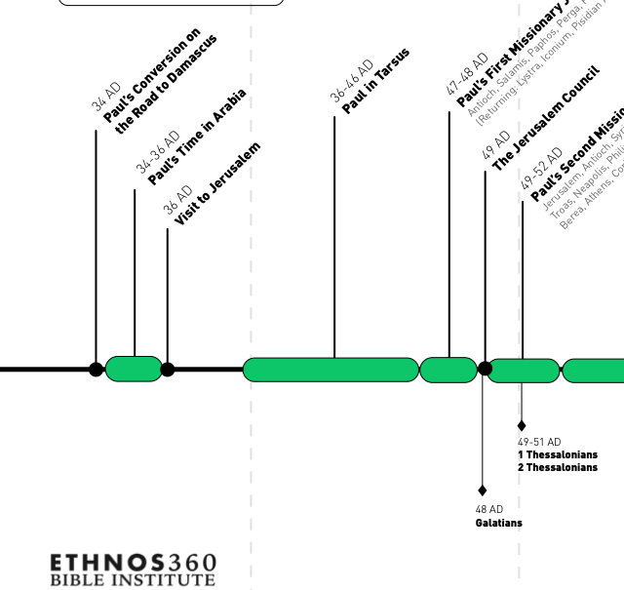

Slide 56
James – Content, Style and Author
James is one of the most practical books in the New Testament, it is filled with God’s wisdom. “Wisdom” as the ability to see and to respond to life’s circumstances from God’s perspective. James does not identify himself specifically, but he was probably the brother, the half-brother, of Jesus Christ. If that’s the case, James was not a believer during Christ’s earthly life. However, he became a believer after the resurrection.

Slide 57
James – it’s goal
The first followers of Christ faced a variety of problems: persecution, criticism, discrimination, slander, and false teaching. They needed to know wisdom to respond to these situations. Today we face the similar problems; so we can benefit from the teaching of James.
The key verses for the book of James is 1:19, 20. “You must understand this, my beloved: let everyone be quick to listen, slow to speak, slow to anger; for your anger does not produce God’s righteousness”
The goal of the book is to help us understand how God works in us to produce righteousness

Slide 58
James 1:1 – 20 - Read

Slide 59
James – it’s structure
It’s very difficult to outline the book of James, because it resembles the wisdom literature in the Old Testament. In that kind of literature, the writer just deals with a variety of topics and he doesn’t attempt to give you a systematic structure throughout the entire book. But one can build a thematic outline of James based on these two verses, James chapter 1, verses 19 and 20. The first part of the book, focuses on the importance of properly responding to trials (the why of trials), and then in the latter part of the book, in a very general way, we see how to respond to trials.

Slide 60
What exactly does he mean by “trial?”
Are we talking here about trials that come because of being persecuted, or are these life’s trials that come to all of us in all these various forms?
I think he’s talking about both, because he says, “many trials” or “trials of many different kinds.” We know these people had faced persecution from Saul, but in the epistle, he also talks about getting along with other people, controlling the tongue, anger, showing mercy and a variety of different issues so I think he’s using it very generally.

Slide 61
Trials are inevitable and have a purpose
James reminds us in 1:2, trials are inevitable. He says, “Consider it pure joy, my brothers, whenever you face trials of many kinds.” He says “when,” not “if.” Then says that we should consider this joy. Now why would anyone rejoice when hammered by problems? Because of what they produce. There are two options here in chapter 1.
We can view trials as a test of faith (vvs 3, 4) or as a temptation to sin from God (v. 13). James says that God’s purpose in trials is not to destroy our faith, rather, to create an opportunity for spiritual growth.
It involves a two-stage process – perseverance then maturity. He says, “Whenever you face trials of many kinds consider it pure joy, because you know that the testing of your faith develops perseverance.” Perseverance is the ability to endure, And what is the result of perseverance? He says, “Perseverance must finish its work so that you may be mature and complete, not lacking anything.” Perseverance leads to maturity, maturity is righteousness.

Slide 62
Importance of proper response to trials
Now according to this verse, the proper response to trials produces God’s righteousness in our lives. Then there are three ways that we can respond so that God can help us to develop his righteousness:
1. quick to listen, or quick to hear
2. slow to speak
3. slow to become angry
So let’s look first of all at the importance of the proper response to trials, and then we’ll take a look at what it means to be quick to hear, slow to speak and slow to become angry.

Slide 63
Quick to listen or hear
I do not think he means listening to the advice of other people. In the context James is saying that we should be quick to hear the Word of God. He says in 1:22-25, “Do not merely listen to the word, and so deceive yourselves. Do what it says. ²³ Anyone who listens to the word but does not do what it says is like someone who looks at his face in a mirror ²⁴ and, after looking at himself, goes away and immediately forgets what he looks like. ²⁵ But whoever looks intently into the perfect law that gives freedom, and continues in it—not forgetting what they have heard, but doing it—they will be blessed in what they do.”

Slide 64
This is key to understanding James 2:26
“For just as the body without the spirit is dead, so faith without works is also dead” Does James contradict Paul?
NO! James is not teaching salvation by works. He is stressing that real faith is a faith that works. Paul is looking at initial justification before God, and in the initial justification of a Christian you can only be saved by faith. But then once we have been saved by faith, the authenticity of our faith should be reflected in the kind of life we live, what we say and what we do. So, James is not contradicting Paul, rather, he’s complementing him. He’s saying that real faith, genuine faith, will be demonstrated in works. To use James’ language, it will not repeatedly look in the mirror of scripture, see problems and do nothing!

Slide 65
Slow to speak
The second response is slow to speak. In chapter 3 he talks about the control of the tongue. James 3:2, “We all stumble in many ways. Anyone who is never at fault in what they say is perfect, able to keep their whole body in check.” James says, one of the ultimate tests of maturity is not church attendance, Bible reading, prayer or witnessing, rather, control of the tongue.
3:1-12. The tongue is a “bit,” “rudder,” “spark.”
It can go one of two ways
3:13-16 False wisdom, Bitter envy and self ambition
3:13-18 True wisdom, pure; then peace-loving, considerate, submissive, full of mercy and good fruit, impartial and sincere. Peacemakers who sow in peace reap a harvest of righteousness.

Slide 66
Slow to become angry
We need to be slow to anger not never be angry. What is making us angry?
In chapter 4 he speaks against anger that betrays selfish desires. This is a continuation of what he talked about in 3:13-16, bitter envy and selfish ambition.

Slide 67
Ends with warnings, advice and encouragement
Submit to God, not the world
Don’t boast or act like you are God
Wealthy people must treat the poor fairly
Be patient, even if you are suffering
Prayer matters
Pray when in need/sick
praise when happy
Care for each other, bring back the wandering one.
¹⁹ My brothers and sisters, if one of you should wander from the truth and someone should bring that person back, ²⁰ remember this: Whoever turns a sinner from the error of their way will save them from death and cover over a multitude of sins.

Slide 68
This ends the EXTENSION period

Slide 69
Six historical periods of the New Testament
Period of preparation. This is the period between the Testaments, sometimes referred to as the intertestamental period. It extends from the writing of Malachi, which was about 420 BC, to the birth of Christ, 5 BC. So there’s a period of about four hundred years between the Testaments, and during this period God was preparing the world for the coming of His Son. Scripture is Galatians 4:4
Period of expectation; this covers the life of Christ. The four Gospels tell us about Christ’s life and provide information about the period of expectation. Scripture is the Gospels
Period of establishment. This refers to the establishment or the birth of the church.
Scripture reference for this period is Acts 1:1 through 6:7.

Slide 70
Six Historical Periods of the New Testament
4. Period of extension: this is the period of the growth of the church as it began to extend itself out from Jerusalem to Judea and Samaria
Scripture reference for this period is Acts 6:8 to 9:31
5. Period of rapid expansion, and this includes Paul’s missionary journeys. The book of Acts ends with Paul’s Roman imprisonment—his first Roman imprisonment
Scripture reference for this is Acts chapter 9, verse 32, to the end of the book, chapter 28, verse 31
6. Period of consolidation, because the main intent in the writing of these epistles was to consolidate or to solidify the churches that had been started by Paul and other early Christians. These are books written after the period covered in the Book of Acts.
This is that period after the book of Acts. The dates for this would be approximately AD 62 to 95, the closing of the New Testament era.

Slide 71
The Period of EXPANSION
During this period, the church experienced unprecedented growth. Paul made three missionary journeys into the Roman provinces of Galatia, Macedonia, and Achaia, and on his third journey, he went to Asia Minor. He established churches in these areas, revisited them, and wrote epistles to them to strengthen their faith in Christ. I call the epistles Paul wrote during the period of expansion the journey epistles, because they were written while he was on his missionary journeys.

Slide 72
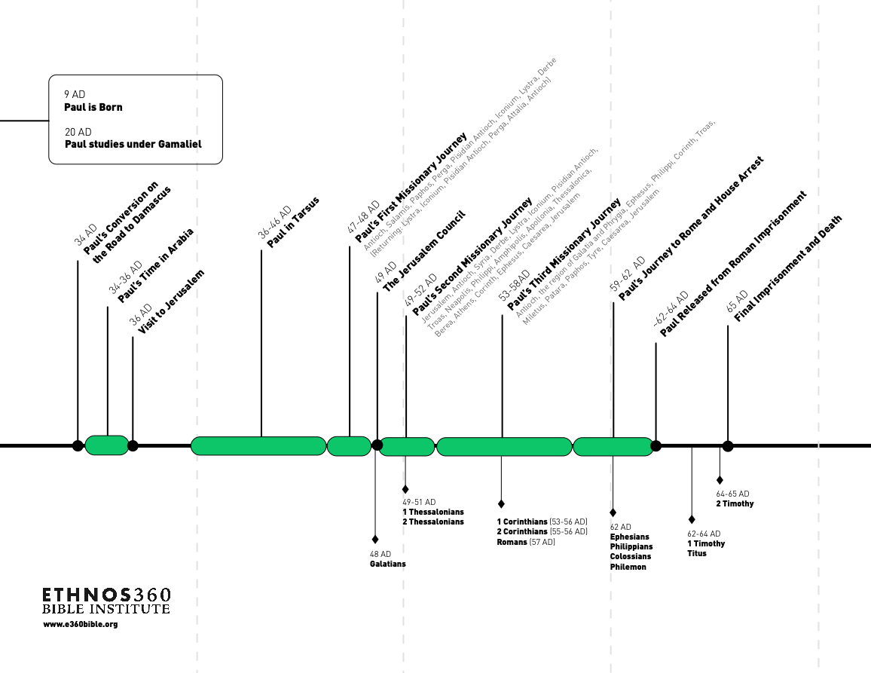
1

Slide 73
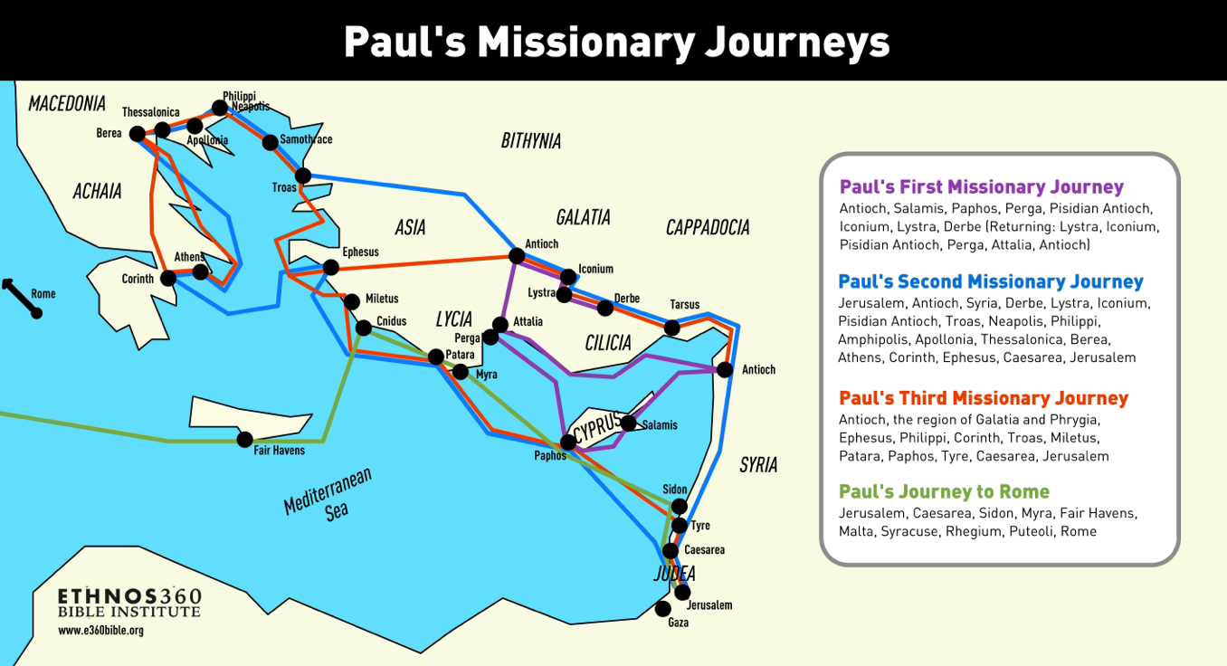

Slide 74
The Period of EXPANSION
After his first journey, Paul wrote one epistle, the epistle to the Galatians. On his second journey, he wrote First and Second Thessalonians. On his third journey, Paul wrote First Corinthians, Second Corinthians, and Romans. So, it’s very easy to remember the chronological order of these epistles if you relate them to Paul’s missionary journeys. On the first journey, he wrote one epistle: Galatians; on the second journey, he wrote two: First and Second Thessalonians; and on the third journey, he wrote three epistles: First and Second Corinthians and Romans.

Slide 75
Peter and the Gentiles
Before surveying Paul’s missionary journey, we must note two key developments that led to the church’s expansion. First, the Lord instructed Peter to take the gospel to Gentile Cornelius. Peter, a devout Jew who kept kosher under Mosaic Law, saw a vision of a sheet with animals, both permitted and forbidden by law. God told Peter three times to kill and eat, signaling that the law and its divisions between Jews and Gentiles were no longer valid. This vision led Peter to preach to Cornelius and his family, setting a precedent for evangelizing Gentiles without requiring them to follow the law. Acts 10 – 11:18.

Slide 76
Significance
We can’t really overestimate how crucial that was for us today, or how difficult that was for the Jews to understand this. God always intended to include Gentiles in his plan of salvation, but the Jews thought that it would take place by the Gentiles becoming Jews. And so this is a totally new strategy to them, and of course, it’s significant for us because we would have had to keep elements of the law (become Jewish) before we could become Christians.

Slide 77
Significance
The second development was the establishment of a new missionary center. The church in Jerusalem was a Jewish church, and through no fault of their own, they were somewhat limited and restricted in their thinking. So, God just moved the center of activity from Jerusalem to Antioch in Syria. The difference is that the church in Antioch was a Gentile church, founded by Greek-speaking Jews. So, they had a broader perspective on people than the church in Jerusalem. And it was here in Antioch, by the way, that believers were first called Christians. And because this was a Gentile church, it was the one that sent out Paul and Barnabas on the first missionary journey.

Slide 78
Paul’s first missionary journey
Luke’s account of the first missionary journey in Acts chapters 13 and 14. The missionary party consisted of Barnabas, Paul, and John Mark. They went to five different cities: they went to Paphos on the island of Cyprus; and then they went into Asia Minor, which is modern-day Turkey; and they went to Antioch in Pisidia—that’s a different Antioch than the one in Syria; they went to Iconium, Lystra and Derbe. This region in Paul’s time was called Galatia, it was the Roman province of Galatia.

Slide 80
Paphos
This event sets the pattern for Paul’s ministry [Acts 13:4-12]. In Paphos on the island of Cyprus, they met a Jewish sorcerer named Bar-Jesus. He was the attendant of the Roman proconsul named Sergius Paulus. Bar-Jesus, aka Elymas, was a sorcerer. As Paul preached to these two men, Bar-Jesus tried to stop him. Paul, looks straight at Elymas, says, “‘You’re a child of the devil and an enemy of everything that is right! You are full of all kinds of deceit and trickery.’” And he says, “‘Now the hand of the Lord is against you, and you are going to be blind, and for a time you will be unable to see the light of the sun.’ And immediately mist and darkness came over him, and he groped about, seeking someone to lead him by the hand. When the proconsul saw what had happened, he believed, for he was amazed at the teaching about the Lord.”

Slide 81
The Jew and Gentile problem
Notice what happens here: a Jewish sorcerer is blinded, not permanently but temporarily, because of his unbelief, and Sergius Paulus, who is a Gentile, believes.
How are we to understand this? Gentiles are increasingly more responsive to the gospel than Jews, and this was an unexpected development. Paul will write about this later in Romans chapters 9-11. This is a difficult passage that is aggressively debated.
We will NOT discuss this today; we will later. In the meantime, here is a video if you would like to start thinking about this. I think it is pretty fair and balanced.
https://www.youtube.com/watch?v=L61xmwEEIgc&t=16s. Skip the add at the beginning.

Slide 82
Conclusion of Journey #1
Acts 14: 26 – 28
“From there they sailed back to Antioch, where they had been commended to the grace of God for the work that they had completed. When they arrived they called the church together and related all that God had done with them, and how he had opened the door of faith for the Gentiles. And they stayed there with the disciples for some time”

Slide 83
Three points
The verses highlight three key points about the first missionary journey:
First, Paul and Barnabas achieved their goal of establishing independent, self-sufficient churches, which Paul credited to God’s grace.
Second, Paul, the apostle of grace, acknowledged his dependence on God’s grace.
Third, Surprisingly, most converts were Gentiles, not Jews, leading many Gentiles to faith in Christ.

Slide 84
The Letter to the Galatians
Galatians was written after the first missionary journey, during which Paul journeyed into the region of Galatia. And after he returned to Antioch in Syria, Paul wrote an epistle to the Galatians. The date for the writing of Galatians was about AD 50, shortly after James. Paul wrote Galatians to defend the gospel of grace. Jewish legalists, sometimes referred to as Judaizers, were threatening the gospel of grace. They wanted to impose the law on Christians, and had they succeeded Christianity might have become nothing more than another religious party within Judaism. We will look at three of the unique features for Galatians, and a threefold outline of the epistle.

Slide 86
Unique content of Galatians
Paul says in 1:17 that he was in Arabia for three years; that’s the only reference we have to Arabia. We don’t have any information about what Paul did during that time. He may have needed time to reconsider his views on Judaism and Christianity. It seems that Paul went after he became a follower of Christ and before he began his ministry. Secondly, in Galatians 3:19-25, Paul explains the purpose of the law. He says that the law was given to lead the nation of Israel to Christ. In other words, Paul insists that the law doesn’t save anyone—keeping the law, at least, doesn’t save anyone. God pardons those who trust Christ as Savior, not those who observe the law. The third unique feature of Galatians is the list of the fruit of the Spirit in Galatians 5:22-23. The unique point is that it’s a cluster of virtues; it’s not individual pieces from which we can choose. Paul doesn’t say that these are the “fruits” of the Spirit; he says that this is the “fruit” of the Spirit.

Slide 87
Outline of Galatians – three parts
First, personal defense of Gospel. In chapters 1 and 2 Paul gives his personal testimony about his gospel and how he received it, emphasizing that it is a gospel that was revealed to him and it’s a gospel of grace.
Second, doctrinal defense of Gospel; in chapters 3 and 4 Paul defends the gospel of grace from the doctrinal perspective of justification by faith.
Third, practical application of Gospel, chapters 5 and 6. Paul applies the principle of Christian liberty to the Christian life, and again he emphasizes that the Christian life is lived by grace and not by law.

Slide 88
Part 1, Personal Defense
1:6-8 “I am astonished that you are so quickly deserting the one who called you in the grace of Christ and are turning to a different gospel— Not that there is another gospel, but there are some who are confusing you and want to pervert the gospel of Christ. But even if we or an angel from heaven should proclaim to you a gospel contrary to what we proclaimed to you, let that one be accursed!”
Paul explodes with fury. He says if someone preaches another gospel than what we proclaimed, even if it’s an angel, let him go to hell and stay there forever!

Slide 89
Paul’s personal defense – two proofs
He uses two proofs. First, he claims that his message was received through divine revelation. In 1:11,12, Paul states, “I want you to know, brothers, that the gospel I preached is not something that man made up. I did not receive it from any man, nor was I taught it; rather, I received it by revelation from Jesus Christ.” Perhaps during that time in Arabia, Paul received further revelation about the gospel. Second, in chapter 2, he says that the church in Jerusalem approved his message and ministry, not to the Jews but to the Gentiles. In 2:2, he explains, “Fourteen years later I went up again to Jerusalem, this time with Barnabas and Titus. I went in response to a revelation and presented the gospel I was preaching among the Gentiles.” In 2:7, he adds, “On the contrary, they saw”—referring to the Jerusalem church—“that I had been entrusted with the task of preaching the gospel to the Gentiles, just as Peter had to the Jews.” Thus, Paul defends his gospel by citing divine revelation and the church's endorsement of his mission to the Gentiles.

Slide 90
Ongoing issue in the early church; 1:13 – 2:13 Jew and Gentile strife
What is the relationship between Jewish practices/rituals and Christianity? What is the role of the Law?

Slide 91
Part 2, Doctrinal Defense
In 3:1, Paul stuns the Galatians, he says, “You foolish Galatians! Who has bewitched you?” In other words, they were acting like they were under a spell, and so he asked them this question: “I would like to learn just one thing from you: Did you receive the Spirit by observing he law, or by believing what you heard? Are you so foolish? After beginning with the Spirit, are you now trying to attain your goal by human effort?” Paul asked them a rhetorical question, “How did you receive the Spirit?” The Spirit is a sign of true faith. They, of course, had received the Spirit as a gift of God’s grace in response to their faith in Christ.

Slide 92
Paul’s argument
He shocks the Judaizers, who insisted that Gentiles keep the law in order to become a part of the body of Christ. He declares in 3:6, that Abraham was justified by faith. “Consider Abraham: ‘He believed God, and it was credited to him as righteousness.’” Paul explains that everyone who believes is a spiritual descendant of Abraham, with Abraham as the spiritual father of both Jews and Gentiles. He anticipates opponents' argument that the law, given 430 years after Abraham's faith, nullifies the covenant previously established by God and thus do away with the promise. Paul counters by emphasizing God's promises are unchangeable, citing that the promises to Abraham and his seed (singular)—meaning Christ—are still valid. Therefore, God has kept his promises to bless the world through Abraham’s descendant—that is, his seed, Christ. The law did not nullify the covenant, and God's promises remain today as they did when given to Abraham. Despite changing people and circumstances, God's promises are steadfast, and he blesses those who have faith.

Slide 93
Paul’s argument continued – what is the purpose of the Law?
He explains the purpose of the law was to define sin. It’s like the boundary between what is right and wrong; if you cross those boundaries, it’s called a transgression. Second, he said the law was given to lead people to Christ; he uses the Greek term “paidagogos,” which is related to our word “pedagogy.” The paidagogos was a trusted servant who was responsible for overseeing a child’s education. So he argues that a person is justified by grace through faith, not by works of the law. That was true of Abraham, and it’s true of believers today; and the law did not nullify the promises made to Abraham, because they were made to Abraham and to his seed, that is, Christ.

Slide 94
Part 3, Practical application
Galatians 5:1 “For freedom Christ has set us free. Stand firm, therefore, and do not submit again to a yoke of slavery”
This is the principle of Christian liberty. Christ is a great liberator. Contrary to what many people might believe, Christians are not in bondage to rules and regulations. Christians, really, are the freest of all men and women. In Christ, as believers, we no longer need to struggle to keep the Law of Moses or anyone else’s law, for that matter, because we are controlled by a different law.

Slide 95
Tightrope of Love
Think of yourself standing on a tightrope over toxic pools. You would not want to fall in these pools, so you’re trying to balance yourself on this tightrope. Now, one of these pools is what we call legalism, what Paul refers to in 5:4: “You who are trying to be justified by the law have been alienated from Christ; you’ve fallen away from grace.” And then the other pool is licentiousness, a life of unrestrained indulgence, 5:13. “You, my brothers and sisters, were called to be free. But do not use your freedom to indulge the flesh” Now what is the tightrope? It’s the tightrope of love. Notice the end of 5:13 and 14, “But do not use your freedom to indulge the sinful nature; rather, serve one another in love. For the entire law is fulfilled in keeping this one command: “Love your neighbor as yourself.” It’s love that keeps us balanced between legalism and licentiousness. One writer put it this way: “Love God and others and do whatever you want.”

Slide 96
Staying on the tightrope
But we don’t walk on that tightrope alone. If we walk it alone, we will fall. We have help, the Holy Spirit. He says in verse 16, ‘I say, live by the Spirit.’ Verse 17: “For the sinful nature desires what is contrary to the Spirit, and [the Spirit] what is contrary to the sinful nature.” Verse 18: “But if you are led by the Spirit, you are not under law.” Verse 22: “But the fruit of the Spirit is love, joy, peace…kindness, goodness…” and so forth. Verse 25: “Since we live by the Spirit, let us keep in step with the Spirit.” The Spirit dominates this section. There are two forces tugging on us: the Spirit and the sinful nature. And he says if we yield to the sinful nature then we’re going to fall off of our tightrope, but if we surrender to the Spirit’s control, then the Spirit will produce in our lives the fruit of the Spirit: joy, peace, patience, kindness, goodness, faithfulness, gentleness and self-control. We have to deal radically with these evil desires. Because of our union with Christ and because of the gift of the Spirit, we are empowered people. We do not need to surrender to our sinful desires, we can have victory over them. THIS IS HARD!

Slide 97
Problems with John Mark and a split between Paul and Barnabus
An event in the First Journey will impact the second. Specifically, John Mark had left the first missionary team before things really heated up in Pisidia, Iconium, and Lystra — where Paul seems to have suffered the most violent persecution of the team (Acts 13:13–14).
Consequently, Luke describes the rift that opened between Paul and Barnabas over John Mark: “There arose a sharp disagreement, so that they separated from each other” (Acts 15:39). No elaboration, no circling back later in Acts to tell us how this story ended. We just watch Barnabas sail off to Cyprus with John Mark while Paul and Silas head to Syria and Cilicia.
THIS IS A STUNNING TURN OF EVENTS AND LUKES SAYS VERY LITTLE. WHAT ARE WE TO MAKE OF THIS?
https://www.desiringgod.org/articles/when-sharp-disagreements-separate

Slide 98
Principles from the event with John Mark
The godliest of people can fail
If this sharp disagreement involved some personal or leadership failure on the part of one or both men, which is possible, we shouldn’t be shocked. Neither was infallible and, like the rest of us, they “[stumbled] in many ways” (James 3:2). Just that possibility reminds us that the Bible doesn’t hide the weakness and failures of its godliest saints and that we and our leaders are weak and fail too.
https://www.desiringgod.org/articles/when-sharp-disagreements-separate

Slide 99
On the other hand . . .
The text does not assign blame. We need to have a category in our minds that it’s possible neither man was wrong. Perhaps Paul rightly discerned that John Mark wasn’t yet ready to participate in the trip Paul was about to take — and Barnabas rightly discerned that God wanted Mark to accompany him. Perhaps Silas was ready to endure the dangers and rigors of Pauline ministry (Acts 9:16), while Mark was ready to train under Barnabas’s patient, encouraging leadership. Later in II Timothy 4:12 Paul describes John Mark as becoming “very useful” in later ministry. That possibility can help guard us from jumping to conclusions when decisions look like failures to us. It may not be the case. Maybe not all failures are actual failures.
https://www.desiringgod.org/articles/when-sharp-disagreements-separate

Slide 100
Principles from the event with John Mark
But when it comes to sharp disagreements between Christian friends we know or within our own churches, let us take very seriously the counsel given us from one of the parties involved in the dispute over John Mark: “If possible, so far as it depends on you, live peaceably with all” (Romans 12:18). No doubt, this counsel came from much hard-won experience.
Note the words “if possible.” These words carry the implication that, for all sorts of reasons, it’s not always possible for brothers and sisters to remain yoked together in ministry. But it is always possible to trust God’s sometimes mysterious, inscrutable purposes; to not pass judgment prematurely; to be quick to forgive others, “as God in Christ forgave [us]” (Ephesians 4:32); and to let love cover a multitude of sins (1 Peter 4:8). For “love bears all things, believes all things, hopes all things, endures all things” (1 Corinthians 13:7). Ministry partnerships sometimes must end, but “love never ends” (1 Corinthians 13:8).
https://www.desiringgod.org/articles/when-sharp-disagreements-separate

Slide 101
Principles from the event with John Mark
As a principle, the more distant we are from other Christians’ sharp disagreements, the less we know of the circumstances or details, the wiser we are to refrain from passing judgment on them.
https://www.desiringgod.org/articles/when-sharp-disagreements-separate

Slide 102
Principles from the event with John Mark
It’s inevitable that disagreements will arise between Christians. Our call is to pursue faithfulness in disagreement, with love always being our aim. Given that the separation between Paul and Barnabas is an anomaly in what the Holy Spirit preserved in Scripture for our instruction, I think it’s safe to assume that most disagreements ought to be reconciled without separation. But when separation occurs, we can glean a lot from the little we know of Paul and Barnabas’s parting.
https://www.desiringgod.org/articles/when-sharp-disagreements-separate

Slide 103
Back to the Book of Acts
Fallout from the first Missionary Journey:
The Council of Jerusalem chapter 15
Gentile involvement in the church was increasing more rapidly than Jewish participation. This alarmed a group of Jewish traditionalists (Judaizers) in the Jerusalem church, who insisted Gentiles must first convert to Judaism and be circumcised before becoming members of the church. A group of Judaizers came to Antioch, a Gentile church, teaching that circumcision was essential for salvation, Paul and Barnabas recognized this as a threat to the gospel of grace. They traveled to Jerusalem and requested that the church resolve this issue.

Slide 104
Acts 15:1-21 - Read
Key verses 10 and 11. ”Now then, why do you try to test God by putting on the necks of Gentiles a yoke that neither we nor our ancestors have been able to bear? No! We believe it is through the grace of our Lord Jesus that we are saved, just as they are.”
Three prohibitions 1. No strangled meat, 2. No blood, 3.No sexual immorality
James the brother of Jesus is leading…. James the Disciple is Martyred in 44 AD, council is about 49 AD.

Slide 105
Impact of the Council
This sets the stage for Paul’s second missionary journey. Paul and his companions began the second journey from Antioch, where they had started their first. They traveled through Galatia, the same region as before. Paul apparently planned to go to Asia, but the Holy Spirit prevented him. It's interesting because we don’t know exactly how the Spirit stopped him. In Acts 16:6, we read that he “was kept by the Holy Spirit from preaching the word in the province of Asia.” When he tried to enter Mysia and Bithynia, the Spirit of Jesus wouldn’t allow it either. The Spirit was guiding Paul to a specific location, directing him by God’s Spirit to Troas, which is located on the northeast corner of Asia Minor. There, an important event in early church history took place. Acts 16:9-10.

Slide 106
Paul’s Macedonian vision - Acts 16:9-10
There are two key truths in this passage. First, Paul saw that the church was universal, spanning Asia and Europe. The Spirit directed him to bridge these continents, establishing a church in both east and west. Second, personally, obedience to God's call is significant. Although it might seem minor, Paul's obedience to his vision blessed hundreds and brought many into God's kingdom. Our obedience can have high stakes, affecting eternal destinies—whether it’s talking to someone nearby or going worldwide.

Slide 107
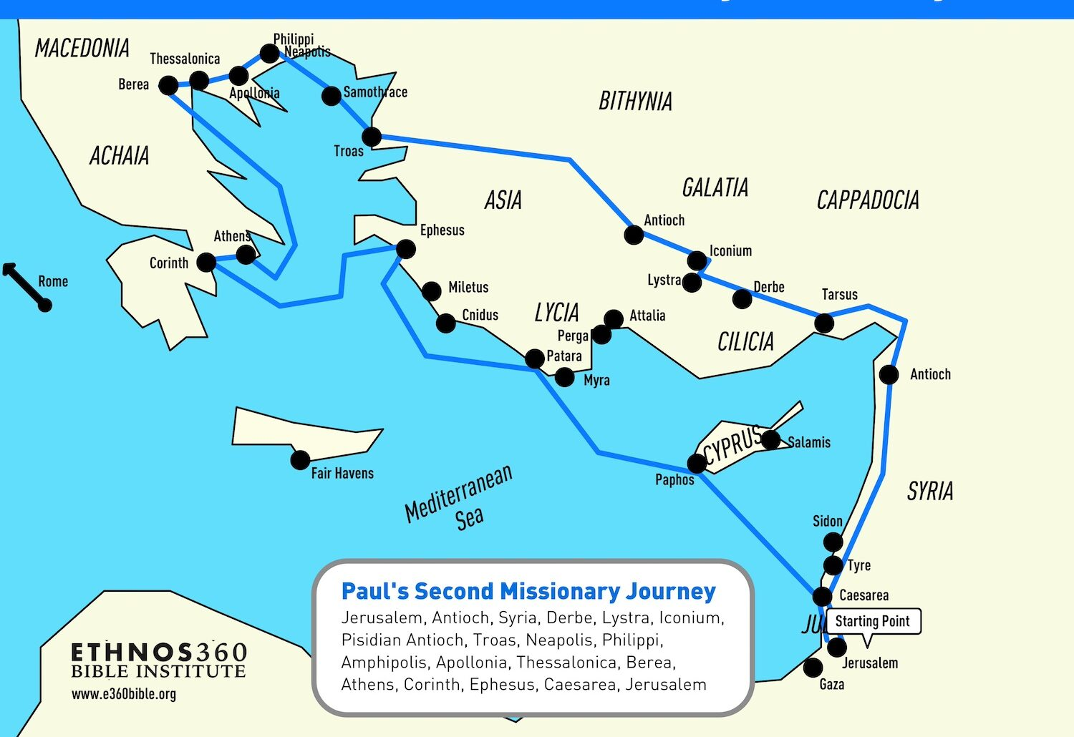

Slide 108
The Second Journey - (Acts 15:36–18:22)
From Troas, then, Paul crosses over into Macedonia, and on his second missionary journey Paul visits five cities: they are Philippi, Thessalonica, Berea, Athens and Corinth. He spent most of his time in the city of Corinth, he was there for about a year and a half. In spite of hardship and persecution, Paul and his traveling companions witnessed the victory of God’s grace over religious prejudice in the city of Thessalonica, over philosophical skepticism in the city of Athens, and over pagan immorality in the city of Corinth. We are going to focus on Paul’s experience at Philippi. In the city of Philippi, which was a retirement center for Roman soldiers, there were three converts: Lydia, a slave girl, and then the Philippian jailer.

Slide 109
Lydia
Because there wasn’t a synagogue at Philippi, Paul went to the place of prayer, and there he met a woman named Lydia. She was a businesswoman, she sold purple cloth from the city of Thyatira, which was a very expensive kind of material. And she was at this place of prayer to worship God, and Luke tells us that the Lord opened her heart to respond to Paul’s message.

Slide 110
The Slave Girl
Luke then tells us about Paul’s encounter with a slave girl who had some kind of a demonic spirit that enabled her to predict the future. She was used and abused by her owners to tell fortunes through demonic power. Paul delivered her, both from the demonic power and from her owners. He cast the demon out of this slave girl and because this jeopardized their income, the owners of this girl protested and Paul and Silas were arrested and placed in prison.

Slide 111
Philippian Jailor
This is the story about Paul and Silas singing at night, even though they had been flogged and placed in chains. And there was an earthquake, and the jailer, thinking that all the convicts had escaped, was about to take his own life. But Paul stopped him, and when he realized that these men were still in the prison, he cries out, “Sirs, what must I do to be saved?” And then in perhaps one of the most concise summaries of the gospel in all of scripture, Paul says in Acts chapter 16, verse 31: “Believe in the Lord Jesus, and you will be saved—you and your household.” So, this prison was really transformed into a holy place. It was a place where this jailer who had no hope found hope, not only for this life but for life after death.

Slide 112
Philippi summarized
So here at Philippi, in the conversion of Lydia, who was a Jewish worshiper, we see the triumph of Christianity over Judaism. In the rescue of this slave girl from demonic powers, we see the triumph of Christianity over demonism. And in the conversion of the Philippian jailer we see the triumph of Christianity over paganism. The converts at Philippi were as different as oil and water, but they all responded to the appeal and the power of the gospel.

Slide 113
Epistles during the second Journey – I&II Thessalonians
During the second journey, Paul visited the cities of Philippi, Thessalonica, Berea, Athens and Corinth. He spent about a year and a half at Corinth. While he was at Corinth he wrote two epistles, he wrote First and Second Thessalonians, and we’re looking at the epistles in their historical or chronological order, rather than their biblical order.

Slide 114
Thessalonians
In studying Paul’s ministry at Thessalonica we discover that Paul’s ministry was cut short, he was only able to minister there for three Sabbaths. Apparently, a persecution forced him out of the city, and so after three weeks he was forced to leave. His work was not finished and we see his great desire to finish what he started. I Thessalonians 2:17,18. ¹⁷ But since we were torn away from you, brothers, for a short time, in person not in heart, we endeavored the more eagerly and with great desire to see you face to face, ¹⁸ because we wanted to come to you—I, Paul, again and again—but Satan hindered us.

Slide 115
I Thessalonians
Now we don’t know how Satan stopped Paul, but somehow Satan prevented Paul from returning to Thessalonica, so he wasn’t able to complete his ministry there and he was concerned about this infant church. While he was at Athens Paul sent Timothy back to Thessalonica, and then when Paul arrived in Corinth Timothy returned bringing good news. And he reported to Paul that in spite of persecution the Thessalonian believers were maturing in their faith, in love, and in hope. And so Paul wrote First Thessalonians to encourage these new Christians.

Slide 116
I Thessalonians
There are two unique features of this epistle. First, Paul refers to the Thessalonians as a model church. In chapter 1, verse [7], he says: “And so you became a model to all the believers in Macedonia and Achaia.” The word for “model” is “tupos” and it indicates an image that can be reproduced. So Paul commends the Thessalonians; this is the kind of church that he hopes all of the churches would become. The other unique feature of First Thessalonians is the fact that the second coming of Christ is mentioned in every chapter. There are five chapters in and in each one Paul makes at least one reference to the second coming. In the first three chapters Paul talks about his personal ministry at Thessalonica, and then in chapters 4, 5, and 6 he answers some concerns that they had regarding some of the events and challenges that they faced.

Slide 117
I Thessalonians 1
Paul commends the Thessalonians for a display of the fundamental virtues of Christianity, these are: faith, love, and hope. These are what identify us as Christians. Paul commends the Thessalonians in verse 3 not only because they possess these virtues, but because of what these virtues have produced. He says, “We continually remember before our God and Father your work produced by faith,”—so their faith had produced work—“your labor prompted by love,”—their love had motivated them to labor to go beyond what was required—and then “your endurance inspired by hope in our Lord Jesus Christ”—so their hope gave them the ability to endure under pressure. Our lives should be radically transformed by faith in Christ, driving us to work, serve, and sacrifice to advance God's kingdom. When facing trials or persecution, our hope should inspire endurance.

Slide 118
I Thessalonians 2 & 3
In chapter 2 Paul reminds the Thessalonians of his ministry, and it’s the kind of description of ministry that should characterize all of us as followers of Christ. Paul says that he ministered with the help of God, and then he says in verse 3, “Our appeal does not spring from error or impure motives, nor are we trying to trick you. On the contrary, we speak as men approved by God to be entrusted with the gospel. We are not trying to please men but God, who tests our hearts. You know we never used flattery, nor did we put on a mask to cover up greed—God is our witness. We were not looking for praise from men, not from you or anyone else. Paul's main goal in ministry was to please God, not to offend or seek approval from people. He prioritized God's view over others' opinions, emphasizing integrity. His personal life and ministry were deeply connected, motivating his actions.

Slide 119
I Thessalonians 4 - 6
Paul was concerned that the Thessalonians not become discouraged by trials and that they continue to grow in their faith, so in chapters 4, 5, and 6 he gives them instructions about living. In chapter 4, he states it’s God’s will for them to be morally or sexually pure, emphasizing sexual sin as an offense against God and urging control of the body in a holy, honorable way. And then, in chapter 4, verses 13-17, he gives them encouragement concerning those who have died. Apparently, some of the Thessalonians had died since Paul had visited the city, and so he says, “I do not want you to grieve like the rest of men, who have no hope,” and he gives a couple of reasons why they shouldn’t grieve as unbelievers who have no hope. Jesus died and rose again, so we believe God will bring with Jesus those who have fallen asleep in Him. The resurrection gives us hope for life after death. When Christ returns, the dead and living will be caught up to meet Him in the air, “for the Lord himself will come down from heaven, with a loud command, with the voice of the archangel and the trumpet call, and the dead in Christ will rise first. After that, we who are still alive and left will be caught up together with them in the clouds to meet the Lord in the air.” Paul concludes, “Therefore encourage one another with these words.”

Slide 120
II Thessalonians
There are three chapters in Second Thessalonians. In the first chapter Paul gives comfort to the Thessalonians in view of the Lord’s coming; in chapter two he corrects the erroneous report that they had received that the day of the Lord had already come; and then in chapter three he gives them commands concerning their responsibility to work.

Slide 121
II Thessalonians 1
The issue in chapter one is the justice of God. The fires of persecution were still burning at Thessalonica. You’ll recall that Paul had been forced to leave the city because of persecution, and apparently when he wrote this epistle the Thessalonians themselves were experiencing persecution from the enemies of the faith. And the pain and suffering that they were experiencing had raised doubts in their minds about the justice of God. And so Paul says, “I want you to know that God is just.” He says that in chapter one verse 6: “He will pay back trouble to those who trouble you and give relief to you who are troubled, and to us as well.” So Paul says that God will judge their enemies; at the second coming of Christ God will balance the scales of God’s justice. So, though God may not deal immediately with the enemies of the faith, he will punish them at the time when Christ returns.

Slide 122
II Thessalonians 2
In chapter two the issue was a misunderstanding of the day of the Lord. Someone had reported to the Thessalonians that the day of the Lord had already come. In chapter two [verses 1-2] we read: “Concerning the coming of our Lord Jesus Christ and our being gathered to him, we ask you, brothers, not to become easily unsettled or alarmed by some prophecy, report or letter supposed to have come from us, saying that the day of the Lord has already come.” The Thessalonians were likely panicked, thinking they were in the day of the Lord, possibly because Paul taught they wouldn’t face God's wrath.

Slide 123
Paul says two events must occur before the day of the Lord. He says in verse 3: “Don’t let anyone deceive you in any way, for that day will not come until the rebellion occurs and the man of lawlessness is revealed, the man doomed to destruction.” First, he says there will be a falling away, a major defection from the faith, and then the man of lawlessness will be revealed. The “man of lawlessness,” as Paul calls him here, is the one that most of us know as the Antichrist. Paul states that before the day of the Lord, there will be a falling away and the revelation of the man of lawlessness, who cannot be revealed until the restrainer is removed. He says in verses 5 and 6, “And don’t you remember that when I was with you I used to tell you these things? And now you know what is holding him back, so that he may be revealed at the proper time.” And in verse 7: “For the secret power of lawlessness is already at work; but the one who now holds it back will continue to do so until he is taken out of the way.”

Slide 124
Who is the Restrainer?
The Holy Spirit: As a member of the Godhead, only the Holy Spirit has the power to restrain Satanic evil. This fits the shift in the text from neuter ("what" restrains) in verse 6 to masculine ("he" who restrains) in verse 7.
The Church: Many interpret the restrainer as the Holy Spirit working through the body of believers on earth
Roman Empire: Early Church Father often believed the Roman Empire provided the order necessary to prevent total lawlessness.
Michael the Archangel: Some interpret the restraining force as Michael, who defends God’s people. (Daniel 12:1)
Preaching the Gospel: The spread of the Gospel is seen as a force limiting the influence of evil.
Russia or the Russian State/Orthodox Empire. This perspective suggests that Russia acts as a spiritual and geopolitical force holding back the Antichrist and the full manifestation of evil before Christ's return.

Slide 125
On 20 November 2022, Patriarch Kirill of Moscow celebrated his 76th birthday. At a reception to mark the occasion, held in the Cathedral of Christ the Savior in Moscow, the Patriarch warned his guests in apocalyptic terms of the current dangers facing Russia and the Russian Orthodox Church. Without explicitly mentioning the war in Ukraine, Kirill called on the Church to play an active part in “the struggle of our Fatherland against global evil” and against “this movement of the Antichrist, which is capable of destroying both the entire world and Russia.” All the forces of the Antichrist, he claimed, would be directed against Russia, because the Russia of today was the “restraining force” that was mentioned in Scripture in relation to the appearance of the Antichrist in the world.
Several months earlier in a sermon he preached in the Cathedral of Christ the Saviour on 7 April, Kirill had called for prayers to be said for peace in Ukraine and for the preservation of the unity of the Orthodox Church. Why, he asked, had external forces attacked the “Russian land”? The Bible, he explained by way of an answer, contains a reference to a certain force that restrains the coming of the Antichrist into the world. It does not say what this force is: some think it was the Roman Empire; others believe it is the Church. The latter view is correct, Kirill claimed, but the restraining force is also “the entire pious people of all times and all countries, it is the Orthodox faith which lives and acts in the Orthodox Church.” This, he concluded, is why the enemies of the Church are now attacking its unity.

Slide 126
Kirill was referring to the passage in St. Paul’s Second Letter to the Thessalonians. This somewhat obscure passage has, as Kirill admitted in his sermon, been subject to a number of interpretations. Although the “man of lawlessness” is generally considered to be the Antichrist, the identity of the “restraining force,” often referred to by the Greek term “katechon,” has been a matter of much dispute. In fact, the concept of Russia as the katechon had become fashionable in a number of far-right nationalist and ultra-Orthodox circles even before the invasion of Ukraine in February 2022; the neo-Eurasianist ideologue Alexander Dugin, for example, has for some years been a regular contributor of apocalyptic articles to the website of the think-tank Katechon (katehon.com). It is not clear how far the concept of Russia as katechon has spread from these extremist fringes to the mainstream of contemporary Russian political thought, but Kirill’s shift from his identification of the “restraining force” as the Church and its followers (in his April sermon) to its identification as Russia itself (in his November birthday address) suggests a move towards a more overtly nationalist position on the part of the Patriarch, who cannot be unaware of the ideological resonances of the concept.
As far as the Russian government is concerned, there has been a noted increase in religious discourse. President Putin’s speech on 30 September 2022 to mark the annexation of four Ukrainian regions by Russia, he denounced Western elites for their rejection of “traditional values,” and described their views as “‘religion in reverse’—outright Satanism.” And he immediately added a quotation from the Sermon on the Mount, where Christ warned of “false prophets”: “By their fruits shall you know them” [Matt. 7.15-16]. Putin thus implied that the “poisonous fruits” of the Western leaders were an indication of their evil nature: the phrase “false prophets” is of course an equivalent of “False Christs” (see for example Matt. 24.24), and hence of the Antichrist.

Slide 127
Dmitry Medvedev, the former Prime Minister and subsequently President of Russia, now the deputy chair of the Security Council, issued a post on his Telegram account on the occasion of the Day of National Unity (4 November 2022), in which he boasted that although Russia had the potential to send its enemies to the fires of hell (evidently a reference to the unleashing of nuclear warfare), it would refrain from doing so. Instead, he said, Russia had the sacred aim of stopping the supreme ruler of hell, “whatever name he uses: Satan, Lucifer or Iblis,” whose aim is destruction.
Taken and edited from - https://publicorthodoxy.org/2023/01/23/apocalypse-delayed-restraining-antichrist/

Slide 128
II Thessalonians 2
Whatever your interpretation of this passage, Paul assures us that we’re not in that day of trouble yet; it’s coming, but it’s not here at the present. They were unsettled, they were alarmed by these false reports. We have a lot of doomsdayer prophets today who are alarmists, who stir people up and get them unsettled and concerned about the coming of the Lord. And I personally believe that Christ could come at any time, but I’m not sure that we always interpret the events in an appropriate biblical way.

Slide 129
II Thessalonians 3
Finally, in chapter three Paul deals with the issue of idleness. Perhaps because they believed that they were already in end times, some of the Thessalonians had stopped working. Some may have quit their jobs. Some had lost their desire for work. This was offensive to Paul because of his Jewish heritage but also because of his Christian faith. The Jews believed that every man should have an occupation. They believed that a person. But it was more than a disregard for a Jewish work ethic that bothered him. He reminds them that God created us to work, he says in verse 10, “For when we were with you, we gave you this rule: ‘If a man will not work, he shall not eat.’” Now Paul doesn’t say here that if a person cannot work, he shouldn’t eat, but he considers idleness a violation of a divine mandate. If a person can work, then they should earn their own living. One writer has put it like this: “God promised to meet your needs, but he never promised to deliver your meals.” So, we have an obligation, if we can, to work and to earn our own living. Paul urges us, then, here in this second epistle not to be disturbed by predictions of gloom and doom.

Slide 130
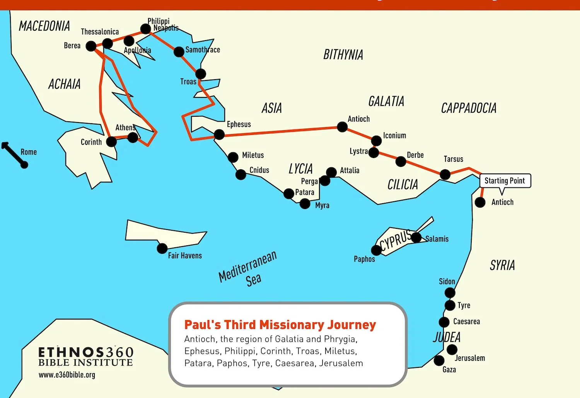

Slide 131
The Third Missionary Journey
On his third missionary journey Paul experiences a riot in the city of Ephesus. Acts 18: 23, marks the beginning of Paul’s third missionary journey. We read in “After spending some time in Antioch, Paul set out from there and traveled from place to place throughout the region of Galatia and Phrygia, strengthening all the disciples.” Then as you read on he came to Ephesus. Ephesus was his headquarters. Ephesus was a religious and commercial center in Asia. The temple of Diana was one of the seven wonders of the ancient world. It was a magnificent monument to idolatry. According to the legend, the image of Diana fell out of heaven on the spot where they had built the temple. Diana was the goddess of fertility and silversmiths made images of Diana, and then they sold them to visitors who came to the city. And people would buy these images or idols in hopes that Diana would bless them and bless their business, etc. Paul’s ministry in Ephesus was so effective that it undermined the ability of these silversmiths to make a living, and this started a riot.

Slide 132
Paul in Ephesus
Luke highlights three aspects of Paul’s ministry in Ephesus: he tells us about Paul’s encounter with the disciples of John the Baptizer; secondly, he gives us a very graphic account of Paul’s miracles in the city of Ephesus; and then he tells us about the riot that was started by a man named Demetrius.

Slide 133
Paul and the Disciples of John the Baptist
In Acts 19, Paul meets men who were disciples of John the Baptist, baptized in preparation for the Messiah but unaware of Jesus or the Holy Spirit. They likely had pre-Pentecost faith. Paul asks if they received the Holy Spirit; they haven't heard of it. They said they were baptized by John, which was a baptism of repentance. Paul then baptizes them in Jesus' name, and when he lays hands on them, the Holy Spirit comes, and they speak in tongues and prophecy. About twelve men are involved.

Slide 134
Interpreting this passage
This passage has specific features that shouldn't be generalized. Paul believed the Spirit was received at faith, not in a second step, and like Peter, he played a role in giving the Spirit to new believers, which shows his apostleship. However, this was a unique, historical event, not a standard practice today. Now, new Christians receive the Spirit upon believing in Jesus, not through later rites.
This is consistent with Luke’s message in Luke – Acts. He is consistently contrasting John the Baptist and Jesus. The distinction Luke draws is the Holy Spirit. Luke 3:15-21

Slide 135
Paul’s Miracles in Ephesus
Luke talks about Paul’s miracles. He tells us in verse 11 that “God did extraordinary miracles through Paul, so that even handkerchiefs and aprons that touched him were taken to the sick, and their illnesses were cured and the evil spirits left them.” The NIV translates the Greek “extraordinary miracles,” and the Greek expression indicates that these were exceptional, unusual miracles, even by biblical standards. Luke also makes it clear that these were supernatural events—supernatural acts and not simply magical tricks—because he tells us about some Jews who apparently witnessed Paul healing people in the name of the Lord Jesus. And so they tried to drive out evil spirits in the name of Jesus but instead, the spirit attacked these men—the seven sons of Sceva—and overpowered them and beat them up. “The spirit jumped on them, gave them such a beating that they ran out of the house naked and bleeding,” so it’s obvious from this particular contrast between Paul and these seven sons of Sceva that his power was supernatural and it was not merely a magician’s trick.

Slide 136
Paul and the Riot in Ephesus
Then, Luke tells us about the riot in the city of Ephesus. Demetrius, an influential silversmith, charged that Paul and his message posed a threat to Ephesus's economy. And he was able to stir up the silversmiths in the city of Ephesus so that they rioted. Verse 28 says that, “When they heard this, they were furious and began shouting: ‘Great is Artemis of the Ephesians!’ Soon the whole city was in an uproar.” It’s interesting that in the midst of what was potentially a dangerous situation, Paul saw this as an opportunity to speak for Christ. In verse 30 we read, “Paul wanted to appear before the crowd, but the disciples would not let him.” Apparently, they had better judgment than Paul did: “Even some of the officials of the province, friends of Paul, sent him a message begging him not to venture into the theater.”

Slide 137
Verse 32 tells us how bad this riot was: “The assembly was in confusion:
Some were shouting one thing, and some another. Most of the people did
not even know why they were there.” At the end of this passage the town
clerk, he argues for order, he says: “Men of Ephesus, doesn’t all the world
know that the city of Ephesus is the guardian of the temple of the great
Artemis and her image which fell from heaven? Therefore, since these facts
are undeniable, you ought to be quiet and not do anything rash.” He wasn’t
a defender of Christianity, he was interested in preserving peace. Paul’s
ministry in Ephesus is an example of what happens when Christianity
comes into contact with a secular society. The result can be explosive,
because Christianity calls for a radical change and commitment, it can’t be
business as usual. The gospel challenged religious and occultic powers at
Ephesus, and the gospel today will challenge established beliefs and
traditions.

Slide 138
Letters written from Ephesus
Paul was in Ephesus about three years on his third missionary journey. While he was in Ephesus, Paul wrote three epistles:
First Corinthians
Second Corinthians
Romans

Slide 139
Corinth
Corinth, in ancient Greece, was a city like Chicago. It was Greece's largest city, located on an isthmus connecting the mainland to the Peloponnesian Peninsula. Due to sailing dangers around the peninsula, cargo was unloaded and carried over land on the Corinthian isthmus. Corinth was also the home of the Isthmus Games; these were second only to the Olympian Games. Corinth was also infamous as a religious center. The temple of Aphrodite dominated the Corinthian skyscape. It stood on the top of an eight hundred foot mountain called the Acrocorinth. Aphrodite was the goddess of love and thousands of priestesses served in the temple as sacred prostitutes. In the evening, priestesses would descend on Corinth to sell sexual favors, making the city infamous for immorality. The verb “korinthiazomai”—meaning “to act like a Corinthian”—became associated with drunkenness and vice. A Greek proverb warned, “it’s not every man who can afford a journey to Corinth,” implying that the temptations there could lead to trouble.

Slide 140
Corinth
Barclay says this in his commentary about Paul’s ministry in Corinth: “In this hot bed of vice, in the most unlikely place in all the Greek world, some of the greatest work of Paul was done and some of the mightiest triumphs of Christianity were won.” So in spite of a hostile environment, an environment of immorality, Paul established a church in Corinth on his second missionary journey. And he wrote First Corinthians in response to a report from Chloe’s household that the Corinthian church was more under the influence of the world than under the influence of God’s Spirit.

Slide 141
I Corinthians
In the first part of the epistle, chapters 1 through 6, Paul writes to correct problems. As one commentator put it: “He wrote to correct disorders which the Corinthians took lightly but which he saw as grave sin.” And then in chapters 7 through 16 Paul wrote to answer questions. Chapter 7 verse 1 gives the transition from the first part of the epistle to the second; in 7:1 we read, “Now for matters you wrote about: It is good for a man not to marry.” And so then Paul continues on—chapters 7, 8, 9 and through 16—to answer questions that the Corinthians had asked about marriage and singleness, meat sacrificed to idols, public worship, the veiling of women, the Lord’s Supper, spiritual gifts, the resurrection, and he even writes in chapter 16 about the collection; apparently some of the Corinthians had some questions about the offering.

