Slide 1
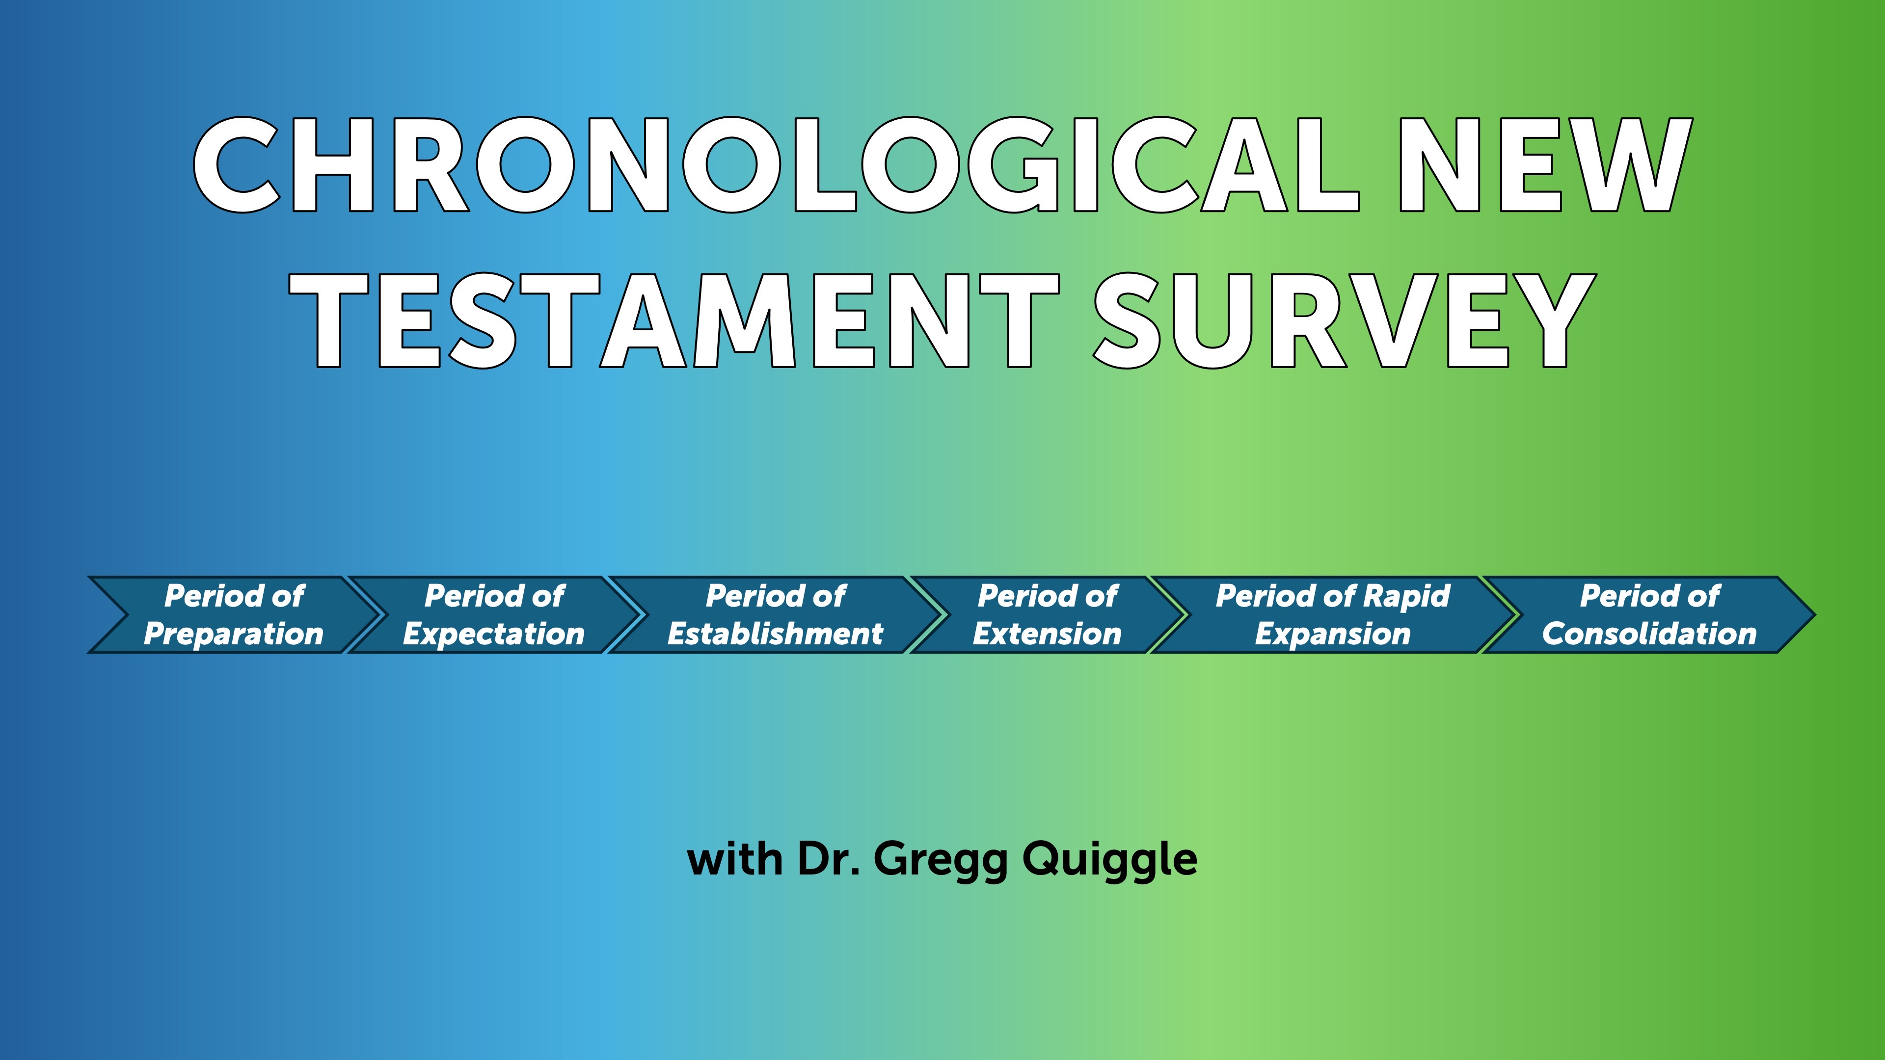

Slide 2
Six historical periods of the New Testament
Period of preparation. This is the period between the Testaments, sometimes referred to as the intertestamental period. It extends from the writing of Malachi, which was about 420 BC, to the birth of Christ, 5 BC. So there’s a period of about four hundred years between the Testaments, and during this period God was preparing the world for the coming of His Son. Scripture is Galatians 4:4
Period of expectation; this covers the life of Christ. The four Gospels tell us about Christ’s life and provide information about the period of expectation. Scripture is the Gospels
Period of establishment. This refers to the establishment or the birth of the church.
Scripture reference for this period is Acts 1:1 through 6:7.

Slide 3
Six Historical Periods of the New Testament
4. Period of extension: this is the period of the growth of the church as it began to extend itself out from Jerusalem to Judea and Samaria
Scripture reference for this period is Acts 6:8 to 9:31
5. Period of rapid expansion, and this includes Paul’s missionary journeys. The book of Acts ends with Paul’s Roman imprisonment—his first Roman imprisonment
Scripture reference for this is Acts chapter 9, verse 32, to the end of the book, chapter 28, verse 31
6. Period of consolidation, because the main intent in the writing of these epistles was to consolidate or to solidify the churches that had been started by Paul and other early Christians. These are books written after the period covered in the Book of Acts.
This is that period after the book of Acts. The dates for this would be approximately AD 62 to 95, the closing of the New Testament era.

Slide 4
Romans
Romans is the last of Paul’s journey epistles, Paul wrote it from Corinth, probably about AD 58. The origin of the church in Rome is a mystery. The Roman Catholic view that Peter started the church is unlikely. Peter is not mentioned in the epistle and it’s inconceivable that Paul would not mention him if he had a significant ministry in the church. Romans is the most doctrinal epistle in the New Testament. Apparently, an apostle had never taught the church at Rome so Paul wrote to provide the church with a comprehensive and systematic statement of the Christian faith.

Slide 5
Romans
Words like condemnation, justification, sanctification, glorification tend to scare us. We’re not sure what we mean, we’re not even sure we want to know what they mean. Consequently, many Christians, often tend to neglect the doctrinal aspects of Christianity. Doctrine is for the scholars, not the average Christian. Paul explodes that myth in this epistle. Paul explains the implications of Christ’s life, death, and resurrection for all humanity. Men and women, Paul writes, are alienated from God by sin, and Paul then makes it clear that what we believe—particularly about God and Christ—can make us right in the sight of God. That in turn will influence what we think about ourselves and the world around us. As one writer puts it: “Paul weaves together logic and the Old Testament scriptures to produce the premier document of Christian theology.”

Slide 6
Luther on Romans
This letter is truly the most important piece in the New Testament. It is purest Gospel. It is well worth a Christian’s while not only to memorize it word for word but also to occupy himself with it daily, as though it were the daily bread of the soul. It is impossible to read or to meditate on this letter too much or too well. The more one deals with it, the more precious it becomes and the better it tastes.

Slide 7
Calvin on Romans
In Calvin’s essay on the theme of Romans, he makes the point that, “If we have gained an understanding of this Epistle, we have an open door to all the most profound treasures of Scripture.” According to Calvin in the Book of Romans, we really do have the key to understand the whole Bible. If we understand Paul here and grasp his main point–“that we are justified by faith”–we will be able to navigate our way through much of the Old Testament, since Paul quotes over sixty passages from the Old Testament and alludes to a number of others. We will also understand the gospel as it is preached by the apostles. In fact, he claims, “if we understand this epistle we have a passage opened to us to the understanding of the whole of Scripture.”

Slide 8
Wesley and Romans
Wesley attended a Moravian service at Aldersgate Street on May 24, 1738. From his diary. “In the evening I went very unwillingly to a society in Aldersgate Street, where one was reading Luther’s preface to the Epistle to the Romans,” “About a quarter before nine, while he was describing the change which God works in the heart through faith in Christ, I felt my heart strangely warmed. I felt I did trust in Christ, Christ alone for salvation; and an assurance was given me that He had taken away my sins, even mine, and saved me from the law of sin and death.”

Slide 9
Outline of Romans
Condemnation, chapters 1:1-3:20, Paul argues all are condemned.
Justification, chapter 3:20-5:21, we’re justified by faith.
Sanctification, chapters 6-8, in Christ we are dead to sin.
Israel, chapters 9-11, an explanation concerning the nation Israel. He answers the question, “has Israel’s rejection of Christ frustrated God’s plan of salvation?”
Application, chapters 12-16, the key idea is living sacrifice.
So it’s condemnation—all; justification by faith; sanctification—dead to sin; explanation concerning the nation Israel and God’s wonderful plan of salvation; and then finally, application—Paul urges us to be living sacrifices.

Slide 10
Condemnation 1:1 – 3:20
“For in it the righteousness of God is revealed through faith for faith; as it is written, ‘The one who is righteous will live by faith.” 1:17.
Paul was proud of the gospel, because it was the power of God to save people from their sins by making them righteous—that is, making sinful men and women acceptable to a holy God. And this is accomplished by faith, by believing that Jesus Christ is God’s Son who died for our sins and now lives to give us new life.

Slide 11
Condemnation
Like a prosecuting attorney Paul builds his case, first against the idolatrous and the immoral, and then against the self-righteous, particularly the self-righteous Jew. Paul says you don’t have to be a rocket scientist to know that there is a God, God has made himself clearly known in creation. Yet instead of thoughtfully considering the evidence for God from what he has created, people foolishly and deliberately pervert the truth. And so, Paul says men and women choose to worship the gods that they have created rather than God the Creator, and Paul says that this is a tragic mistake, because they are without excuse. There is no justifiable reason for worshiping dumb lifeless idols rather than the Living God. (Remember he is writing this from Ephesus, where they had a riot about idols...)

Slide 12
Condemnation
So, Paul says God abandoned them—literally “gave them over”; three times he says God gave over people to their foolish choices. Men and women who reject God, then, become the victim of their depraved natures. In chapter 1, verse 24, we read these terrible words: “Therefore God gave them over in the sinful desires of their hearts to sexual impurity for the degrading of their bodies with one another. They exchanged the truth of God for a lie and worshiped and served created things rather than the Creator—who is forever praised. Amen.”

Slide 13
Condemnation
And then again in verse 26, he says, “Because of this, God gave them over to shameful lusts.” Paul’s warning couldn’t be clearer: people who don’t believe in the Living and the True God are without excuse. But secondly, Paul says we become like the god or gods we worship. If we worship God who is holy and righteous, then we will become holy and righteous. But if we worship idols fashioned like animals, then we will become animalistic in our behavior.

Slide 14
Condemnation
Secondly, Paul states that sin is far worse than people think. Not just the ungodly, but also religious and moral people fall short of God's glory. God is kind, tolerant, and patient, but not soft on sinners; He holds everyone accountable to His standards of truth and righteousness, judging impartially. In chapter 2, verse 11, he says, “For God does not show favoritism.” Paul refutes the self-righteousness and moral relativism of today. Americans value individual rights and freedom, but some abandon truth and absolute standards of right and wrong. Paul explains that even religious people, like the Jews, turn their assets into liabilities by trying to justify themselves and condemn others, ultimately causing their downfall. The problem isn’t lack of faith but lack of genuine faith—the only virtue needed for true righteousness with God.

Slide 15
Condemnation
Paul brings his argument to a conclusion in chapter 3, saying sin is lethal, and it has affected everyone. In chapter 3:9, he says, “What shall we conclude then? Are we any better?”—speaking of himself as a Jew—“Not at all! We have already made the charge that Jews and Gentiles alike are all under sin.” All, are sinners, even the self-righteous moralistic Jews are guilty. Now, Paul saw clearly the evil of humanity and the worthlessness of self-righteousness; however, Paul also saw clearly that God had a solution for the sin problem. Though people are great sinners, Jesus Christ is a greater Savior, and Paul turns to God’s solution for mankind’s problem in the next section.

Slide 16
Justification, chapter 3:20-5:21
In Christ, we are offered the joyful opportunity for justification. This is what sets Christianity apart in such a beautiful way from all other religions around the world. Every other faith typically teaches salvation through works—you have to earn it, almost like a do-it-yourself project. But Paul has already shown us that self-righteousness isn’t enough. Now, he’s going to share how we can truly attain God’s righteousness—a right standing with a holy God. In this part, he highlights two key principles: justification and faith.

Slide 17
Justification
Justification is a legal term that refers to God’s act of granting righteousness to sinful people. By his grace, God declares sinners righteous. Justification has two aspects: one negative and one positive. Negatively, God pardons guilty sinners by forgiving their sins and no longer holding them against them. Positively, he gives pardoned sinners the righteousness of Christ. A human judge or president may pardon a criminal, but that person still remains a pardoned criminal with a record. Human authorities can pardon, but they cannot justify. God, however, not only pardons sin but also provides righteousness. In that sense, justification is like a coin with two sides: pardon for guilt and the provision of righteousness.

Slide 18
Faith
However, there's an important detail to keep in mind. The provision is open to everyone, but not everyone will receive it. This naturally leads us to wonder: who does God justify? The answer is clear—He justifies only those who trust in Christ. In chapter 3, verses 21-34, Paul highlights the word “faith” eight times. Faith is a supernatural gift. It involves the totality of your being. It unites you to Christ. In chapter 3, verse 22, Paul writes: “This righteousness from God comes through faith in Jesus Christ to all who believe.” These are the ones who are justified—the ones who respond with faith to Jesus as their Savior. When someone does this, God clears their debt, makes things right, forgives their sins, and gives them His righteousness. This happens BECAUSE they are united to Christ, or as Paul says, “in Christ.”

Slide 19
Imputed or Alien righteous
We are never saved by “our righteousness.” Instead, we are saved by Christ’s righteousness that becomes ours by faith. By faith we are in Christ, and thus His righteousness becomes ours, and He takes on our sin and guilt. He paid for it, PARDON FOR GUILT. His righteousness becomes ours, PROVISION FOR RIGHTEOUSNESS.

Slide 20
Sinners saved by Faith
There are two kinds of people in the world: sinners and sinners. Some are justified by faith, and some are not.

Slide 21
New Perspective on Paul
The New Perspective on Paul argues that the traditional-Protestant understanding of justification is mistaken; rather than opposing works-righteousness, Paul is, according to the New Perspective, opposing Jewish boundary markers in the New Testament people of God. One standard view within the New Perspective on Paul is that initial justification is by faith and recognizes covenant status (ecclesiology), while final justification is partially by works, albeit works produced by the Spirit.
https://www.thegospelcoalition.org/essay/justification-new-perspective-paul/

Slide 22
New Perspective
According to them, Jewish systems of salvation were not based on works-righteousness but rather on covenantal nomism, the belief that one enters the people of God by grace and remains in it through obedience to the covenant. This means that Paul could not have been referring to works-righteousness by his phrase “works of the law”; instead, he was referring to Jewish boundary markers that made clear who was or was not within the people of God. These Jewish "boundary markers" (circumcision, dietary laws) excluded Gentiles. So, the issue was not works-righteousness, but inclusion in the covenant community. Jewish “boundary markers” were not the basis of whether or not you were in the community.
https://www.thegospelcoalition.org/essay/justification-new-perspective-paul/

Slide 23
N. T. Wright
The problem with this is how Wright defines justification. It has nothing to do with soteriology. As Wright has noted in his book, the Gospel message is strictly about the declaration that Christ is King. As a person recognizes this fact, they are included in the covenant and will remain in the covenant as long as they are faithful to the covenant and the commands of the King.
He sees Justification as functioning like a verdict in court: by acquitting someone, it confers on that person the status “righteous.” But how are we righteous? Are we made righteous by acknowledging Christ as King? The demons know this. Are we inherently righteous? Wright certainly would not agree with this (of course he doesn´t get into the issue of sin). So how are we acquitted and given the status of being righteous? Since Wight denies imputation, then the only way that God can acquit us is that we have done something to earn that status, ie; covenantal faithfulness.

Slide 24
Comments
I believe they are correct in saying salvation involves connection to the body of Christ – the community. It is not as individualistic as we make it out to be.
They are right about Paul attacking Jewish “boundary markers” as necessary conditions to be part of the community.
They fail to address the issue of righteousness. How are we actually righteous before God? I believe this is by imputed or alien righteousness.

Slide 25
Key texts
Ephesians 2:8–10; 2 Timothy 1:8–10; Titus 3:4–7 and Works Righteousness
On the surface, Ephesians 2:8–10; 2 Timothy 1:8–10; and Titus 3:4–7 contrast a grace soteriology with a works-righteousness soteriology. However, there is not much discussion of these three texts in pro-and-con New Perspective arguments in critical/liberal scholarship. Should not these texts be part of the analysis concerning justification in Romans, Galatians, and Philippians 3? Why are they not? Because in the critical/liberal world, most scholars believe Paul is not the author of Ephesians, 2 Timothy, and Titus.
https://www.thegospelcoalition.org/essay/justification-new-perspective-paul/

Slide 26
Key Texts
Even if they are right, AND I DO NOT AGREE WITH THEM, they undercut works-righteousness.

Slide 27
Sanctification – Chapters 6-8
It’s easy to see that, even though we follow Christ and have been saved from sin’s penalty, we still struggle against sin's power. As believers, we continue to face temptations similar to those faced by non-believers. So, as we explore this third part of Romans, sanctification. Two questions arise. First: Should a believer feel stuck in frustration due to repeated defeats by sin? And second: Is there any power that can help a Christian overcome sinful impulses? Paul addresses both of these questions in Romans chapters 6 and 7.

Slide 28
What is Sanctification?
Sanctification is the joyful journey where believers, once justified, progressively break free from sin and grow closer to God. It’s during this process that we discover the answers to our two questions. While justification has already freed us from the penalty of sin, many of us still face daily battles against its power. Even though we are made right with God, we still live in these imperfect bodies that can be tempted by our sinful nature. Fortunately, Paul shares with us the struggles we face and offers hope — reminding us that through Christ, we have been given victory over sin’s attempts to hold us back.

Slide 29
Chapter 6
In chapter 6, Paul explains that Christians must understand that their old life—before Christ—is over and dead, nailed to the cross. He asks if we should continue sinning to increase grace, and answers, "By no means! We died to sin; how can we live in it any longer?" Jesus' death and resurrection gave us a new life, transforming us from unbelievers to believers with new values and motives. Paul states we experience this new life through three responses: count, offer, and obey.

Slide 30
Count
First, in chapter 6, verse 11, he says: “In the same way, count yourselves dead to sin but alive to God in Christ Jesus.” When we see the word “count,” it means to depend on or trust in something completely. Think of expressions like “you can bank on it” or “you can count on it”—they show how sure we are about something. Similarly, we can and should confidently see ourselves as no longer under the power of sin. This means we can have full assurance that sin no longer controls us. So, the first practical step is to genuinely consider ourselves dead to sin, with absolute certainty.

Slide 31
Offer
In verse 13, Paul encourages us to dedicate ourselves to God. He reminds us not to use our bodies for sinful purposes, but instead to offer ourselves to God, who has brought us from death to life. This means making a mindful and ongoing choice to serve Christ. It can be helpful to start each day with a simple prayer, like saying, “Today I am a servant of Christ, and I will not let myself fall into sin.” By doing so, we dedicate the new day to serving Him and not succumbing to temptation.

Slide 32
Obey
And so, thirdly, he encourages us to obey God and not give in to sin. He reminds us that each day presents choices—like in verse 16: “Don’t you know that when you offer yourselves to someone to obey him as slaves, you are slaves to the one you obey—whether it’s sin, which leads to death, or obedience, which leads to righteousness?” The key practical step here—related to that important truth—is that as we face daily choices, we can choose to do what is right or to disobey. Because we are alive to sin but also dedicated to Christ as His servants, we have the power to say no to sin. We can confidently declare, “No, I don’t need to obey you,” and instead say yes to what’s right and pleasing to God. When we understand who we are in Christ and what He has called us to do, the answer to whether we must live forever frustrated by ongoing sin is clear: a wholehearted “No!”

Slide 33
Chapter 7 – The War Within
Paul describes feeling like a walking civil war, doing what he hates and not what he wants. So, must Christians always be frustrated by sin? The answer is no, because we’ve been crucified with Christ, making us dead to sin and able to obey God instead. Yet, Paul still struggles with sin's power, raising the question of whether there's a power that can free us. In chapter 7, verse 15, Paul says he doesn't understand his actions—doing what he hates. In verse 24, he laments, "Who will rescue me from this body of death?" But in verse 25, he thanks God through Jesus Christ; the answer is in Christ. Sin is strong, but Christ is stronger, and trusting in Him, we can be delivered.

Slide 34
Chapter 8
In chapter 8, Paul explains that the Holy Spirit is a powerful force in Christ, surpassing sin's influence. He states [v.1], “There is now no condemnation for those in Christ Jesus, because through Christ the law of the Spirit of life has set me free from the law of sin and death.” He notes that what the law couldn’t do, God accomplished through his Son. Paul gives three assurances from having the Spirit: first, the resurrection—“He who raised Jesus from the dead will also give life to our mortal bodies” [v.11]; second, adoption—believers are God’s children, not slaves to fear, but endowed with the Spirit of sonship, crying ‘Abba, Father,” and the Spirit testifies with our spirit [vs. 15-16]; third, future glorification—those predestined will be conformed to Christ’s likeness, called, justified, and glorified [vs. 29-30]. The answer to the second question is yes: there is a power more potent than sin—the Spirit within us, enabling victory not through effort but reliance on the Spirit.

Slide 35
Summarizing chapter 6-8
I think we can summarize chapters 3-[8] with three theological terms: justification, sanctification, and glorification. Justification delivers us from the penalty of sin, sanctification is the process by which we are being delivered from the power of sin, and in glorification, we will be delivered from the presence of sin. So, justification delivers from the penalty of sin, sanctification from the power of sin, and ultimate glorification from the presence of sin. That’s why Paul can close chapter 8 with such a wonderful and confident assurance, he says [vs. 37-39]: “Now in all these things we are more than conquerors through him who loved us. For I am convinced that neither death nor life, neither angels nor demons, neither the present nor the future, nor any powers, neither height nor depth, nor anything else in all creation, will be able to separate us from the love of God that is in Christ Jesus our Lord.”

Slide 36
Chapters 9 – 11 – The Problem of Israel
Paul thoughtfully brings up a profound question about Israel: has God turned away from Israel? The mystery of Israel’s rejection is deeply rooted in God's sovereign plan. Paul explains that in His sovereignty, God makes choices—He chose Isaac over Ishmael and Jacob over Esau. It’s understandable that our human hearts find this concept difficult; it can seem truly unfair.

Slide 37
Chapters 9 - 11
Why does God choose some people and not others? Paul doesn’t really answer that question directly. Instead, he reminds us that we, as finite humans, shouldn’t question God’s choices. It’s beyond our understanding to second-guess the actions of an infinite God. Even if God explained His plans and purposes, we might still find it hard to fully understand them. So, Paul then asks, does Israel’s rejection mean they have no future? His answer is no. He explains that because God is sovereign and wise, He has turned Israel’s unbelief into an opportunity to bring righteousness to everyone. Paul describes how, because of Israel’s unbelief, the Gentiles are like branches grafted into an olive tree. Instead of disrupting God’s plan of salvation, Israel’s unbelief has actually created a wider opportunity for more people to come to Christ.

Slide 38
Israel’s Future – “All Israel will be saved”
Many evangelical and dispensational scholars interpret "Israel" as the literal, ethnic nation of Israel. This view holds that, before the return of Christ, a future generation of the Jewish people will experience a widespread, national turning to God to accept Jesus as their Messiah
Another traditional interpretation, often rooted in Reformed theology, argues that "all Israel" does not refer to every single Jewish person. Instead, it means "all the elect of Israel"—referring to the cumulative total of Jewish people throughout history whom God has chosen to save. This aligns with Paul's earlier statement in Romans 9:6 that "not all who are descended from Israel are Israel."

Slide 39
Israel’s Future – “All Israel will be saved”
3. A third major perspective argues that "Israel" in this context refers to "spiritual Israel"—a unified body comprising both believing Jews and Gentiles (non-Jews) who are grafted together into one family of faith. In this view, "all Israel" refers to the complete, collective number of all God's chosen people, Jew and Gentile alike.

Slide 40
Conclusions
Regardless, anti-Semitism is wrong and it is on the rise!

Slide 41
John of Chrysostom, 344-407 CE
The strongest attacks on Jews and Judaism by the Church Fathers are to be found in the Homilies of Chrysostom (344-407 C.E.) in his Antioch sermons. He is considered to be among the most beloved and admired in Church history. His name translates in Greek as St. John the Golden Mouthed. His discourses were prompted by the fact that many Christians were meeting on friendly terms with Jews, visiting Jewish homes, and attending their synagogues. Chrysostom said: "The Jews sacrifice their children to Satan....they are worse than wild beasts. The synagogue is a brothel, a den of scoundrels, the temple of demons devoted to idolatrous cults, a criminal assembly of Jews, a place of meeting for the assassins of Christ, a house of ill fame, a dwelling of iniquity, a gulf and abyss of perdition."
"The Jews have fallen into a condition lower than the vilest animal. Debauchery and drunkenness have brought them to the level of the lusty goat and the pig. They know only one thing: to satisfy their stomachs, to get drunk, to kill, and beat each other up like stage villains and coachmen."
"The synagogue is a curse, obstinate in her error, she refuses to see or hear, she has deliberately perverted her judgment; she has extinguished with herself the light of the Holy Spirit."
Chrysostom further said that the Jews had become a degenerate race because of their "odious assassination of Christ for which crime there is no expiation possible, no indulgence, no pardon, and for which they will always be a people without a nation, enduring a servitude without end."
He elaborated further on God's punishment of the Jews:
"But it was men, says the Jew, who brought these misfortunes upon us, not God. On the contrary, it was in fact God who brought them about. If you attribute them to men, reflect again that even supposing men had dared, they could not have had the power to accomplish them, unless it had been God's will...Men would certainly not have made war unless God had permitted them...Is it not obvious that it was because God hated you and rejected you once for all?"
On another occasion Chrysostom is quoted as saying "I hate the Jews because they violate the Law. I hate the synagogue because it has the Law and the prophets. It is the duty of all Christians to hate the Jews."
Chrysostom's Homilies were to be used in seminaries and schools for centuries as model sermons, with the result that his message of hate would be passed down to succeeding generations of theologians. The nineteenth century Protestant cleric R. S. Storr called him "one of the most eloquent preachers who ever since apostolic times have brought to men the divine tidings of truth and love." A contemporary of Storr, the great theologian John Henry Cardinal Newman, described Chrysostom as a "bright, cheerful, gentle soul, a sensitive heart...

Slide 42
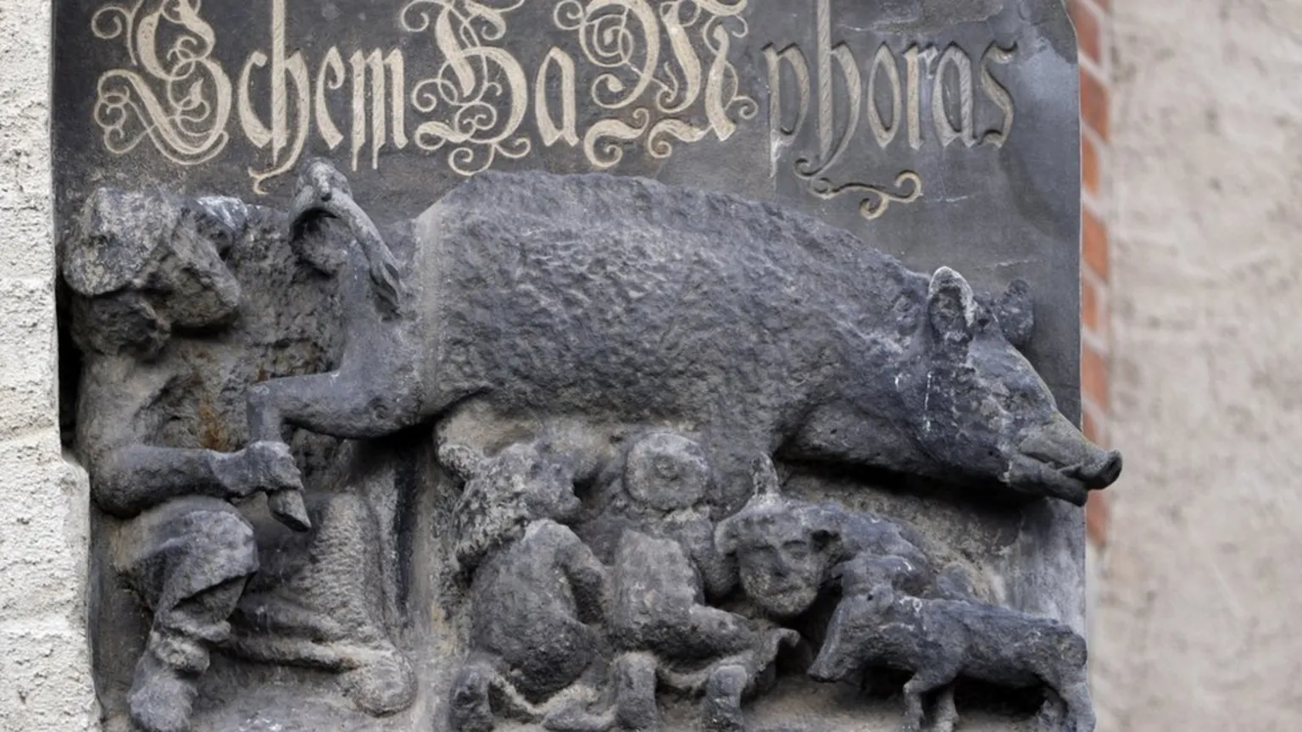

Slide 43
The Protocols
The Protocols of the Elders of Zion is an antisemitic hoax and forgery purporting to detail a Jewish plot for global domination. Largely plagiarized from several earlier sources, it was first published in Imperial Russia in 1903, translated into multiple languages, and disseminated internationally in the early part of the 20th century. It played a key part in popularizing belief in an international Jewish conspiracy.

Slide 44
The Protocols inspired many other books that promoted antisemitic conspiracy theories. Among the best known in the United States was Henry Ford’s The International Jew: The World’s Foremost Problem. Ford was the founder of the Ford Motor Company. He was one of the most famous and respected people in the United States by the 1920s. The International Jew was first serialized in Ford’s newspaper, The Dearborn Independent. It was quickly published as a book and translated into at least 16 languages, including German.

Slide 45
Egypt Trip – March 5 - 15
https://www.travelplanners4u.com/post/egypt-and-the-bible-and-early-christianity-march-2027
Sign up now! We are only taking 35!

