Slide 1

Genesis 12–13

Slide 2
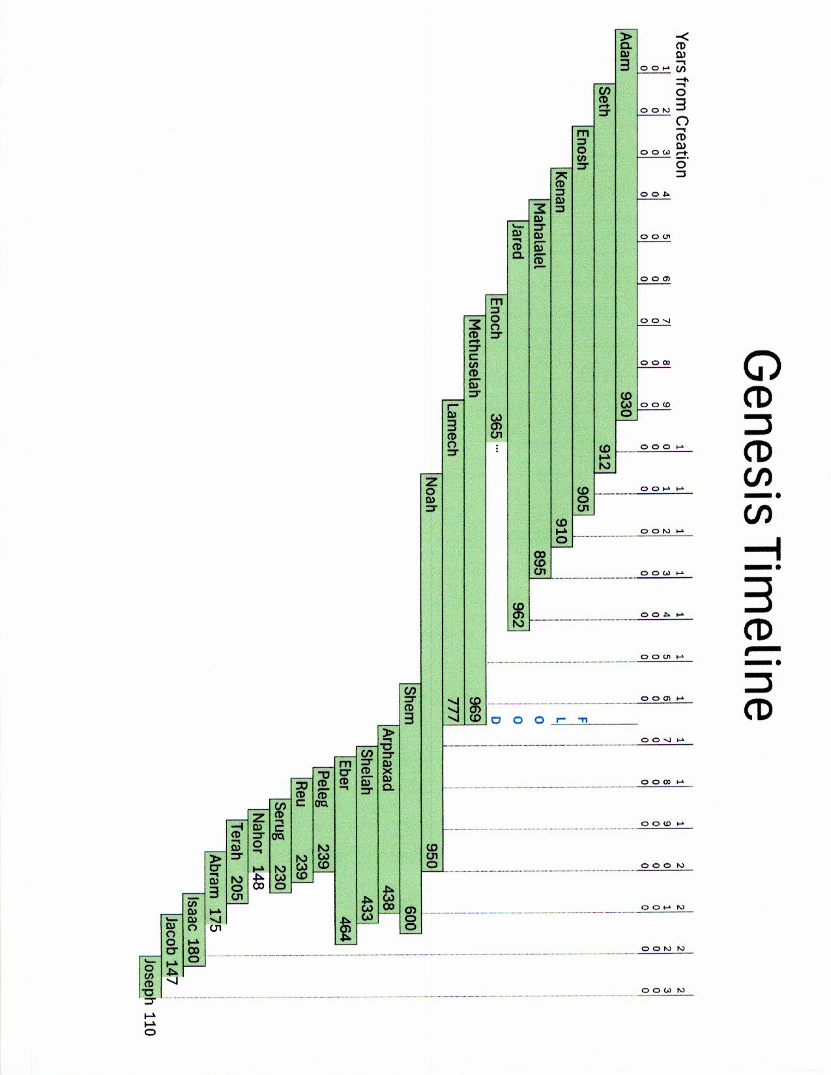
11 Chapters
19 Generations
2000 Years
39 Chapters
4 Generations
300 Years
Ch. 1 2 3 4 5 6 7 8 9 10 11 12 13 14 15 16 17 18 19 20 21 22 23 24 25 26 27 28 29 30 31 32 33 34 35 36 37 38 39 40 41 42 43 44 45 46 47 48 49 50
Abram / Abraham
Isaac
Jacob
Joseph

Slide 3

Genesis 12–13

Slide 4
Emotions

Slide 5
Observations
Who? What? Where? When? Why? How?
Repetitions: Words/Ideas
Connecting Words/Time Words
Comparisons/Contrasts
Surprises/Curious Details
.
.
.
.

Slide 6
Table Assignments
Genesis
12:1–5
12:6–9
12:10–13:4
13:5–13
13:14–18
Who are the main characters?
What is revealed about the main characters?
What is the flow of the narrative?
How does this episode flow from the previous episode into the next episode?
Is there anything surprising? Curious details? Missing details?
What is the author intending to communicate to his readers?
How does Christ illuminate the author’s message?

Slide 7
Themes

Slide 8
Abram’s Journey
Ur of the Chaldeans
Haran
God speaks to Abram
Canaan
Shechem (great tree of Moreh)
(Altar)
God speaks to Abram
between Bethel and Ai
(Altar)
Calls on the name of the Lord
toward the Negev
Egypt
Canaan
to the Negev
place to place
between Bethel and Ai
[Altar]
Calls on the name of the Lord
(Lot departs)
God speaks to Abram
Hebron (great trees of Mamre)
(Altar)

Slide 9
So What?
What is the author’s intended message?

Slide 10
Abram’s Journey
Ur of the Chaldeans
Haran
God speaks to Abram
Canaan
Shechem (great tree of Moreh)
(Altar)
God speaks to Abram
between Bethel and Ai
(Altar)
Calls on the name of the Lord
toward the Negev
Egypt
Canaan
to the Negev
place to place
between Bethel and Ai
[Altar]
Calls on the name of the Lord
(Lot departs)
God speaks to Abram
Hebron (great trees of Mamre)
(Altar)

Slide 11
So What?
What is the author’s intended message?
How does it fit in the Bible and connect to Christ?
How will it change the way you live?

Slide 12
Genesis 12–13

Slide 13
Interpreting Narrative
Listen to and appreciate the story.
Understand the overarching story.
Understand how the episodes connect.
Recognize the context of the story.
Ask questions about the details of the story.
Observe how characters change throughout the story.
Let the narrative guide your insights and application.
What is the author’s intended message?
How does it fit in the Bible and connect to Christ?
How should it affect us now?

