Slide 1
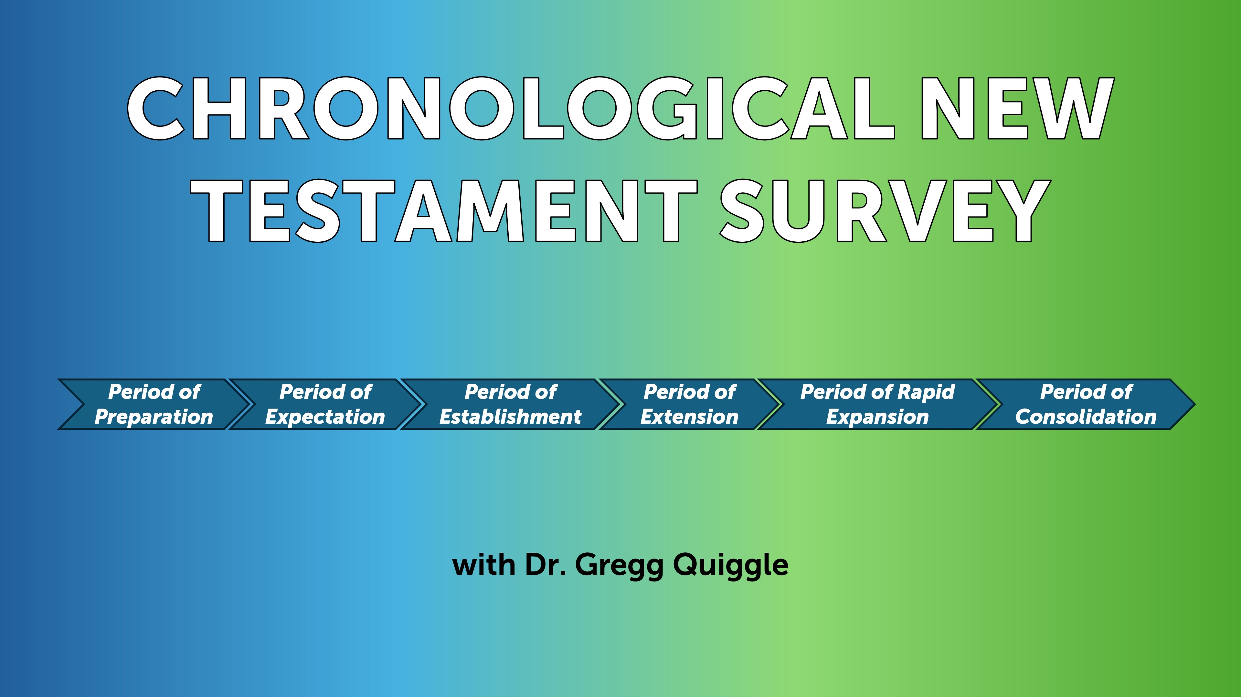

Slide 2
Romans
Romans is the last of Paul’s journey epistles, Paul wrote it from Corinth, probably about AD 58. The origin of the church in Rome is a mystery. The Roman Catholic view that Peter started the church is unlikely. Peter is not mentioned in the epistle and it’s inconceivable that Paul would not mention him if he had a significant ministry in the church. Romans is the most doctrinal epistle in the New Testament. Apparently, an apostle had never taught the church at Rome so Paul wrote to provide the church with a comprehensive and systematic statement of the Christian faith.

Slide 3
Romans
Words like condemnation, justification, sanctification, glorification tend to scare us. We’re not sure what we mean, we’re not even sure we want to know what they mean. Consequently, many Christians, often tend to neglect the doctrinal aspects of Christianity. Doctrine is for the scholars, not the average Christian. Paul explodes that myth in this epistle. Paul explains the implications of Christ’s life, death, and resurrection for all humanity. Men and women, Paul writes, are alienated from God by sin, and Paul then makes it clear that what we believe—particularly about God and Christ—can make us right in the sight of God. That in turn will influence what we think about ourselves and the world around us. As one writer puts it: “Paul weaves together logic and the Old Testament scriptures to produce the premier document of Christian theology.”

Slide 4
Luther on Romans
This letter is truly the most important piece in the New Testament. It is purest Gospel. It is well worth a Christian’s while not only to memorize it word for word but also to occupy himself with it daily, as though it were the daily bread of the soul. It is impossible to read or to meditate on this letter too much or too well. The more one deals with it, the more precious it becomes and the better it tastes.

Slide 5
Calvin on Romans
In Calvin’s essay on Romans, he makes the point that, “If we have gained an understanding of this Epistle, we have an open door to all the most profound treasures of Scripture.” According to Calvin, in Romans, we have the key to understand the whole Bible. If we grasp Paul –“that we are justified by faith”–we will be able to navigate our way through much of the Old Testament, since Paul quotes over sixty passages from the Old Testament and alludes to a number of others. We will also understand the gospel as it is preached by the apostles. In fact, he claims, “if we understand this epistle we have a passage opened to us to the understanding of the whole of Scripture.”

Slide 6
Wesley and Romans
Wesley attended a Moravian service at Aldersgate Street on May 24, 1738. From his diary. “In the evening I went very unwillingly to a society in Aldersgate Street, where one was reading Luther’s preface to the Epistle to the Romans,” “About a quarter before nine, while he was describing the change which God works in the heart through faith in Christ, I felt my heart strangely warmed. I felt I did trust in Christ, Christ alone for salvation; and an assurance was given me that He had taken away my sins, even mine, and saved me from the law of sin and death.”

Slide 7
Outline of Romans
Condemnation, chapters 1:1-3:20, Paul argues all are condemned.
Justification, chapter 3:20-5:21, we’re justified by faith.
Sanctification, chapters 6-8, in Christ we are dead to sin.
Israel, chapters 9-11, an explanation concerning the nation Israel. He answers the question, “has Israel’s rejection of Christ frustrated God’s plan of salvation?”
Application, chapters 12-16, the key idea is living sacrifice.
So, it’s condemnation—all; justification by faith; sanctification—dead to sin; explanation concerning the nation Israel and God’s wonderful plan of salvation; and then finally, application—Paul urges us to be living sacrifices.

Slide 8
Condemnation 1:1 – 3:20
“For in it the righteousness of God is revealed through faith for faith; as it is written, ‘The one who is righteous will live by faith.” 1:17.
Paul was proud of the gospel, because it was the power of God to save people from their sins by making them righteous—that is, making sinful men and women acceptable to a holy God. And this is accomplished by faith, by believing that Jesus Christ is God’s Son who died for our sins and now lives to give us new life.

Slide 9
Condemnation
Like a prosecuting attorney Paul builds his case, first against the idolatrous and the immoral, and then against the self-righteous, particularly the self-righteous Jew. Paul says you don’t have to be a rocket scientist to know that there is a God, God has made himself clearly known in creation. Yet instead of thoughtfully considering the evidence for God from what he has created, people foolishly and deliberately pervert the truth. And so, Paul says men and women choose to worship the gods that they have created rather than God the Creator, and Paul says that this is a tragic mistake, because they are without excuse. There is no justifiable reason for worshiping dumb lifeless idols rather than the Living God.

Slide 10
Condemnation
So, Paul says God abandoned them—literally “gave them over”; three times he says God gave over people to their foolish choices. Men and women who reject God, then, become the victim of their depraved natures. In chapter 1, verse 24, we read these terrible words: “Therefore God gave them over in the sinful desires of their hearts to sexual impurity for the degrading of their bodies with one another. They exchanged the truth of God for a lie and worshiped and served created things rather than the Creator—who is forever praised. Amen.”

Slide 11
Condemnation
And then again in verse 26, he says, “Because of this, God gave them over to shameful lusts.” Paul’s warning couldn’t be clearer: people who don’t believe in the Living and the True God are without excuse. But secondly, Paul says we become like the god or gods we worship. If we worship God who is holy and righteous, then we will become holy and righteous. But if we worship idols fashioned like animals, then we will become animalistic in our behavior.

Slide 12
Condemnation
Secondly, Paul states that sin is far worse than people think. Not just the ungodly, but also religious and moral people fall short of God's glory. God is kind, tolerant, and patient, but not soft on sinners; He holds everyone accountable to His standards of truth and righteousness, judging impartially. In chapter 2, verse 11, he says, “For God does not show favoritism.” Paul refutes the self-righteousness and moral relativism of today. Americans value individual rights and freedom, but some abandon truth and absolute standards of right and wrong. Paul explains that even religious people, like the Jews, turn their assets into liabilities by trying to justify themselves and condemn others, ultimately causing their downfall. The problem isn’t lack of faith but lack of genuine faith—the only virtue needed for true righteousness with God.

Slide 13
Condemnation
Paul brings his argument to a conclusion in chapter 3, saying sin is lethal, and it has affected everyone. In chapter 3:9, he says, “What shall we conclude then? Are we any better?”—speaking of himself as a Jew—“Not at all! We have already made the charge that Jews and Gentiles alike are all under sin.” All, are sinners, even the self-righteous moralistic Jews are guilty. Now, Paul saw clearly the evil of humanity and the worthlessness of self-righteousness; however, Paul also saw clearly that God had a solution for the sin problem. Though people are great sinners, Jesus Christ is a greater Savior, and Paul turns to God’s solution for mankind’s problem in the next section.

Slide 14
Justification, chapter 3:20-5:21
In Christ, we are offered the joyful opportunity for justification. This is what sets Christianity apart in such a beautiful way from all other religions around the world. Every other faith typically teaches salvation through works—you have to earn it, almost like a do-it-yourself project. But Paul has already shown us that self-righteousness isn’t enough. Now, he’s going to share how we can truly attain God’s righteousness—a right standing with a holy God. In this part, he highlights two key principles: justification and faith.

Slide 15
Justification
Justification is a legal term that refers to God’s act of granting righteousness to sinful people. By his grace, God declares sinners righteous. Justification has two aspects: one negative and one positive. Negatively, God pardons guilty sinners by forgiving their sins and no longer holding them against them. Positively, he gives pardoned sinners the righteousness of Christ. A human judge or president may pardon a criminal, but that person still remains a pardoned criminal with a record. Human authorities can pardon, but they cannot justify. God, however, not only pardons sin but also provides righteousness. In that sense, justification is like a coin with two sides: pardon for guilt and the provision of righteousness.

Slide 16
Faith
However, there's an important detail to keep in mind. The provision is open to everyone, but not everyone will receive it. This naturally leads us to wonder: who does God justify? The answer is clear—He justifies only those who trust in Christ. In chapter 3, verses 21-34, Paul highlights the word “faith” eight times. Faith is a supernatural gift. It involves the totality of your being. It unites you to Christ. In chapter 3, verse 22, Paul writes: “This righteousness from God comes through faith in Jesus Christ to all who believe.” These are the ones who are justified—the ones who respond with faith to Jesus as their Savior. When someone does this, God clears their debt, makes things right, forgives their sins, and gives them His righteousness. This happens BECAUSE they are united to Christ, or as Paul says, “in Christ.”

Slide 17
Imputed or Alien righteous
We are never saved by “our righteousness.” Instead, we are saved by Christ’s righteousness that becomes ours by faith. By faith we are in Christ, and thus His righteousness becomes ours, and He takes on our sin and guilt. He paid for it, PARDON FOR GUILT. His righteousness becomes ours, PROVISION FOR RIGHTEOUSNESS.

Slide 18
Sinners saved by Faith
There are two kinds of people in the world: sinners and sinners. Some are justified by faith, and some are not.

