Slide 1
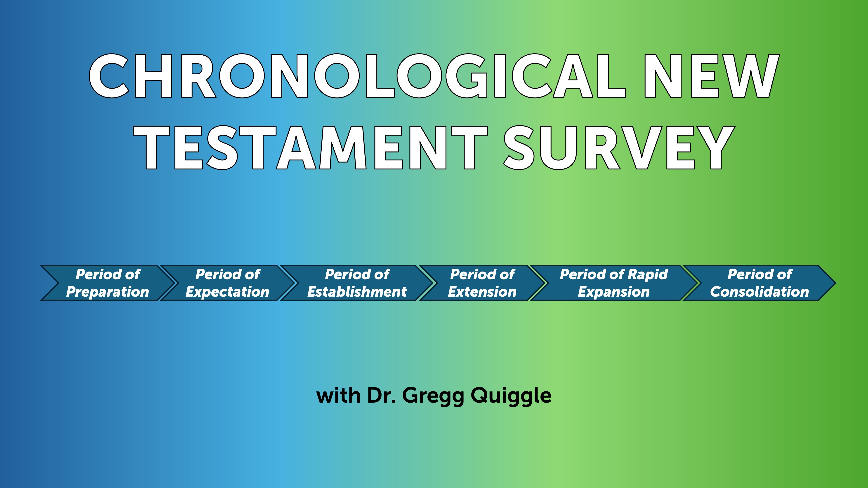

Slide 2
New Perspective on Paul
The New Perspective on Paul argues that the traditional-Protestant understanding of justification is mistaken; rather than opposing works-righteousness, Paul is, according to the New Perspective, opposing Jewish boundary markers in the New Testament people of God. One standard view within the New Perspective on Paul is that initial justification is by faith and recognizes covenant status (ecclesiology), while final justification is partially by works, albeit works produced by the Spirit.
https://www.thegospelcoalition.org/essay/justification-new-perspective-paul/

Slide 3
New Perspective
According to them, Jewish systems of salvation were not based on works-righteousness but rather on covenantal nomism, the belief that one enters the people of God by grace and remains in it through obedience to the covenant. This means that Paul could not have been referring to works-righteousness by his phrase “works of the law”; instead, he was referring to Jewish boundary markers that made clear who was or was not within the people of God. These Jewish "boundary markers" (circumcision, dietary laws) excluded Gentiles. So, the issue was not works-righteousness, but inclusion in the covenant community. Jewish “boundary markers” were not the basis of whether or not you were in the community.
https://www.thegospelcoalition.org/essay/justification-new-perspective-paul/

Slide 4
N. T. Wright
The problem with this is how Wright defines justification. It has nothing to do with soteriology. As Wright has noted in his book, the Gospel message is strictly about the declaration that Christ is King. As a person recognizes this fact, they are included in the covenant and will remain in the covenant as long as they are faithful to the covenant and the commands of the King.
He sees Justification as functioning like a verdict in court: by acquitting someone, it confers on that person the status “righteous.” But how are we righteous? Are we made righteous by acknowledging Christ as King? The demons know this. Are we inherently righteous? Wright certainly would not agree with this (of course he doesn´t get into the issue of sin). So how are we acquitted and given the status of being righteous? Since Wight denies imputation, then the only way that God can acquit us is that we have done something to earn that status, ie; covenantal faithfulness.

Slide 5
Comments
I believe they are correct in saying salvation involves connection to the body of Christ – the community. It is not as individualistic as we make it out to be.
They are right about Paul attacking Jewish “boundary markers” as necessary conditions to be part of the community.
They fail to address the issue of righteousness. How are we actually righteous before God? I believe this is by imputed or alien righteousness.

Slide 6
Key texts
Ephesians 2:8–10; 2 Timothy 1:8–10; Titus 3:4–7 and Works Righteousness
On the surface, Ephesians 2:8–10; 2 Timothy 1:8–10; and Titus 3:4–7 contrast a grace soteriology with a works-righteousness soteriology. However, there is not much discussion of these three texts in pro-and-con New Perspective arguments in critical/liberal scholarship. Should not these texts be part of the analysis concerning justification in Romans, Galatians, and Philippians 3? Why are they not? Because in the critical/liberal world, most scholars believe Paul is not the author of Ephesians, 2 Timothy, and Titus.
https://www.thegospelcoalition.org/essay/justification-new-perspective-paul/

Slide 7
Key Texts
Even if they are right, AND I DO NOT AGREE WITH THEM, they undercut works-righteousness regardless of who wrote them.

Slide 8
Sanctification – Chapters 6-8
It’s easy to see that, even though we follow Christ and have been saved from sin’s penalty, we still struggle against sin's power. As believers, we continue to face temptations similar to those faced by non-believers. So, as we explore this third part of Romans, sanctification. Two questions arise. First: Should a believer feel stuck in frustration due to repeated defeats by sin? And second: Is there any power that can help a Christian overcome sinful impulses? Paul addresses both of these questions in Romans chapters 6 and 7.

Slide 9
What is Sanctification?
Sanctification is the joyful journey where believers, once justified, progressively break free from sin and grow closer to God. It’s during this process that we discover the answers to our two questions. While justification has already freed us from the penalty of sin, many of us still face daily battles against its power. Even though we are made right with God, we still live in these imperfect bodies that can be tempted by our sinful nature. Fortunately, Paul shares with us the struggles we face and offers hope — reminding us that through Christ, we have been given victory over sin’s attempts to hold us back.

Slide 10
Chapter 6
In chapter 6, Paul explains that Christians must understand that their old life—before Christ—is over and dead, nailed to the cross. He asks if we should continue sinning to increase grace, and answers, "By no means! We died to sin; how can we live in it any longer?" Jesus' death and resurrection gave us a new life, transforming us from unbelievers to believers with new values and motives. Paul states we experience this new life through three responses: count, offer, and obey.

Slide 11
Count
First, in chapter 6, verse 11, he says: “In the same way, count yourselves dead to sin but alive to God in Christ Jesus.” When we see the word “count,” it means to depend on or trust in something completely. Think of expressions like “you can bank on it” or “you can count on it”—they show how sure we are about something. Similarly, we can and should confidently see ourselves as no longer under the power of sin. This means we can have full assurance that sin no longer controls us. So, the first practical step is to genuinely consider ourselves dead to sin, with absolute certainty.

Slide 12
Offer
In verse 13, Paul encourages us to dedicate ourselves to God. He reminds us not to use our bodies for sinful purposes, but instead to offer ourselves to God, who has brought us from death to life. This means making a mindful and ongoing choice to serve Christ. It can be helpful to start each day with a simple prayer, like saying, “Today I am a servant of Christ, and I will not let myself fall into sin.” By doing so, we dedicate the new day to serving Him and not succumbing to temptation.

Slide 13
Obey
And so, thirdly, he encourages us to obey God and not give in to sin. He reminds us that each day presents choices—like in verse 16: “Don’t you know that when you offer yourselves to someone to obey him as slaves, you are slaves to the one you obey—whether it’s sin, which leads to death, or obedience, which leads to righteousness?” The key practical step here—related to that important truth—is that as we face daily choices, we can choose to do what is right or to disobey. Because we are alive to sin but also dedicated to Christ as His servants, we have the power to say no to sin. We can confidently declare, “No, I don’t need to obey you,” and instead say yes to what’s right and pleasing to God. When we understand who we are in Christ and what He has called us to do, the answer to whether we must live forever frustrated by ongoing sin is clear: a wholehearted “No!”

Slide 14
Chapter 7 – The War Within
Paul describes feeling like a walking civil war, doing what he hates and not what he wants. So, must Christians always be frustrated by sin? The answer is no, because we’ve been crucified with Christ, making us dead to sin and able to obey God instead. Yet, Paul still struggles with sin's power, raising the question of whether there's a power that can free us. In chapter 7, verse 15, Paul says he doesn't understand his actions—doing what he hates. In verse 24, he laments, "Who will rescue me from this body of death?" But in verse 25, he thanks God through Jesus Christ; the answer is in Christ. Sin is strong, but Christ is stronger, and trusting in Him, we can be delivered.

