Slide 1
Chronological Survey of the New Testament
A quick recap…
Just a reminder, I am indebted to Dr. Bill Marty (MBI emeritus) for the structure and some of the content

Slide 2
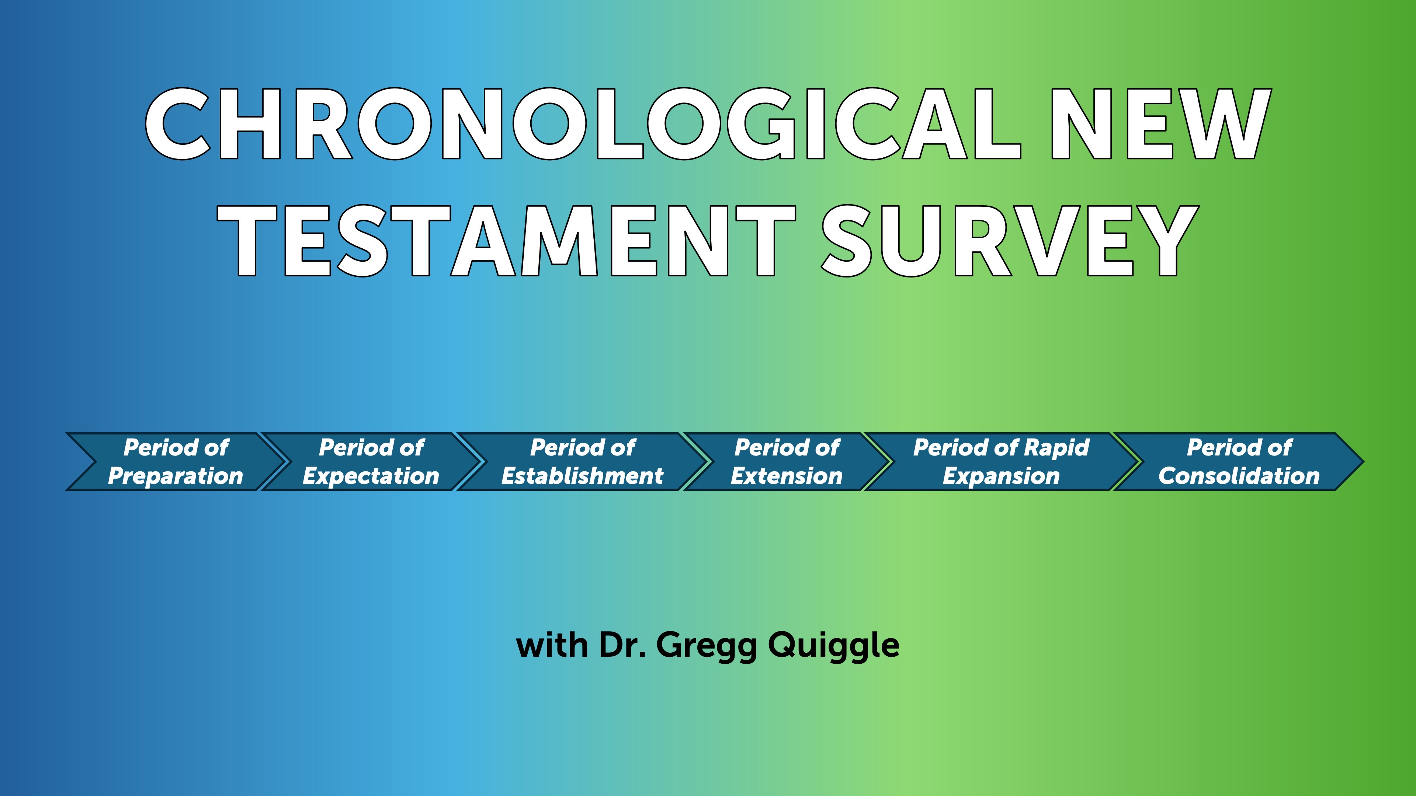

Slide 3
New Testament Books
There are 27 books divided into two broad divisions: history and epistles.
There are five books of history in the New Testament. These books give us the story line. The five books of history are the four gospels: Matthew, Mark, Luke and John. And they record the story of Jesus Christ. The fifth historical book is Acts. Acts gives the record of the birth and the growth of the church, the most important institution that was ever formed.
We have twenty-two epistles from Romans to Revelation.
  What is an epistle? An epistle is a letter written to either a church or an individual.

Slide 4
Epistles
We can also divide the Epistles into two categories.
We have “Paul’s Epistles” and then what we call the “General Epistles.”
If you take the view that Paul did not write the book of Hebrews, then there are thirteen epistles in the New Testament which were written by Paul. They are Romans, First and Second Corinthians, Galatians, Ephesians, Philippians, Colossians, First and Second Thessalonians, First and Second Timothy, Titus and Philemon.
Then we have nine general epistles: Hebrews; James; First and Second Peter; First, Second and Third John; Jude and Revelation. These books are called “General Epistles” because they were written to the churches generally rather than to a specific local congregation.

Slide 5
Pauline vs General - Illustration
PAULINE - First Thessalonians chapter 1. Paul says, “Paul, Silas, and Timothy, to the church of the Thessalonians in God the Father and the Lord Jesus Christ.” To a specific church.
GENERAL - First Peter, he begins his epistle, “Peter, an apostle of Jesus Christ, to God’s elect, strangers in the world, scattered throughout Pontus, Galatia, Cappadocia, Asia, and Bithynia.” To Churches generally.

Slide 6
Storyline of New Testament
In the four gospels, we read about Jesus’ birth, his wonderful life, his sacrificial death, and his amazing resurrection. Acts continues the story of the resurrected Christ. In the book of Acts, we read about the outpouring of God’s Spirit, and then the birth and the growth of the church. The Epistles tell us about our privileges and responsibilities as members of the body of Christ. Revelation, the last book in the New Testament, reveals what the future holds. God has a plan, and history is moving toward a climactic conclusion when the Lord Jesus Christ will return and establish his rule over all the universe.

Slide 7
Chronological Approach
Why?
It is helpful to place the books of the New Testament in their historical periods, and this arrangement will help us understand each book in its historical and cultural context.

Slide 8
Six historical periods of the New Testament
Period of preparation. This is the period between the Testaments, sometimes referred to as the intertestamental period. It extends from the writing of Malachi, which was about 420 BC, to the birth of Christ, 5 BC. So, there’s a period of about four hundred years between the Testaments, and during this period God was preparing the world for the coming of His Son. Scripture is Galatians 4:4
Period of expectation; this covers the life of Christ. The four Gospels tell us about Christ’s life and provide information about the period of expectation. Scripture is the Gospels
Period of establishment. This refers to the establishment or the birth of the church.
Scripture reference for this period is Acts 1:1 through 6:7.

Slide 9
Six Historical Periods of the New Testament
4. Period of extension: this is the period of the growth of the church as it began to extend itself out from Jerusalem to Judea and Samaria
Scripture reference for this period is Acts 6:8 to 9:31
5. Period of rapid expansion, and this includes Paul’s missionary journeys. The book of Acts ends with Paul’s Roman imprisonment—his first Roman imprisonment
Scripture reference for this is Acts chapter 9, verse 32, to the end of the book, chapter 28, verse 31
6. Period of consolidation, because the main intent in the writing of these epistles was to consolidate or to solidify the churches that had been started by Paul and other early Christians. These are books written after the period covered in the Book of Acts.
This is that period after the book of Acts. The dates for this would be approximately AD 62 to 95, the closing of the New Testament era.

Slide 10
Period of Preparation
Malachi to the birth of Christ and the ministry of John the Baptist.

Slide 11
Key Text John chapter 9
Read chapter see especially verse 16. THEY ARE MORE CONCERNED WITH RITUAL THAN RELATIONSHIP. THEY ARE SPIRITUALLY BLIND.

Slide 12
Conclusion
Galatians 4:4—“But when the time had fully come, God sent His Son,”
Paul tells us in this verse that God controls history, and even though He wasn’t speaking through a prophet in the period between the two Testaments, God was at work. He controlled nations so that at the strategic time in history, His Son came into the world as Savior. This is the period of PREPARATION.

Slide 13
Period of expectation
This covers the life of Christ. The four Gospels tell us about Christ’s life and provide information about the period of expectation. Scripture is the Gospels

Slide 14
Summary of each of the Gospels
1. Matthew presents Jesus as the Jewish Messiah, the fulfillment of Old Testament hopes.
2. Mark portrays him as the suffering Son of God, who offers himself as a sacrifice for sins.
3. Luke’s Jesus is the Savior for all people, who brings salvation to all nations and people groups.
4. In John, Jesus is the eternal Son of God, the self-revelation of God the Father.
Having four gospels gives us a deeper, more profound understanding of who Jesus is and what he did. Source - https://zondervanacademic.com/blog/gospel-definition

Slide 15
Summary of the Four Gospels – appeal for modern readers
The four gospels may appeal to four different modern readers
Matthew would appeal to the religious person, the religious seeker.
Mark, who focuses on Jesus’ works, would appeal to the practical person, the pragmatic man or woman.
Luke presents Jesus Christ as the ideal perfect man and would appeal to the idealist who is looking for perfection
John writes about Christ in such a way that it challenged the intellect and appeals to the heart. So, if you are theological or philosophical in nature, it’s a gospel that would appeal to you.

Slide 16
Application – Studying the Gospels
1. Remember the purpose and audience of the book
2. Why did the author pick this story and how does it fit with the overall story? The INDIVIDUAL story needs to be understood in light of the OVERALL story!

Slide 17
Conclusion of Unit number #2
In Matthew chapter 16:18, Christ made a statement that changed the course of history. “And I tell you that you are Peter, and on this rock I will build my church, and the gates of Hades will not overcome it”
Christ said he would build his church, and hell's gates would not prevail against it. We'll explore the church's beginning—a movement so strong that even hell can't stop it. Over two thousand years, Christ’s promise proves true. Why is the church so powerful? What drives its enduring strength?
Unit # 3 - The “Establishment of the Church.” We will focus will be on the birth and the growth of the church in Jerusalem.

Slide 18
The Period of Establishment
Unit # 3 - The “establishment of the church.” We will focus will be on the birth and the growth of the church in Jerusalem.

Slide 19
The Period of Establishment
We move into the third historical period in our survey of the New Testament. This is the “establishment of the church.” In this period, the focus will be on the birth and the growth of the church in Jerusalem.
Scripture reference for this period is Acts 1:1 through 6:7.

Slide 20
The Book of Acts
The full title is ”The Acts of the Apostles,” but I think it is better thought of as “The Acts of the Holy Spirit through the Apostles.” It is not really a story about humans; it is the story of the third person of the Trinity as He works with humans, and His work is to glorify Christ. So, in that sense, it is an extension of the Gospels. The continuing work of Christ through the Holy Spirit.

Slide 21
The Pattern of Establishment
These Chapters will show a consistent pattern
Luke explains to us how the church overcame a series of threats. The pattern for the opposition is external, internal, external, internal. What I mean by that is the church was threatened externally with persecution, and it was jeopardized internally by problems within the body of Christ.

Slide 22
The Period of EXTENSION
The scripture references for that period are Acts 6:8 through Acts 9:31. In this section in the book of Acts, Luke turns his inspired spotlight on three men: Stephen, Philip and Saul. Stephen preaches a powerful sermon to his countrymen in Jerusalem. Philip, who was one of those seven deacons, is driven by persecution to Samaria and he preaches the gospel in Samaria, which was a very bold step for the early believers. Saul, who at this point is not a Christian or a follower of Christ, is miraculously converted on the road to Damascus and then he’s commissioned to take the gospel to the Gentiles. So, Stephen preaches to the Jews, Philip proclaims the gospel to the Samaritans, and Saul is saved and commissioned to take the gospel to the Gentiles.

Slide 23
Epistle during this period - James
During the period of establishment we saw the birth and the growth of the church. Now in the period of extension of the church moves into Judea and Samaria. We’re looking at the epistles in their chronological order.
The first epistle, James, written during this period of extension. Written approximately AD 50, the context is the aftermath of the stoning of Stephen. Acts 8:1, “And Saul approved of their killing him. On that day a great persecution broke out against the church in Jerusalem, and all except the apostles were scattered throughout Judea and Samaria.” James 1:1, James, a servant of God and of the Lord Jesus Christ, To the twelve tribes scattered among the nations: Greetings. Consider it pure joy, my brothers and sisters,^{[a]} whenever you face trials of many kinds . . .” Primarily Jewish Christians.

Slide 24
James – it’s goal
The first followers of Christ faced a variety of problems: persecution, criticism, discrimination, slander, and false teaching. They needed to know wisdom to respond to these situations. Today we face the similar problems; so we can benefit from the teaching of James.
The key verses for the book of James is 1:19, 20. “You must understand this, my beloved: let everyone be quick to listen, slow to speak, slow to anger; for your anger does not produce God’s righteousness”
The goal of the book is to help us understand how God works in us to produce righteousness

Slide 25
The Period of RAPID EXPANSION
During this period, the church experienced unprecedented growth. Paul made three missionary journeys into the Roman provinces of Galatia, Macedonia, and Achaia, and on his third journey, he went to Asia Minor. He established churches in these areas, revisited them, and wrote epistles to them to strengthen their faith in Christ. The epistles Paul wrote during the period of expansion could be called “the journey epistles,” because they were written while he was on his missionary journeys.

Slide 26
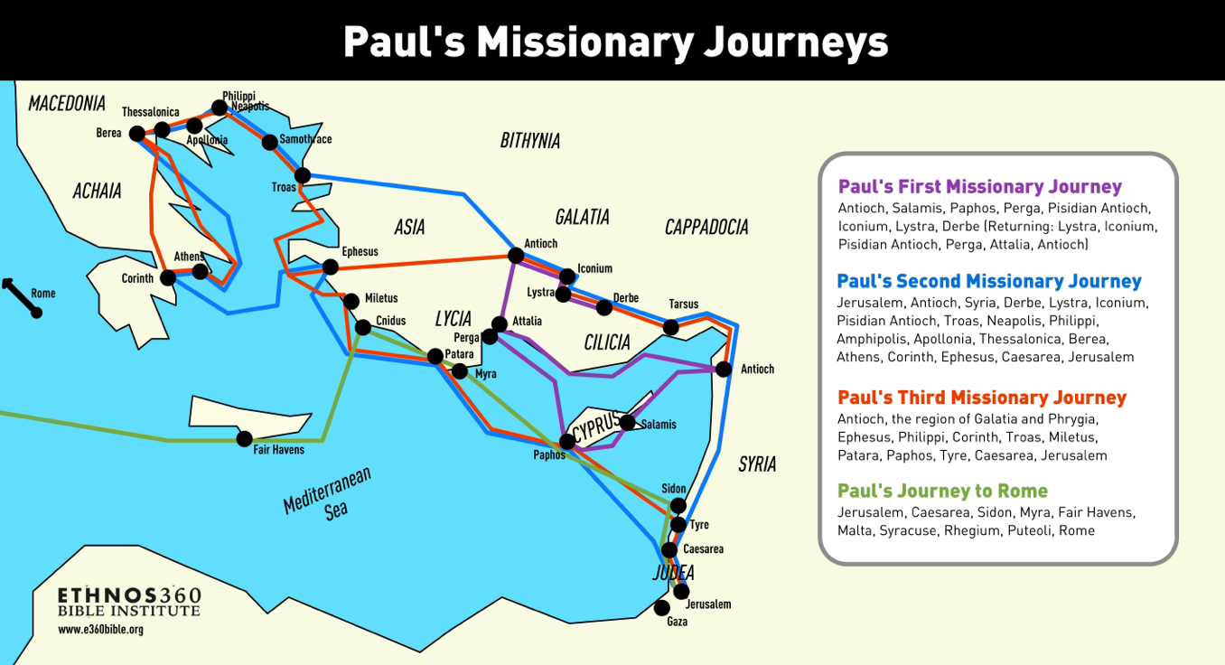

Slide 27
The Period of RAPID EXPANSION
After his first journey, Paul wrote one epistle, the epistle to the Galatians. On his second journey, he wrote First and Second Thessalonians. On his third journey, Paul wrote First Corinthians, Second Corinthians, and Romans. So, it’s very easy to remember the chronological order of these epistles if you relate them to Paul’s missionary journeys. On the first journey, he wrote one epistle: Galatians; on the second journey, he wrote two: First and Second Thessalonians; and on the third journey, he wrote three epistles: First and Second Corinthians and Romans.

Slide 28
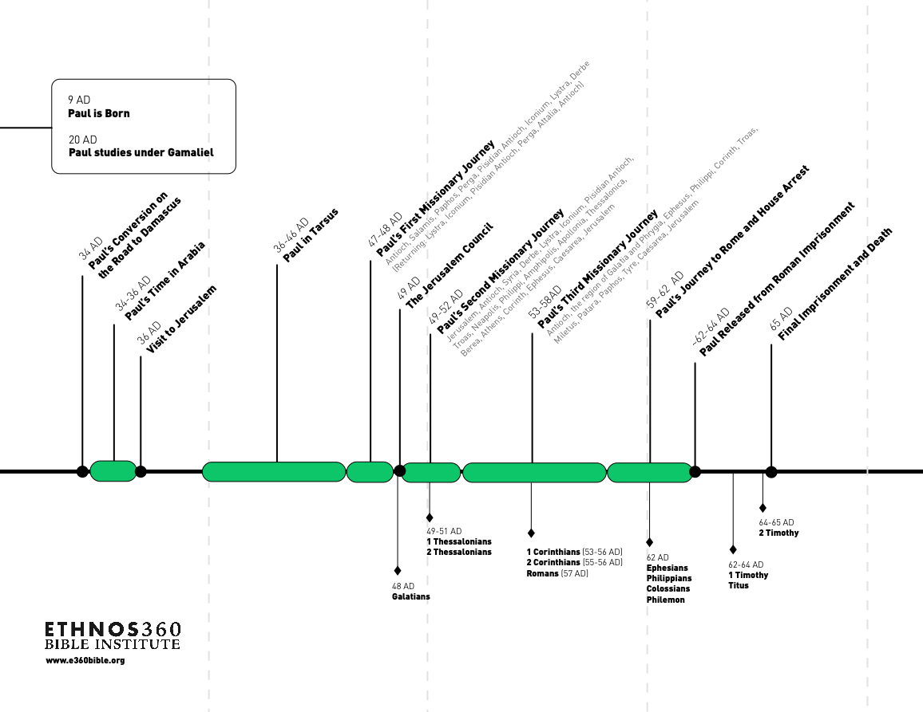
1
https://www.youtube.com/watch?v=L61xmwEEIgc&t=16s

Slide 29
Summary of the Journeys
Surprisingly, most converts were Gentiles, not Jews. This will create major problems that threaten the Church. Specifically, how much of the First Testament ritual and practice MUST Christians continue to practice? Does following Christ mean rejecting Jewish practice? What about the Law? Must you be circumcised to be saved? What about dietary laws? Remember, to Jews, Gentiles were considered unclean, idolatrous, and often morally corrupt (see Deut. 7:1 — 6; Lev. 20:22 — 26).

Slide 30
In our study, we have reached the last of Paul’s epistles, Romans. So, let’s return to that letter.

