Slide 1
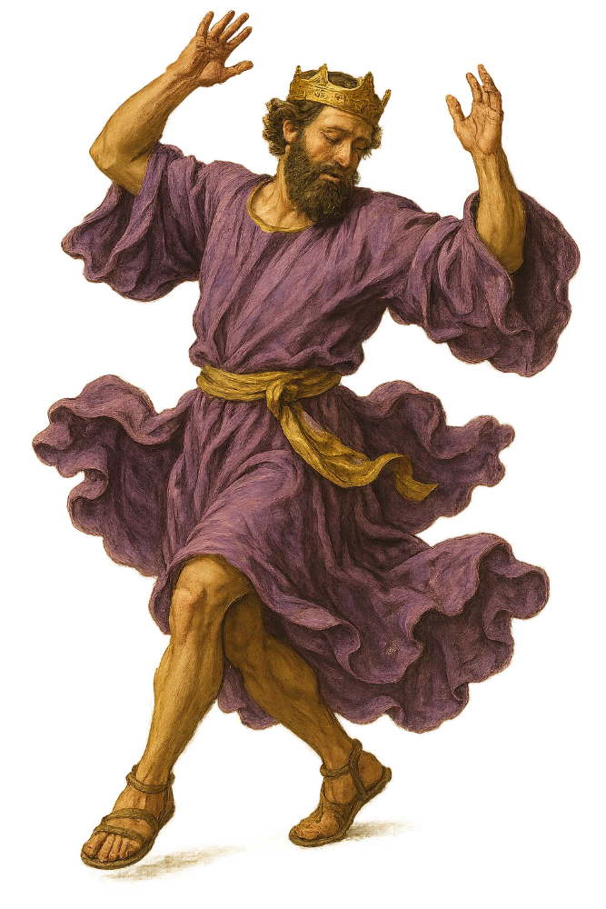
“Dancing with David”
The King after God’s Own Mind
Daniel I. Block
Veritas Community
College Church
September 20, 2026

Slide 2
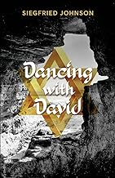
A. The Inspiration for the Title
Hot Springs AR
2023

Slide 3
The Inspiration for the Title
Hot Springs AR
2023
1 Chronicles 15:29

Slide 4
David danced before the Lord
And as the ark of the covenant of YHWH came to the city of David, Michal the daughter of Saul looked out of the window and saw King David dancing and celebrating, and she despised him in her heart.
2 Samuel 6:13–14

Slide 5
¹³When those carrying the ark of YHWH took six steps, he [David] sacrificed a bull and a fattened calf. . . ¹⁴By the way David was dancing with all (his) strength before YHWH. David was wearing a linen ephod. ¹⁵David and all the house of Israel were bringing up the ark of YHWH with a shout and a trumpet sound. . . . ¹⁶And as the ark of YHWH was entering the city of David. . . By the way Michal, Saul’s daughter, was looking down through the window. . . . she [Michal] saw the king, David, jumping and dancing before YHWH, and she despised him in her heart.

Slide 6
Dancing in the Psalms
Psalm 30:11 (ESV)
“You have turned for me my mourning into dancing;
you have loosed my sackcloth
and clothed me with gladness,”
Psalm 149:3 (ESV)
“Let them praise his name with dancing,
making melody to him with hand drum and lyre!”
Psalm 150:4 (ESV)
“Praise him with hand drum and dance;
praise him with strings and pipe!”

Slide 7
The Inspiration for the Title
Hot Springs AK
2023
1 Samuel 13:13–14

Slide 8
1 Samuel 13:13–14
¹³ Samuel said to Saul, "You have acted foolishly. You have not fulfilled (שָׁמַר) the charge of YHWH your God, which he laid on you. Surely YHWH would have established (הֵכִין) your kingdom over Israel forever (עַד עוֹלָם).
¹⁴ But now your kingdom shall not endure. YHWH has sought out (בִּקֵּשׁ) a man after his own heart/mind (כִּלְבָבוֹ), and YHWH has charged him to be prince (נַגִיד) over his people, because you have not fulfilled the charge that YHWH has laid on you.”

Slide 9
David was the man after God’s own heart.
This did not mean primarily that he was a man with a heart like God’s [which he largely had], but that he was the person whom YHWH had in mind (לֵב) from the beginning to be Israel’s king.
How do we know this?

Slide 10
B. David’s Place in God’s Grand Program of Redemption
Since the covenant involving YHWH, the land of Canaan, and Israel served as a microcosm of the covenant involving God, the cosmos, and all living things, then we could expect that God’s covenant with David would be a microcosm of his covenantal relationship with Adam.

Slide 11
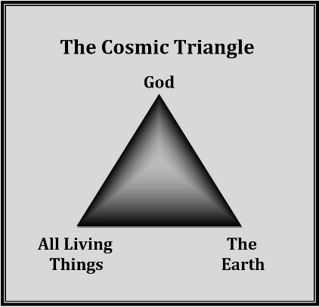
The Relationship between the Divine Creator and His Creation

Slide 12
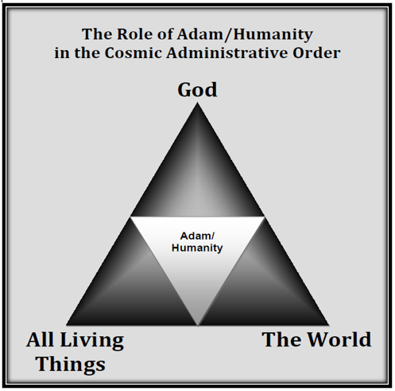
The Royal Link between the Divine Creator and His Creation

Slide 13
Just as God appointed Adam/humanity to supervise and promote the smooth operation of the triangular cosmic economy, so he appointed David and his heirs as administrators of the Israelite economy.

Slide 14
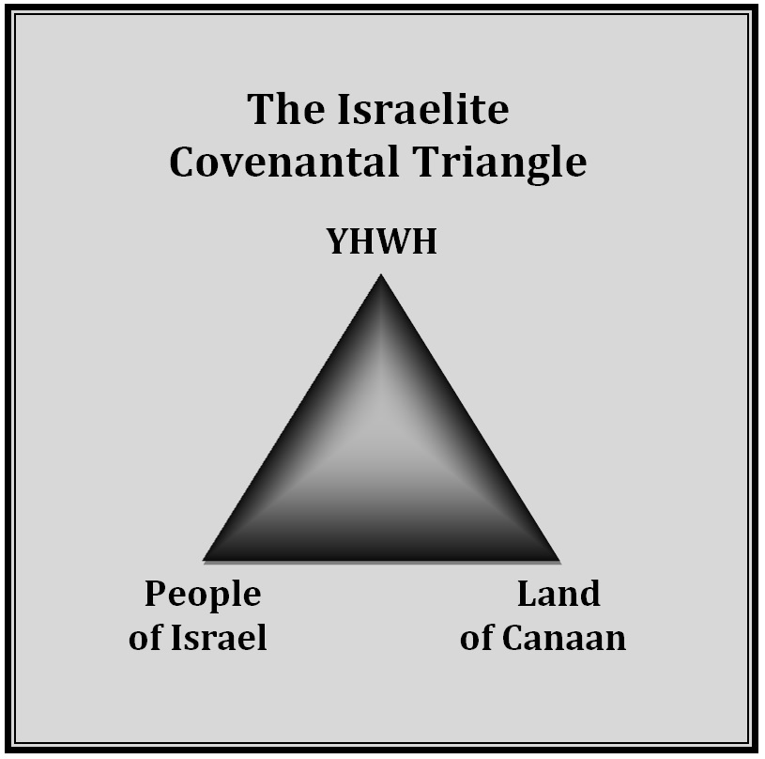
The Relationship
between YHWH
and Israel

Slide 15
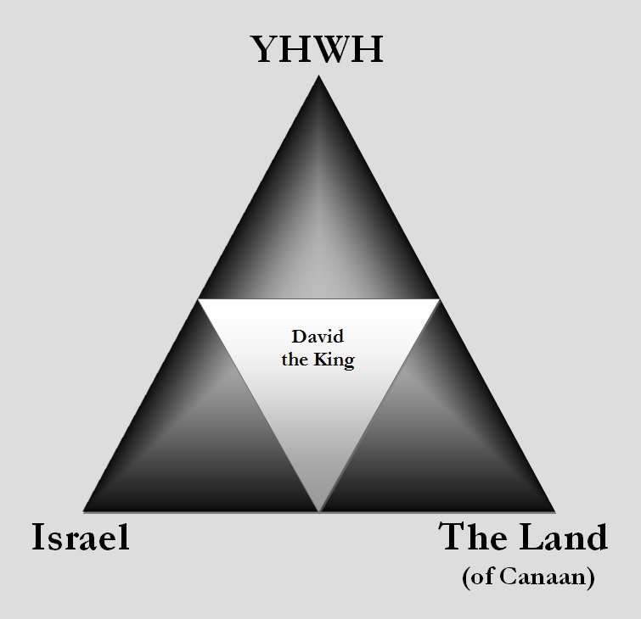
The Royal Link between YHWH
and Israel

Slide 16
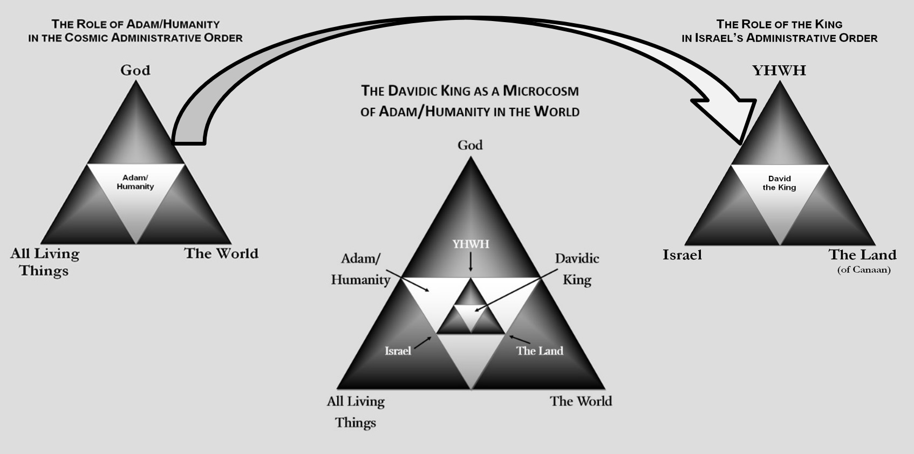
Introduction
David’s Place in God’s Covenantal Program

Slide 17
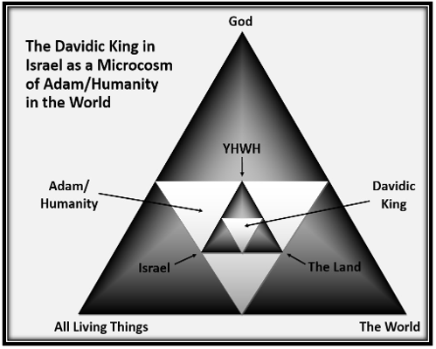

Slide 18
B. Precursors to/Premonitions of the Rise of David
1. In the Patriarchal Stage of the Israelite Covenant
Genesis 17:6
I will make you exceedingly prolific, and I will make you into nations (לְגוֹיִם), and kings (מְלָכִים) shall come from you.

Slide 19
Genesis 22:17–18
¹⁷ I will surely bless you, and I will surely multiply your descendants (זֶרַע) as the stars of heaven and as the sand on the seashore.
And your descendant (זֶרַע) shall possess (וְיִרַשׁ) the gate of his enemies (אֹיְבָיו), ¹⁸ and in your descendant (זֶרַע) shall all the nations of the earth be blessed, because you have listened to my voice.

Slide 20
Genesis 24:60
And [Rebekah’s family] blessed Rebekah and said to her, “Our sister, may you become thousands of ten thousands, and may your offspring (זַרְעֵךְ) possess (וְיִירַשׁ) the gate of those who reject him (שֹׂנְאָיו)!”
Note: these are Arameans, representatives of the world out there.

Slide 21
Genesis 49:8–10
⁸ You are Judah;
your brothers will praise you.
Your hand will be on the necks of your enemies;
your father's sons will pay homage (הִשְׁתַּחֲוָה) to you.
⁹ Judah is a lion’s cub
—my son, you have gone up (עָלָה)—
he crouches; he lies down like a feline—
like a lioness—who dares rouse him?
¹⁰ The sceptre will not depart from Judah,
the staff from between his feet,
until the one comes whose [royal] charge it is,*
and to whom the the peoples submit (יִקְהָה, hapax, “obedience?)
*Cf. מִשְׁפָּט, Ezek 21:37[32];
also 1 Sam 8:10, מִשְׁפַּט הַמֵּלֶךְ).

Slide 22
2. The Exodus-Sinai Stage of the Israelite Covenant
Numbers 24:7–9
⁷ His (Israel’s/Jacob’s) king will be greater than Agag,
and his kingdom will be exalted.
⁸ God brought him out of Egypt;
he is like the horns of an aurochs for them.

Slide 23
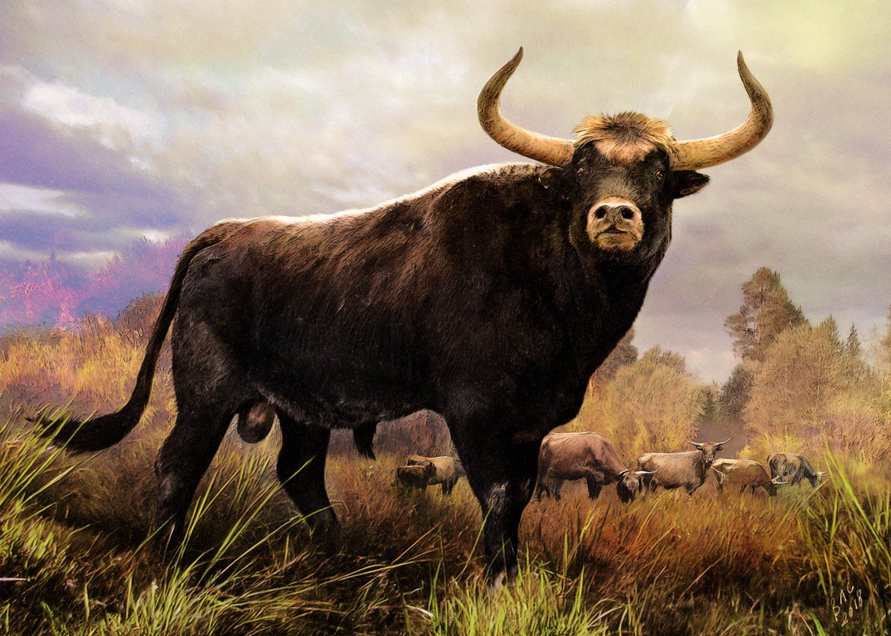
Artistic rendering
of an Aurochs
Domesticated
in Asia
(extinct 1637)

Slide 24
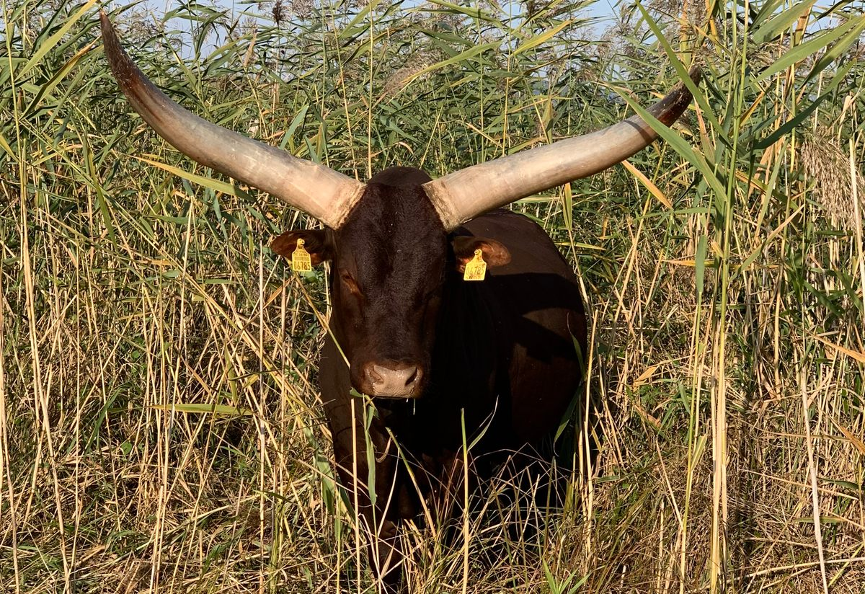
The Return of the Aurochs
Thando,
a pure Watusi breeding bull

Slide 25
⁸ God brought him out of Egypt;
he is like the horns of an aurochs for them.
He will feed on enemy nations and gnaw their bones;
he will strike them with his arrows.
⁹ He crouches,
he lies down like a lion or a lioness—
who dares to rouse him?
Those who bless you will be blessed,
and those who curse you will be cursed (Num 24:7–9).

Slide 26
Numbers 24:17
I see him, but not now;
I perceive him, but not near.
A star will come from Jacob,
and a sceptre will emerge from Israel.
He will smash the forehead of Moab
and strike down all the descendants of Sheth.

Slide 27
3. In Conquest and Settlement Stage of the Israelite Covenant
In Deuteronomy 28:36, at the heart of his litany of covenant curses, Moses warned that should the Israelites persist in their rebellion against YHWH, he would send “you and the king whom you have installed over yourselves” (מַלְכְךָ אֲשֶׁ֣ר תָּקִים עָלֶיךָ ) off into exile among the nations.

Slide 28
Deuteronomy 17:14–20
¹⁴ When you enter the land that YHWH your God is giving you, take possession of it, live in it, and say, “I would like to appoint a king over us like all the nations around us,”
¹⁵ then you must appoint over yourselves the king whom YHWH your God chooses. You must appoint a king from your fellow Israelites (“brothers”). You may not set a foreigner over yourselves, or someone who is not of your people.

Slide 29
¹⁶ However, he must not acquire many horses for himself or send the people back to Egypt to acquire many horses, for YHWH has told you, “You must never go back that way again.’ ¹⁷ He must not acquire many women for himself; this will prevent his heart from going astray. He must not acquire very large amounts of silver and gold for himself.

Slide 30
¹⁸ When he is seated on his royal throne, for himself he must write a copy of this Covenant Teaching (Torah) on a scroll in the presence of the Levitical priests.
¹⁹ It must remain with him, and he must read from it all the days of his life, so that he may learn to demonstrate fear for YHWH his God by observing all the words of this Covenant Teaching (Torah), and by putting into practice all the ordinances.

Slide 31
²⁰ This will prevent his heart from being elevated above his countrymen and will keep him from going off course from this command, either to the right or the left, and will ensure that he and his sons will reign over Israel for a long time.

Slide 32
In Hannah’s “Magnificat”
1 Samuel 2:
⁸ He raises up the poor from the dust;
he lifts the needy from the ash heap
to make them sit with princes
and inherit a seat of honor.
For the pillars of the earth are YHWH’s,
and on them he has set the world.

Slide 33
⁹ He will guard the feet of his faithful ones,
but the wicked shall be cut off in darkness,
for not by might shall a man prevail.
¹⁰ The adversaries of YHWH shall be broken to pieces;
against them he will thunder in heaven.
YHWH will judge the ends of the earth;
he will give strength to his king
and exalt the horn of his anointed (מָשִׁיחַ)
The rest of “1 David” is concerned with answering the riddle posed by the last line: Who is YHWH’s anointed?

Slide 34
4. In the mind of the author of the Book of Ruth
¹⁶ Then Naomi took the child, and placed him on her bosom, and she became his foster-mother. ¹⁷And the neighborhood women gave him a name, saying, “A son has been born to Naomi!”
So they named him Obed. He is the father of Jesse, the father of David.

Slide 35
Now these are the descendants of Perez:
Perez fathered Hezron;
and Hezron fathered Ram;
and Ram fathered Amminadab;
and Ammindadab fathered Nahshon;
and Nahshon fathered Salmah;
and Salmon fathered Boaz (#7);
and Boaz fathered Obed;
and Obed fathered Jesse;
and Jesse fathered David!
Micah 5:2 [1]
But you, Bethlehem Ephrathah,
though you are small
among the clans of Judah,
from you will come for me
one who will be ruler over Israel,
whose origins are ancient,
from eternity past.

Slide 36
The Author of Ruth’s Historical Vision
 |  |  |  |  |  |  |  |  | David |  | Noah | Noah
 |  |  |  |  |  |  |  | Jesse |  |  | Lamech | Lamech
 |  |  |  |  |  |  | Obed |  |  | Methuselah | Methuselah
 |  |  |  |  |  | Boaz |  |  |  | Enoch
 |  |  |  |  | Salmon |  |  |  | Jared
 |  |  |  | Nahshon |  |  |  | Mehalalel |  |  | Genesis 5
 |  | Amminadab |  |  |  |  | Kenan
 |  | Ram |  |  |  | Enosh
 | Hezron |  |  |  | Seth
Perez |  |  |  | Adam

Slide 37
D. The Significance of David in 1 David–4 David
(1 Samuel–2 Kings)
The frequency with which David’s name appears in the First Testament suggests that he was by far the most important character in Israel’s history.
The name’s 1,075 occurrences compare with 767 for Moses, 349 for Jacob, and 236 for Abram/Abraham.

Slide 38
The Attention to David in Samuel–Kings
Approximate dates | Historical period | Narrated time (years) | Narrative time (number of chapters)
1030–930 BC | United Monarchy | 100 1.5 years per chapter | 66
930–722 BC | The Divided Kingdoms | 208 (× 2) 27 years per chapter | 28
722–586 BC | The Kingdom of Judah | 136 17 years per chapter | 8
1030–586 BC | Iron Age Israel | 444 4.5 years per chapter | 102

Slide 39
The Attention to David in Chronicles
Approximate dates | Historical period | Narrated time (years) | Narrative time (number of chapters)
1030–930 BC | United Monarchy | 100 | 29 [66, S-K]
930–722 BC | The Divided Kingdoms | 208 (× 2) | 19 [28, S-K]
722–586 BC | The Kingdom of Judah | 136 | 8 [8, S-K]
1030–586 BC | Iron Age Israel | 444 | 56 [102, S-K]

Slide 40
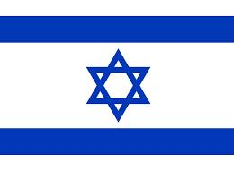
D. The Significance of David in Psalms and the Prophets
E. The Significance of David in the New Testament
F. The Significance of David Today

Slide 41
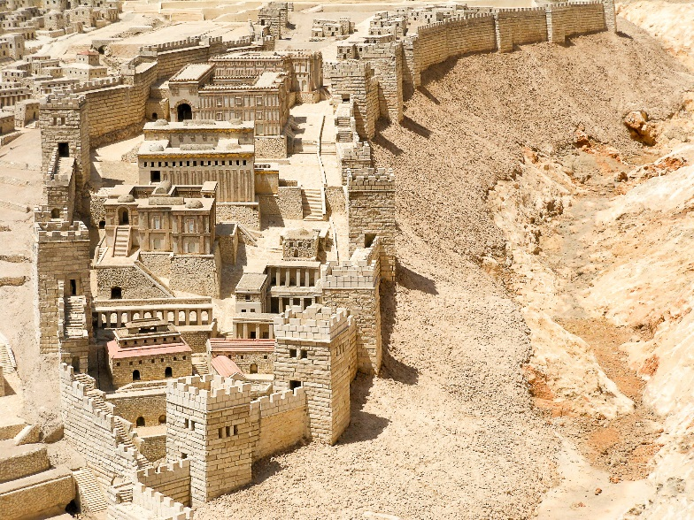
Looking
for King David

Slide 42
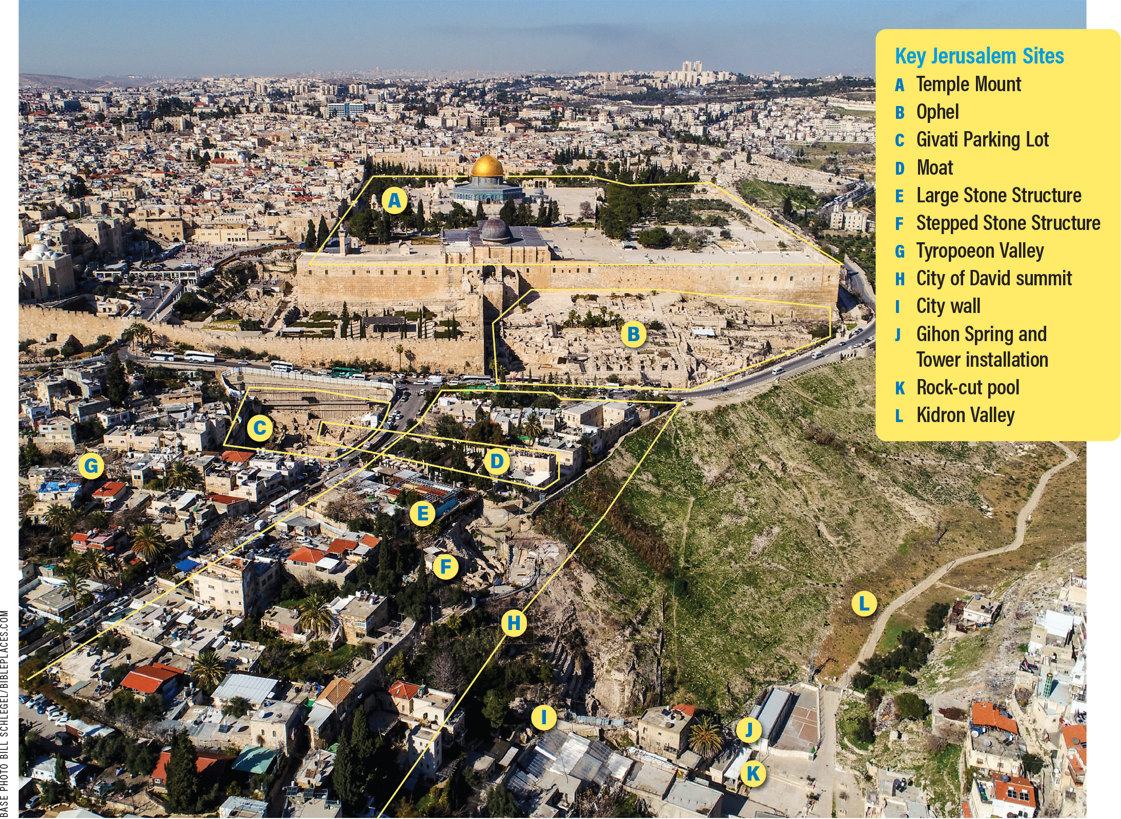
Looking for
King David

Slide 43
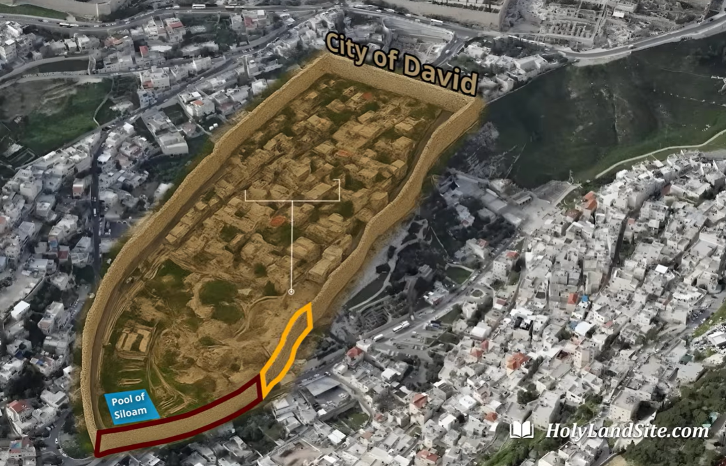
Looking
for
King
David’s
Tomb

Slide 44
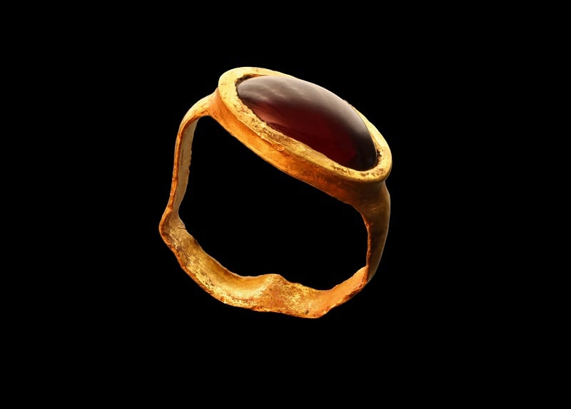
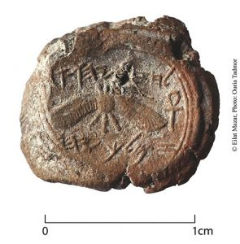
Looking for David
A Gold Ring From the City of David
(ca. 300 BC)
Hezekiah’s Seal Bulla (ca. 700 BC)
“Belonging to Hezekiah (son of Ahaz) king of Judah”
( hdwhy klm whyqzHl)
But where is David?

Slide 45
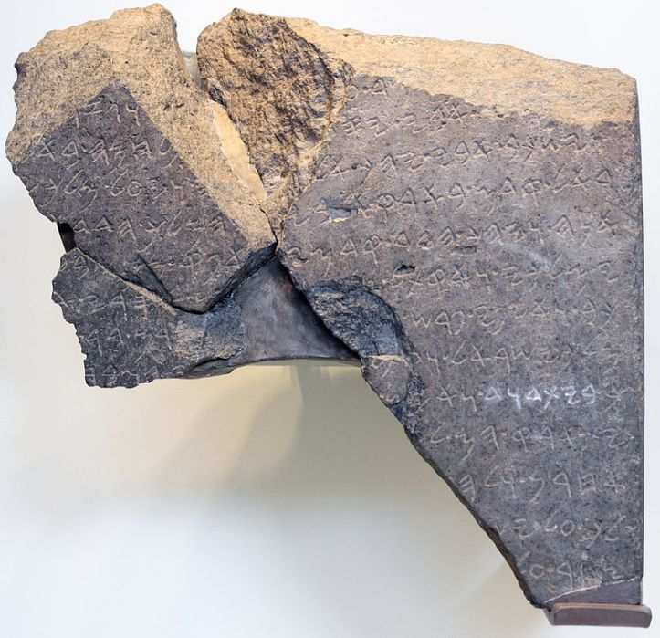
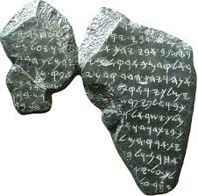
Looking for David
1. and cut
2. my father went up he fought at
3. And my father lay down, he went to his... And the king of I
4. rael entered previously into my father's land.... Hadad made me king
5. And Hadad went in front of me... I departed from... seven...
6. s of my kingdom, and I slew...nty kin... who harnessed thou.
7. riots and thousands of horsemen,... ram son of
8. king of Israel, and... killed...iahu son of...
9. g of the house of David. And I set
10. their land into
11. other
12. led over Is
13. siege upon Tel Dan Stela ca. 841 BC
Hazael King of Aramean Damascus
(whom Elisha anointed, 1 Kings 19:17; 2 Kings 8)

Slide 46
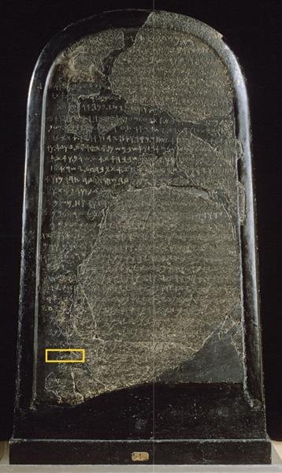
Looking for David
The Mesha Stela 835 BC
Line 31 …dw…xb.
“house of …vid”
“Mesha’s Stele and the House of David,”
André Lemaire, Jean-Philippe Delorme,
BAR 48.4 (Winter, 2022): 34–41.

Slide 47
Joy to the World The Lord is Come
1. Joy to the world; the Lord is come;
Let Earth receive her King;
Let ev'ry heart prepare him room,
And heav'n and nature sing.
2. Joy to the Earth, the Savior reigns;
Our mortal songs employ,
While fields and floods, rocks, hills and plains,
Repeat the sounding joy.

Slide 48
3. No more let sins and sorrows grow,
Nor thorns infest the ground;
He comes to make his blessings flow
Far as the curse is found.
4. He rules the world with truth and grace,
And makes the nations prove
The glories of his righteousness,
And wonders of his love.

