Slide 1
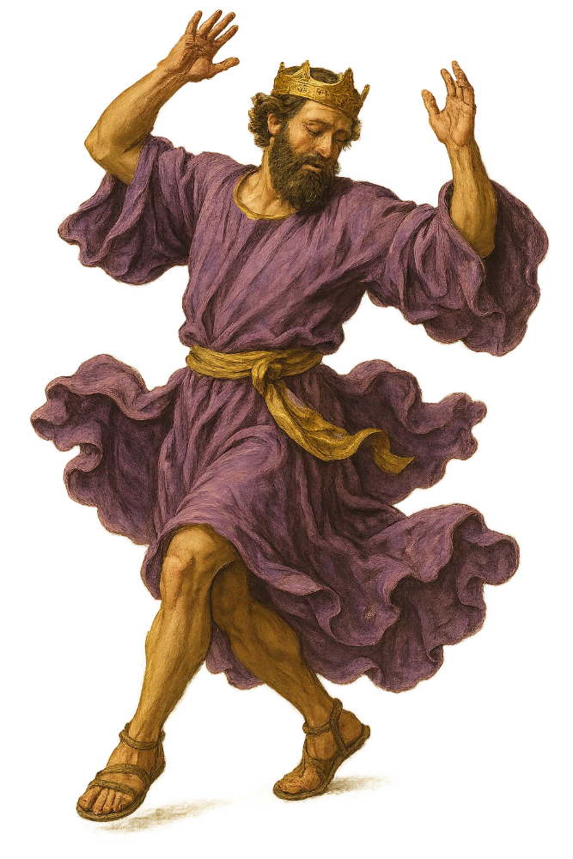
“Dancing with David”
The King after God’s Own Mind
Daniel I. Block
Veritas Community
College Church
September 27, 2026

Slide 2
#2
Introducing the Herald of the Star Dancer:
The Miracle Birth and Mission of Samuel

Slide 3
A. The Structure of the Samuel Narrative (1 Sam 1:1–16:23)
1. Samuel’s Miraculous Birth (1:1–2:11a)
a. The Account of Samuel’s Birth (1:1–28)
b. The Celebration of Samuel’s Birth (2:1–11a)
2. Samuel’s Call to Prophetic Ministry (2:11b–4:1a)
a. The Context of the Call:
The Crisis of Spiritual Leadership in Israel (2:11b–36)
b. The Nature of the Call:
The Provision of Spiritual Leadership in Israel (3:1–4:1a)

Slide 4
3. Samuel’s Public Ministry (4:1b–7:17)
a. The Context of Samuel’s Ministry: The National Emergency (4:1b–7:2)
(1) The Military Emergency (4:1b–2)
(2) The Spiritual Emergency (4:3–7:2)
• The Symptom of the Crisis (4:3)
• The Response to the Crisis (4:4)
• The Complication of the Crisis: The Role of the Ark (4:5–7:2)
b. The Nature of Samuel’s Ministry: His Response to the Emergency (7:3–17)
(1) His Immediate Response (7:3–14)
(2) His On-going Response (7:15–17)

Slide 5
4. Samuel and the Emergence of Kingship in Israel (8:1–16:23)
a. The Rise of Saul (8:1–12:25)
(1) The Crisis of Leadership in Israel (8:1–22)
(2) YHWH’s Solution for the Crisis (9:1–11:13)
• The Divine Commissioning of the King (9:1–10:16)
• The Divine Election of the King (10:17–26)
• The Divine Authentication of the King (10:27–11: 13)
(3) Samuel’s Response to the Crisis (11:14–12:25)
• The Occasion for the Response (11:14–15)
• The Nature of the Response (12:1–25)

Slide 6
b. The Demise of Saul (13:1–16:23)
(1) The Philistine Crisis (13:1–14:52)
• The Nature of the Crisis (13:1–7)
• The Causes of the Crisis (13:8–23)
• Saul’s Response to the Crisis (14:1–52)
* The Heroism of Jonathan (14:1–15)
* The Folly of Saul (14:16–46)
• The Needlessness of the Crisis (14:47–52)

Slide 7
b. The Demise of Saul (13:1–16:23)
(1) The Philistine Crisis (13:1–14:52)
(2) The Amalekite Crisis (15:1–35)
• The Test of Saul (15:1–9)
• The Evaluation of Saul (15:10–23)
• The Rejection of Saul (15:24–35)
(3) The Spiritual Crisis (16:1–23)
• The Divine Election of David (16:1–13)
• The Divine Rejection of Saul (16:14–23)

Slide 8
5. The Haunting Role of Samuel (19:18–24; 28:3–25)
a. Samuel’s Prophetic Power over Saul (19:18–24)
(1) The Occasion (19:18–19)
(2) The Warning Signs (19:20–21)
(3) The Demonstration (19:22–24)
b. Samuel’s Necromantic Power over Saul (28:3–25)
(1) The Nature of the Crisis (28:3–6)
(2) Saul’s Response to the Crisis (28:7–25)
• His Necromantic Inquiry (28:7–14)
• Samuel’s Response (28:15–19)
• Saul’s Reaction (28:20–25)

Slide 9
B. Samuel’s Roles in Israel’s Story
Straddling the fence between the period of the Judges and institution of the monarchy Samuel occupied a unique position in the history of Israel.
We may grasp this by noting the multi-dimensional nature of his ministry.

Slide 10
1. Samuel the Administrator (שֹׁפֵט)
Samuel apparently serves Israel as the last of the series of administrators (שֹׁפְטִים) who governed in Israel between the death of Joshua and the coronation of Saul. The basis for this opinion is found in 1 Sam 7:15–17, which notes that he took care of Israel from Bethel, Gilgal and Ramah (cf. Deborah, Judg 4:5). But the comparison with the judges of Judges is not quite accurate, since Samuel never acted as a “deliverer,” raised up by YHWH to rescue Israel from an enemy oppressor (cf. Judg 2:16, 18).

Slide 11
2. Samuel the Priest
a. Arguments in Favor of Priestly Status
(1) Hannah dedicated her son to YHWH at the temple (1:27–28; cf. בֵּית יהוהת, v. 24).
(2) Samuel served YHWH as Eli’s apprentice (מְשָׁרֵת אֶת יהוה לִפְנֵי עֵלִי) in the temple of YHWH (הֵיכָל) at Shiloh, where the Ark of God was (3:1–3, 21).

Slide 12
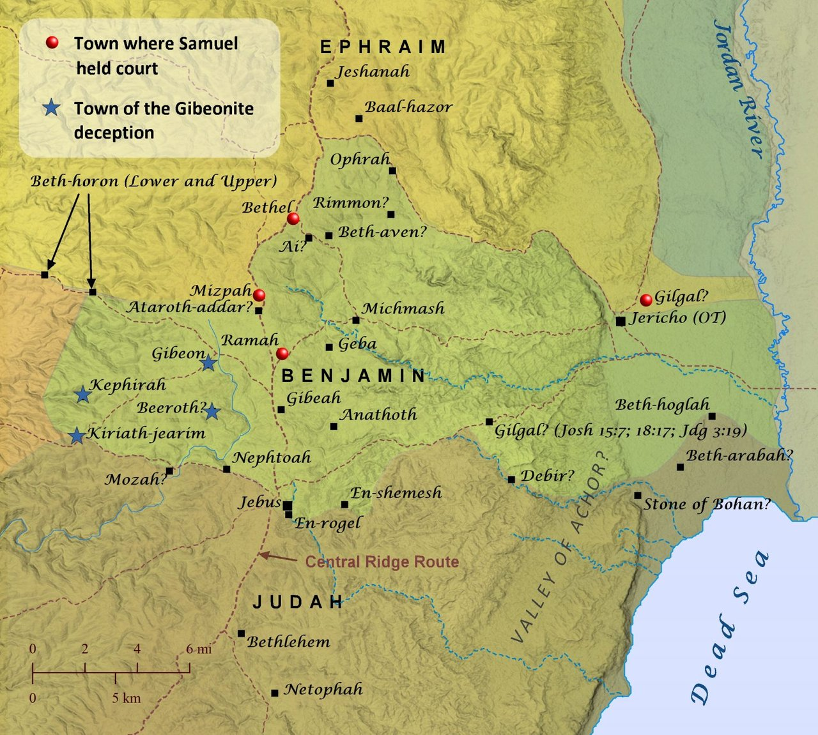
Samuel’s World
(13–15 miles from Ramah to Shiloh)
Shiloh

Slide 13
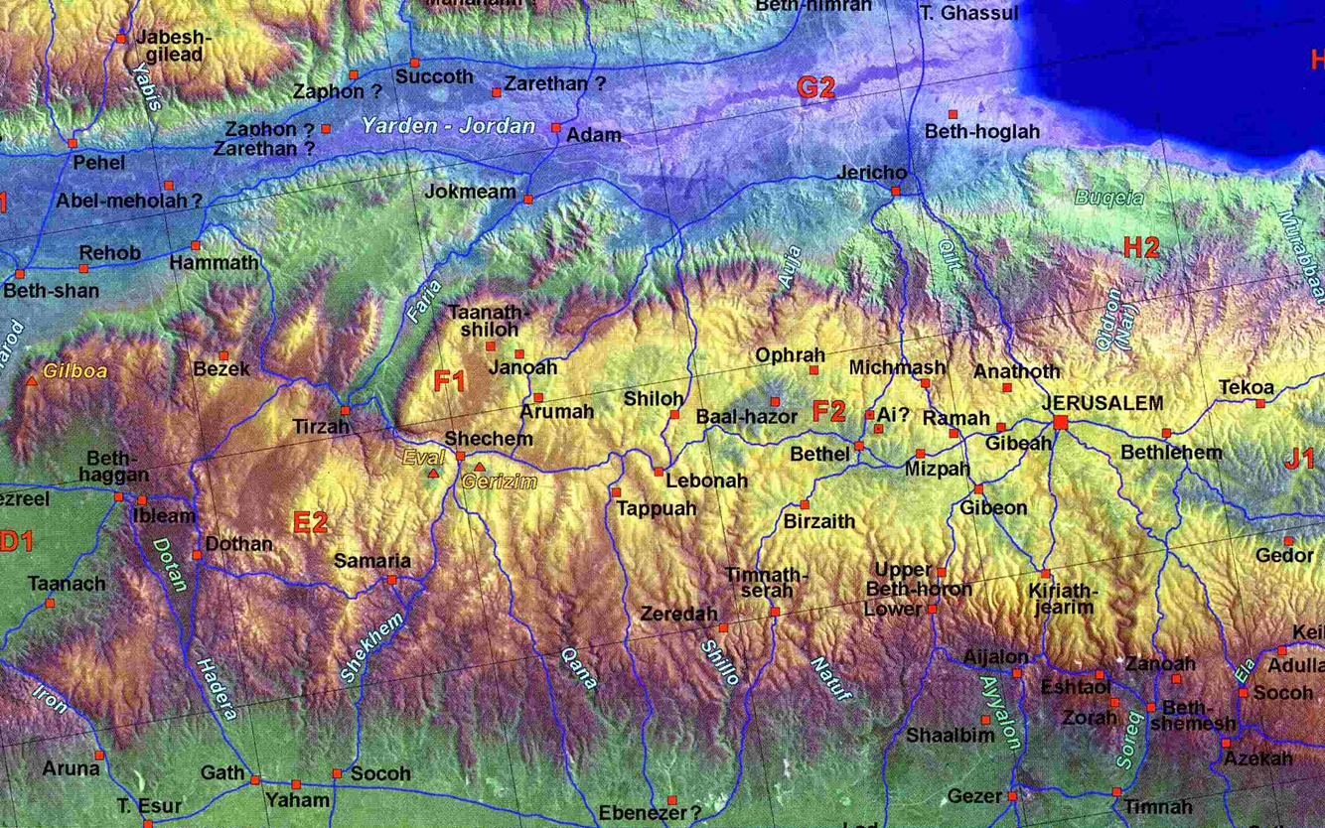

Samuel’s World

Slide 14
2. Samuel the Priest
a. Arguments in Favor of Priestly Status
(1) Hannah dedicated her son to YHWH at the temple (1:27–28).
(2) Samuel served YHWH as Eli’s apprentice (מְשָׁרֵת אֶת יה לִפְנֵי עֵלִ) in the temple of YHWH (הֵיכָל) at Shiloh, where the Ark of God was (3:1–3, 21).
(3) The genealogy of Chronicles places Elkanah and Samuel in the Kohathite line of the Levites, from which Aaron also came (1 Chr 6:28).

Slide 15
(4) After Eli’s demise Samuel acted like a priest. He built altars to YHWH (7:17); offered burnt offerings (7:10; in 13:8–15 he fails to show up); officiated at communal meals at the high place (9:12–14, 19, 22–24; 11:15 [זְבָחִים]; 16:1–5).

Slide 16
b. Arguments against Samuel’s Priestly Status
The narrator identified his father Elkanah as an Ephraimite (1:1).
The narrator never portrayed Samuel officiating at the main cult center at Shiloh.
The Chronicler does not place Samuel in the Aaronic line of Kohathites (cf. 1 Chr 6:49–53).
During Samuel’s tenure Ahijah, a great grandson of Eli, wore the official breastpiece of the high priest (1 Sam 14:3).

Slide 17
Samuel the Nazirite (1:11)
But Samuel’s Nazirite status differed from that of Samson, whose role was appointed by YHWH, and that described in Numbers 6, where the vow was personal and voluntary.
Here his mother devoted him to God as a Nazirite all his life.

Slide 18
4. Samuel the Prophet
This was undoubtedly the role that the narrator viewed as most significant.
We may examine his prophetic status from several angles.
Called by YHWH to prophetic service when he was a mere child, he was formally labeled a “prophet” in 3:20; cf. 9:9).
In fact, all Israel, from Dan to Beersheba quickly recognized him as a prophet of YHWH.

Slide 19
Elsewhere he was referred to as a “seer,” because of his ability to see reality as God sees it (1 Sam 9:9), and a “man of God” (9:6, 7, 8, 10). Verse 6 describes this “man of God” as one whom the people held in high esteem, and one whose pronouncements came true (9:6).
As a prophet, Samuel served as a reliable spokesman for God (1 Sam 8:10; 10:18; 15:1b–2). YHWH did not let any of his words fall (3:19), and all that he said came true (9:6; 28:17).

Slide 20
As a prophet Samuel called on his people to repent (7:3) and preached to the people in keeping with the Covenant Teaching [Torah] of Moses (8:11–18; 10:18–19; 12:6–25; cf. Deut 17:14–20). His conviction of the primacy of obedience over sacrifice is fundamental to Mosaic and New Testament religion (15:17–23; cf. Deut 10:12–11:1; Rom 12:1; Math 23:23):
“What sorrow awaits you teachers of religious law and you Pharisees. Hypocrites! For you are careful to tithe even the tiniest income from your herb gardens, but you ignore the more important aspects of the law—justice, mercy, and faith. You should tithe, yes, but do not neglect the more important things.”

Slide 21
Note:
The significance of Samuel for the rise of the monarchy in Israel (the primary concern in the books of Samuel) is reflected in the fact that almost two-thirds of the Samuel narrative is devoted to his relationship with Saul (274 out of 431 verses).
The prophet continued to move in and out of the narrative, but he functioned increasingly as a “behind the scenes” divine conscience for the king, and through him to the people. Occasionally he was out of the picture for extended sections of the narrative all together (compare chapters 11, 14).

Slide 22
C. Two Notable Stories in the Dancer’s Herald’s’ Arrival on the Scene
Samuel’s Miraculous Birth (1:1–2:11a)
a. The Account of Samuel’s Birth (1:1–28)
b. The Celebration of Samuel’s Birth (2:1–11a)
2. Samuel’s Call to Prophetic Ministry (2:11b–4:1a)
a. The Context of the Call:
The Crisis of Spiritual Leadership in Israel (2:11b–36)
b. The Nature of the Call:
The Provision of Spiritual Leadership in Israel (3:1–4:1a)

Slide 23
a. The Account of Samuel’s Birth (1:1–28)
Elements of Biblical “Birth Narratives”:
The introduction of a pious but infertile woman (who longs for a son)
A divine revelation/visitation announcing the conception of a special child and/or the special destiny of the child.
The announcement of the child’s birth
The naming of the child.
Examples: Sarah (Gen 18:9–15), Rebekah (Gen 25:19–26), Rachel (Gen 30:1–24)

Slide 24
A Comparison of the Birth Accounts of Samuel and John ben Zacharias
 | 1 Samuel 1:1–2:11a | Luke 1:5–25, 57–80
1 | The Father’s Status: Elkanah וַיִּזְכְּרֶהָ, “YHWH remembered her” (v. 19) | The Father’s Status: Zacharias “YHWH remembers”
 | A pious Ephraimite (1:1, 3, 21) Now this man used to go up year by year from his city to worship and to sacrifice to YHWH of hosts at Shiloh, where the two sons of Eli, Hophni and Phinehas, were priests of YHWH. | A righteous Levite (1:6) And they were both righteous before God, walking blamelessly in all the commands and statutes of the Lord (kyrios).

Slide 25
2 | The Mother’s Status: Hannah | The Mother’s Status: Elizabeth
 | A pious woman who regularly went to the sanctuary a woman of prayer (vv. 12–16) and faithful to vows (11, 2, 24–28) humble and submissive before YHWH (v. 19, הִשְׁתַחֲוָה) | They were both righteous before God, walking blamelessly in all the commands and ordinances of the Lord. (v. 6)
 | a barren woman: Hannah had no children (v. 2) YHWH had closed her womb (v. 6) | they had no child, because Elizabeth was barren, and both were advanced in years. (v. 7) I am an old man, and my wife is advanced in years (v. 18)

Slide 26
3 | The divine visitation (?) | The divine visitation
 | Ironically(?) the priest, God’s representative, Eli, thinks Hannah is drunk and tells her, “Go in peace, and the God of Israel grant your petition that you have made to him” (v. 17). But in so doing he has blessed the mother of the person who will announce YHWH’s sentence on him (10–14) | The angel of the Lord (v. 11) appeared to the righteous priest, commended him for his righteousness, and announced to the righteous man troubled by the angel’s visit: “And Zechariah was troubled when he saw him, and fear fell upon him. But the angel said to him, “Do not be afraid, Zechariah, for your prayer has been heard, and your wife Elizabeth will bear you a son, and you shall call his name John. And you will have joy and gladness, and many will rejoice at his birth, for he will be great before the Lord. (vv. 13–15).

Slide 27
4 | Mission/commission of the Child | Mission/commission of the Child
 | Nazirite: “O YHWH of hosts, if you will indeed look on the affliction of your servant and remember me and not forget your servant, but will give to your servant a son, then I will give him to YHWH all the days of his life, and no razor shall touch his head.”(v. 11) Therefore, I have lent him to YHWH. As long as he lives, he is lent to YHWH” (v. 28). | Nazirite: He will be great before the Lord. And he must not drink wine or strong drink, and he will be filled with the Holy Spirit, even from his mother's womb. And he will turn many of the children of Israel to the Lord their God, and he will go before him in the spirit and power of Elijah, to turn the hearts of the fathers to the children, and the disobedient to the wisdom of the just, to make ready for the Lord a people prepared” (vv. 15–17).

Slide 28
5 | Announcing the Pregnancy | Announcing the Pregnancy
 | They rose early in the morning and worshipped before YHWH; then they went back to their house at Ramah. And Elkanah knew Hannah his wife, and YHWH remembered her. (v. 19) | ²³And when his time of service was ended, he went home. ²⁴ After these days his wife Elizabeth conceived, and for five months she kept herself hidden, saying, ²⁵ “Thus the Lord has done for me in the days when he looked on me, to take away my reproach among people.

Slide 29
6 | Announcing the child’s birth | Announcing the child’s birth
 | They rose early in the morning and worshipped before YHWH; then they went back to their house at Ramah. And Elkanah knew Hannah his wife, and the Lord remembered her. And in due time Hannah conceived and bore a son. (vv. 19–20) | Now the time came for Elizabeth to give birth, and she bore a son. ⁵⁸And her neighbors and relatives heard that the Lord had shown great mercy to her, and they rejoiced with her. (v. 57–58)

Slide 30
6 | Announcing the child’s birth | Announcing the child’s birth
 | They rose early in the morning and worshipped before YHWH; then they went back to their house at Ramah. And Elkanah knew Hannah his wife, and YHWH remembered her. And in due time Hannah conceived and bore a son. (vv. 19–20) | Now the time came for Elizabeth to give birth, and she bore a son. ⁵⁸And her neighbors and relatives heard that the Lord had shown great mercy to her, and they celebrated with her. (v. 57–58)

Slide 31
7 | Naming the Child | Naming the Child
 | She called his name Samuel, for she said, “I have asked for him from YHWH.” (v. 20) | ⁵⁹ And on the eighth day they came to circumcise the child. And they would have called him Zechariah after his father, ⁶⁰ but his mother answered, “No; he shall be called John.” ⁶¹ And they said to her, “None of your relatives is called by this name.” ⁶² And they made signs to his father, inquiring what he wanted him to be called. ⁶³ And he asked for a writing tablet and wrote, “His name is John.” And they all wondered. (vv. 59–63)

Slide 32
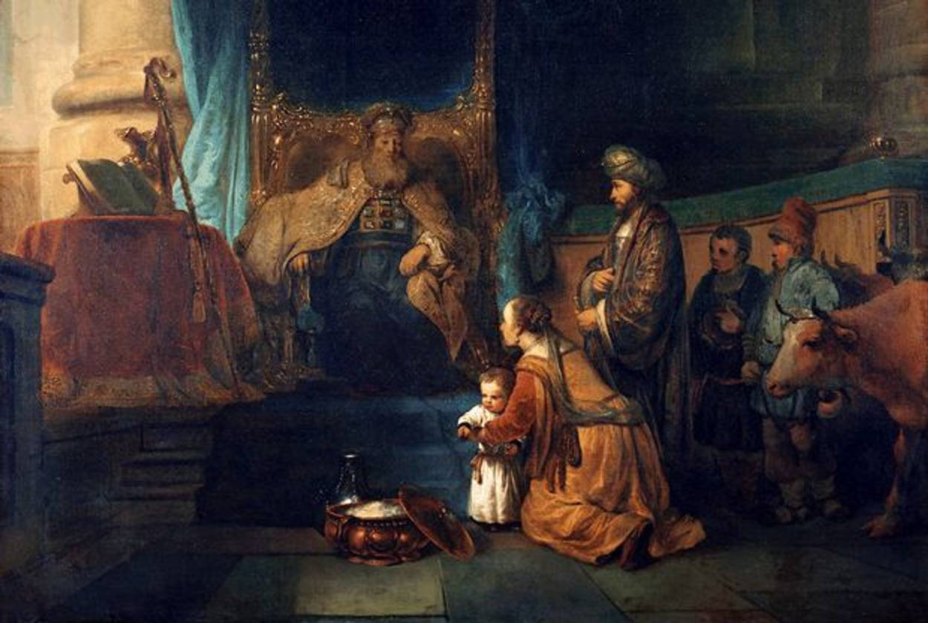
Hannah Presenting Samuel to Eli the Priest in Shiloh
Gerbrand van den Eeckhout (ca. 1665)

Slide 33
How old was Samuel when Hannah brought him to Eli?
⁴ And when she had weaned him, she took him up with her, along with a three-year-old bull, an ephah of flour, and a skin of wine, and she brought him to the house of YHWH at Shiloh. And the child was young.

Slide 34
a. The Celebration of Samuel’s Birth (2:1–11a)
¹ Then Hannah prayed—
in the spirit of prophecy (Tg, ברוח נבואה) and said:
"My heart celebrates in YHWH;
in YHWH my horn is lifted high.
My mouth boasts over my enemies,
for I delight in your deliverance.
² "There is no one holy like YHWH;
there is no one besides you;
there is no Rock like our God.

Slide 35
³ "Do not keep talking so proudly
or let your mouth speak such arrogance,
for YHWH is a God who knows,
and by him deeds are weighed.
⁴ "The bows of the warriors are broken,
but those who stumbled are armed with strength.
⁵ Those who were full hire themselves out for food,
but those who were hungry are hungry no more.
She who was barren has borne seven children,
but she who has had many sons pines away.

Slide 36
⁶ "YHWH brings death and makes alive;
he brings down to the grave and raises up.
⁷ YHWH sends poverty and wealth;
he humbles and he exalts.
⁸ He raises the poor from the dust
and lifts the needy from the ash heap;
he seats them with princes
and has them inherit a throne of honor.
"For the foundations of the earth are YHWH's;
on them he has set the world.

Slide 37
⁹ He will guard the feet of his faithful servants,
but the wicked will be silenced in the place of darkness.
"It is not by strength that one prevails;
¹⁰ those who oppose YHWH will be broken.
The Most High will thunder from heaven;
YHWH will judge the ends of the earth.
"He will give strength to his king
and exalt the horn of his anointed."
¹¹ Then Elkanah went home to Ramah. (1 Sam 2:1–11 NIV, modified))
the pillars of

Slide 38
b. The Celebration of John ben Zacharias’ Birth (Luke 1:67–80)
⁶⁷ His father Zechariah was filled with the Holy Spirit and prophesied:
⁶⁸ "Praise be to the Lord, the God of Israel,
because he has come to his people and redeemed them.
⁶⁹ He has raised up a horn of salvation for us
in the house of his servant David
⁷⁰ (as he said through his holy prophets of long ago),
⁷¹ salvation from our enemies
and from the hand of all who hate us—

Slide 39
⁷² to show mercy to our ancestors
and to remember his holy covenant,
⁷³ the oath he swore to our father Abraham:
⁷⁴ to rescue us from the hand of our enemies,
and to enable us to serve him without fear
⁷⁵ in holiness and righteousness before him all our days.
⁷⁶ And you, my child,
will be called a prophet of the Most High;
for you will go on before the Lord
to prepare the way for him,

Slide 40
⁷⁷ to give his people the knowledge of salvation
through the forgiveness of their sins,
⁷⁸ because of the tender mercy of our God,
by which the rising sun will come to us from heaven
⁷⁹ to shine on those living in darkness
and in the shadow of death,
to guide our feet into the path of peace.“
⁸⁰ And the child grew and became strong in spirit; and he lived in the wilderness until he appeared publicly to Israel.

Slide 41
Why did I read these two texts?
To introduce you to the best of biblical poetry.
To show you how Luke—the gentile author—knows the Scriptures and how he writes.
To give you a glimpse of the significance of the birth of Samuel as the herald of the first David—he too was a voice crying in the wilderness: Prepare the way of YHWH, the king of Israel.

Slide 42
2. Samuel’s Call to Prophetic Ministry (2:11b–4:1a)
a. The Context of the Call:
The Crisis of Spiritual Leadership in Israel (2:11b–36)
b. The Nature of the Call:
The Provision of Spiritual Leadership in Israel (3:1–4:1a)

Slide 43
(1) Differences from Other Call Narratives
There is no arresting theophany at the outset, only the sound of YHWH’s voice. Only retrospectively does the narrator speak of a visionary experience (3:15).
There is no hint of resistance on the part of the one called, only unfamiliarity with the sound of YHWH’s voice.

Slide 44
There is no formal commissioning, only an announcement to the boy of what YHWH has determined to do to the house of Eli. In fact, the intended target of the oracle had to extract it from the young lad.
There is no divine reassurance for the one called, or announcement of the divine presence. Ironically, it is the victim of the impending divine action who offers reassurance (3:17–18), because he recognized that it had in fact been the voice of God that Samuel has heard.

Slide 45
(2) Samuel’s Character as a Youth
Except for Moses, the paradigmatic prophet, of all the prophets in the Hebrew Bible the narrator has provided the roundest portrait in his portrayal of Samuel. The closest competitors would be Elijah and Elisha (in that order), and perhaps Jeremiah in the narratives of the book by this name. But the narrator has not whitewashed this man.
On the one hand, he was a man of extra-ordinary moral character. On the other hand. . . . (next week)

Slide 46
At a time when religious leaders were corrupt (1:9; 2:12–17) and blind (3:2)
Samuel ministered “to YHWH before Eli the priest” (‎מְשָׁרֵת אֶת־יְהוָה אֶת־פְּנֵי עֵלִי הַכֹּהֵן, 2:11; 3:1), and “before YHWH,” (‎מְשָׁרֵת אֶת־פְּנֵי יְהוָה), wearing the ephod (v. 18).
Samuel “grew up [walking] with YHWH” (‎וַיִּגְדַּל הַנַּעַר שְׁמוּאֵל עִם־יְהוָה)
Samuel “continued to grew in stature and beauty with both YHWH and men” (‎ הֹלֵךְ וְגָדֵל וָטוֹב גַּם עִם־יְהוָה וְגַם עִם־אֲנָשִׁים, 2:26).

Slide 47
At a time when religious leaders were corrupt, Samuel matured physically and spiritually.
At a time when “communication from YHWH was rare,” Samuel heard and submitted to the voice of YHWH (3:4–9).
At a time when adults were captive to their children’s power (22–25), Samuel fearlessly rebuked his “father figure,” who happened to be the priest at the central sanctuary (3:11–18).
At a time when YHWH had abandoned his people, he was with Samuel and confirmed his status as a prophet and a member of YHWH’s court (3:19–21).

Slide 48
Application
1 When we walk with the Lord, in the light of his Word,
What a glory he sheds on our way;
While we do his good will, he abides with us still,
And with all who will trust and obey.
Trust and obey, for there’s no other way
To be happy in Jesus, But to trust and obey.

Slide 49
Not a shadow can rise, not a cloud in the skies,
But his smile quickly drives it away;
Not a doubt or a fear, not a sigh or a tear,
Can abide while we trust and obey.
Not a burden we bear, not a sorrow we share,
But our toil he does richly repay;
Not a grief or a loss, not a frown or a cross,
But is blest if we trust and obey.
Trust and obey, for there’s no other way
To be happy in Jesus—but to trust and obey.

Slide 50
Then in fellowship sweet, we will sit at his feet,
Or we’ll walk by his side in the way;
What he says we will do; where he sends, we will go,
Never fear, only trust and obey.
Trust and obey, for there’s no other way
To be happy in Jesus—but to trust and obey.

