Slide 1
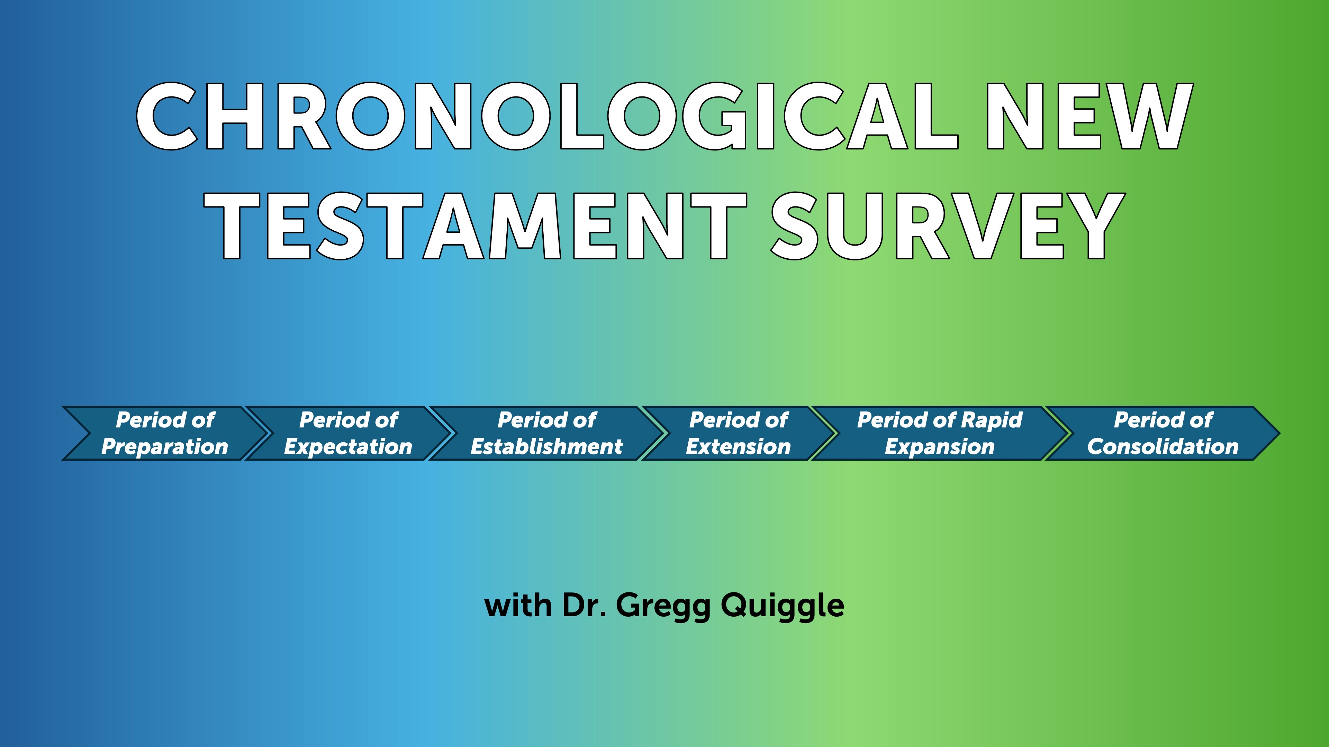

Slide 2
Comments
I believe they are correct in saying salvation involves connection to the body of Christ – the community. It is not as individualistic as we make it out to be.
They are right about Paul attacking Jewish “boundary markers” as necessary conditions to be part of the community.
BUT they fail to address the issue of righteousness. How are we actually righteous before God? I believe this is by imputed or alien righteousness.

Slide 3
Key texts
Ephesians 2:8–10; 2 Timothy 1:8–10; Titus 3:4–7 and Works Righteousness
On the surface, Ephesians 2:8–10; 2 Timothy 1:8–10; and Titus 3:4–7 contrast a grace soteriology with a works-righteousness soteriology. However, there is not much discussion of these three texts in pro-and-con New Perspective arguments in critical/liberal scholarship. Should not these texts be part of the analysis concerning justification in Romans, Galatians, and Philippians 3? Why are they not? Because in the critical/liberal world, most scholars believe Paul is not the author of Ephesians, 2 Timothy, and Titus.
https://www.thegospelcoalition.org/essay/justification-new-perspective-paul/

Slide 4
Key Texts
Even if they are right, AND I DO NOT AGREE WITH THEM, these texts undercut works-righteousness regardless of who wrote them.

Slide 5
Good thinkers on this Subject
D. A. Carson and Doug Moo
Short article - https://learn.ligonier.org/guides/the-new-perspective-on-paul
Short video - https://www.youtube.com/watch?v=VTRd7xWYf8Q

Slide 6
Sanctification – Chapters 6-8
It’s easy to see that, even though we follow Christ and have been saved from sin’s penalty, we still struggle against sin's power. As believers, we continue to face temptations similar to those faced by non-believers. So, as we explore this third part of Romans, sanctification. Two questions arise. First: Should a believer feel stuck in frustration due to repeated defeats by sin? And second: Is there any power that can help a Christian overcome sinful impulses? Paul addresses both of these questions in Romans chapters 6 and 7.

Slide 7
What is Sanctification?
Sanctification is the joyful journey where believers, once justified, progressively break free from sin and grow closer to God. It’s during this process that we discover the answers to our two questions. While justification has already freed us from the penalty of sin, many of us still face daily battles against its power. Even though we are made right with God, we still live in these imperfect bodies that can be tempted by our sinful nature. Fortunately, Paul shares with us the struggles we face and offers hope — reminding us that through Christ, we have been given victory over sin’s attempts to hold us back.

Slide 8
Chapter 6
In chapter 6, Paul explains that Christians must understand that their old life—before Christ—is over and dead, nailed to the cross. He asks if we should continue sinning to increase grace, and answers, "By no means! We died to sin; how can we live in it any longer?" Jesus' death and resurrection gave us a new life, transforming us from unbelievers to believers with new values and motives. Paul states we experience this new life through three responses: count, offer, and obey.

Slide 9
Count
First, in chapter 6, verse 11, he says: “In the same way, count yourselves dead to sin but alive to God in Christ Jesus.” When we see the word “count,” it means to depend on or trust in something completely. Think of expressions like “you can bank on it” or “you can count on it”—they show how sure we are about something. Similarly, we can and should confidently see ourselves as no longer under the power of sin. This means we can have full assurance that sin no longer controls us. So, the first practical step is to genuinely consider ourselves dead to sin, with absolute certainty.

Slide 10
Offer
In verse 13, Paul encourages us to dedicate ourselves to God. He reminds us not to use our bodies for sinful purposes, but instead to offer ourselves to God, who has brought us from death to life. This means making a mindful and ongoing choice to serve Christ. It can be helpful to start each day with a simple prayer, like saying, “Today I am a servant of Christ, and I will not let myself fall into sin.” By doing so, we dedicate the new day to serving Him and not succumbing to temptation.

Slide 11
Obey
And so, thirdly, he encourages us to obey God and not give in to sin. He reminds us that each day presents choices—like in verse 16: “Don’t you know that when you offer yourselves to someone to obey him as slaves, you are slaves to the one you obey—whether it’s sin, which leads to death, or obedience, which leads to righteousness?” The key practical step here—related to that important truth—is that as we face daily choices, we can choose to do what is right or to disobey. Because we are alive to sin but also dedicated to Christ as His servants, we have the power to say no to sin. We can confidently declare, “No, I don’t need to obey you,” and instead say yes to what’s right and pleasing to God. When we understand who we are in Christ and what He has called us to do, the answer to whether we must live forever frustrated by ongoing sin is clear: a wholehearted “No!”

Slide 12
Chapter 7 – The War Within
Paul describes feeling like a walking civil war, doing what he hates and not what he wants. So, must Christians always be frustrated by sin? The answer is no, because we’ve been crucified with Christ, making us dead to sin and able to obey God instead. Yet, Paul still struggles with sin's power, raising the question of whether there's a power that can free us. In chapter 7, verse 15, Paul says he doesn't understand his actions—doing what he hates. In verse 24, he laments, "Who will rescue me from this body of death?" But in verse 25, he thanks God through Jesus Christ; the answer is in Christ. Sin is strong, but Christ is stronger, and trusting in Him, we can be delivered.

Slide 13
Chapter 8
Chapter 8 presents the Spirit as a power greater than sin. Paul writes, “There is now no condemnation for those in Christ Jesus, because through Christ the law of the Spirit of life has set me free from the law of sin and death” [v.1] — what the law could not do, God did through his Son. Three assurances follow: resurrection, “He who raised Jesus from the dead will also give life to our mortal bodies” [v.11]; adoption, with the Spirit of sonship replacing fear and testifying with our spirit [vs. 15-16]; and glorification for those predestined, called, and justified [vs. 29-30]. Victory over sin comes by reliance on the indwelling Spirit, not effort.

Slide 14
Summarizing chapter 6-8
We can summarize chapters 3-[8] with three theological terms: justification, sanctification, and glorification. Justification delivers us from the penalty of sin, sanctification is the process by which we are being delivered from the power of sin, and in glorification, we will be delivered from the presence of sin. So, justification delivers from the penalty of sin, sanctification from the power of sin, and ultimate glorification from the presence of sin. That’s why Paul can close chapter 8 with such a wonderful and confident assurance, he says [vs. 37-39]: “Now in all these things we are more than conquerors through him who loved us. For I am convinced that neither death nor life, neither angels nor demons, neither the present nor the future, nor any powers, neither height nor depth, nor anything else in all creation, will be able to separate us from the love of God that is in Christ Jesus our Lord.”

Slide 15
Chapters 9 – 11 – The Problem of Israel
Paul raises a profound question about Israel: has God turned away from Israel? The mystery of Israel’s rejection is deeply rooted in God's sovereign plan. Paul explains that in His sovereignty, God makes choices—He chose Isaac over Ishmael and Jacob over Esau. It’s understandable that our human hearts find this concept difficult; it can seem truly unfair.

Slide 16
Chapters 9 - 11
Why does God choose some people and not others? Paul doesn’t really answer that question directly. Instead, he reminds us that we, as finite humans, shouldn’t question God’s choices. It’s beyond our understanding to second-guess the actions of an infinite God. Even if God explained His plans and purposes, we might still find it hard to fully understand them. So, Paul then asks, does Israel’s rejection mean they have no future? His answer is no. He explains that because God is sovereign and wise, He has turned Israel’s unbelief into an opportunity to bring righteousness to everyone. Paul describes how, because of Israel’s unbelief, the Gentiles are like branches grafted into an olive tree. Instead of disrupting God’s plan of salvation, Israel’s unbelief has actually created a wider opportunity for more people to come to Christ.

Slide 17
Israel’s Future – What does “All Israel will be saved” mean?
There are three basic schools of thought

Slide 18
Dispensational
Dispensational scholars interpret "Israel" as the literal, ethnic nation of Israel. This view holds that, before the return of Christ, a future generation of the Jewish people will experience a widespread, national turning to God to accept Jesus as their Messiah

Slide 19
Some Reformed
Another traditional interpretation, often rooted in Reformed theology, argues that "all Israel" does not refer to every single Jewish person. Instead, it means "all the elect of Israel"—referring to the cumulative total of Jewish people throughout history whom God has chosen to save. This aligns with Paul's earlier statement in Romans 9:6 that "not all who are descended from Israel are Israel."

Slide 20
Third Perspective
A third major perspective argues that "Israel" in this context refers to "spiritual Israel"—a unified body comprising both believing Jews and Gentiles (non-Jews) who are grafted together into one family of faith. In this view, "all Israel" refers to the complete, collective number of all God's chosen people, Jew and Gentile alike. Blurs Jew / Gentile distinction.

Slide 21
Conclusions
Regardless, anti-Semitism is wrong and it is on the rise!

Slide 22
John of Chrysostom, 344-407 CE
The strongest attacks on Jews and Judaism by the Church Fathers are to be found in the Homilies of Chrysostom (344-407 C.E.) in his Antioch sermons. He is considered to be among the most beloved and admired in Church history. His name translates in Greek as St. John the Golden Mouthed. His discourses were prompted by the fact that many Christians were meeting on friendly terms with Jews, visiting Jewish homes, and attending their synagogues. Chrysostom said: "The Jews sacrifice their children to Satan....they are worse than wild beasts. The synagogue is a brothel, a den of scoundrels, the temple of demons devoted to idolatrous cults, a criminal assembly of Jews, a place of meeting for the assassins of Christ, a house of ill fame, a dwelling of iniquity, a gulf and abyss of perdition."
"The Jews have fallen into a condition lower than the vilest animal. Debauchery and drunkenness have brought them to the level of the lusty goat and the pig. They know only one thing: to satisfy their stomachs, to get drunk, to kill, and beat each other up like stage villains and coachmen."
"The synagogue is a curse, obstinate in her error, she refuses to see or hear, she has deliberately perverted her judgment; she has extinguished with herself the light of the Holy Spirit."

Slide 23
Chrysostom continued
Chrysostom further said that the Jews had become a degenerate race because of their "odious assassination of Christ for which crime there is no expiation possible, no indulgence, no pardon, and for which they will always be a people without a nation, enduring a servitude without end."
He elaborated further on God's punishment of the Jews:
"But it was men, says the Jew, who brought these misfortunes upon us, not God. On the contrary, it was in fact God who brought them about. If you attribute them to men, reflect again that even supposing men had dared, they could not have had the power to accomplish them, unless it had been God's will...Men would certainly not have made war unless God had permitted them...Is it not obvious that it was because God hated you and rejected you once for all?"
On another occasion Chrysostom is quoted as saying "I hate the Jews because they violate the Law. I hate the synagogue because it has the Law and the prophets. It is the duty of all Christians to hate the Jews."
Chrysostom's Homilies were to be used in seminaries and schools for centuries as model sermons, with the result that his message of hate would be passed down to succeeding generations of theologians. The nineteenth century Protestant cleric R. S. Storr called him "one of the most eloquent preachers who ever since apostolic times have brought to men the divine tidings of truth and love." A contemporary of Storr, the great theologian John Henry Cardinal Newman, described Chrysostom as a "bright, cheerful, gentle soul, a sensitive heart...

Slide 24
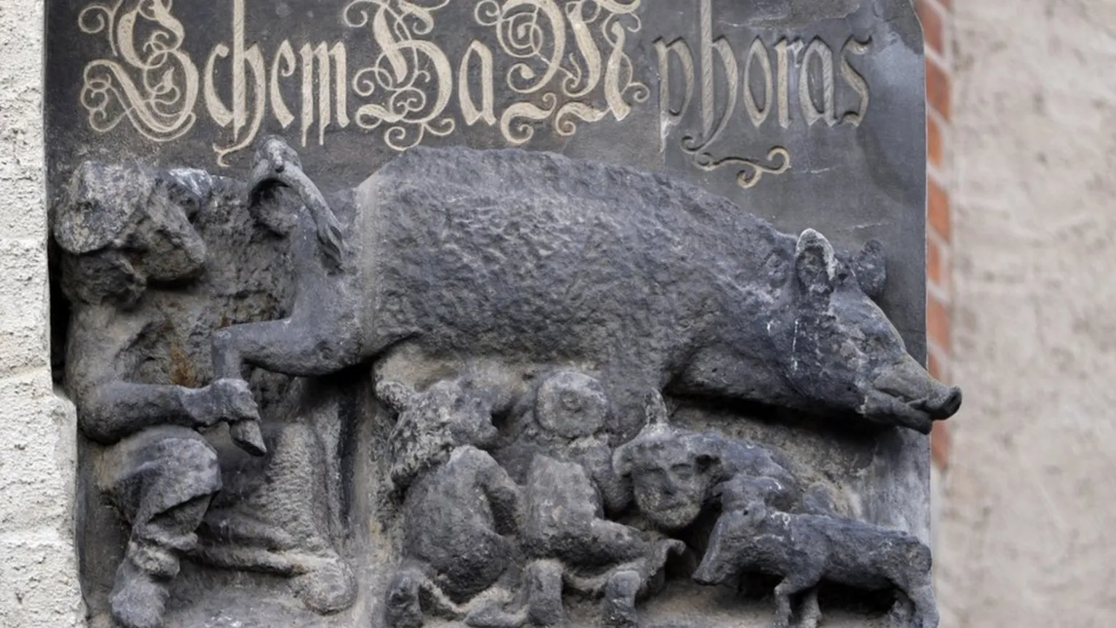

Slide 25
The Protocols
The Protocols of the Elders of Zion is an antisemitic hoax and forgery purporting to detail a Jewish plot for global domination. Largely plagiarized from several earlier sources, it was first published in Imperial Russia in 1903, translated into multiple languages, and disseminated internationally in the early part of the 20th century. It played a key part in popularizing belief in an international Jewish conspiracy.

Slide 26
The Protocols inspired many other books that promoted antisemitic conspiracy theories. Among the best known in the United States was Henry Ford’s The International Jew: The World’s Foremost Problem. Ford was the founder of the Ford Motor Company. He was one of the most famous and respected people in the United States by the 1920s. The International Jew was first serialized in Ford’s newspaper, The Dearborn Independent. It was quickly published as a book and translated into at least 16 languages, including German.

Slide 27
Even Evangelicals
During the 1920s and 1930s, Moody Monthly promoted the fabricated Protocols of the Elders of Zion as evidence of a global conspiracy, adopting an apocalyptic, fundamentalist perspective. Although these fabricated texts were initially presented as real-world threats in evangelical literature, the magazine later repudiated these views following the established consensus of the work as a forgery.

