Slide 1
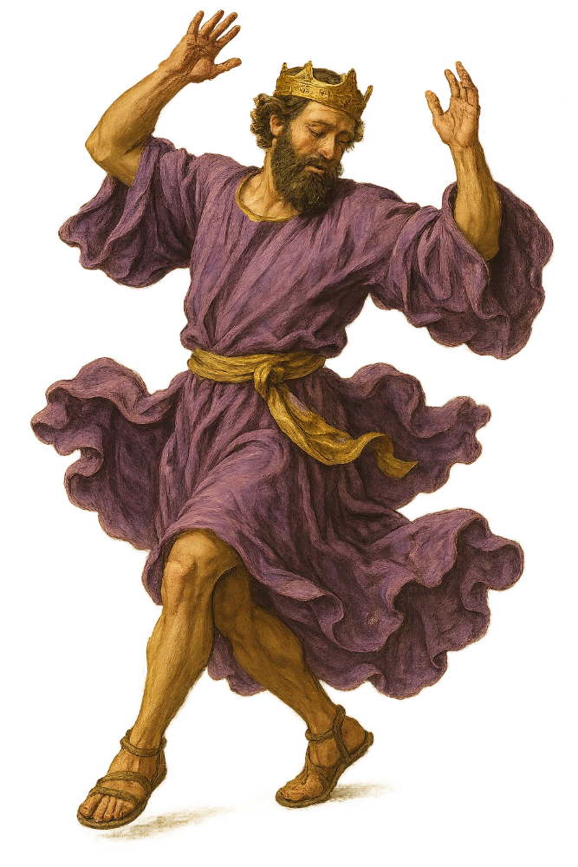
“Dancing with David”
The King after God’s Own Mind
Daniel I. Block
Veritas Community
College Church
October 4, 2026

Slide 2
Announcements
Reading for next week: 1 Samuel 16–17
“The Dramatic Introduction
of the Star Dancer”
Rabbi Yehiel Poupko
“What’s it like being a Jew in America today?”
Windsor Park Auditorium
October 6
1:30 PM

Slide 3
2. Samuel’s Call to Prophetic Ministry (2:11b–4:1a)
a. The Context of the Call:
The Crisis of Spiritual Leadership in Israel (2:11b–36)
b. The Nature of the Call:
The Provision of Spiritual Leadership in Israel (3:1–4:1a)

Slide 4
(1) Differences from Other Call Narratives
There is no arresting theophany at the outset, only the sound of YHWH’s voice. Only retrospectively does the narrator speak of a visionary experience (3:15).
There is no hint of resistance on the part of the one called, only unfamiliarity with the sound of YHWH’s voice.

Slide 5
There is no formal commissioning, only an announcement to the boy of what YHWH has determined to do to the house of Eli. In fact, the intended target of the oracle had to extract it from the young lad.
There is no divine reassurance for the one called, or announcement of the divine presence. Ironically, it is the victim of the impending divine action who offers reassurance (3:17–18), because he recognized that it had in fact been the voice of God that Samuel has heard.

Slide 6
(2) Samuel’s Character as a Youth
Except for Moses, the paradigmatic prophet, of all the prophets in the Hebrew Bible the narrator has provided the roundest portrait in his portrayal of Samuel. The closest competitors would be Elijah and Elisha (in that order), and perhaps Jeremiah in the narratives of the book by this name. But the narrator has not whitewashed this man.
On the one hand, he was a man of extra-ordinary moral character. On the other hand. . . . (next week)

Slide 7
At a time when religious leaders were corrupt (1:9; 2:12–17) and blind (3:2)
Samuel ministered “to YHWH before Eli the priest” (‎מְשָׁרֵת אֶת־יְהוָה אֶת־פְּנֵי עֵלִי הַכֹּהֵן, 2:11; 3:1), and “before YHWH,” (‎מְשָׁרֵת אֶת־פְּנֵי יְהוָה), wearing the ephod (v. 18).
Samuel “grew up [walking] with YHWH” (‎וַיִּגְדַּל הַנַּעַר שְׁמוּאֵל עִם־יְהוָה)
Samuel “continued to grew in stature and beauty with both YHWH and men” (‎ הֹלֵךְ וְגָדֵל וָטוֹב גַּם עִם־יְהוָה וְגַם עִם־אֲנָשִׁים, 2:26).

Slide 8
At a time when religious leaders were corrupt, Samuel matured physically and spiritually.
At a time when “communication from YHWH was rare,” Samuel heard and submitted to the voice of YHWH (3:4–9).
At a time when adults were captive to their children’s power (2:22–25), Samuel fearlessly rebuked his “father figure,” who happened to be the priest at the central sanctuary (3:11–18).
At a time when YHWH had abandoned his people, he was with Samuel and confirmed his status as a prophet and a member of YHWH’s court (3:19–21).

Slide 9
#3
The Foil for the Star Dancer:
What is Saul doing on this stage?
(1 Samuel 8–15)

Slide 10
Hannah’s Riddle
1 Samuel 2:10
The Most High will thunder from heaven;
YHWH will administer justice the ends of the earth.
"He will give strength to his king
and exalt the horn of his anointed.
But who will this person be?
Whom did God, who inspired Hannah, have in mind?

Slide 11
A. The Background to the Rise of Saul
(1 Samuel 4:1b–8:22)
1. The National Crisis
a. The Military Emergency: The Philistine Threat (4:1b–2)

Slide 12
But who were the Philistines?
• They were not Canaanites—they appear in Thutmose III’s records (1479–1425 BC) under the general rubric of “Sea Peoples” threatening the stability of the Egyptian control of the eastern Mediterranean lands that includes group names like Peleset, Tjeker, Shekelesh, Denyen, Weshesh and Sherden.

Slide 13

The Reliefs at Ramesses III’s mortuary temple at Medinet Habu show the Egyptians repulsing the Sea Peoples—both on land and at sea (as shown in this drawing of the sea-battle scene).
The Art of Warfare in Biblical Lands, By Yigael Yadin

Slide 14
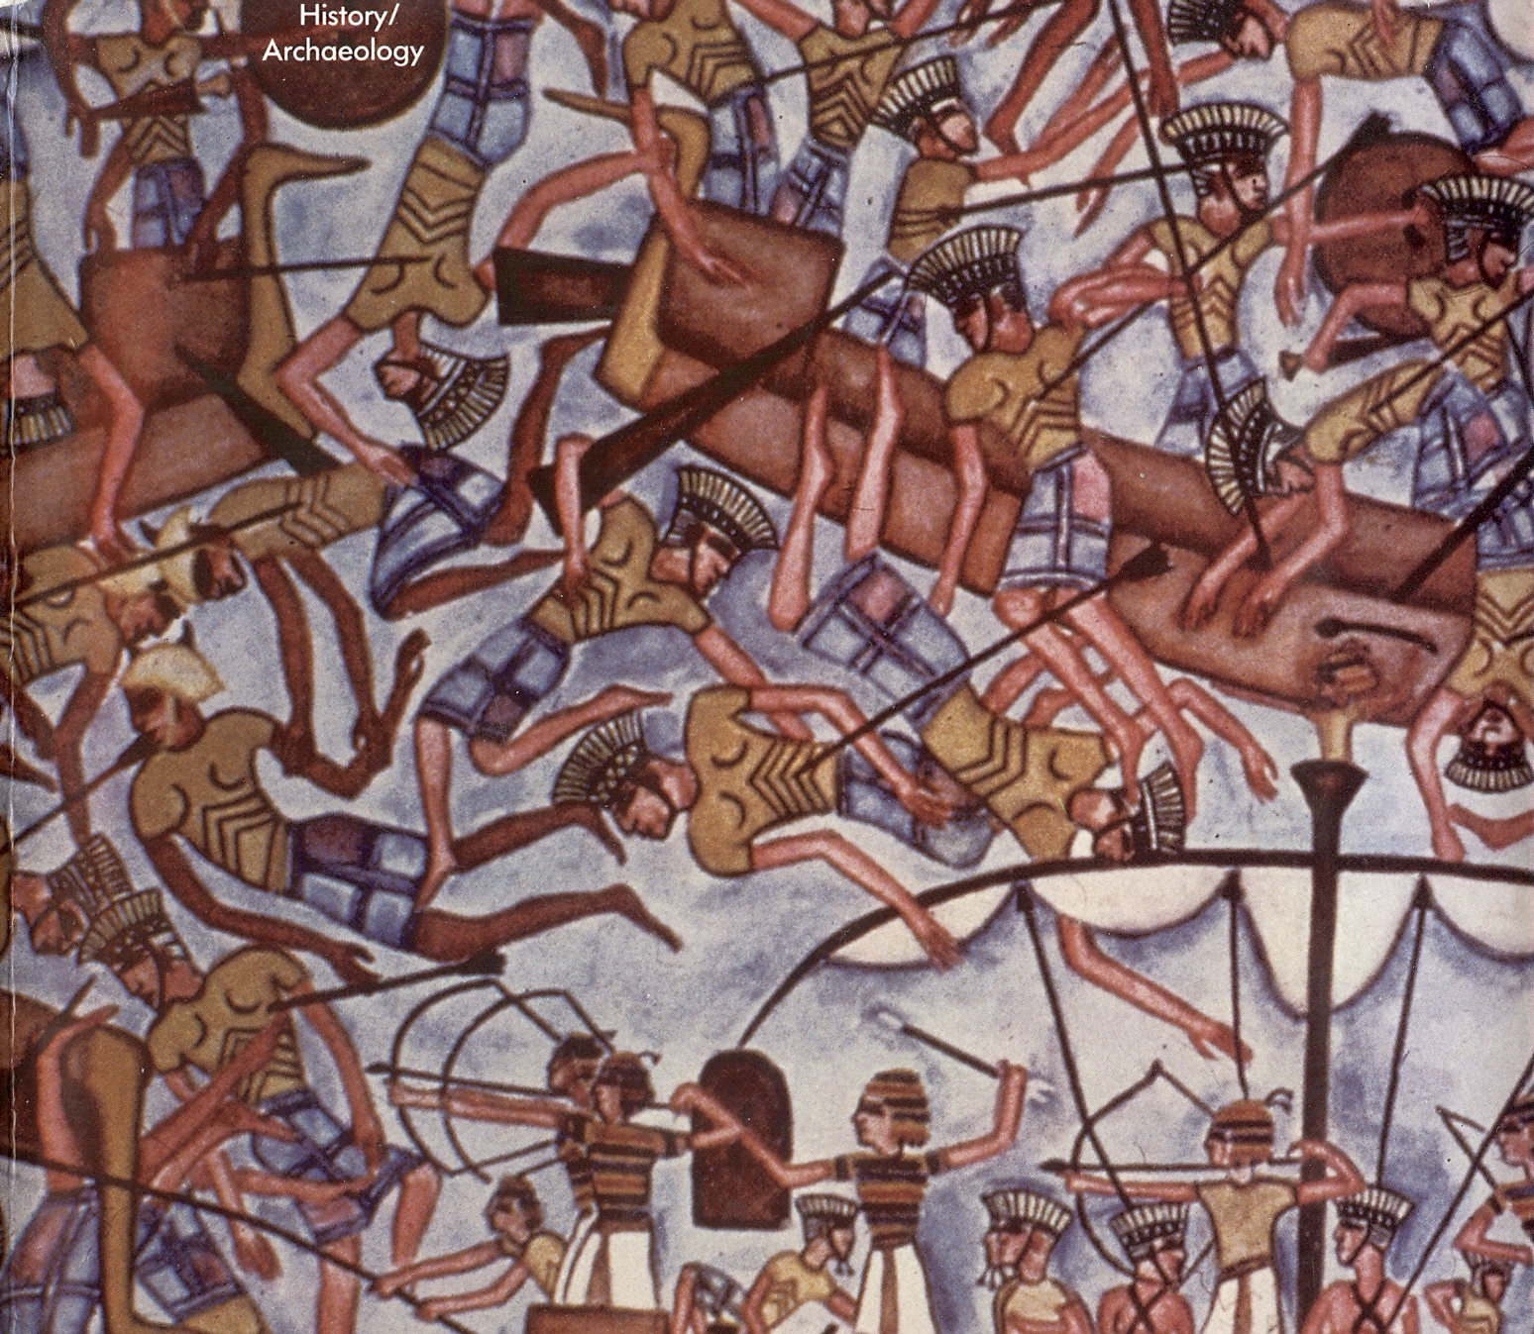

Slide 15
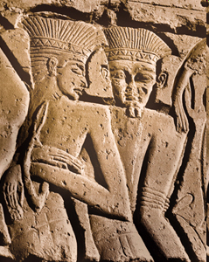
The Sea Peoples with their Distinctive Headdress

Slide 16
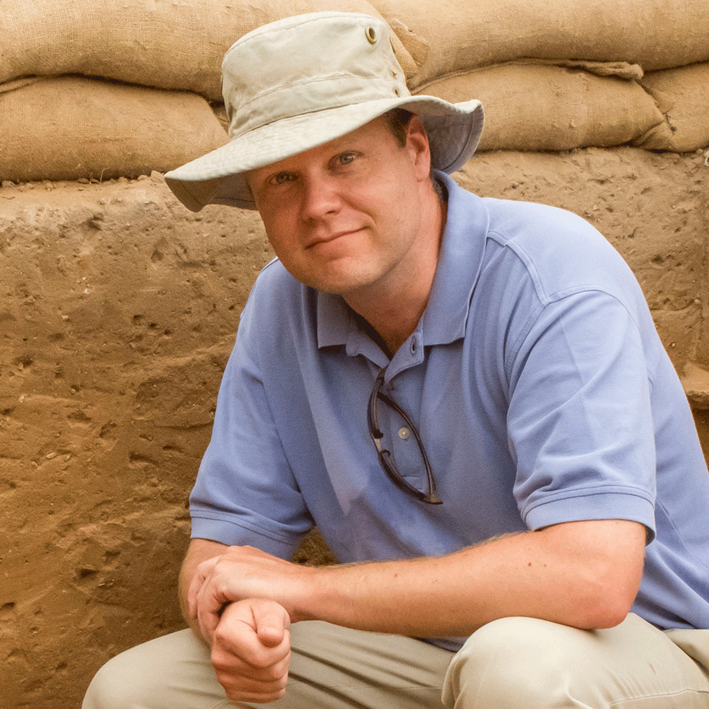
From where did these Sea Peoples come?
• The Bible calls them Cherethites [Crete] and Pelethites (2 Sam 8:18), Philistines [Pelesheth] and Caphtorites (Gen 10:14 30:14)
• Other records have them coming overland.
• DNA records confirm this (Daniel Master)

Slide 17
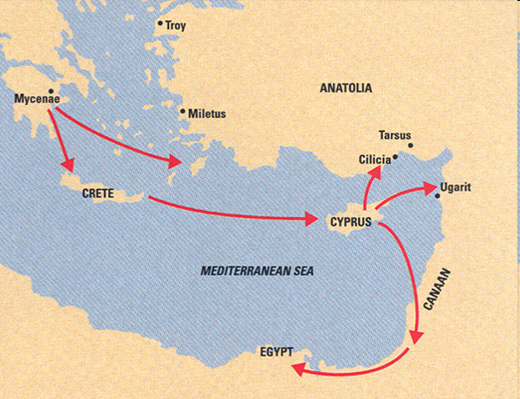
From Where Did the Philistines Come?
Ugarit was one of many Canaanite city-states. and it went down in the general chaos and demise of the Bronze Age caused by the Sea Peoples' invasion around 1200BC. Among the invading Sea Peoples were the Indo-European Philistines, who settled to the south of the Canaanites and gave their name to Palestine.

Slide 18
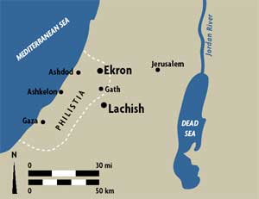
The Philistine Pentapolis

Slide 19
What was the Philistines’ role in the biblical narrative?
--to test Israel’s fidelity to YHWH after the Canaanites had been defeated.
Judges 3:
¹ These are the nations that YHWH left in the land to test those Israelites who had not experienced the wars of Canaan. . .

Slide 20
³ These are the nations: the Philistines (those living under the five Philistine rulers), all the Canaanites, the Sidonians, and the Hivites living in the mountains of Lebanon from Mount Baal-hermon to Lebo-hamath.
⁴ These people were left to test the Israelites—to see whether they would listen to the commands that YHWH had given to their ancestors through Moses.

Slide 21
A. The Background to the Rise of Saul
(1 Samuel 4:1b–8:22)
1. The National Crisis
a. The Military Emergency: The Philistine Threat (4:1b–2)
b. The Spiritual Emergency: The Loss of the Ark of the Covenant (4:3–7:2)
• The Symptom of the Crisis (4:3)
• The Response to the Crisis (4:4)
• The Complication of the Crisis: (4:5–7:2)

Slide 22

The Two Tablets of the Covenant
Stored in the Presence of God

Slide 23
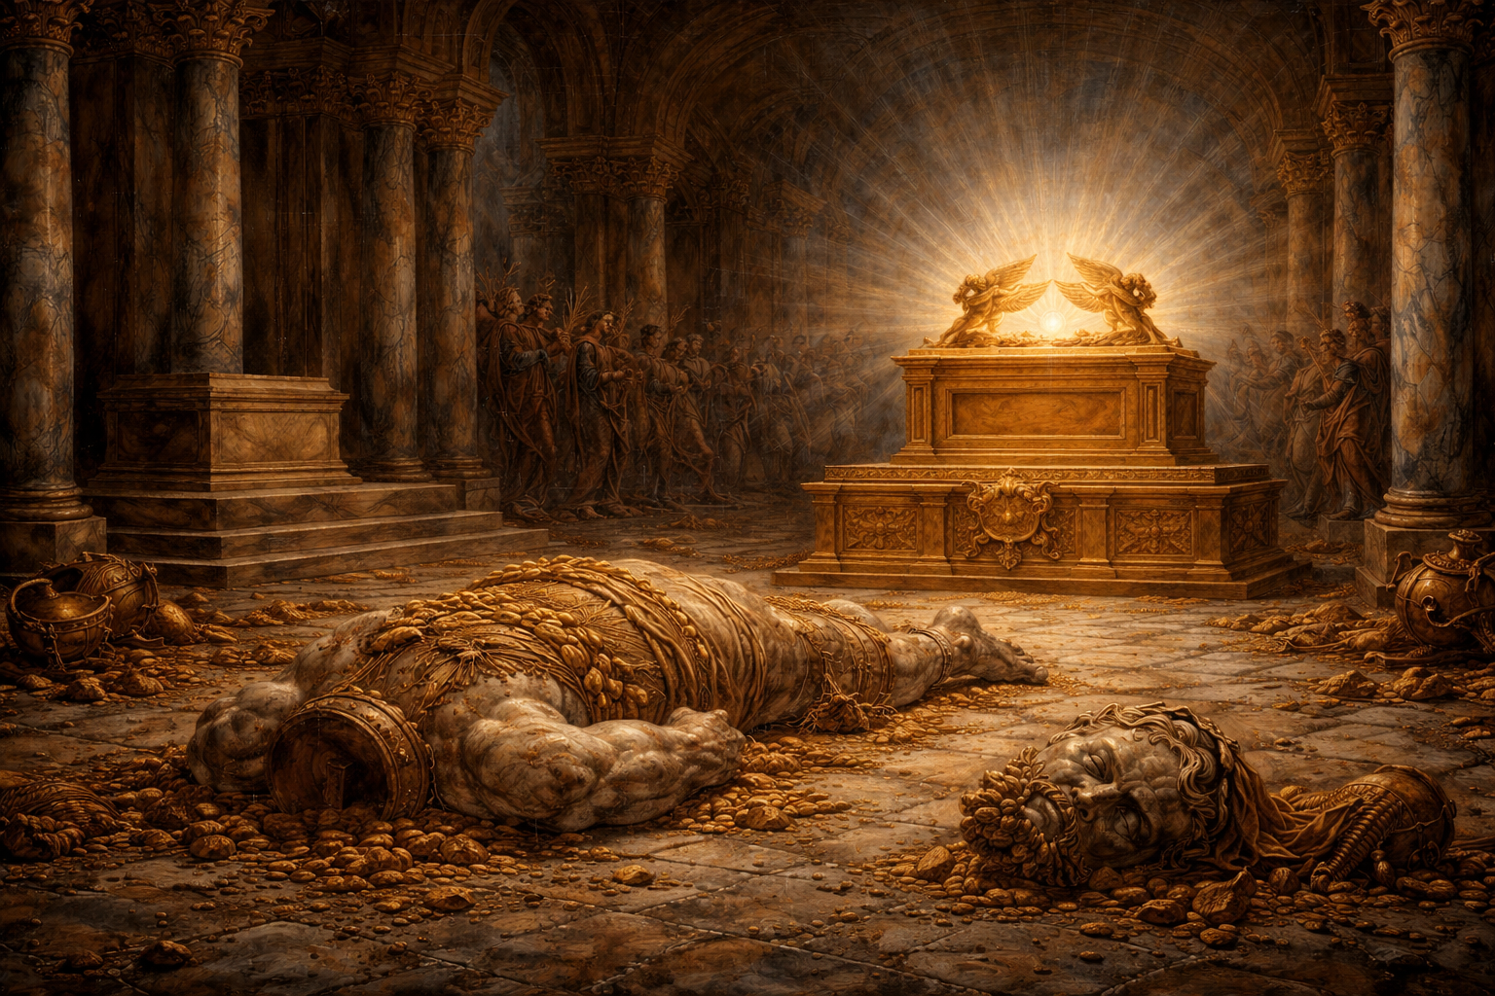
What on earth
has happened
to Dagon?

Slide 24
A. The Background to the Rise of Saul (1 Samuel 4:1b–8:22)
1. The National Crisis (4:1b–7:2)
a. The Military Emergency: The Philistine Threat (4:1b–2)
b. The Spiritual Emergency: The Loss of the Ark of the Covenant (4:3–7:2)
• The Symptom of the Crisis (4:3)
• The Response to the Crisis (4:4)
• The Complication of the Crisis: The Role of the Ark (4:5–7:2)
2. Samuel’s Response to the Crisis (7:3–17)

Slide 25
A. The Background to the Rise of Saul (1 Samuel 4:1b–8:22)
The National Crisis (4:1b–7:2)
Samuel’s Response to the Crisis (7:3–17)
a. His Immediate Response (7:3–14)
• His Call for Repentance (7:3–4)
• His Prayer for Deliverance (7:5–9)
• YHWH’s Answer to His Prayer (7:10–14)
b. His Longer-Range Response (7:15–17)

Slide 26
A. The Background to the Rise of Saul
(1 Samuel 4:1b–8:22)
The National Crisis (4:1b–7:2)
Samuel’s Response to the Crisis (7:3–17)
The People’s Response to the Crisis (8:1–22)

Slide 27
3. The People’s Response to the Crisis (8:1–22)
The Crisis of Leadership in Israel and Samuel’s Reaction (8:1–6)
“Install a king for us to govern us like all the nations.”
Note the ambiguity
Do they want a monarchy like the nations have?
Do they want a king to govern them like the nations’ kings govern them?

Slide 28
From where does this notion come?
Deuteronomy 17:14–20 (Moses’ “Charter for Kingship”)
¹⁴ When you enter the land that YHWH your God is giving you, and you possess it, and you have settled in it, and you say, “I would like to set over myself a king like all the nations that surround me,” ¹⁵ you may certainly set over yourself a king whom YHWH your God chooses. One from among your siblings you may set over yourself as king. You may not install over yourself a foreigner who is not your sibling.

Slide 29
¹⁶ However, he may not accumulate large numbers of horses for himself, and he may not send the people back to Egypt, to multiply horses, because YHWH has said to you, “You must never return that way again.” ¹⁷ And he may not accumulate for himself women, lest his heart turns aside, and silver and gold he may not accumulate excessively for himself.

Slide 30
¹⁸ However, as he sits on the throne of his kingdom, for himself he must write a copy of this Torah [Teaching] on a scroll before the Levitical priests.
¹⁹ And it must accompany him, and he must read it every day of his life so that he may learn to demonstrate trusting awe before YHWH his God, keeping all the words of this Torah [Covenant Teaching] and all these ordinances by doing them, ²⁰ lest his heart rise above his siblings and lest he turn aside from the command—either to the right or to the left, so that his reign and those of his sons may be extended over his kingdom in the midst of Israel.

Slide 31
3. The People’s Response to the Crisis (8:1–22)
The Crisis of Leadership in Israel and Samuel’s Reaction (8:1–6)
YHWH’s Reaction to the People’s Response (8:7–18)
• His Interpretation of the People’s Demand for Samuel (8:7–9a)
• His Warning for the People (8:9b–18)

Slide 32
• His Warning for the People (8:9–18)
⁶ Samuel disapproved (“The matter was evil in Samuel’s eyes”) of their request for a king to govern them, and he prayed to YHWH for guidance. ⁷ “Do everything they say to you,” YHWH replied, “for they are rejecting me, not you. They don’t want me to be their king any longer. ⁸ Ever since I brought them from Egypt they have continually abandoned me and followed other gods. And now they are treating you the same way. ⁹ Do as they ask, but warn them sternly and declare to them the oracle concerning the king ((מִשְׁפַט הַמֶּלֶךְ who will exercise royal authority (יִמְלֹךְ) over them.

Slide 33
¹⁰So Samuel declared all YHWH’s words to the people who were asking him for a king. ¹¹ “This is will be the policy of the king who will reign over you,” Samuel said. “The king will conscript your sons for himself and assign them to his chariots and his horsemen, making them run into battle ahead of his chariots. ¹² For himself he will appoint them as generals and captains in his army, and some he will appoint to plow his fields and harvest his crops, and some to forge his weapons and equipment for his chariot. ¹³ He will conscript your daughters from you and force them to make perfumes or cook and bake for himself.

Slide 34
¹⁴ He will take away the best of your fields and vineyards and olive groves and give them to his favored subjects. ¹⁵ He will take a tenth of your grain and your grape harvest and distribute it among his officers and his favored subjects. ¹⁶ He will take your male and female servants and demand the finest of your cattle and donkeys for his own use. ¹⁷ He will demand a tenth of your flocks, and you yourselves will become his subjects, even his servants. ¹⁸ When that day comes, you will beg for relief from this king you are demanding, but then YHWH will not help you.”

Slide 35
3. The People’s Response to the Crisis (8:1–22)
The Crisis of Leadership in Israel and Samuel’s Reaction (8:1–6)
YHWH’s Reaction to the People’s Response (8:7–18)
• His Interpretation of the People’s Demand for Samuel (8:7–9a)
• His Warning for the People (8:9b–18)
• His Reaffirmation of His Reaction (8:19–22)

Slide 36
B. Samuel and the Emergence of Kingship in Israel (8:1–16:23)
The Rise of Saul (9:1–12:25)
a. The Narrator’s Introduction of Saul (9:1–14a)
b. Samuel’s Private Commissioning of Saul (9:15–10:16)
• Preparation for Saul’s Commissioning (שִׁלֵּחַ, 9:1–27)
• The Nature of Saul’s Commissioning
“anointing as ruler” (הֲלוֺא מָשַׁחֲךָ יהוה עַל־נַחֲלָתוֺ לְנָגִיד, 10:1)

Slide 37
Samuel’s Opening Words to Saul (9:20–21)
¹⁹ “I am the seer!” Samuel replied. “Go up to the place of worship ahead of me. We will eat there together, and in the morning I’ll tell you what you want to know and send you on your way.
²⁰ And don’t worry about those donkeys that were lost three days ago, for they have been found. And I am here to tell you that you and your family are the focus of all Israel’s hopes.”
²¹ Saul replied, “But I’m only from the tribe of Benjamin, the smallest tribe in Israel, and my family is the least important of all the families of that tribe! Why are you talking like this to me?”

Slide 38
b. Samuel’s Private Commissioning of Saul (9:15–10:16)
• Preparation for Saul’s Commissioning (שִׁלֵּחַ, 9:1–27)
• The Nature of Saul’s Commissioning
“anointing as ruler” (הֲלוֺא מָשַׁחֲךָ יהוה עַל־נַחֲלָתוֺ לְנָגִיד, 10:1)
• The Authentication of Saul’s Commissioning (10:2–13)
• Epilogue to Saul’s Commissioning (10:14–16)

Slide 39
b. Samuel’s Private Commissioning of Saul (9:15–10:16) c. YHWH’s Public Election of Saul as King (10:17–27)
• Samuel’s Preamble to the Election Ritual (10:1710) • The Means of Divine Election (10:20–21)
• The Presentation Nature of Saul’s Commissioning
“anointing as ruler” (הֲלוֺא מָשַׁחֲךָ יהוה עַל־נַחֲלָתוֺ לְנָגִיד, 10:1)
• The Authentication of Saul’s Commissioning (10:2–13)
• Epilogue to Saul’s Commissioning (10:14–16)

Slide 40
B. Samuel and the Emergence of Kingship in Israel (8:1–16:23)
The Rise of Saul (9:1–12:25)
a. The Narrator’s Introduction of Saul (9:1–14a)
b. Samuel’s Private Commissioning of Saul (9:15–10:16)
c. YHWH’s Public Election of Saul as King at Mizpah (10:17–27)
d. The Confirmation of Saul’s Election (11:1–12:25)
• Saul’s Rescue of Jabesh Gilead (11:1–11:13)
• The Reaffirmation of Saul’s Commissioning at Gilgal (11:14–12:25)

Slide 41
b. Samuel’s Private Commissioning of Saul (9:15–10:16) c. YHWH’s Public Election of Saul as King (10:17–27)
• Samuel’s Preamble to the Election Ritual (10:17–19) • The Means of Divine Election (10:20–21)
• The Presentation Nature of Saul’s Commissioning
“anointing as ruler” (הֲלוֺא מָשַׁחֲךָ יהוה עַל־נַחֲלָתוֺ לְנָגִיד, 10:1)
• The Authentication of Saul’s Commissioning (10:2–13)
• Epilogue to Saul’s Commissioning (10:14–16)

Slide 42
A Comparison of the Narrator’s Portrayal of the Anointings of Saul and David

Slide 43
A Comparison of the Anointing Accounts of Saul and David
1 Samuel 10:1[1–13] | 1 Samuel 16:13[1–13]
The anointing happened in an unnamed town in the region of Zuph, presumably Samuel’s home in Ephraim (cf. 9:5–21). | The anointing happened in Bethlehem, David’s hometown and the home of Boaz, as well as the burial place of Rachel, Saul’s ancestress (Gen 35:19).
The anointing was preceded by a dinner with thirty guests, but then conducted as a private affair on the street at the edge of the town at dawn with no witnesses (9:22–27). | The anointing was preceded by a sacrifice to YHWH (zābaḥ layhwh) and conducted in the presence of the elders of the town, and Jesse’s family.

Slide 44
A Comparison of the Anointing Accounts of Saul and David
1 Samuel 10:1[1–13] | 1 Samuel 16:13[1–13]
The election involved YHWH merely announcing to Samuel privately that he was to anoint “a man from the land of Benjamin” (9:16–17). | The election involved an elaborate public process, climaxing in calling David in from the field (he had not even been invited to the sacrifice!), and identifying him as the chosen one (v. 12).
The instrument of anointing was a pak, an ordinary flask, a juglet (10:1) | The instrument of anointing was the official “horn of the oil” (qeren, 16:1, 13).
The verb of anointing was šāpak, “to pour” (10:1) | The verb of anointing was māšaḥ, “to anoint” (16:13).

Slide 45
A Comparison of the Anointing Accounts of Saul and David
1 Samuel 10:1[1–13] | 1 Samuel 16:13[1–13]
Samuel responded verbally to the event with a rhetorical question, “Has not YHWH anointed you ruler (nāgîd) over his human grant (naḥălâ). | No verbal response was needed. Samuel left immediately for Ramah.

Slide 46
A Comparison of the Anointing Accounts of Saul and David
1 Samuel 10:1[1–13] | 1 Samuel 16:13[1–13]
YHWH confirmed his election of Saul with three attesting signs (ʾôtôt, 10:2–13), linked to the “Spirit of YHWH/God” rushing upon him upon him (ṣālaḥ ʿālāyw). That Spirit would come and go and sometimes be replaced by “a disastrous spirit from God” (rûaḥ rāʿâ mēʾēt yhwh; 16:14–23). | YHWH confirmed his election of David by having “the Spirit YHWH” (rûaḥ YHWH) rush to him (ṣālaḥ ʾel) [and remain with him] from that day forward. Remarkably, the Spirit of YHWH is never mentioned again in the Samuel narrative until the end, where David acknowledges the inspiration of “the Spirit of YHWH” behind his literary work (2 Sam 23:2).

Slide 47
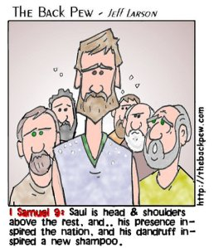
a. Was Saul the right man for the throne?
• His Benjaminite status (9:1)
• His reputation as a warrior (9:1b)
• His physical qualities (9:2)

Slide 48
Saul’s qualifications for what lay ahead?
• His Benjaminite status (9:1)
• His reputation as a warrior (9:1b)
• His physical qualities (9:2)
• His practical reliability (9:3–4)
• His respect for a social inferior (9:5–10)
• His sensitivity to father and prophet (9:5–10)
Later
• His self-deprecating disposition (v. 21)

Slide 50
Did Samuel not realize there was a problem with the anointing of Saul?
The timing was off in chapter 8 (cf. Deut 17:13).
The motivation was wrong. “Give us a king like the nations.”
He was not what Jacob had in mind in Genesis 49:10.
He was exposed by lot (10:17–24)
He was from Benjamin (Judges 19–21).
Later he recognized that the demand for a king was of a piece with their history of rebellion against YHWH (1 Sam 12:6–15).

Slide 51
Remarkably YHWH will charge Samuel to anoint Saul, and David and Samuel in a backhanded way (10:1) will refer to Saul as YHWH’s anointed—but the narrator of the Samuel and David story will never do so.
The narrator of the account of Saul is Shakespearean in his portrayal of the man as the ultimate tragic figure:
He was offered the world, but there was no way he could achieve it. He had too many character flaws, and in any case he was not the man God had in mind from the beginning.

Slide 52
b. What about 1 Samuel 13:13–14?
¹³ And Samuel said to Saul, “You have done foolishly. You have not kept the command of YHWH your God, with which he commanded you. For then YHWH would have established your kingdom over Israel forever.
¹⁴ But now your kingdom shall not continue. YHWH has sought out a man after his own heart, and YHWH has commanded him to be prince over his people, because you have not kept what YHWH commanded you.”

Slide 53
How did the Israelites respond to the test represented by the Philistines?
a. Instead of trusting YHWH, they treated his ark of the covenant as a good luck charm.
b. Instead of letting God be king, they demanded a king like the nations around had.
c. Instead of protesting the choice of Saul (not a Judahite), they accepted him as their king (chap. 12)
After this Saul’s problems became his own. Instead of embodying righteousness and trusting YHWH (Deut 17:18–20) he was personally faithless.

Slide 54
What lessons can we learn from Saul?
To listen to the voice of God is better than sacrifice (15:19–23).
It is perfectly acceptable and right for God continually to test his servants regarding their fidelity to him, but it is absolutely forbidden for the servant to test the fidelity of their divine Lord.

Slide 55
We need to listen to Samuel:
So fear YHWH—demonstrate trusting awe in him–and serve him with integrity with all your heart; consider what great things he has done for you
We need to pray YHWH’s prayer daily:
Hallowed be YHWH’s name by our flourishing with him
and by our steadfast endurance in the time of testing.
“Lead us not into the test, but rescue us from the evil”—going after any other gods. (Matt 6:13)—for the kingdom is YHWH’s forever and ever. Amen.

Slide 56
Teach me thy way, O Lord (B. Mansell Ramsey, 1919)
1 Teach me thy way, O Lord; teach me thy way!
Thy guiding grace afford; teach me thy way!
Help me to walk aright, more by faith, less by sight;
lead me with heav’nly light; teach me thy way!
2 When I am sad at heart, teach me thy way!
When earthly joys depart, teach me thy way!
In hours of loneliness, in times of dire distress,
in failure or success, teach me thy way!

Slide 57
3 When doubts and fears arise, teach me thy way!
When storms o'erspread the skies, teach me thy way!
Shine thro' the cloud and rain, thro' sorrow, toil, and pain;
make thou my pathway plain; teach me thy way!
4 Long as my life shall last, teach me thy way!
Where’er my lot be cast, teach me thy way!
Until the race is run, until the journey’s done,
until the crown is won, teach me thy way!

