Slide 1
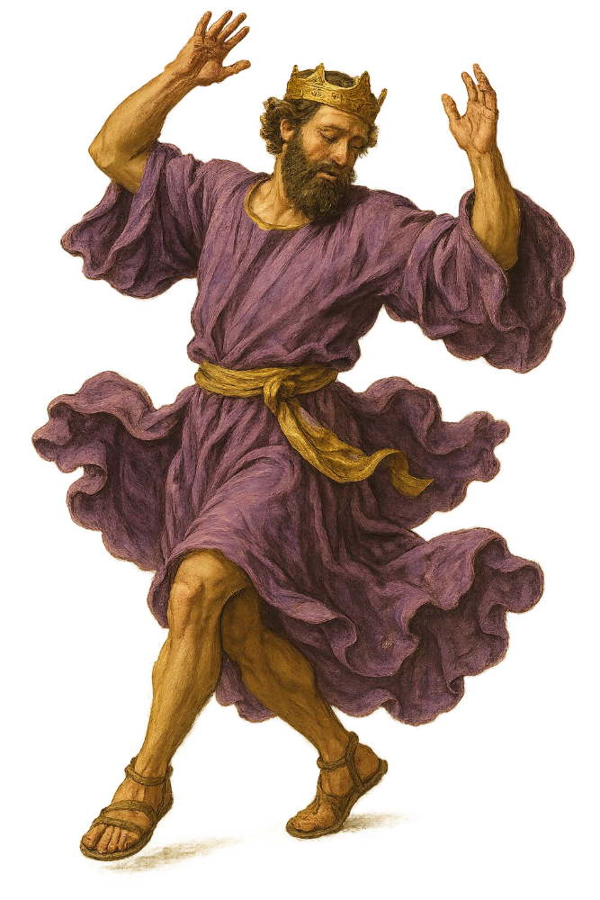
“Dancing with David”
The King after God’s Own Mind
Daniel I. Block
Veritas Community
College Church
October 11, 2026

Slide 2
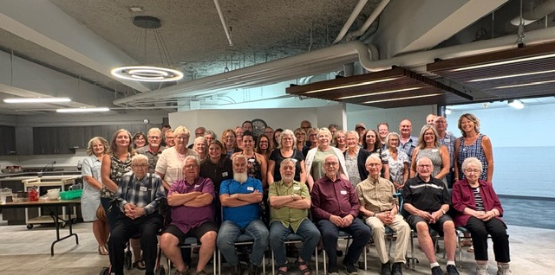

Slide 3
#4
The Dramatic Introduction of the Star Dancer:
The Man in God’s Own Mind (1 Samuel 16–17)

Slide 4
David:
The Man after YHWH’s Own Heart and Mind
(1 Samuel 13:13–14)
¹³ And Samuel said to Saul, “You have done foolishly. You have not kept the charge of YHWH your God, with which he charged you. For then YHWH would have established your kingdom over Israel forever.
¹⁴ But now your kingdom shall not continue. YHWH has sought out a man after his own heart/mind, and YHWH has charged him to be prince over his people, because you have not kept YHWH’s charge for you.”

Slide 5
A. YHWH’s Election of the Man He Had in Mind from the Beginning (16:1–23)
This time the anointing of the king occurred entirely under the initiative of YHWH. YHWH rebuffed Samuel for grieving over Saul and told him to go to Bethlehem to officiate at a zebaḥ meal.
YHWH had chosen his man from the family of Jesse. When David was identified, Samuel anointed him, and the Spirit of YHWH left Saul and came mightily upon the king-elect.

Slide 6
^{16:1} YHWH said to Samuel, “How long will you grieve over Saul, since I have rejected him from being king over Israel? Fill your horn (קֶרֶן) with oil, and go. I will send you to Jesse the Bethlehemite, for I have provided for myself a king among his sons.” (כִּי-רָאִיתִי בְּבָנָיו לִי מֶלֶךְ.)
² And Samuel said, “How can I go? If Saul hears it, he will kill me.”
And YHWH said, “Take a heifer with you and say, ‘I have come to sacrifice to YHWH.’ ³ And invite Jesse to the sacrifice, and I will show you what you shall do. And you shall anoint for me him whom I declare to you.”

Slide 7
1. YHWH’s Charge to Samuel (vv. 1–3)
Notes:
The instrument of anointing.
YHWH’s total control of this procedure and the target of Samuel’s action (no lot here).

Slide 8
2. Samuel’s Response (vv. 4–5)
⁴ Samuel did what YHWH commanded and came to Bethlehem.
The elders of the city came to meet him trembling and said, “Do you come peaceably?” (שָׁלוֺם)
⁵ And he said, “Peaceably (שָׁלוֺם); I have come to sacrifice to YHWH. Consecrate yourselves (הִתְקַדֵּשׁ) and come with me to the sacrifice.” And he consecrated (וַיְקַדֵּשׁ) Jesse and his sons and invited them to the sacrifice.

Slide 9
Notes:
Why are the elders of Bethlehem worried?
Why do they need to sacrifice?
Why the emphasis on consecration” (הִתְקַדֵּשׁ/קִדֵּשׁ)

Slide 10
3. The Frustrating Process of Divine Election (vv. 6–10)
⁶ When they came, he looked on Eliav and thought, “Surely YHWH's anointed is before him.”
⁷ But YHWH said to Samuel, “Do not look on his appearance or on the height of his stature, because I have rejected (מָאַס) him.
For YHWH sees not as man sees: man looks on the outward appearance, but YHWH looks on the heart.”
⁸ Then Jesse called Abinadav and made him pass before Samuel. And he said, “Neither has YHWH chosen (בָּחַר) this one.”
⁹ Then Jesse made Shammah pass by. And he said, “Neither has YHWH chosen(בָּחַר) this one.” ¹⁰ And Jesse made seven of his sons pass before Samuel. And Samuel said to Jesse, “YHWH has not chosen(בָּחַר) from any of these.”

Slide 11
4. The Surprising Resolution of the Frustration (vv. 11–13)
¹¹ Then Samuel said to Jesse, “Are all your sons here?” And he said, “There remains yet the youngest, but look, he is tending the sheep.”
And Samuel said to Jesse, “Send and get him, for we will not sit down till he comes here.”
¹² And he sent and brought him in. Now he was tanned [ruddy] and had beautiful eyes and was handsome. And YHWH said, “Arise, anoint him, for this is he.”

Slide 12
The Surprising Resolution of the Frustration
Notes:
After emphasizing that YHWH does not look on the outside like people do, why this emphasis on David’s physical appearance. (Cf. Daniel and his buddies in Dan 1).

Slide 13
The Surprising Resolution of the Frustration
¹³ Then Samuel took the horn of oil and anointed him in the midst of his brothers. And the Spirit of YHWH rushed upon David from that day forward. And Samuel rose up and went to Ramah.
Notes:
What is the significance of the Spirit in this instance?

Slide 14
A Comparison of the Narrator’s Portrayal of the Anointings of Saul and David

Slide 15
A Comparison of the Anointing Accounts of Saul and David
1 Samuel 10:1[1–13] | 1 Samuel 16:13[1–13]
The anointing happened in an unnamed town in the region of Zuph, presumably Samuel’s home in Ephraim (cf. 9:5–21). | The anointing happened in Bethlehem, David’s hometown and the home of Boaz, as well as the burial place of Rachel, Saul’s ancestress (Gen 35:19).
The anointing was preceded by a dinner with thirty guests, but then conducted as a private affair on the street at the edge of the town at dawn with no witnesses (9:22–27). | The anointing was preceded by a sacrifice to YHWH (zābaḥ layhwh) and conducted in the presence of the elders of the town, and Jesse’s family.

Slide 16
A Comparison of the Anointing Accounts of Saul and David
1 Samuel 10:1[1–13] | 1 Samuel 16:13[1–13]
The election involved YHWH merely announcing to Samuel privately that he was to anoint “a man from the land of Benjamin” (9:16–17). | The election involved an elaborate public process, climaxing in calling David in from the field (he had not even been invited to the sacrifice!), and identifying him as the chosen one (v. 12).
The instrument of anointing was a pak, an ordinary flask, a juglet (10:1) 3–4 inches tall. | The instrument of anointing was the official “horn of the oil” (qeren, 16:1, 13).

Slide 17
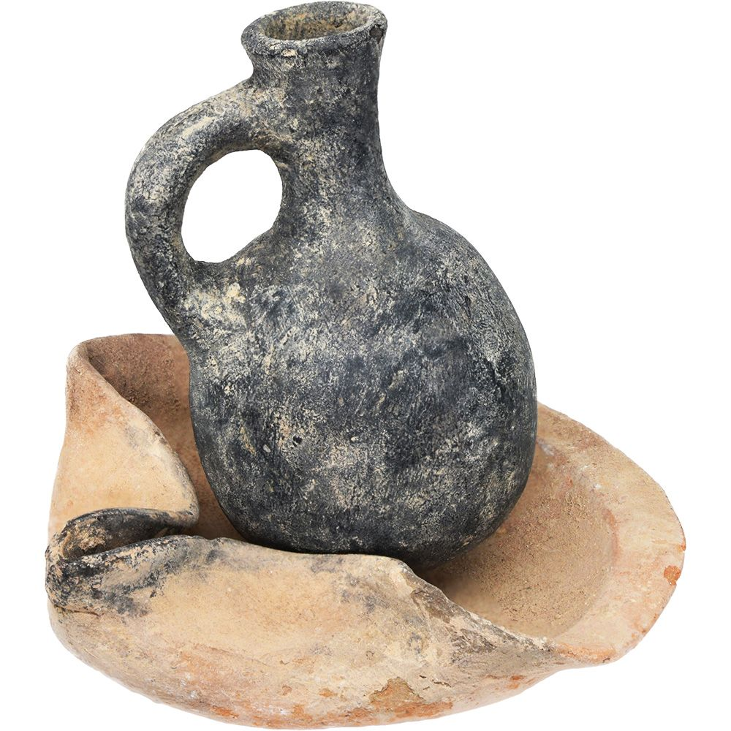
An Israelite pak
8th–7th century BC

Slide 18
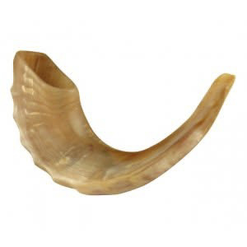
A Ram’s Horn for Anointing

Slide 19
A Comparison of the Anointing Accounts of Saul and David
1 Samuel 10:1[1–13] | 1 Samuel 16:13[1–13]
The verb of anointing was šāpak, “to pour” (10:1) | The verb of anointing was māšaḥ, “to anoint” (16:13).
Samuel responded verbally to the event with a rhetorical question, “Has not YHWH anointed you ruler (nāgîd) over his human grant (naḥălâ). | No verbal response was needed. Samuel left immediately for Ramah.

Slide 20
A Comparison of the Anointing Accounts of Saul and David
1 Samuel 10:1[1–13] | 1 Samuel 16:13[1–13]
YHWH confirmed his election of Saul with three attesting signs (ʾôtôt, 10:2–13), linked to the “Spirit of YHWH/God” rushing upon him upon him (ṣālaḥ ʿālāyw). That Spirit would come and go and sometimes be replaced by “a disastrous spirit from God” (rûaḥ rāʿâ mēʾēt yhwh; 16:14–23). | YHWH confirmed his election of David by having “the Spirit YHWH” (rûaḥ YHWH) rush to him (ṣālaḥ ʾel) [and remain with him] from that day forward. Remarkably, the Spirit of YHWH is never mentioned again in the Samuel narrative until the end, where David acknowledges the inspiration of “the Spirit of YHWH” behind his literary work (2 Sam 23:2).

Slide 21
2 Samuel 23:1–4
^{23:1} Now these are the last words of David:
The oracle of David, the son of Jesse,
the oracle of the man who was raised on high,
the anointed of the God of Jacob,
the sweet psalmist of Israel:
² “The Spirit of YHWH speaks by me;
his word is on my tongue.
³ The God of Israel has spoken;
the Rock of Israel has said to me:
When one rules justly over men,
ruling in the fear of God,
⁴ He dawns on them like the morning light,
like the sun shining forth on a cloudless morning,
like rain that makes grass to sprout from the earth.

Slide 22
Psalm 51
⁷ Purge me with hyssop, and I shall be clean;
wash me, and I shall be whiter than snow.
⁸ Let me hear joy and gladness;
let the bones that you have broken rejoice.
⁹ Hide your face from my sins,
and blot out all my iniquities.
¹⁰ Create in me a clean heart, O God,
and renew a right spirit within me.
¹¹ Cast me not away from your presence,
and take not your Holy Spirit from me.
¹² Restore to me the joy of your salvation,
and uphold me with a willing spirit.

Slide 23
5. The Introduction of David to Saul (16:14–23)
a. The Diagnosis of and Prescription for Saul’s Malady (vv. 14–15)
¹⁴ Now the Spirit of YHWH departed from Saul, and a harmful spirit from YHWH tormented him. ¹⁵ And Saul's servants said to him, “Look now, a harmful spirit from God is tormenting you.
¹⁶ Let our lord now command your servants who are before you to seek out a man who is skillful in playing the lyre, and when the harmful spirit from God is upon you, he will play it, and you will be well.”

Slide 24
The Symptoms and Diagnoses of and Prescription for Saul’s Malady (vv. 14–15)
Saul’s Response to the Diagnosis and Prescription (vv. 17–19)
¹⁷ So Saul said to his servants, “Provide for me a man who can play well and bring him to me.”
¹⁸ One of the young men answered, “Look, I have seen a son of Jesse the Bethlehemite, who is skillful in playing, a man of valor, a man of war, prudent in speech, and a man of good presence, and YHWH is with him.”
¹⁹ So Saul sent messengers to Jesse and said, “Send me David your son, who is with the sheep.”

Slide 25
The Symptoms and Diagnoses of and Prescription for Saul’s Malady (vv. 14–15)
Saul’s Response to the Diagnosis and Prescription (vv. 17–19)
David’s Giftedness as a Musical Therapist (16:20–23)
²⁰ And Jesse took a donkey loaded with bread and a skin of wine and a young goat and sent them by David his son to Saul.

Slide 26
²¹ And David came to Saul and entered his service. And Saul loved him greatly, and he became his armor-bearer.
²² And Saul sent to Jesse, saying, “Let David remain in my service, for he has found favor in my sight.” ²³ And whenever the harmful spirit from God was upon Saul, David took the lyre and played it with his hand. So Saul was refreshed and was well, and the harmful spirit departed from him.

Slide 27
B. YHWH’s Response to the National Crisis (17:1–18:9)
David: The Man after the Yahweh’s Own Heart
David's battle with Goliath is paradigmatic, introducing the reader to many themes that will dominate the entire David narrative. This is the longest episode in the story of David 1–2 Samuel (58 verses) and second longest in Samuel–Kings (Solomon’s prayer in 1 Kgs 8 is 66 verses).

Slide 28
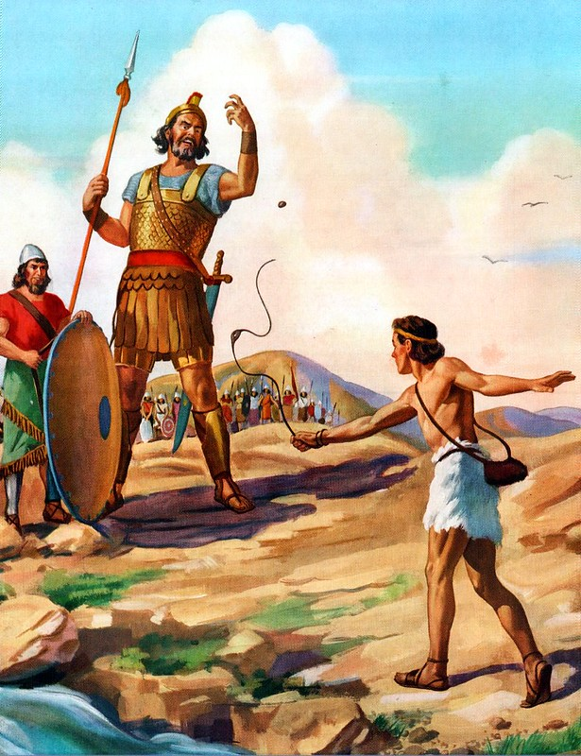
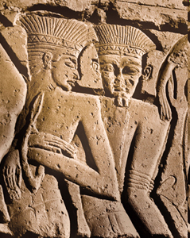
And what shall we do with Goliath?
What’s wrong with this picture?
Let’s start with the hair?

Slide 29
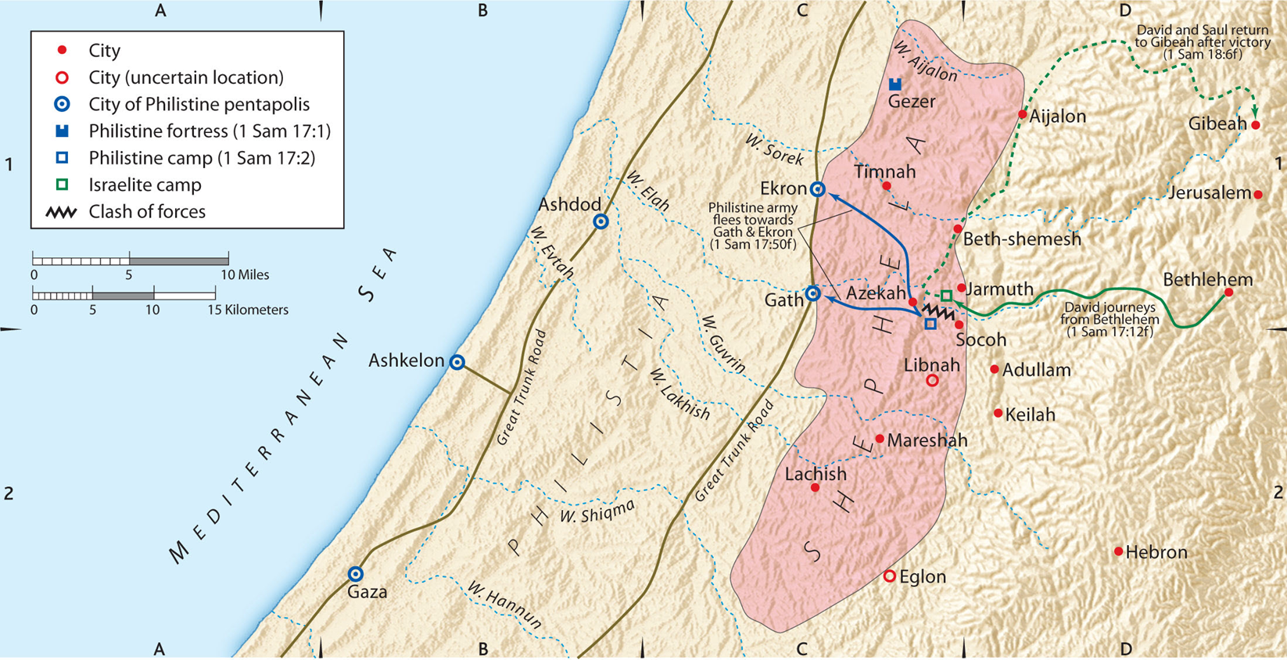
1. The Nature and Context of the Crisis (vv. 1–3)

Slide 30
The Nature and Context of the Crisis (vv. 1–3)
2. The Physical Challenge: Goliath (vv. 4–7)

Slide 31
⁴ Then Goliath, a Philistine champion from Gath, came out of the Philistine ranks to face the forces of Israel. He was over nine feet tall!
⁵ He wore a bronze helmet, and his bronze coat of scale [chest and back] armor mail weighed 125 pounds. ⁶ He also wore bronze shin armor, and he carried a bronze javelin on his shoulder. ⁷ The shaft of his spear was like a weaver’s beam, tipped with an iron spearhead that weighed 15 pounds. His armor bearer walked ahead of him carrying a shield.

Slide 32
2. The Physical Challenge (vv. 4–7)
His status: the Philistine champion (אִישׁ הַבֵּנַיִם)

Slide 33

Jonathan Toews
His third Stanley Cup in six years

Slide 34
2. The Physical Challenge (vv. 4–7)
His status: the Philistine champion (אִישׁ הַבֵּנַיִם)
His name: Golyath (גָּלְיָת, cf. Ugaritic glyt)
Tsumura: This may be an ancient name for a giant-hero
cf. 1 Chr 20:5, “Elhanan killed Lahmi the brother of Golyath the Gittite”
c. His size: 9 feet 9 inches (6 cubits and a span)

Slide 35
And what shall we do with Goliath?

Slide 36
DSS, LXX, Josephus Ant. 6.171 read “four cubits”—but the weight and dimensions of the armor require a larger person.
Tsumura—such gigantism may have resulted from dysfunction of the pituitary gland. W. J. Martin (U. of Liverpool) mentions a man John Middleton (1600) buried in Hale near Liverpool who was 9 feet 3 inches. Archaeologists have discovered skeletons 3.2 meters (8 feet), when the average height of adult males was ca. 5 feet.

Slide 37
2. The Physical Challenge (vv. 4–7)
  His social status: the Philistine champion (אִישׁ הַבֵּנַיִם)
  His name: Golyath (גָּלְיָת, cf. Ugaritic glyt
His size: 9 feet 9 inches (6 cubits and a span)
His armor: 125-pound coat of mail
–an armor-bearer carrying his shield.
e. His spiritual status: an uncircumcised Philistine (17:26)
3. The Psychological Challenge (vv. 4–7)

Slide 38
Golyath’s Taunt (vv. 8–11)
⁸ Golyath stood and shouted a taunt across to the Israelites. “Why are you all coming out to fight?” he called. “I am the Philistine champion, but you are only the servants of Saul. Choose one man [as your champion] to come down here and fight me! ⁹ If he kills me, then we will be your slaves. But if I kill him, you will be our slaves! ¹⁰ I defy the armies of Israel today! Send me a man who will fight me!” ¹¹ When Saul and the Israelites heard this, they were terrified and deeply shaken.

Slide 39
The Nature and Context of the Crisis (vv. 1–3)
The Physical Challenge (vv. 4–7)
The Psychological Challenge: Golyath’s Taunt (vv. 8–11)
The Arrival of David (vv. 12–20)

Slide 40
1. The Nature and Context of the Crisis (vv. 1–3)

Slide 41
The Nature and Context of the Crisis (vv. 1–3)
The Physical Challenge (vv. 4–7)
The Psychological Challenge: Golyath’s Taunt (vv. 8–11)
The Arrival of David (vv. 12–20)
The Problem in the Israelite Camp (vv. 21–25)
David’s Response to the Challenge (vv. 26–37)

Slide 42
6. David’s Response to the Challenge (17:26–37)
His Questions (vv. 26–30)
⁶ David asked the soldiers standing nearby, “What will a man get for killing this Philistine and ending his defiance of Israel? Who is this uncircumcised Philistine anyway, that he is allowed to defy the armies of the living God?”
²⁷ And these men gave David the same reply. They said, “Yes, that is the reward for killing him.”

Slide 43
²⁸ But when David’s oldest brother, Eliav, heard David talking to the men, he was angry. “What are you doing around here anyway?” he demanded. “What about those few sheep you’re supposed to be taking care of? I know about your pride and deceit. You just want to see the battle!”
²⁹ “What have I done now?” David replied. “I was only asking a question!” ³⁰ He walked over to some others and asked them the same thing and received the same answer.

Slide 44
6. David’s Response to the Crisis (17:26–37)
His Questions (vv. 26–30)
His Offer to Serve as Israel’s Champion (vv. 31–37)
³¹ Then David’s question was reported to King Saul, and the king sent for him.
³² “Don’t worry about this Philistine,” David told Saul. “I’ll go fight him!”
³³ “Don’t be ridiculous!” Saul replied. “There’s no way you can fight this Philistine and possibly win! You’re only a boy, and he’s been a man of war since his youth.”

Slide 45
³⁴ But David persisted. “I have been taking care of my father’s sheep and goats,” he said. “When a lion or a bear comes to steal a lamb from the flock, ³⁵ I go after it with a club and rescue the lamb from its mouth. If the animal turns on me, I catch it by the jaw and club it to death. ³⁶ I have done this to both lions and bears, and I’ll do it to this uncircumcised Philistine, too, for he has defied the armies of the living God! ³⁷ YHWH who rescued me from the claws of the lion and the bear will rescue me from this Philistine!”
Saul finally consented. “All right, go ahead,” he said. “And may YHWH be with you!”

Slide 46
7. YHWH’s Resolution of the Crisis (17:38–54)
a. The Champion’s Preparation (17:38–40)
³⁸ Then Saul gave David his own armor—a bronze helmet and a coat of mail. ³⁹ David put it on, strapped the sword over it, and took a step or two to see what it was like, for he had never worn such things before.
“I can’t go in these,” he protested to Saul. “I’m not used to them.”
So David took them off again. ⁴⁰ He picked up five smooth stones from a stream and put them into his shepherd’s bag. Then, armed only with his shepherd’s staff and his sling, he started across the valley to fight the Philistine.

Slide 47
b. The Champion’s Victory (17:41–49)
• The Preliminary Dialogue between the Champion of Darkness and the Champion of Light (vv. 41–47)
⁴¹ The Philistine walked out toward David with his shield bearer ahead of him. ⁴² When he looked and saw this ruddy-faced and handsome young boy he sneered at him. ⁴³ “Am I a dog, that you come at me with sticks?” And the Philistine cursed David by the names of his gods. ⁴⁴ “Come over here, and I’ll give your flesh to the birds and wild animals!” the Philistine yelled.

Slide 48
⁴⁵ David replied to the Philistine, “You come to me with sword, spear, and javelin, but I come to you in the name of YHWH Tsevaoth, the God of the armies of Israel, whom you have defied.
⁴⁶ Today YHWH will hand you over into my hands, and I will defeat you and cut off your head. And then I will give the corpses (פֶּגֶר) of the Philistine camp to the birds of the sky and wild animals of the land that the whole earth may know that there is a God [fighting] for Israel! ⁴⁷ And everyone assembled here will know that YHWH does not rescue his people with sword and spear because this is YHWH’s battle, and he will deliver you into our hands!”

Slide 49
• The Climactic Moment (vv. 48–49)
⁴⁸ As the Philistine moved closer to attack, David ran quickly to the battle line toward the Philistine.
⁴⁹ Reaching into his shepherd’s bag, David took out a stone, he slung it with his sling and struck the Philistine in his forehead. The stone pierced his forehead and he fell face down on the ground.

Slide 50
c. The Champion’s Trophy (17:50–54)
⁵⁰ So David triumphed over the Philistine with only a sling and a stone, for he had no sword. ⁵¹ Then David ran over and pulled Goliath’s sword from its sheath. David used it to kill him and cut off his head.
. . . . .
⁵⁴ (Later David would take the Philistine’s head to Jerusalem, but he stored the man’s armor in his own tent.)

Slide 51
When the Philistines saw that their champion was dead, they turned and ran. ⁵² Then the men of Israel and Judah gave a great shout of triumph and rushed after the Philistines, chasing them as far as Gath and the gates of Ekron. The bodies of the dead and wounded Philistines were strewn all along the road from Sha‘araim, as far as Gath and Ekron. ⁵³ Then the Israelite army returned and plundered the deserted Philistine camp.

Slide 52


She‘arayim
Expanding the Significance
of the Champion’s Victory over Goliath

Slide 53
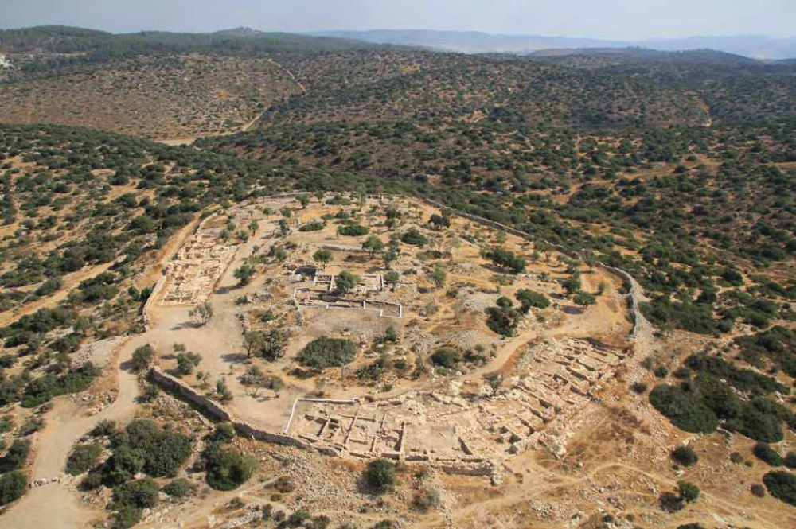
N
Khirbet Qeiyafa
Sha‘arayim
(“Two Gates”)

Slide 54
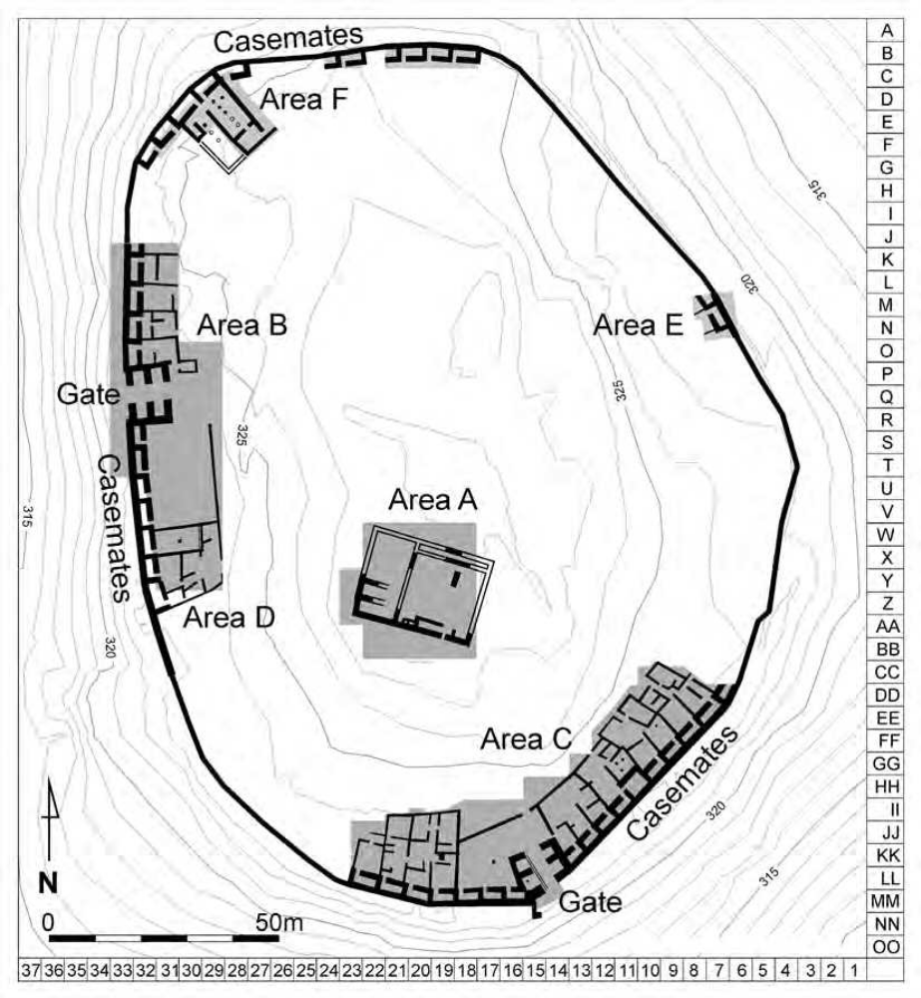
Khirbet Qeiyafa
Sha‘arayim
(“Two Gates”)

Slide 55
8. The Multi-Dimensional Significance of YHWH’s Victory (17:55–18:9)
David's Relationship to His Family (17:55–58)
David's Relationship to Jonathan (18:1–4)
David's Relationship to the People (18:5–7)
David's Relationship to Saul (18:8–9)

Slide 56
C. The Theological Significance of 1 Samuel 17
What does this account tell us about Saul?
What does this account tell us about Goliath?
His name occurs only twice (in vv. 4 and 23), while “the Philistine” 28 times.
What does this account tell us about David?
What does this account tell us about Jerusalem? (v. 54)
What does this account tell us about David’s family (vv. 28–30)?

Slide 57
c.
6. What does this account tell us about God?
⁴⁶ This day YHWH will deliver you into my hand, and I will strike you down and cut off your head. And I will give the dead bodies of the host of the Philistines this day to the birds of the air and to the wild beasts of the earth, that all the earth may know that there is a God in Israel, ⁴⁷ and that all this assembly may know that YHWH saves not with sword and spear. For the battle is YHWH's, and he will give you into our hand.”

Slide 58
Where else do we find this sort of revelatory statement?
Exodus 7:5; 14:4, 18.
Joshua 4:21–24.
1 Kings 8:43.
2 Kings 19:15–19
¹⁵ And Hezekiah prayed before YHWH and said: “O YHWH, the God of Israel, enthroned above the cherubim, you are the God, you alone, of all the kingdoms of the earth; you have made the heavens and the earth.

Slide 59
¹⁶ Incline your ear, O YHWH, and hear; open your eyes, O YHWH, and see; and hear the words of Sennacherib, which he has sent to mock the living God. ¹⁷ Truly, O YHWH, the kings of Assyria have laid waste the nations and their lands ¹⁸ and have cast their gods into the fire, for they were not gods, but the work of men's hands, wood and stone. Therefore, they were destroyed. ¹⁹ So now, O YHWH our God, save us, please, from his hand, that all the kingdoms of the earth may know that you, O YHWH, are God alone.”

Slide 60
5. The Paradigmatic Significance of chapter 17.
Like the Pharaoh in Exodus and Sennacherib in 2 Kings 19, this Philistine represented all the forces of darkness arrayed against the kingdom of God, represented not by Saul, Israel’s champion, but by David, the man after God’s own heart. And if we read the story of David to the end, we recognize that this event was paradigmatic (provided the images and visual vocabulary) for the greater David, who would take on the forces of evil once and for all.

Slide 61
5. The Paradigmatic Significance of chapter 17.
However, while David would suffer many indignities, he would not die for the sins of his people. But he would flourish as king over Israel.
Colossians 2:1–15
¹¹ When you came to Christ, you were “circumcised,” but not by a physical procedure. Christ performed a spiritual circumcision—the cutting away of your sinful nature. ¹² For you were buried with Christ when you were baptized. And with him you were raised to new life because you trusted the mighty power of God, who raised Christ from the dead.

Slide 62
5. The Paradigmatic Significance of chapter 17.
¹³ You were dead because of your sins and because your sinful nature was not yet cut away. Then God made you alive with Christ [Messiah], for he forgave all our sins. ¹⁴ He canceled the record of the charges against us and took it away by nailing it to the cross. ¹⁵ In this way, he disarmed the spiritual rulers and authorities. He shamed them publicly by his victory over them on the cross.

Slide 63
5. The Paradigmatic Significance of chapter 17.
Colossians 1:13–14
God the Father has enabled you to share in the inheritance that belongs to his people, who live in the light. ¹³ For he has rescued us from the kingdom of darkness and transferred us into the Kingdom of his dear Son, ¹⁴ who purchased our freedom and forgave our sins.
Hallelujah! What a Savior!

Slide 64
Martin Luther, A Mighty Fortress is our God
1 A mighty fortress is our God,
a bulwark never failing;
our helper he, amid the flood
of mortal ills prevailing.
For still our ancient foe
does seek to work us woe;
his craft and power are great,
and armed with cruel hate,
on earth is not his equal.

Slide 65
2 Did we in our own strength confide,
our striving would be losing,
were not the right Man on our side,
the Man of God's own choosing.
You ask who that may be?
Christ Jesus, it is he;
Lord Sabaoth his name,
from age to age the same;
and he must win the battle.

Slide 66
3 And though this world, with devils filled,
should threaten to undo us,
we will not fear, for God has willed
his truth to triumph through us.
The prince of darkness grim,
we tremble not for him;
his rage we can endure,
for lo! his doom is sure;
one little word shall fell him.

Slide 67
4 That Word above all earthly powers
no thanks to them abideth;
the Spirit and the gifts are ours
through him who with us sideth.
Let goods and kindred go,
this mortal life also;
the body they may kill:
God's truth abideth still;
his kingdom is forever!

